Slide 1
American Academy of Family Physicians
Resident Membership

Slide 2
Mission:
Improve the health of patients, families, and communities by serving the needs of members with professionalism and creativity.
Practice Enhancement
Education
Advocacy
Health of the Public
www.aafp.org
Notes:
AAFP’s mission is outcome focused on what it means to serve the needs of its 124,900 members, recognizing that the health of patients, families, and communities is the ultimate goal. The AAFP serves its members needs through its four strategic focus areas: advocacy, education, practice enhancement, and health of the public.

Slide 3
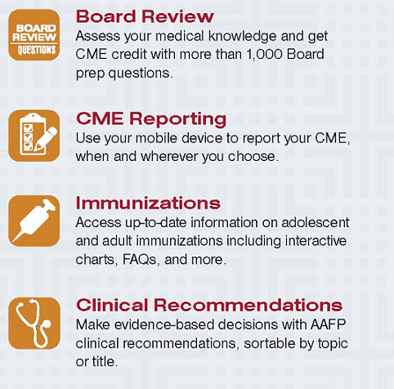
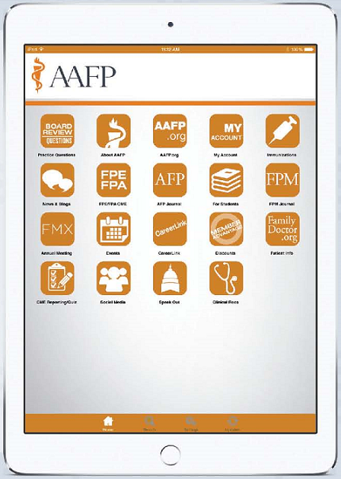
Family Medicine is in Your Hands.
Now the AAFP is too.

Slide 4
Career Resources
AAFP Board Prep Resources – Online/Self-study
Online Board Review Questions – 1,200-plus questions, organized into 10-question quizzes, FREE to AAFP members.
Special Resident Pricing:
FP Essentials™ and FP Audio™ – Family medicine-focused CME that fits your schedule, with monographs, audio, or a combined subscription.
FP Comprehensive™ – 1,200-plus questions, 18 practice tests, five years of FP Essentials clinical content, or customize your own tests. Flash drive or CD.
Board Review-Self Study – available online, flash drive, or DVD/CD.
Notes:
May be hard to think about preparing for your Boards as you start your residency. But what about your ITE? Your ITE can be a predictor for how well you will do on your Boards, and can help you focus on areas in which you need additional study.
The AAFP offers a variety of ways to help you prepare for the ABFM Boards and can help you prepare also for your ITE.
AAFP’s Online Board review questions are a member favorite, regardless of whether you are a resident or practicing physician with several years in practice and are in your maintenance of certification cycle. Besides being free to all AAFP members, they are substantive – with more than 1,200 questions, that are organized into 10-question quizzes you can work on in increments. Use your results to help you determine areas in which you may need more focus. In addition to the training and preparation you’ll receive, you can also earn up to 21.75 prescribed AAFP credits while learning.
AAFP offers a number of self-study resources to help you when you are ready to prepare for your Boards. Again, although it may seem like a long time before you have to begin worrying about your Boards, these resources can help you not only prepare for your exam, but also reinforce your clinical training throughout residency. The self-study Board prep resources are designed to help you study how you like, where you like, whether it’s a clinical or audio monograph subscription, or an online resource – they are developed to help you how and when you need them. And Resident members can purchase them from the AAFP catalog at a substantially discounted resident member price.

Slide 5
Career Resources
AAFP Board Review Resources – Live courses
Family Medicine Board Review Express™
When you’re ready, AAFP’s Board Review Express Live courses offer an intensive study opportunity over 3.5 days to help you prepare for your exam. Offered throughout the year, and across the nation.
Upcoming courses:
Dallas, TX
Feb. 22-25, 2017
St. Louis, MO
March 1-4, 2017*
** Live Online Streaming Course or attend the St. Louis course in person!
Notes:
Again, although you may not be ready for a live course, it’s good to know they will be available when you are. AAFP’s family medicine focused live courses offer an intensive focus on the medical principles of family medicine, help with test-taking strategies, and increase your knowledge with case studies and more than 400 Board exam-type questions. The courses have gained in popularity among residents in their final year who are preparing for their initial Board exam.

Slide 6
Primary+ includes CME Reporter and Requirements Planner (previously CME Reporting and CME Tracker), and a new service, Procedure Tracker.
American Board of Family Medicine – MC-FP requirements
Applications-Employers
Credentialers/Insurers/Licensure
American Board of Family Medicine – MC-FP requirements
Notes:
Family physician members’ favorite time-saving resource is quickly becoming a favorite among resident members, too.
The American Board of Family Medicine requires all residents to complete at least 50 MC-FP points before the end of residency, including one self-assessment module (SAM) and one Part IV module. The AAFP offers a number of MC-FP and CME resources, like SAM working groups, METRIC modules, the self-study and board review courses just discussed, and of course the American Family Physician articles and quizzes. Throughout the course of your residency, use the AAFP's CME reporting tool to track and share your MC-FP points.
Then, when you’re ready to begin to apply for a position, or considering a practice, your training, including any special training you may have done, is already stored for you – accessible and ready to email anywhere, anytime.
When you’ve secured the position, your training is again captured to send to credentialers, insurers, and licensing agencies, if the employer or practice you contract with doesn’t handle that for you.
And keep it going. Your CME requirements as part of the ABFM’s MC-FP process and for your AAFP membership (once you become a practicing family physician member) continues throughout your career. Reporting your CME while you’re in residency is a good habit to start, and one you’ll appreciate when you’re facing your deadline to report it to the ABFM, or for your state licensure, for hospital privileges or whatever the need may be. The AAFP also offers a tracking tool that members can use to help them track state, insurer, hospital or other CME requirements and identify CME opportunities that meet those requirements.
CME Reporter was recently enhanced with a more robust search function. Members can use Requirements Planner to track requirements by other organizations such as state medical boards or hospitals. Based on the topical requirements indicated by the member, CME is suggested that may meet those requirements. CME already reported on their transcript that may meet those topics will also be automatically notated. The new Procedure Tracker tool allows members to quickly log clinical procedures that can be retrieved when they are applying for privileges.

Slide 7
www.AAFPCareerLink.org
Find a job with CareerLink: Post your resume anonymously, and create personal alerts and job seeker accounts.
www.aafp.org.careers
Career Planning Resources: Get help with writing a CV, salary negotiation, employment contracts, compensation models, and more.
Notes:
And when you’re ready, or if you want to explore, the AAFP offers both CareerLink and Career Planning Resources. AAFP CareerLink helps family physicians and employers find each other, with opportunities to connect with your choice of employers from the comfort of your home or office, gain direct access to physician employers looking to hire, make new connections and broaden your network, and explore career opportunities available to you.
AAFP’s career planning resources provides multiple resources for evaluating opportunities, developing your CV, interviewing, and negotiating contracts.

Slide 8
Practice Resources
The FPM Toolbox
Disease Management: Asthma
Claim correction form
Diabetes encounter form
Medicare initial preventive physical exam encounter form
ICD-10
Documentation elements for common diagnoses
And more!
More than 100 downloadable tools: www.aafp.org/fpm/toolbox
Notes:
AAFP has developed educational materials specifically for your patients, that can continually reinforce your instructions for patient care regimen long after they leave your office. Family Doctor.org has become a favorite site among family physicians and patients alike for easy-to-read, instructive health care materials.

Slide 9
Patient Resources
Zika virus:
http://familydoctor.org/familydoctor/en/diseases-conditions/zika.html
Obesity and Fitness:
http://www.aafp.org/patient-care/public-health/fitness-obesity.html
AAFP Immunization Schedules:
http://www.aafp.org/patient-care/public-health/immunizations/schedules.html
Pain Management and Opioid Abuse:
http://www.aafp.org/patient-care/public-health/pain-opioids.html
Notes:
The AAFP provides you with current public health information when you need it – from immunizations, to fitness, to the zika virus – the AAFP has a long-running reputation for providing family physicians with timely information to help patients make the best health care decisions for themselves and their family.

Slide 10
(in English and Spanish)
The AAFP recently updated its award-winning familydoctor.org website to improve the user experience for the more than 4 million people who visit the resource each month looking for medical information and general health recommendations.
Notes:
AAFP has developed educational materials specifically for your patients, that can continually reinforce your instructions for patient care regimen long after they leave your office. Family Doctor.org has become a favorite site among family physicians and patients alike for easy-to-read, instructive health care materials.

Slide 11
Tobacco and Nicotine Resources
Office-Based Tools
Community Engagement
Advocacy
Evidence-Based Knowledge
Ask and Act
Tar Wars
National
Policies
Office Champions
Primary Care and Public Health
State/Local Advocacy Resources
Position Paper
Patient Education and Engagement
Chapter Involvement
Tobacco-Free Champions
Member Education
Coding Reference
At-Risk Populations
Notes:
Nationally and locally, the AAFP targets issues like tobacco and nicotine use among patients and whole communities with tools to help family physicians help patients break destructive behaviors that erode their health and further burdens the nation’s healthcare system.
As a community leader, the AAFP arms you with programs and ideas to help you improve your community’s health.
Tar Wars – For more than 25 years, Tar Wars has helped generations of children embrace a smoke-free world with its tobacco-free messages.
Ask and Act – AAFP’s tobacco-cessation program can help you open the discussion with patients about their smoking, and arms you with tools to help them quit.

Slide 12
Leadership Resources
Do you have what it takes to be a family medicine leader?
Cultivate communication skills to use with patients/community.
Participate in key health care discussions.
Develop effective leadership skills.
Contribute the resident voice.
Travel to AAFP meetings and conferences.
Network with the nation’s family physicians and residents.
Notes:
While you are a resident, the AAFP offers a number of ways to engage with your peers, network with practicing family physicians, and grow in leadership positions within the Academy at the national or chapter levels. The AAFP is one of the few specialty organizations to active enlist resident members in leadership roles.
As an AAFP leader, you can:
Cultivate communication skills to use with patients/community
Participate in key health care discussions.
Develop effective leadership skills.
Contribute the resident voice.
Travel to AAFP meetings and conferences.
Network with the nation’s family physicians and residents

Slide 13
Leadership Positions
Elected:*
Appointed:**
AAFP Board of Directors (BOD)
Chair of the National Conference
Delegate and Alternate Delegate to AAFP Congress of Delegates (2)
Society of Teachers of Family Medicine BOD
AAFP Foundation Board of Trustees
Association of Family Medicine Residency Directors (BOD)
AAFP Commission Members (5)
Delegates to AMA-Resident and Fellow Section (2)
Resident Delegate to the AMA House of Delegates (2-year term)
Resident Representative to the AAFP Center for International Health Initiatives (CIHI)
*Annually, at the National Conference of Family Medicine Residents and Medical Students
**Selected from applications by committee
Notes:
There are several ways residents can engage and grow in the AAFP as a family medicine leader:
Elected Positions – elected annually at the National Conference of Family Medicine Residents and Medical Students:
AAFP Board of Directors (BOD)
Chair of the National Conference
Delegate and Alternate Delegate to AAFP Congress of Delegates (2)
Society of Teachers of Family Medicine (BOD)
AAFP Foundation Board of Trustees
Association of Family Medicine Residency Directors BOD
Appointed Positions – Selected from applications by committee:
AAFP Commission Members (5)
Delegates to AMA-Resident and Fellow Section (2)
Resident Delegate to the AMA House of Delegates
Resident Representative to the AAFP Center for International Health Initiatives (CIHI)
Go to www.aafp.org/getinvolved for ideas that may fit your goals.

Slide 14
National Conference of Family Medicine Residents and Medical Students
Mark your calendar.
Join 2,000+ family medicine residents and students.
July 27 - July 29, 2017
Kansas City Convention Center
Kansas City, MO
aafp.org/nc
Notes:
Get involved with the National Conference of Family Medicine Residents and Medical Students. More than 2,000 family medicine residents and medical students attended this annual event last year in Kansas City, Missouri. Residents have the opportunity to connect with family medicine leaders, learn valuable clinical skills, and meet hundreds of students researching residency programs, as well as author and vote on resolutions that provide direction to the AAFP at the national level.

Slide 15
Educational Programming
Easing into practice
Maternal care
Finances and educational debt
Global health
Exposition Hall
400-plus exhibitors
50-plus physician employers
Fellowship programs
AAFP CareerLink
Notes:
Educational Programming: Choose from main stage sessions, workshops, musculoskeletal clinics, procedural skills courses, and poster presentations of specific interest to residents, such as:
--Easing into practice
--Maternal care
--Finances and educational debt
--Global health
Sessions are offered in six key focus areas:
Career planning
Clinical skills
Health policy and advocacy
Leadership development
Practice management
Research
Exposition Hall: Explore resources from over 400 exhibitors, including 50+ physician employers, fellowship programs, medical mission opportunities, government agencies, medical literature, and more. AAFP Careerlink will be onsite to provide information on all aspects of a job search.

Slide 16
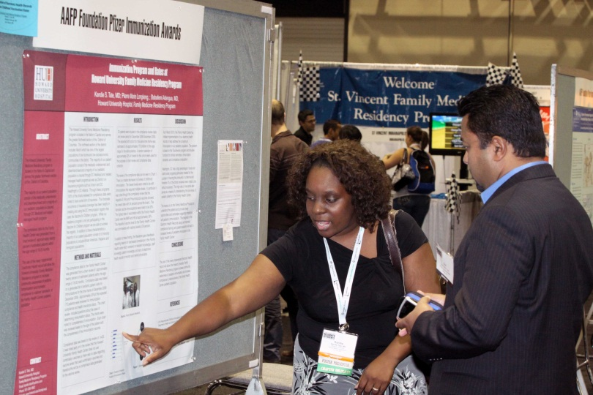
Leadership Forum
Serve as your chapter’s resident delegate.
Author a resolution.
Run for a leadership position.
Poster Presentations
Research
Clinical Inquiry
Educational Program
Community Project
Notes:
AAFP resident members have a voice in AAFP policy direction.
National Conference affords the opportunity for hands-on leadership training. Learn about informed decision making and how to influence AAFP policies, programs, and services by participating in the resident congress sessions.
Get involved by:
Serving as your chapter’s resident delegate
Authoring a resolution
Running for a leadership position
For a schedule of events, past resolutions, and a full list of elected and appointed positions available visit the website.
Poster Presentations: If you have research you would like to present, submit an application to present at National Conference.
Posters are selected based on their originality, relevance to family medicine, and clarity of communication.
Poster categories:
Research
Clinical Inquiry
Educational Program
Community Project

Slide 17
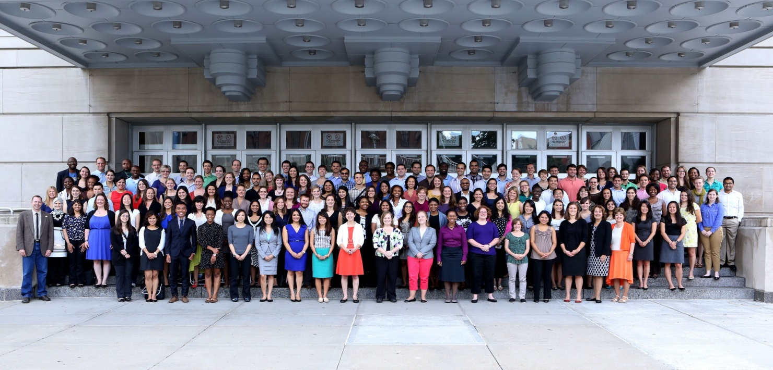
Network, Socialize, Connect
Expo Hall Grand Opening
Conference Celebration
Scholarships
220 available
$600 Foundation scholarships
AAFP member
Notes:
Network, Socialize, Connect: Network with nationally recognized family medicine leaders and interact with hundreds of your peers from around the country who are passionate about family medicine.
Expo Hall Grand Opening: Join us at this Expo Hall kick-off event for networking and fun on Friday evening.
Conference Celebration: Enjoy the historic Midland Theatre in downtown Kansas City, and celebrate with your fellow attendees on Saturday night.
Entry into both of these events is included with the registration fee.
Scholarships: Be recognized for your passion and talent as a future family physician. Apply for a scholarship to attend National Conference. 220 are available. The $600 scholarships are made possible by the American Academy of Family Physicians Foundation Family Medicine Leads program.
You must be an AAFP resident member to apply. Not a member? Join today at www.aafp.org/join.
Deadline for submission: May 1.
Categories: Minority Scholarships Program for Residents, Community Outreach Award, and Tomorrow's Leader Award.
Scholarship descriptions, eligibility requirements, and applications are available online at www.aafp.org/nc.
Some state chapters offer additional scholarships.

Slide 18
AAFP
Family Medicine Experience (FMX)
Sept. 12-16, 2017
Henry B. Gonzalez Convention Center
San Antonio, TX
Notes:
Family Medicine Experience (FMX for short) is the AAFP’s annual meeting. Formerly Assembly, FMX is where 5,000 or more family physicians from across the country celebrate family medicine with their peers.
This year FMX will be held in San Antonio, TX from September 12 through 16, 2017.
Residents and students pay only $100 to attend.
Attendees welcome it as time to not only update their knowledge and skills but to network with peers from across the country.
Resident and student attendees enjoy many opportunities to meet active, established family physicians, learn alongside and from them, and even learn about various practice styles.
Among the many educational opportunities at FMX are hands-on procedural workshops including pain management techniques, ECG, musculoskeletal injections, soft tissue surgery, and more.
FMX is designed by family physicians for family physicians to keep family medicine residents and practicing physicians current in a world of change.
Witness the official policy-making body of the AAFP at work during the AAFP Congress of Delegates. Congress is held right before FMX also in San Antonio. Congress is a good place to access leadership opportunities in your chosen specialty.

Slide 19
Family Medicine Specialty Resources
Promoting Family Medicine
Advocating for you…and your future.
Federal legislators
State legislators
Insurers, third-party payors
Notes:
Among the many resources the AAFP offers members is advocacy for you as a family physician, and for family medicine’s future. Less well known are AAFP’s private sector advocacy initiatives, among them: Pay for Performance, physician profiling, retail health clinics, and payment: bundling, coding and claim denials.

Slide 20
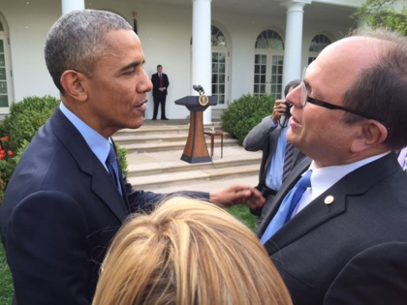
AAFP leaders take the message of family medicine to Congress.
AAFP Past Chair Robert Wergin, MD (left), thanked President Obama for his leadership at a White House ceremony to mark repeal of the Medicare sustainable growth rate.
Notes:
Each year, AAFP leaders converge on the Hill and work year-round with congressional leaders and staff to keep issues that impact family medicine and quality health care at the forefront. This year, the AAFP celebrated the end of more than a decade long effort working with legislators to repeal the Medicare sustainable growth rate (SGR) formula, a major step toward physician payment reform.

Slide 21
Advocate from your laptop, phone or tablet
Anytime, real time
Be informed & involved in your future
Notes:
As an AAFP member, your involvement is key. As a resident, your time is limited. But the AAFP’s Speak Out can ensure that your voice and message are heard by the legislators who can make a difference. Sign up for Legislative Alerts, and you’ll be notified when a critical vote is pending, and how you can tell legislators what you think from your laptop.

Slide 22
Other Online Resources
Considering post-residency training?
Fellowship Directory for Family Physicians
Family Medicine Clerkship/ Preceptorship Directory
Looking for international experience?
International Family Medicine Opportunities
Residency Programs with International Rotations
Notes:
AAFP offers a variety of resources online for residents who may not follow a direct three-year route to completion.
If you’re considering a post-residency fellowship or additional training, the AAFP and STFM co-sponsored Fellowship Directory online can help you find the training you’re looking for. Also, review the Preceptorship Directory.
Looking for international experience? The AAFP has listed several options for you -- during, or after residency.

Slide 23
Networking Resources
Member Interest Groups
(www.aafp.org/mig)
Global Health
Solo/Small Group Practice
Rural Health
Emergency Medicine/Urgent Care
Direct Primary Care
Oral Health
Single Payer Health Care
Hospital Medicine
Reproductive Health
Adolescent Health
Telehealth
School Doctor
Notes:
Join any or all of AAFP’s members-only interest groups. Read and add to discussions, build or post wikis, and read blogs from peer AAFP members. Current member interest groups include Direct Primary Care, Emergency Medicine Urgent Care, Global Health, Hospital Medicine, Independent Solo/Small Group Practice, Oral Health, Reproductive Health Care, Rural Health, Single Payer Health Care, School Doctor, and Telehealth and more. All that’s required is your AAFP membership and interests.

Slide 24
Awards and Scholarships
AAFP Award for Excellence in Graduate Medical Education
Community Outreach Awards
Minority Scholarship Program
Tomorrow’s Leader Award
Scholarships to attend National Conference
www.aafp.org/awards
AAFP Foundation Resident Research Grants
Family Medicine Cares Resident Service Award
www.aafpfoundation.org
Notes:
Through awards or scholarships, AAFP offers several opportunities for you to show your commitment to family medicine, and be rewarded for it.
At www.aafp.org/awards, residents can find a number of opportunities to achieve recognition for leadership and for scholarships to attend National Conference.
At the AAFP Foundation (www.aafpfoundation/org) residents can research additional scholarship opportunities to help them attend AAFP’s National Conference, as well as opportunities to submit proposals for research grants.

Slide 25
Your Specialty Organization
We‘re in it for you, for life
For more information:
Career
AAFP Member Resource Center
(800) 274-2237
aafp@aafp.org
Education
Practice
Family medicine specialty
Notes:
The AAFP supports your commitment to family medicine.

