Slide 1



Hot Topics in Preventive Care Updates 2025-2026 OAFP Conference 2026
Presenters: Safina Koreshi¹, Tiantian White²
^{Affiliations:}
^{1. Care Oregon,}
2. Oregon Health & Science University

Slide 2
Conflict of Interest
No conflict of interest to disclose

Slide 3
Outline
USPSTF updates
Immunization guidelines updates and evidence review
Dietary guidelines updates and evidence review
Low value care/Healthcare system implications

Slide 4
Outline
USPSTF updates
Immunization guidelines updates and evidence review
Dietary guidelines updates and evidence review
Low value care/Healthcare system implications

Slide 5
USPSTF Evidence Grade Review
Certainty
A
High
B
Moderate
C
I
?
D
Net Benefit
Small
Moderate
Substantial
Notes:
Grade A: Recommends the service; high certainty of substantial net benefit.
Grade B: Recommends the service; high certainty of moderate or moderate certainty of moderate/substantial net benefit.
Grade C: Recommends selectively; moderate certainty of small net benefit.
Grade D: Recommends against; no net benefit or harms outweigh the benefit.
Grade I: Evidence is insufficient to assess net benefit

Slide 6
Updates: USPSTF Final Recommendations
Recommendation(s) | Date | Grade | Change from Prior/Note
Screen women of reproductive age, including those who are pregnant and postpartum for IPV. In those who screen positive, evaluate and if appropriate provide or refer for evidence-based interventions that include multiple components and ongoing support. | June 2025 | B | No major change from 2018 Rec/ No evidence on appropriate interval for screening
Screen for caregiver abuse and neglect in older or vulnerable adults | June 2025 | I | No change from 2018
Osteoporosis screening in women Screen F ≥ 65 Screen postmenopausal F < 65 w ↑ risk for osteoporotic fx as determined by formal clinical risk assessment tool | Jan 2025 | B | No major change – more specific than 2018 rec: “bone measurement testing” ⇒ hip or lumbar DXA, stepwise risk stratification
Osteoporosis screening in men | Jan 2025 | I | No major change -
Notes:
# Caregiver abuse & neglect
Applying I statement: consider risk (higher if +isolation, lack of social support, functional impairment, poor physical health/physical disability, cognitive impairment, low socioeconomic status, and history of being in an abusive relationship etc)
Financial exploitation and neglect = most common forms
- Studies needed to assess accuracy of screening tools for caregiver abuse and benefits vs harms of screening for and intervening on caregiver abuse
# IPV
- Compared to 2018 Δ: highlights pregnant and post-partum individuals in rec statement because evidence base strongest for this population
screening tools: Humiliation, Afraid, Rape, Kick (HARK)¹⁷; Hurt, Insult, Threaten, Scream (HITS)¹⁸; and Woman Abuse Screening Tool (WAST)
# Osteoporosis
For postmenopausal < 65, first assess for the presence of 1 or more risk factors for osteoporosis. If 1 or more risk factors are present, assess for increased risk using a formal clinical risk assessment tool. For women assessed to be at increased risk, screen for osteoporosis with DXA BMD, with or without fracture risk assessment. To achieve the benefit of screening to reduce morbidity and mortality from fractures, women found to have osteoporosis should be further evaluated, counseled, and, if appropriate, receive evidence-based management.
Tools to estimate fx risk: FRAX (input age, wt, estrogen use, height, previous fx, smoking, steroid use, RA, EtOH etc), FRC, Garvan Fx risk calculator; Tools to identify osteoporosis: Osteoporosis Risk Assessment Instrument ORAI (input: wt + age + estrogen use) and Osteoporosis Self-Assessment Tool (OST: input = wt + age)

Slide 7
Updates: USPSTF Draft Recommendations
Topic | Current Recommendation(s) | Grade | Last updated
Cervical Cancer Screening | Age 21-29: Recommend screen q3y cytology alone. Age 30-65: Q3y cytology alone OR q5y w hrHPV alone OR q5y w hrHPV + cytology | A | 2018
 | F < 21, > 65 w adequate prior screening, F w hx hysterectomy w removal of cervix wo hx of CIN 2 or 3 | D
vs
Topic | Draft Recommendation(s) | Grade | Last updated
Cervical Cancer Screening | Age 21-29: Recommend screen q3y cytology alone. Age 30-65: Q5y clinician- or patient-collected hrHPV primary screen F 30-65 . Q3y cytology alone or q5y hrHPV + cytology as an alternative. | A | Dec 2024
 | F < 21, > 65 w adequate prior screening, F w hx hysterectomy w removal of cervix wo hx of CIN 2 or 3 | D
Notes:
Self-collection of HPV test for screening has similar accuracy to clinician-collected tests and is associated with increased screening in underscreened individuals (low SES, Latina/NAAN/Asian, sexual gender minority, rural, people w disability, age 60-65) and in historically underscreened populations. The accuracy does not appear to show a difference between home or clinic setting for self-collection. However, most of the evidence for increased rates of screening was for home self-collection of HPV.
FDA approved self collection: Cobas HPV (DNA-based), Onlarity HPV (DNA-based, only FDA approved test that can identify and report genotypes beyond 16/18), FDA approval for self-collection limited to clinical or in-office settings. Aptima (mRNA based, lowest agreement values vs physician collect) studied but not approved for self-collection. Also note there is lack of dx accuracy studies for urine compared to vaginal or cervical swabs.
When self-collection not appropriate: high risk individuals (+HIV, utero DES exposure, previous high-grade lesion or hx cervical cancer).

Slide 8
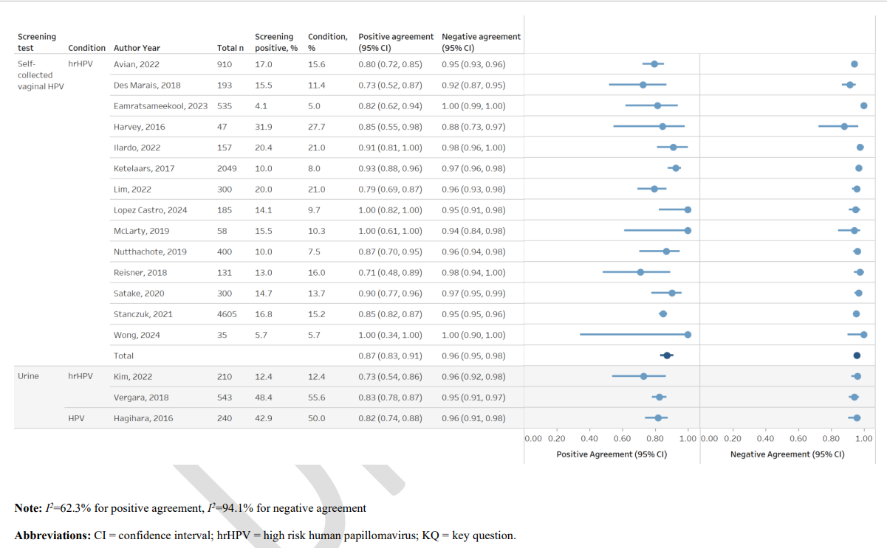
hrHPV Self-Collect vs Clinician Collect
USPSTF reviewed 14 studies that reported on agreement between self-collected vs clinician-collected samples
5/14 in US
pooled positive agreement was 0.87 (95% CI, 0.83 to 0.91; I 2=62.3%)
pooled negative agreement was 0.96 (95% CI, 0.95 to 0.98; I 2=94.1%)
No studies reported variation in test agreement by population characteristics
No differences in test agreement due to test and assay characteristics
Notes:
16 test agreement studies were fair-quality and a single study was rated good-quality. The risk of bias for the fair-quality studies was primarily from possible introduction of selection bias and loss of participants from the analysis

Slide 9
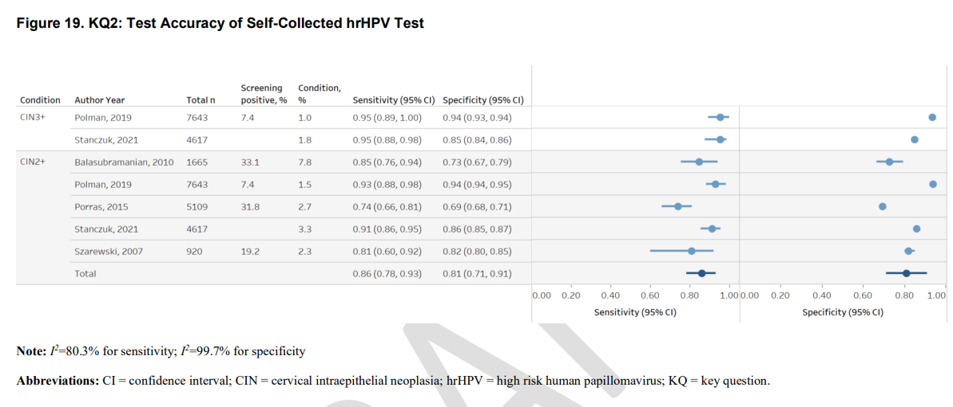
hrHPV Self-Collect Accuracy
USPST reviewed 6 studies that reported accuracy or relative accuracy of self-collect hrHPV tests
For CIN2:
pooled sensitivity = 0.86 (95% CI, 0.78 to 0.93; I 2=80.3%)
pooled sensitivity = 0.86 (95% CI, 0.78 to 0.93; I 2=80.3%)
For CIN 3:
sensitivity = 0.95 with similar 95% confidence intervals (95% CI, 0.89 to 1.00 and 95% CI, 0.88 to 0.98)
specificity were 0.85 (95% CI, 0.84 to 0.86) and 0.94 (95% CI, 0.93 to 0.94)
Accuracy Studies reviewed:
Notes:
All six of the test accuracy studies were fair quality. Risk of bias was primarily from possible introduction of selection bias, verification bias (as described above), and loss of participants from the analysis

Slide 10
Guideline Meets Clinical Practice
HRSA 2025 updated guideline on cervical cancer screening: Patient-collected hrHPV testing is appropriate for average-risk individuals aged 30–65 years
Average risk:
Asx
No hx of CIN2+, AIS, or cervical cancer
Not immunocompromised (EX HIV+)
No in-utero DES exposure
FDA approved for self-collect:
BD OnclarityTM HPV assay by Becton Dickson - Copan 522C.80 dry swab FLOQ swab ® for HPV self-collection
Cobas® by Roche - use either the Copan 522C.80 FlowQ swab (Copan Diagnostics) or Evalyn brush (Rovers medical devices) collection device
Abbott Alinity m HR HPV assay - simpli-COLLECTTM HPV collection kit or the Evalyn brush (Rovers medical devices) collection device
Teal Wand® is approved for at-home self-collection
Notes:
Source: ASCCP-Practice-Advisory-Self-Collection-for-Cervical-Cancer-Screening-final-updated-10-2-25.pdf
HRSA guideline kicks in for plans Jan 2027
BD Onlarity, Abbott Alinity, BD Onclarity, and Roche Cobas tests are approved for self-collection in “a healthcare setting. A healthcare setting is not strictly defined, however should be in a location where specimens can be processed by trained personnel and transported to a testing laboratory under controlled conditions. A healthcare setting may include, but is not limited to a hospital, emergency department, urgent care center, ambulatory clinic, physician office, mobile clinic, pharmacy, lab collection site, or a medical director-staffed school or community health clinic.
Teal Wand: patient completes a form on the company’s website, they are connected virtually with a provider, who then orders the kit and will review the results. The kit is mailed to the home of the patient, who collects the sample using the Teal Wand® dry swab and sends it to the lab for processing

Slide 11
Updates: USPSTF Draft Recommendations
 | 2018 Recommendations | Dec 2024 Draft Recommendations
Postmenopausal Women | For 1º prevention of fx in community-dwelling individuals: Daily supp ≤400 IU vitD and ≤ 1000mg Ca [D] Daily supp > 400 IU vitD and > 1000mg Ca [I] | For 1º prevention of fx in community-dwelling individuals Vit D w or wo Ca [D] For prevention of falls in community-dwelling individuals: Vit D w or wo Ca [D]
Men | VitD and Ca supplementation, alone or combined, for 1º prevention of fx in community-dwelling individuals [I]
Premenopausal Women | VitD and Ca supplementation, alone or combined, for 1º prevention of fx in community-dwelling individuals [I] | (Does not comment on this population)
Notes:
For this update, the USPSTF reviewed new evidence that showed there was no benefit of vitamin D with or without calcium across a broad range of doses to prevent fractures or of vitamin D to prevent falls
Holroyd C, Cooper C, Dennison E. Epidemiology of osteoporosis. Best Pract Res Clin Endocrinol Metab. 2008;22(5):671-685.
Draft: https://www.uspreventiveservicestaskforce.org/uspstf/draft-recommendation/vitamin-d-calcium-combined-supplementation-primary-prevention-falls-fractures-communitydwelling-adults#citation10
Evidence summary: USPSTF found 19 randomized clinical trials (RCTs) that reported on fracture, fall, or all-cause mortality outcomes with vitamin D or calcium supplementation, or both, over 9 months to 7 years of followup. Concluded all these studies showed no significant results for protective effect of vit D and Ca in this population. On Harm, 7 trials reported on the incidence of participants with kidney stones. The pooled RR for vitamin D with or without calcium compared with placebo was 1.11 (95% CI, 1.03 to 1.21; 10 RCTs; 99,036 participants) over 2.5 to 7 years of followup, corresponding to an ARD of 2 more participants with kidney stones per 1,000 persons treated (95% CI, from 1 more to 5 more).
Screening for vitamin D is low-value care - don’t do it

Slide 12
Guideline Meets Clinical Practice
Do not prescribe vit D and Ca for "community dwelling" asymptomatic postmenopausal individuals age 60 and up
Does NOT apply to:
Hx of osteoporotic fx
Dx of osteoporosis
Confirmed vitD deficiency
Other co-morbidities that increase risk of deficiency EX CKD, malabsorption
Related topic: VitD screening
2021 USPSTF: I grade for screening vit D in asx community-dwelling non-pregnant adults
Low-value care
Notes:
Community dwelling = not livingin a nursing home or other institutional care setting
Sources:
USPSTF Recommendation: Vitamin D Deficiency in Adults: Screening | United States Preventive Services Taskforce
Screening for Vitamin D Deficiency in Adults: US Preventive Services Task Force Recommendation Statement | Complementary and Alternative Medicine | JAMA | JAMA Network
Special populations:
Children: Vitamin D Supplementation in Infants, Children, and Adolescents | AAFP
AAP 2008 all infants, children, and adolescents receive a minimum of 400 IU of vitamin D daily through diet or supplements; AFP: all grade C (consensus, disease-oriented evidence, usual practice, expert opinion, or case series) Evidence - Infants ingesting less than 1 L (33.8 fl oz) of formula per day, as well as all breastfed or partially breastfed infants, should receive 400 IU of supplemental vitamin D daily. Children and adolescents consuming less than 1 L of vitamin D–fortified milk per day should receive 400 IU of supplemental vitamin D daily. Despite these recommendations, there are no studies showing that universal supplementation improves patient-oriented outcomes, such as the reversal of lethargy, irritability, and growth failure, attributed to vitamin D deficiency. Reminder vit D deficiency RFs: Anticonvulsant drugs, fat malabsorption, darker skin, exclusive breastfeeding, insufficient sunlight exposure, low maternal vit D for infants. Endocrine society 2024 – supplement children (Vitamin D for the Prevention of Disease: An Endocrine Society Clinical Practice Guideline)
Pregnant women:
Endocrine society 2024 updates: supplement pregnant women Vitamin D for the Prevention of Disease | Endocrine Society; PNI vitamin has 400 IU vit D generally; ACOG; vit D deficiency common during pregnancy, esp among high-risk groups, including vegetarians, women with limited sun exposure (eg, those who live in cold climates, reside in northern latitudes, or wear sun and winter protective clothing) and ethnic minorities, especially those with darker skin, consider screen based on risk and supplement w 1000-2000 IU if confirmed deficiency (Source: Vitamin D: Screening and Supplementation During Pregnancy | ACOG)

Slide 13
Updates: USPSTF Draft Recommendations
Topic | Draft Recommendations | Grade | Draft Release Date | Change compared to prior
Perinatal Depression | Provide or refer those at increased risk of perinatal depression to counseling interventions during pregnancy and the postpartum period. | B | April 2025 | No change vs 2019
Screen for unhealthy EtOH use | Adults: screen in primary care setting and provide brief behavioral counseling interventions if positive screen | B | Aug 2025 | No change vs 2018
 | Adolescents: screening and brief behavioral counseling interventions for alcohol use in primary care settings | I | Aug 2025
Notes:
Perinatal Depression: https://www.uspreventiveservicestaskforce.org/uspstf/draft-recommendation/perinatal-depression-interventions-to-prevent
EtOH use screen: https://www.uspreventiveservicestaskforce.org/uspstf/draft-recommendation/unhealthy-alcohol-use-adolescents-adults-behavioral-counseling-interventions

Slide 14
Clinical practice - EtOH
EtOH use higher than opioids
EtOH > higher hospitalization
MSR for EtOH underutilized
OR state level data
Notes:
SAMHSA's latest NSDUH report provides rates in comparison to other states. The alcohol-specific data is in Tables 15-18 (general alcohol use, pages 29-36) and Tables 25-26 (AUD, pages 49-51)
OHA's Overdose Dashboard has pretty recent data related to alcohol-related deaths (screenshot below)
OHA has a report that highlights alcohol related deaths from 2011-2022 and by age/sex/race/geography

Slide 15
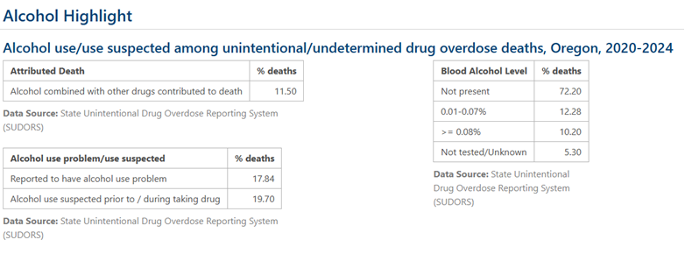
Clinical practice - EtOH
EtOH use higher than opioids
EtOH > higher hospitalization
Meds are under-prescribed
OR state level data
Notes:
SAMHSA's latest NSDUH report provides rates in comparison to other states. The alcohol-specific data is in Tables 15-18 (general alcohol use, pages 29-36) and Tables 25-26 (AUD, pages 49-51)
OHA's Overdose Dashboard has pretty recent data related to alcohol-related deaths (screenshot below)
OHA has a report that highlights alcohol related deaths from 2011-2022 and by age/sex/race/geography

Slide 16
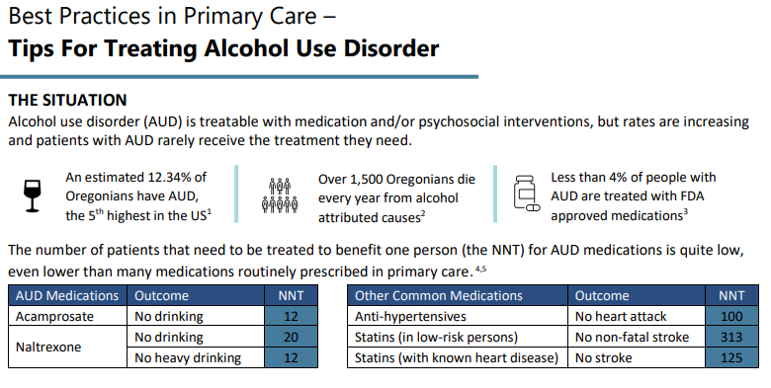
Clinical Practice: AUD

Slide 17
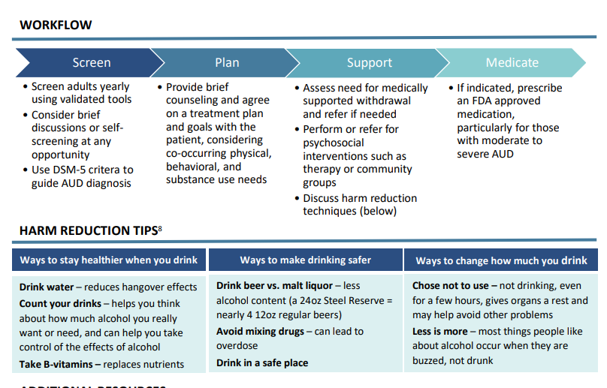

Slide 18
USPSTF – concern over "quiet paralysis"
USPSTF cannot be abolished without Congressional action, however:
USPSTF usually meets 3 times a year, last meeting was March 2025
Usually, annual report to Congress – no report submitted in 2025
Historically ~20 new guidelines per year, fewer in 2025
5/16 members' terms ended in Jan, 2026, and new members have not been selected
Notes:
New members selected by HHS secretary
Source: The task force that shapes America’s preventive care has not met in a year | CNN
Solutions: advocacy (AMA wrote a letter to Kennedy), be diligent in looking out for alternative reliable sources for updates (EX HRSA, ACOG, AAFP etc)

Slide 19
Outline
USPSTF updates
Immunization guidelines updates and evidence review
Dietary guidelines updates and evidence review
Low value care/Healthcare system implications

Slide 20
Shifting Winds of ACIP, CDC & Immunization Guidelines
June 2025
All 17 ACIP members dismissed, 8 ne members appointed by passing traditional multi-year vetting process
Aug 2025
30 non-voting liaison orgs (including major medical societies) removed from ACIP workgroups
Sep 2025
7 additional ACIP members appointed, including individuals w hx opposing vax guidance
Recommendations changes:
MMRV no longer recommended for children under 4
Covid 19 vax rec changed from universal to “individual decision-making”
Dec 2025
Recommendation change:
Removed universal rec for newborn hep B vax at birth
Jan 2026
Recommendation changes:
CDC released revised ped imm schedule wo formal ACIP vote: 13 vax targeting 17 VPDs > 7 vax targeting 11 VPDs
Removal of universal rec for Covid 19, hep A, hep B, flu, rotavirus, and men ACWY
March 2026
Federal judge blocked changes to vax rec and ACIP membership (AAP litigation)

Slide 21



Summary of Proposed Federal Guideline Changes
Unchanged:
DTaP / Tdap
MMR
IPV (Polio)
Hib
Pneumococcal (PCV)
Varicella
HPV
Removed from universal (shifted to risk-based or SCDM):
Hep B for newborns
Hep A
Rotavirus
Influenza
Covid 19
MenACWY and MenB
Removed from universal/routine:
Covid 19 (adults)
Covid 19 (pregnancy)
No major change:
Hep B, influenza, RSV, Tdap, pneumococcal, shingles

Slide 22
AAP vs CDC Ped Immunization Recommendations
Vaccine | AAP | CDC
HAV | 2-dose series at 12-23 months | Falls under SCDM. If chosen, 2-dose series between 12-23 months.
HBV | 3-dose series: First dose within 24 hours of birth, second dose between 1 and 2 months, and third dose between 6 and 18 months of age | Falls under SCDM. If chosen, 3-dose series: First dose at 2 months and no earlier, then at 4 months, and between 6-18 months.
HPV | 2-dose series between 9 and 12 years of age | 1 dose between 11 and 12 years of age
Influenza | 1 to 2 doses annually starting at 6 months depending on vaccination history and status. After 9 years of age, 1 annual dose | Falls under SCDM. If chosen, 2 doses within first year starting at 6 months. After 9 years of age, 1 annual dose
MenACWY | 2-dose series: first dose between 11 and 12 years and second dose at 16 years of age | Falls under SCDM. If chosen, 2-dose series: first dose between 11 and 12 years and second dose at 16 years of age.
Rotavirus | 2/3-dose series at 2, 4 and 6 months of age. Cannot be started after 15 weeks of age. | Falls under SCDM. If chosen, 2/3-dose series at 2,4, and 6 months of age.
RSV | 1 dose during RSV season younger than 8 months, depending on maternal vaccine status | Only for certain high-risk groups. For children with mothers who did not have the vaccine, 1 dose between birth and 7 months of age. For children with high-risk conditions, 2-dose series between birth and 7 months and between 8 and 19 months of age.
Notes:
Source:
https://www.infectiousdiseaseadvisor.com/features/cdc-vs-aap-vaccine-schedule/
CDC cuts to childhood vaccine recommendations - The Lancet Infectious Diseases
HHS has removed the controversial schedule

Slide 23

Making Sense of Conflicting Guidelines
HHS/ACIP cited reasons for changes in vaccination guidelines
Low incidence and/or associated mortality & morbidity with certain illnesses EX hep A and rotavirus in the US
Peer high-income countries EX Denmark has a fewer vaccines on schedule for fewer diseases
Cited lack of RCT “proving” effectiveness of certain vaccines in reducing adverse disease outcomes such as hospitalizations e.g. MenACWY, childhood influenza
Concern over vaccine safety
Notes:
Source: https://perma.cc/8HTR-4KME

Slide 24
Making Sense of Conflicting Guidelines
Issues with HHS evidence assessment:
Different contexts between Denmark and US
Denmark requires least # vaccine doses that protect against least # disease among peer countries
While overall incidence is low for certain VPDs like hep A, there has been increasing number of outbreaks in recent years
HHS misses the point that for certain VPDs like hep A, vax prevents spread of disease and provides protection in adulthood where disease manifestation is more severe
HHS assessment focused heavily on lack of RCT evidence and dismissed observational epidemiological studies
Notes:
# Denmark vs US
Diff healthcare systems: universal healthcare in Denmark, US has higher burdens of certain diseases e.g. hep B, US is more culturally and economically diverse
According to table 2 in HHS’s own document, most other high income countries require x1.3 to x2 vaccine doses vs Denmark and protect against more VPDs
Hep A:
- Increase in outbreaks due to opioid epidemic: https://www.chop.edu/vaccine-education-center/vaccine-details/hepatitis-a-vaccine
Hep A more severe in adults: https://www.cdc.gov/pinkbook/hcp/table-of-contents/chapter-9-hepatitis-a.html
Flu:
280 pediatric influenza-related deaths 2024-2025, 89% occurred in patients who were incompletely vaccinated, while also highlighting this past influenza season as the most severe in over 15 years
Rigorously designed observational studies can provide good evidence, esp. where RCT may not be ethical or practical (would need infeasibly large sample to study rare outcomes like death and where vaccine has demonstrated effectiveness by observational studies, randomizing is likely not ethical):
Ped flu study: https://pubmed.ncbi.nlm.nih.gov/41506521/
Systemic review on covid, flu, RSV: https://www.nejm.org/doi/full/10.1056/NEJMsa2514268

Slide 25
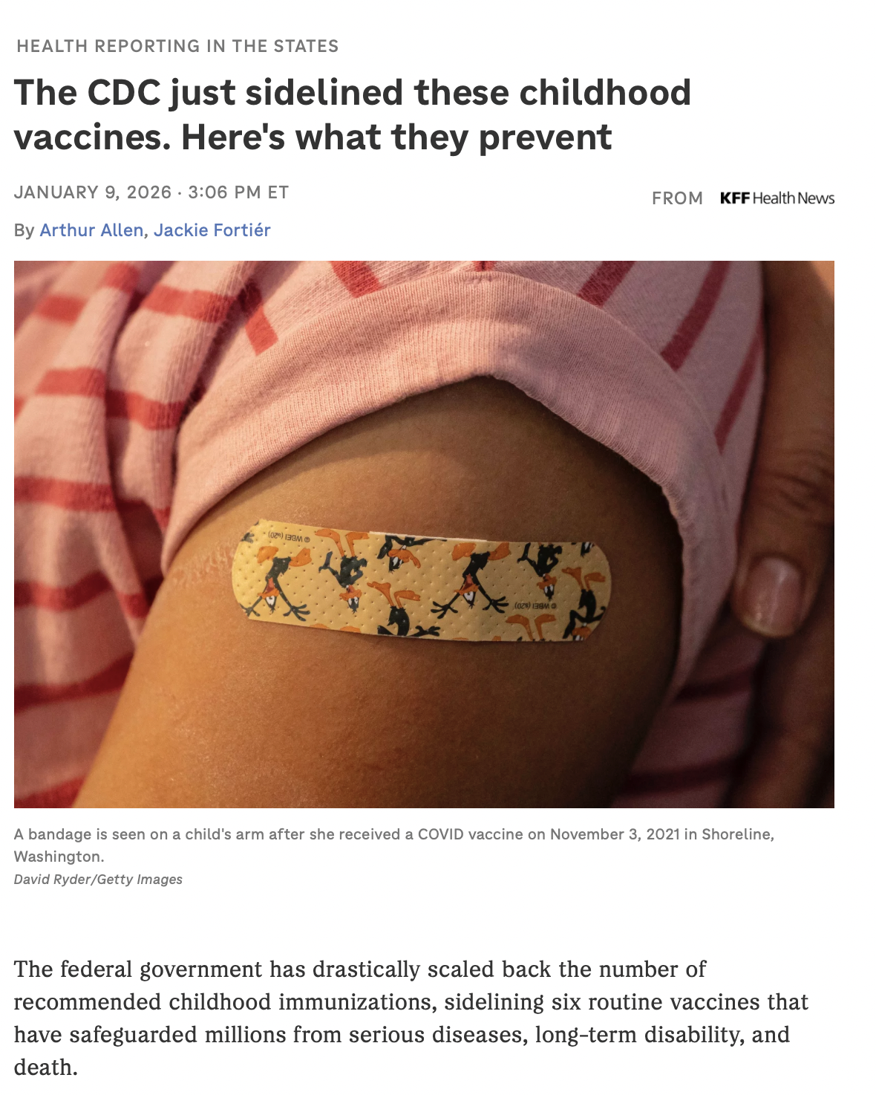
Implications for Clinical Practice
West Coast Health Alliance/WCHA formed Sep 2025 provides science-based vaccine recommendations
WCHA recommendations align with medical societies (EX AAP)

Slide 26

Discussion
What have you seen and experienced in your practice with these guideline changes?
What are you worried/confused about going forward?
Notes:
Combine slide 20 and 21

Slide 27
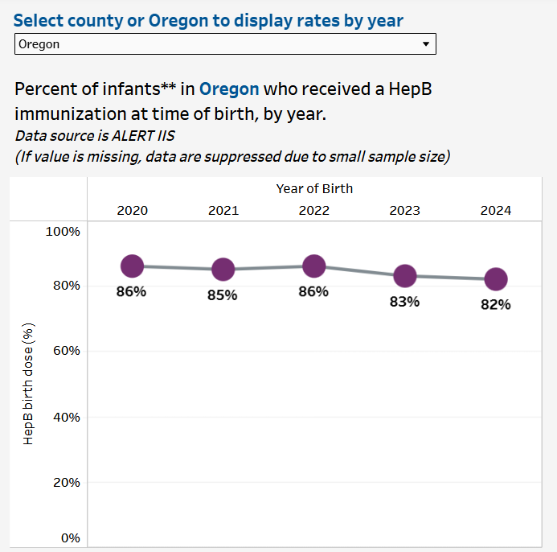
Discussion
Policy + Media ≠ Evidence
What to do when not supported in clinical practice at the level needed
Covid era
Present state
Impact/implications:
Notes:
EX of MMR: Even though MMR recommendation did not change, general trend has been more vaccine hesitancy meets clinical practice > rising measles
Data source: OHA Infant Hepatitis B Immunizations | Tableau Public Oregon Early Childhood Immunization Rates | Tableau Public

Slide 28
Outline
USPSTF updates
Immunization guidelines updates and evidence review
Dietary guidelines updates and evidence review
Low value care/Healthcare system implications

Slide 29
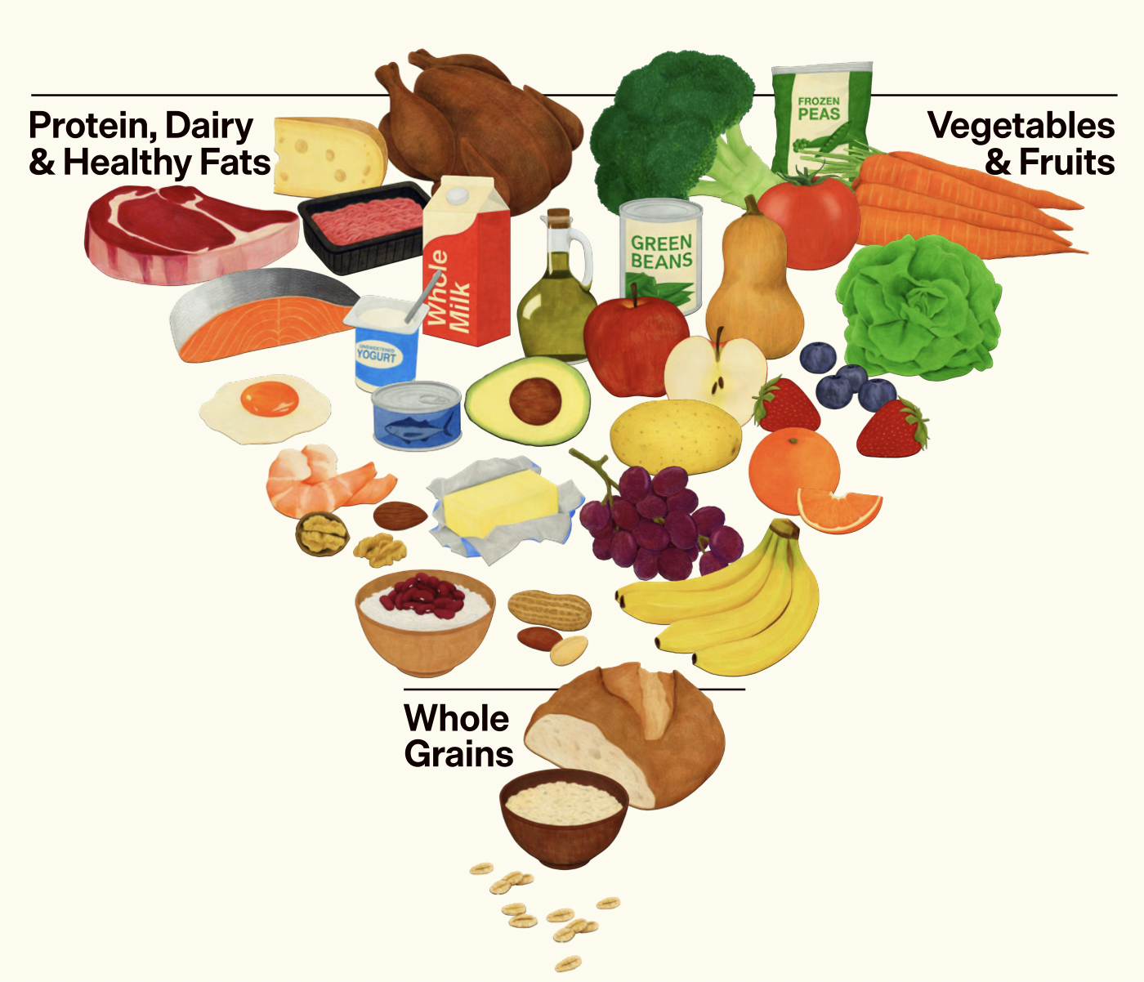
Updates: Dietary Guideline for Americans
2026: DGA 2025-2030 released
Key points:
Fruits & vegetables throughout the day
Whole grains over refined carbs
Limit highly-processed foods
Limit added sugars
Inverse food pyramid
Emphasis on meat & full fat dairy
Rec ↑ protein intake (0.8g/kg > 1.2-1.6g/kg)
Less specific rec for reducing alcohol intake
Notes:
# EtOH
2020-2025 guideline: limiting intake to 2 drinks or less in a day for men and 1 drink or less in a day for women
2025-2030: drink less alcohol

Slide 30
DGA 2025-2030 Score Card
DGA 2025-2030 Key Recommendation | Consistent w Other Guidelines | Comparison guidelines
Avoid highly processed foods and added sugar | Yes | ADA, ACLM, AHA guidelines
Whole grains over refined grains | Yes
Eat a variety of fruits and vegetables and choose preferably whole fruits and vegetables | Yes
Inverted food pyramid: emphasis on meat and full-fat dairy; low-carb, high-protein diet | No for general population
Increase protein intake in diet, no distinction between protein from animal sources versus plant sources | No
Incorporate healthy fat from whole foods (EX meats, poultry, eggs, seafoods, nuts, seeds, full-fat dairy, olives, avocados; prioritize oil with essential FA. “Other options can include butter or beef tallow”) | (self-conflicting)
Notes:
Sources:
ACLM dietary spectrum: ACLM-Dietary-Spectrum-2024F.pdf ACLM-Food-As-Medicine-Jumpstart.pdf
AHA 2026 dietary guidance: 2026 Dietary Guidance to Improve Cardiovascular Health: A Scientific Statement From the American Heart Association | Circulation
ADA 2019 consensus dietary rec for people with DM or pre-DM dotn716df5119697054952701dd04dc1b405.pdf Nutrition Therapy for Adults With Diabetes or Prediabetes: A Consensus Report | Diabetes Care | American Diabetes Association
# Vegetables:
ADA: emphasis on non-starchy vegetables
# Processed Foods:
ACLM: avoid processed foods, citing evidence including Hall 2019 RCT diets rich in UPFs cause excess calorie intake and weight gain Source: https://www.cell.com/action/showPdf?pii=S1550-4131%2819%2930248-7
AHA: Exposure to the ultra‐processed dietary pattern and increased adverse health outcomes has found direct associations in 32 of 45 meta‐analyses. Specifically regarding cardiometabolic health outcomes, the review found a direct association in 21 of 24 meta‐analyses. Using prespecified evidence classification criteria, convincing evidence was found for higher risks of incident cardiovascular disease–related mortality and type 2 diabetes (dose‐response). Highly suggestive evidence was found for higher risks of incident heart disease–related mortality and type 2 diabetes, and higher prevalence of obesity. Source: https://www.ahajournals.org/doi/10.1161/JAHA.124.035986; full AHA 2026 dietary guideline:https://www.ahajournals.org/doi/10.1161/CIR.0000000000001435 https://www.ahajournals.org/doi/10.1161/CIR.0000000000001435
# whole grains over refined
Align with AHA guideline
# Meat and full-fat dairy
AHA guideline specially recommends “low-fat or fat-free dairy products instead of full-fat dairy products” for CV health
ACLM: plant protein preferred over animal protein
# Fat
Beef tallow and butter tend to be higher than saturated fat, plants has more unsaturated fats

Slide 31
What do other guidelines & evidence say?
On quantity of protein & carbs
ADA consensus:
There is evidence that ↓carb for glycemia in DM+ individuals, LCD or VLCD for select DM+ with poor control
But no optimal % carb, protein, fat – individualized approach and requirements
Limited research on impact of protein quantity on DM+ or pre-DM individuals – varying protein amt have not demonstrated Δ in DM-related outcomes
AHA
Did not comment on quantity of protein but emphasizes types of protein
Advocates diet rich in fiber: a/w ↓risk CVD, T2DM, CRC
ACLM
Most people, including those on a plant-based diet, exceed recommended amount of protein (0.8g per kg)
Excess protein stored as fat
Notes:
ADA consensus guideline:
defined LCD as < 45% carb in diet, and VLCD as < 26% carb
no optimal percentage of calories from carbohydrate, protein and fat, so people with or at risk of diabetes should adapt their diet based on individual preferences and requirements.
AHA:
Dietary patterns higher in legumes and lower in red and processed meat have been associated with lower CVD and coronary heart disease risk
higher unsaturated to saturated fat ratios a/w favorable CV health
Substitution analyses based on large cohort studies concluded that the replacement of red and processed meat with alternative foods (legumes, nuts, poultry, dairy, and eggs) was associated with a lower coronary heart disease risk
# Protein
AHRQ 2024 Systemic Review: Evidence is insufficient to draw conclusion on any benefit of protein intake and sarcopenia, bone disease, or kidney disease
Source: https://effectivehealthcare.ahrq.gov/sites/default/files/related_files/effect-protein-intake.pdf
Benefit of increasing protein intake based on literature showing small benefit in particular contexts and for particular outcomes EX LBM in subjects in resistance training, source: https://pmc.ncbi.nlm.nih.gov/articles/PMC8978023/?utm_source=chatgpt.com

Slide 32
What do other guidelines & evidence say?
Types of protein
AHA:
Shift from meat to plant sources
Consume fish/seafood regularly
Low-fat or fat-free dairy > full fat diary
If +red meat, choose lean cuts and limit portion size
ACLM: plant => animal source of protein for ↓obesity, type 2 diabetes, heart disease, and some cancers
Fat
ADA: saturated fat => unsaturated fats (esp. monounsaturated fats from plant sources) to ↓ total and LDL-cholesterol and CVD risk
ACLM: recommends healthy fat from plant source EX olives, nuts
AHA: saturated fat => polyunsaturated fat a/w ↓CVD risk, animal fats (butter, beef tallow) high in saturated fat => non-tropical oil to ↓LDL
Notes:
AHA:
Animal fats (eg, beef tallow and butter) and tropical oils (eg, coconut oil, cocoa butter, and palm oil) are relatively high in saturated fat, whereas nontropical plant oils (eg, soybean, canola, and olive oils) are relatively high in unsaturated fat. Strong evidence shows that replacing butter with plant oils and spreads containing predominantly unsaturated fat decreases low-density lipoprotein cholesterol concentrations.22 Limited evidence shows that substituting butter with plant oils and spreads with predominantly unsaturated fat is associated with a lower CVD morbidity and mortality risk.22,57 Similarly, replacement of beef fat/tallow or lard with nontropical plant oils lowers low-density lipoprotein cholesterol concentrations.58–61 Replacement of tropical plant oils with nontropical plant oils also lowers low-density lipoprotein cholesterol concentrations.22,62

Slide 33
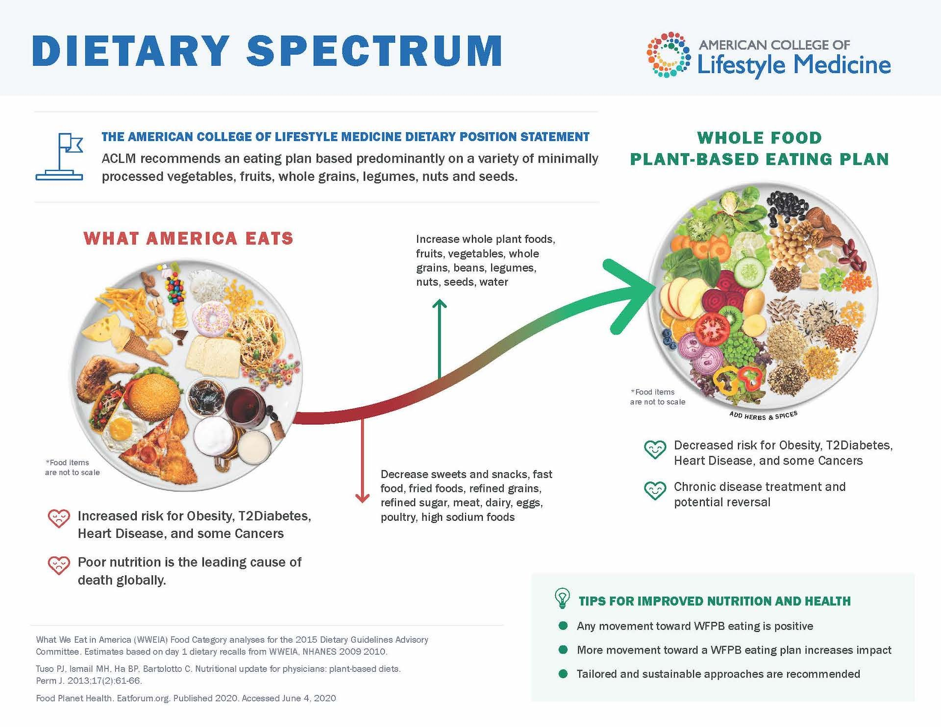
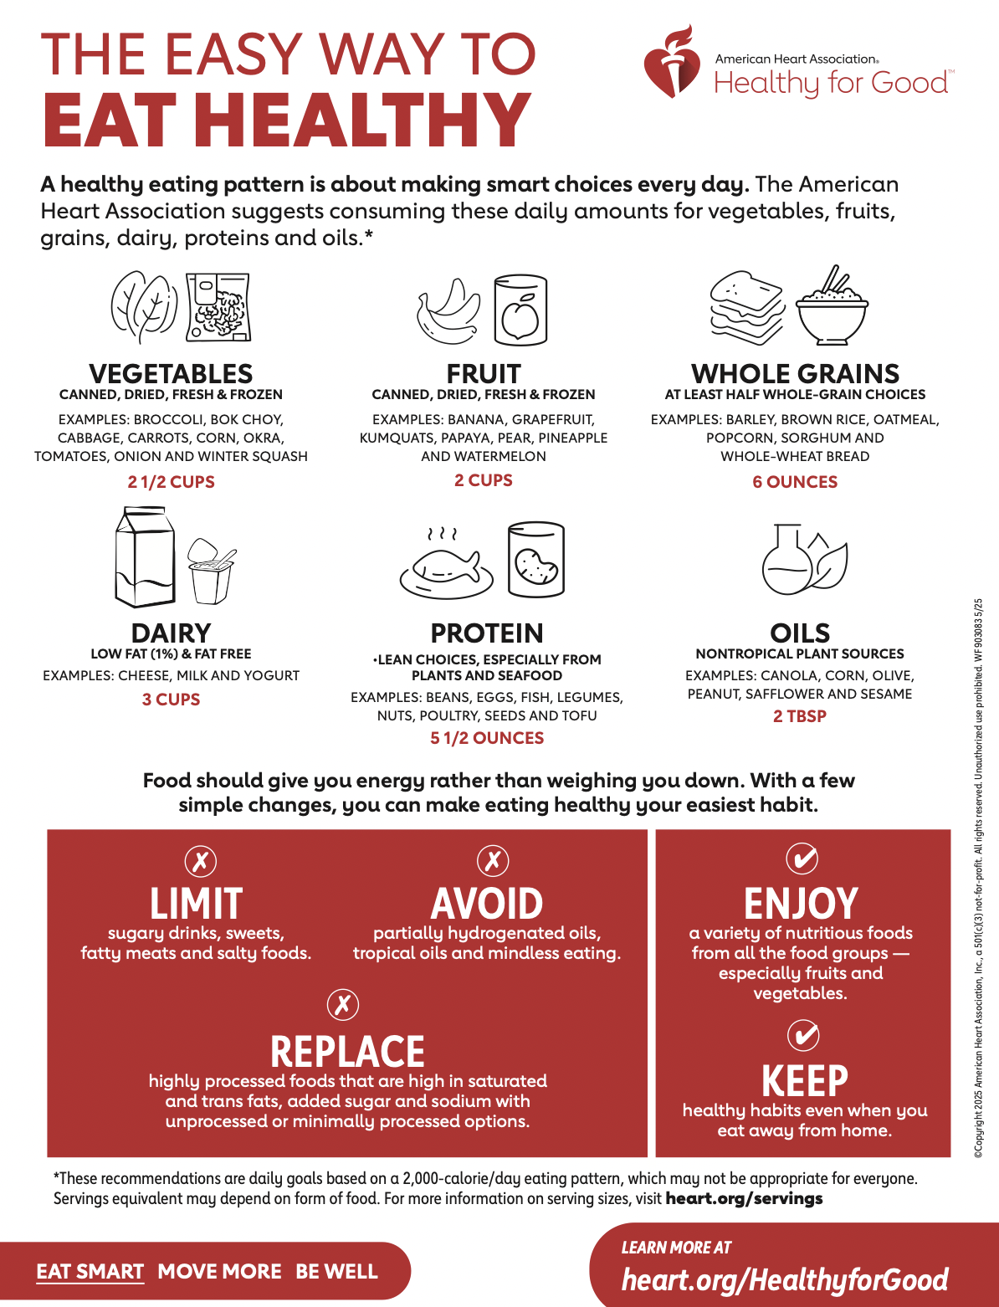

Slide 34
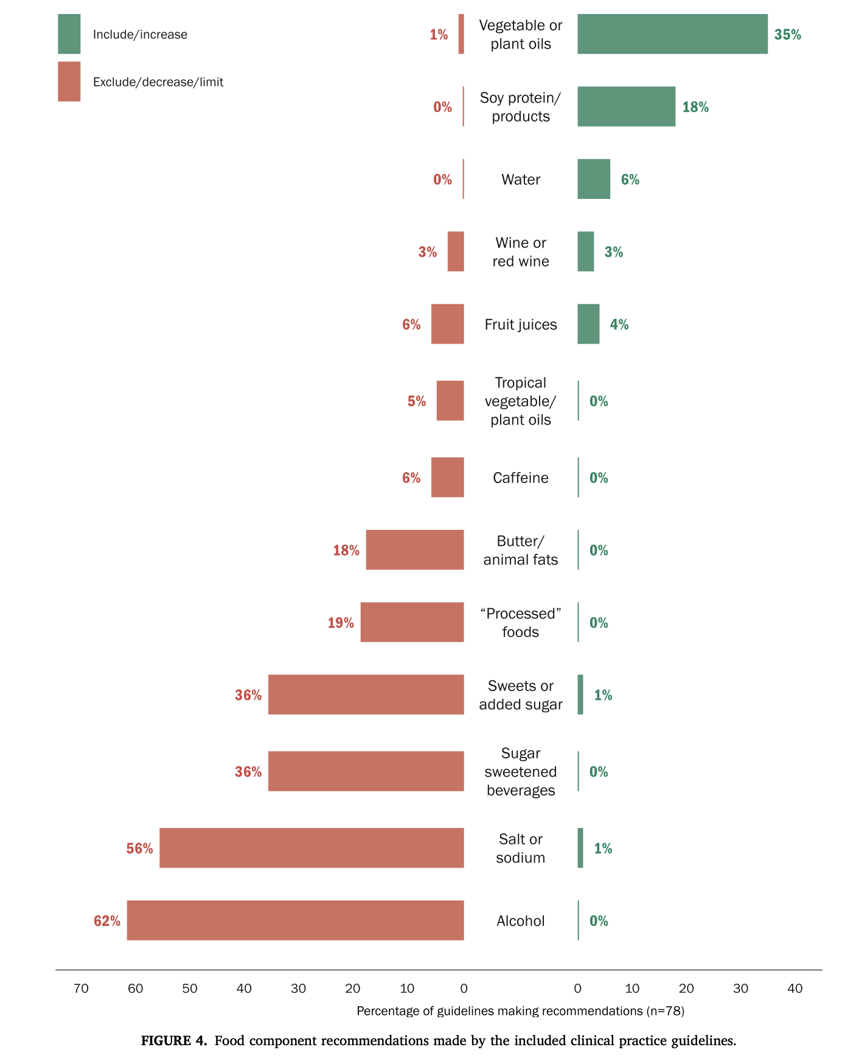
Consensus of Other Existing Dietary Guidelines
Source: Cara et al 2023
Notes:
Source: https://pmc.ncbi.nlm.nih.gov/articles/PMC10201822/
ACLM reviewed 78 CPGs (clinical practice guidelines) 2010-2022 for major chronic conditions (autoimmune, 7; cancers, 5; cardiovascular-related, 35; digestive, 11; diabetes, 12; weight-related, 4; or multiple, 3) and general health promotion (n = 1)
approximately half (49%) endorsed patterns centered on plant foods
Overall, CPGs were most closely aligned in promoting consumption of major plant food groups (vegetables = 74% of CPGs, fruit = 69%, whole grains = 58%), whereas discouraging intake of alcohol (62%) and salt or sodium (56%).
CVD and diabetes CPGs were similarly aligned with additional messaging to consume legumes/pulses (60% of CVD CPGs; 75%, diabetes), nuts and seeds (67%, CVD), and low-fat dairy (60%, CVD).
Diabetes guidelines discouraged sweets/added sugars (67%) and sweetened beverages (58%).
This alignment across CPGs should boost clinician confidence in relaying such dietary guidance to patients in accordance with their relevant CPGs.

Slide 35

Implications for Clinical Practice
What does nutrition counseling look like in your practice?
How did the new DGA change your practice, if at all?
To what extent has the new DGA come up in your clinical encounters with patients or conversations with colleagues?
What are you worried/confused about going forward in terms guiding patients on nutrition?
What do we do when policy is discordant with clinical evidence and practice?

Slide 36
Outline
USPSTF updates
Immunization guidelines updates and evidence review
Dietary guidelines updates and evidence review
Low value care/Healthcare system implications

Slide 37
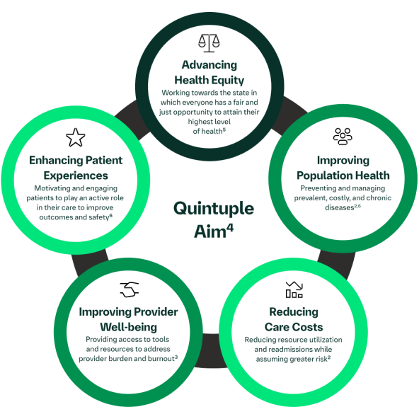
Low value care
Quintuple aim review
Importance of being a good steward of healthcare resources
Examples of preventive low-value care that is not evidence-based
Vit D screening
Too frequent cervical cancer screening
Notes:
Source: Oregon-Low-Value-Care-Report-Final-July-2020.pdf

Slide 38
Low value care
Low value care/health care waste
Refer to medical treatments, tests and procedures that have been shown through evidence and research, to provide little benefit in specific clinical scenarios.
Low-value care has the potential to result in poor physical, emotional and financial outcomes for patients, and it contributes to the high cost of health care.
Reducing low-value care has the potential to reduce patient risk and a variety of health care related costs
Oregon-Low-Value-Care-Report-Final-July-2020.pdf
Notes:
Source: Oregon-Low-Value-Care-Report-Final-July-2020.pdf

Slide 39
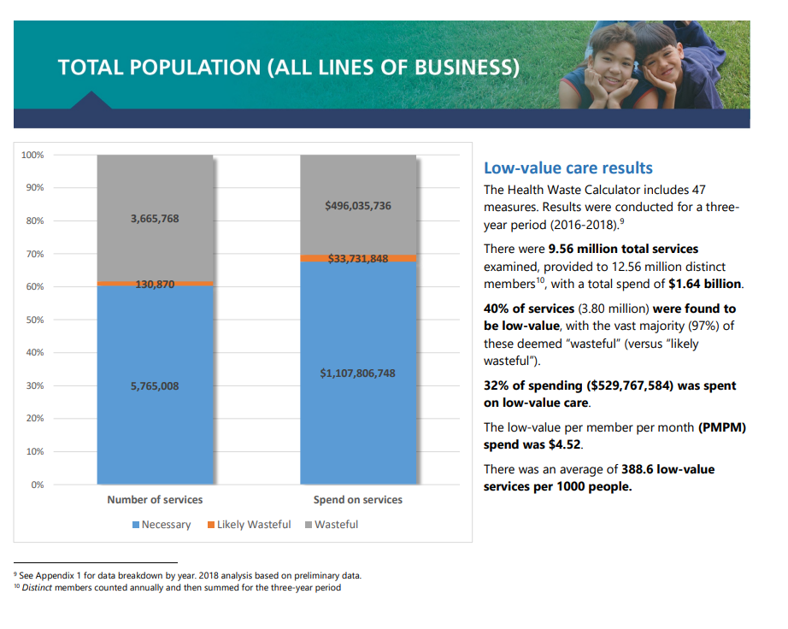

Slide 40
Low Value Care in Oregon
Low-value Care | # services | # patients affected | # Cost
Population-based screening for Vitamin D deficiency | 82,728 | 79,740 | $7,639,365
Too frequent cervical cancer screening for women who have had adequate prior screening and are not otherwise at high-risk for cervical cancer | 29,957 | 29,218 | $1,352,109
Notes:
Source: Oregon-Low-Value-Care-Report-Final-July-2020.pdf Calculated over 3 year period 2016-2018

Slide 41
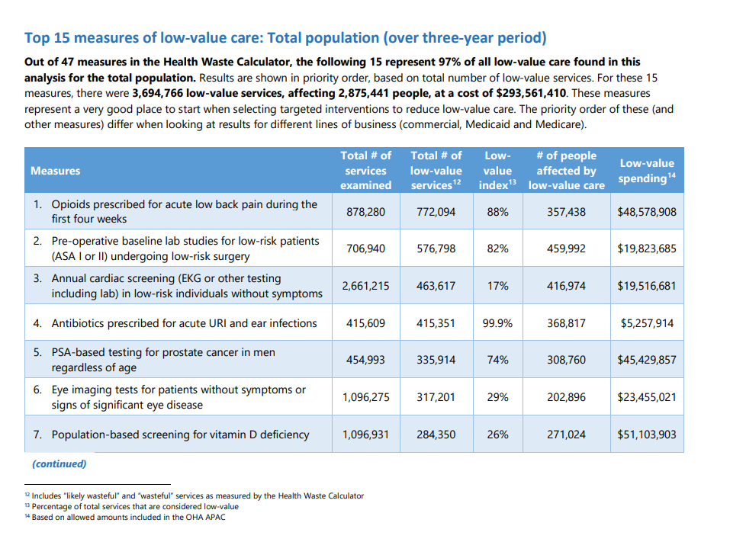

Slide 42
