Slide 1


    Fear No More: Management of Pediatric Anxiety and Depression.
Joe Thoits MD
Assoc Prof of Psychiatry / Child & Adolescent Psychiatry, OHSU
Medical Director Child & Adolescent Psychiatry Unit 6
Unity Center for Behavioral Health
May, 2026
Notes:
ANXIETY DISORDERS ARE AMONG THE MOST COMMON PSYCHIATRIC DISORDERS IN CHILDHOOD.
Anxiety disorders are among the most common psychiatric conditions in children and adolescents, with estimates of the lifetime prevalence of any anxiety disorder among youth in the range of 15%–20% (Beesdo et al. 2009). Moreover, anxiety disorders impair functioning in family, academic, and social settings in affected youth (Beesdo et al. 2009; Rynn et al. 2011) and double the risk for anxiety or depressive disorders in adulthood (Pine et al. 1998; Kaplow et al. 2001; Woodward and Fergusson 2001; Zimmermann et al. 2003; Rynn et al. 2011). In addition, the presence of an anxiety disorder in children and adolescents increases the risk for substance abuse and both suicidal ideation and suicide attempts (Pine et al. 1998; Kaplow et al. 2001; Woodward and Fergusson 2001; Zimmermann et al. 2003; Rynn et al. 2011). However, these disorders are often untreated, particularly in pediatric populations (Chavira et al. 2004).
Generalized anxiety disorder (GAD), separation anxiety disorder (SAD), and social phobia/social anxiety disorder are the most frequently occurring childhood anxiety disorders (Wehry et al. 2015) and frequently cooccur. As such, these three childhood anxiety disorders are often referred to as the “pediatric anxiety triad” (Walkup et al. 2008). Importantly, many (Walkup et al. 2001, 2008), but not all (Rynn et al. 2001, 2007; Strawn et al. 2015a), psychopharmacologic studies in children and adolescents have treated the pediatric anxiety triad as a monolith, rather than focusing on individual diagnoses. The reasons for this approach are multifactorial (e.g., including phenomenologic, clinical, theoretical, and epidemiologic data) and are the result of high rates of comorbidity among the triad disorders (Walkup et al. 2008), comparable onset patterns (Beesdo et al. 2010), common neurocircuitry (Blackford and Pine 2012; Strawn et al. 2012b), and similar responses to pharmacotherapy and psychotherapy, especially cognitive behavioral therapy (CBT) (Compton et al. 2010; Kendall et al. 2010; Strawn et al. 2012a).

Slide 2
Disclosure
I have no actual or potential conflict of interest in relation to this program/presentation.

Slide 3
Objectives:
1) Review DSM V anxiety and depressive disorder diagnoses, including common presentations, screening tools and recognition of comorbid conditions commonly encountered in family medicine settings.
2) Review current evidence-based treatment recommendations/guidelines for treating anxiety and depressive disorders.
3) Review some of the most commonly encountered challenges to treating anxiety and depressive disorders and ways to manage those challenges.
Notes:
Identify and differentiate common presentations of anxiety and depressive disorders in adolescents, including the use of age‑appropriate screening tools and recognition of comorbid conditions commonly encountered in family medicine settings.
Apply evidence‑based, family‑centered management strategies for adolescent anxiety and depression, including initial counseling approaches, indications for pharmacologic treatment, safety planning, and criteria for referral or collaborative care.

Slide 4
Agenda
Case Examples
Screening and Diagnosis
Education
Selecting an Appropriate Initial Treatment
Adjusting Treatment
Case Conclusions
Best Practice

Slide 5

“We suffer more often in imagination than in reality.”
Notes:
Seneca

Slide 6

Case JK
15-year-old freshman at local elite high school, referred by her therapist for psychiatric evaluation
Two seizures at school
“… they opted to switch providers (peds neurologist) after he was unable to find a neurologic or medical cause for her symptoms.”
No prior psychiatric history.

Slide 7
Case JK
“Since those two events, however, things have reportedly gotten substantially worse at home. JK has always had perfectionistic and anxious qualities, she and parents say, but since the seizures she has emphasized school to a much greater degree, has seemingly raised her own high standards and as a result has been unbearable to deal with. Parents say she is aggressive with them, verbally abusive, very rigid and demanding, all to a degree they have never previously seen before. JK says that she has “always been hard on myself” and that she has always been “very anxious about school,” citing the fact that both of her parents attended Ivy league schools. She says, and they agree, that recently she has been even more wound up about school, has had a harder time actually doing her work because she is so stressed out about doing things right. When it comes to most things, “I don’t do it until I’m perfect at it,” she says. “I’m scared to start things if I can’t do it perfectly.” She admits to having “always thought I had anxiety,” and says that for a long time “it has been masked.””

Slide 8

Case JK
Medications:
-Trileptal 600mg BID
-Lorazepam 0.5mg prn
Rating Scales:
-BDI-II: 19
-GAD-7: 17

Slide 9

Case: JT
12-year-old NA from Medford, OR
Prior diagnoses: RAD, FAS, ADHD, ODD
Admitted to Unity after he “blew out” of sub-acute
“Mom says that JT’s struggles have always centered around the fact that he is abysmal at asking for help when he needs it. The frustration and irritability mounts, he cannot manage, does not ask for help and then he gets aggressive.” -- H&P
“I kept flipping out, I can’t control my body.” -- patient

Slide 10

Case: JT
Born premature, adopted at 2 years of age
History of 8+ inpatient stays, many medication trials
Meds on admit: MPH 36/10, Amantadine 25
Hospital day 26, informed of pending transfer, assaulted this provider → seclusion/restraints
Hospital day 27 → seclusion/restraints
Hospital day 29 → walked out with secure transport driver

Slide 11

Assessment..
Notes:
A narrative approach to psychiatric interviewing focuses on the patient's life story, co-constructing a meaningful narrative of their experiences and illness. It involves active, non-judgmental listening and uses open-ended questions to understand the patient's subjective experience, social context, and the meaning they make of events, moving beyond a simple diagnosis-focused approach. Key elements include focusing on temporality, social context, and establishing a strong rapport to create a safe space for storytelling.

Slide 12
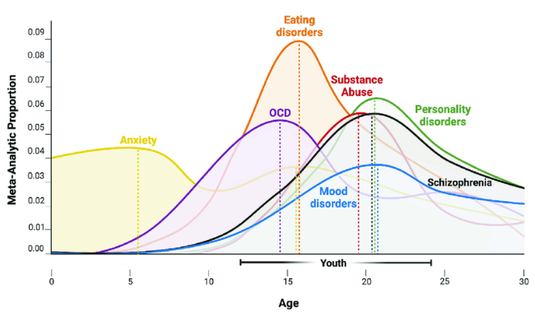

Slide 13
Anxiety is typical. Sometimes.
  Infancy: being startled, exposure to strangers
  Toddlers: separation from caregiver
  Preschoolers: supernatural creatures
  School-aged: physical well-being and natural disasters
  Adolescents: social and existential concerns
Notes:
Clinically significant anxiety (ie an anxiety disorder) must be distinguished form everyday worries and fears, which are common to the human experience and normative in specific developmental stages:

Slide 14
DSM V: Anxiety Disorders
Separation Anxiety Disorder | Excessive worry about being separated from caregiver; duration > 4 weeks in children
Selective Mutism | Lack of speech in particular situations despite talking in other settings; duration > 4 weeks
Specific Phobia | Excessive fear of a particular object or situation; duration > 6 months
Social Anxiety Disorder | Excessive fear of social situations or being observed, fear of negative evaluation
Panic Disorder | Multiple panic attacks without identifiable trigger, persistent apprehension about having a panic attack and/or excessive behavioral changes to avoid having a panic attack
Agoraphobia | Avoidance of two of the following situations: public transportation, open spaces, enclosed spaces, crowds and being outside of the home
Generalized Anxiety Disorder | Intense worry about multiple everyday tasks or situations; duration > 6 months, in kids one additional sx (poor sleep, fatigue, poor concentration, restlessness, muscle tension)
Notes:
“PEDIATRIC ANXIETY TRIAD” -Walkup
According to DSM-5,1 separation anxiety is characterized by developmentally inappropriate, excessive worry or distress associated with separation from a primary caregiver or major attachment figure.
Social anxiety is characterized by excessive fear or worry about being negatively evaluated by others in social situations.
Generalized anxiety is characterized by excessive, uncontrollable worries regarding numerous everyday situations or activities.
---------------------
SOCIAL ANXIETY DIS:
EYE CONTACT IS OFTEN UNCOMFORTABLE FOR THESE KIDS…
POSTURE MAY BE OVERLY RIGID, SPEECH MAY BE ABNORMALLY SOFT…
IMPAIRMENT HELPS DISTINGUISH BETWEEN NOMATIVE SHYNESS AND SOCIAL ANXIETY DISORDER.
EXAMPLES OF IMPAIRMENT INCLUDE DIFFICULTIES MAKING OR KEEPING FRIENDS, LIMITED ROMANTIC RELATIONSHIPOS, SCHOOL REFUSAL, NOT PARTICIPATING IN EXTRA-CURRICULAR ACTIVITIES, AND SIGNIFICANT CHILD DISTRESS.

Slide 15
Comorbidity is common.
Anxiety disorders are highly comorbid with each other and other disorders.
  GAD most likely to be comorbid with another anxiety disorder or mood disorder.
    In NCSA, children with GAD had a 66% lifetime comorbidity rate with other anxiety disorders
      41% with Specific Phobia
      21% with Separation Anxiety Disorder
      20% with Social Anxiety Disorder
    In NCSA, children with GAD had a 59% lifetime comorbidity rate with mood disorders (e.g. MDD, persistent depressive disorder, BPAD).
*NCSA = National Comorbidity Survey Replication Adolescent Supplement.
Notes:
Animals: Fears of dogs, spiders, insects, and snakes are very common.
Natural environment: Children often develop phobias related to heights, thunderstorms, and water.
Blood-injection-injury: Fear of needles, getting shots, blood, or other injuries is a frequent type of phobia.
Situational: This category includes specific fears like flying, being in small spaces (claustrophobia), or riding in cars.

Slide 16
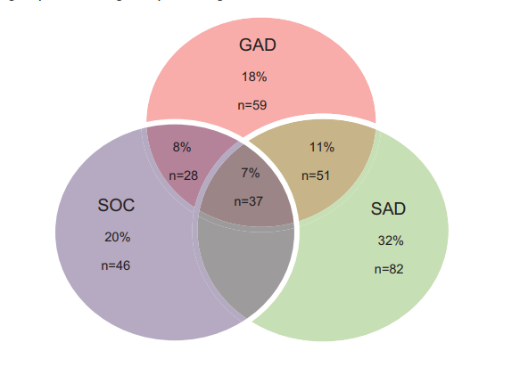
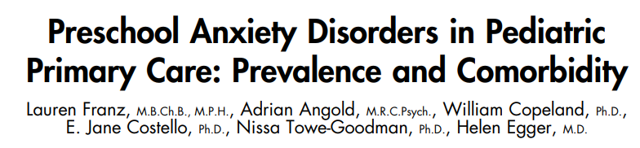
Close to three-fourths of preschoolers who met criteria for an anxiety disorder had only a single anxiety disorder.

Slide 17
Differential Dx Anxiety Disorders
Selected DSM-5 criteria | ADHD | Anxiety
Problems Concentrating | XXX | XXX
Avoidant Behaviors | XX | XXX
Hard to remember things | XXX | XXX
Doesn’t follow directions | XXX | XXX
Fidgety, Squirmy, Restless, motor restlessness | XXX | XXX
Talks Excessively | XXX | X
Extreme Distractibility | XXX | XX
Irritability | XX | XXX
Muscle Tension |  | XX
Sleep Dysregulation | X | XXX

Slide 18

Anxiety disorders run in families
Notes:
Children of anxious parents are more likely to exhibit clinical levels of anxiety than children of non-anxious parents.
Genetic and non-genetic factors:
1. Anxious caregivers promote more avoidance in the child by providing higher levels of family accommodation.
2. Anxious caregivers may also directly model fearful and avoidant behavior, providing the child with more opportunities for vicarious fear learning with less modeling of nonavoidant coping strategies.

Slide 19
Anxiety → depression
“My own mind, I am fairly certain, will always gravitate toward anxiety. And like many, I will often be disinclined to do anything about it. The reasons for this are no doubt complex and myriad. But it is certain that anxiety is exhausting and demoralizing: in many cases, as you listen to your anxious thoughts you get tired and apathetic. You get depressed. And that hopelessness, inaction and despair can become a sort of cocoon, a protective layer between you and the high-pitched terror of it all, and maybe, over time, even a painful and perverse comfort.”
The Anxious Idiot, D. Smith, 8/11/12, www.nytimes.com

Slide 20

Depression
Persistent and pervasive sadness, anhedonia, boredom or irritability that is functionally impairing and relatively unresponsive to the usual experiences that might usually be expected to bring about relief
DSM V…
-Adjustment disorder with depressed mood
-Persistent depressive disorder
-Major depressive disorder
-Disruptive Mood Dysregulation Disorder
-Premenstrual Dsyphoric Disorder

Slide 21

MDD Comorbidity is common:
  40-90% have another psychiatric disorder
  30-80% anxiety
  10-80% disruptive disorders
  20-30% substance use
Richardson LP, Katzenellenbogen R. Childhood and adolescent depression: the role of primary care providers in diagnosis and treatment. Curr Probl Pediatr Adolesc health Care. 2005 Jan; 35 (1): 6-24.

Slide 22
Diagnosis:
Screening
  General Mental Health: Pediatric Symptom Check-list, CBC-L
  Depressive Symptom Scales: BDI-II, PHQ-A
  Anxiety Symptom Scales: SCARED, MASC
Clinical history is crucial
  Current symptoms
  Negative life events
  Social supports
Differential Diagnosis
  Anxiety/Depression
  ADHD/LD
  Substance Use D/O
  EDO

Slide 23
Treatment planning:
Diagnosis.
Nature and purpose of treatment.
Risk and benefits of treatment.
Alternative treatments and their risks and benefits.
Risks and benefits of declining treatment.

Slide 24
Educating Patients:
Course & Natural History
~90% of MDE will remit after 1.5 to 2 years
Without treatment, adolescent MDE typical duration 7 to 9 months
Recovery is the rule, but recurrence is common
  20-40% relapse within 2 years
  70% within 5 years*
*Birmaher B, Arbelaez C, Brent D: Course and outcome of child and adolescent major depressive disorder. Child Adolescent Psychiatric Clin N Am 11(3): 619-637, 2002
Notes:
Patients and families can be encouraged that recovery from depression is the rule, not the exception, but that treatment will require commitment and there is a risk for future recurrence.
It is important to address any hopelessness regarding depression and its treatment, as hopelessness has been shown to predict withdrawal from treatment and suicidal behavior.
There are no controlled trials of psychoeducation, but psychoeducation seems to improve adherence to treatment and reduce the symptoms of depression.
Even in the absence of formal family therapy, it is virtually impossible to successfully treat a child or adolescent patient without the close involvement of parents. First, the clinician has to recognize that motivation for treatment comes often from the parents, and therefore the treatment contract must involve them. Second, the parents may observe aspects of the child’s functioning or symptoms that either the child is not aware of or does not wish to share, and this information is vital to the development of a realistic and effective treatment contract. Third, the parents are able to monitor their child’s progress and serve as a safety net.

Slide 25
Educating Patients:
Activation
Encourage patients to engage in activities that may help to lessen depressive/anxiety symptoms
Physical activity can decrease depressive symptoms*
Correct sleep dysfunction
School involvement
Family involvement is paramount
Chanudda Nabkasorn et al. Effects of physical exercise on depression, neuroendocrine stress hormones and physiological fitness in adolescent females with depressive symptoms, European Journal of Public Health, Volume 16, Issue 2, 1 April 2006, pgs 179–184.
Notes:
Encourage patients to engage in activities that may lessen depressive symptoms. Patients with depression often withdraw from activities that they used to enjoy and instead spend more time ruminating about their symptoms or sleeping. Providers can explain how behaviors and thoughts contribute to a negative spiral that worsens depression, and reversing these thoughts and behaviors are the first steps to feeling better.
For children and adolescents, returning to school and having activities with friends can be very important first steps to feeling better.
Studies have also shown that physical activity can decrease depressive symptoms, independent of other treatments for depression.
Encouraging patients to begin walking each day or joining a non-competitive sport can be very helpful toward changing negative thoughts and improving depression. Families can support younger children with increasing activities by planning outings, such as walks, bike rides, trips to the pool.
Since sleep dysfunction is common with depression and anxiety disorders, providers can also counsel youth on good sleep hygiene and setting regular sleeping hours, including discontinuing daytime naps.
Subjective sleep complaints are a very prominent component of early-onset depression, although subjective complaints and objective observations of sleep in a sleep laboratory are not closely correlated.
The most consistent sleep laboratory finding associated with depressive onset, persistence, and recurrence is increased sleep latency.
Insomnia has been found to have a stronger relationship with onset and growth of depressive symptoms than vice versa.
Even in the absence of formal family therapy, it is virtually impossible to successfully treat a child or adolescent patient without the close involvement of parents.
First, the clinician has to recognize that motivation for treatment comes often from the parents, and therefore the treatment contract must involve them.
Second, the parents may observe aspects of the child’s functioning or symptoms that either the child is not aware of or does not wish to share, and this information is vital to the development of a realistic and effective treatment contract.
Third, the parents are able to monitor their child’s progress and serve as a safety net.

Slide 26

Selecting Initial Treatment
1) Psychotherapy
2) Medication
Determining factors:
  Severity and sub-type of depression/anxiety
  Comorbid conditions
  Family psychiatric history
  Family/social environment
  Patient preference
Notes:
Although the evidence is mixed, studies in adults suggest that incorporating patient preference into treatment decisions may improve treatment adherence, satisfaction, and outcomes for depression.
-Severity and sub-type of depression/anxiety:
→ Worse the symptoms, more likely to consider pharmacotherapy.
→ Neuro-vegetative symptoms of depression, weight loss/sleep, any signs of role failure, much likely to consider pharmacotherapy.
-Comorbid conditions:
Especially ADHD, therapy is going to be nigh impossible without some traction in the form of pharmacotherapy.
-Family psychiatric history:
Just as there genetic predisposition to getting these conditions, so too is there genetic predisposition for benefit, as well as adverse experience, from treatment with medication.
-Family/Social environment:
Can parents reliably get them in to be seen? Can they make it to therapy? If not, less likely to refer them.
Want to consider treatment, concerned about ADHD medication compliance? Give it at school.
Patient Preference:

Slide 27
Practice Parameter for the Assessment and Treatment of Children and Adolescents with Depressive Disorders. JAACAP, 46:11, November 2007
Selecting Initial Treatment:
Therapy
AACAP guidelines: all youth receive some form of psychotherapy, even if they take antidepressant medication
Uncomplicated, mild symptoms → supportive therapy
Complicated, moderate-severe symptoms → specific therapy and/or medication
Notes:
Although the evidence is mixed, studies in adults suggest that incorporating patient preference into treatment decisions may improve treatment adherence, satisfaction, and outcomes for depression.

Slide 28
* Dialectical Behavior Therapy Compared With Enhanced Usual Care for Adolescents With Repeated Suicidal and Self-Harming Behavior: Outcomes Over a One-Year Follow-Up. JAACAP 2016;55(4):295–300.
**Practice Parameter for the Assessment and Treatment of Children and Adolescents with Depressive Disorders. JAACAP, 46:11, November 2007
Selecting Initial Treatment:
Therapy
Cognitive Behavioral Therapy (CBT)
  Effective in treating both anxiety and depressive disorders
Dialectical Behavioral Therapy (DBT)*
  Effective in reducing self-harm behavior, SI and depressive symptoms
Interpersonal Psychotherapy (IPT)**
  Effective for adolescent depression, superior to twice-monthly supportive clinical management
Notes:
CBT is one of the most widely tested psychotherapeutic techniques.
8 to 16 sessions of CBT over a period of 3-4 months have been shown to be more efficacious than alternative psychotherapies.
Agenda. Homework. Soliciting Feedback.
“But in the end, both CBT’s advocates and its critics can agree on two things: no form of psychotherapy offers a reliable miracle cure, and it’s never easy making neat science out of the often nebulous encounter we call psychotherapy.”
CBT techniques focus on
-identifying/changing negative self-defeating thought patterns
-increasing positive behaviors and activities
-exposure-response-prevention
DBT-A is an effective treatment for self-harming adolescents with traits of borderline personality disorder in terms of reducing self-harm behavior, suicidal ideation and depressive symptoms.
DBT-A leads to significantly more favorable outcomes with respect to reduction in the frequency of self-harm behavior both in the short- and long-term perspective.
DBT-A leads to more rapid clinical improvements in suicidal ideation, depression and borderline symptoms than does usual care.
Mindfulness
Distress Tolerance
Emotion Regulation
Interpersonal Effectiveness
In this treatment, depression is conceptualized as occurring within an interpersonal matrix and IPT-A targets resolution of interpersonal stress that seems to be associated with the adolescent’s depression. IPT-A begins by taking an interpersonal inventory of important relationships in order to determine appropriate treatment targets. The types of problems typically targeted by IPT-A are loss, role disputes, role transitions, interpersonal skills deficits, or adjustment to a single-parent family. The goal of treatment is to replace conflictual, unfulfilling relationships with those that are more meaningful, rewarding, and less conflictual.
Mufson, et al. Efficacy of interpersonal psychotherapy for depressed adolescents Archives Gen Psychiatry 56(6): 573-579, 1999.
Dialectical Behavior Therapy Compared With Enhanced
Usual Care for Adolescents With Repeated Suicidal and
Self-Harming Behavior: Outcomes Over a One-Year
Follow-Up
Mehlum Et al, JAACAP, volume k55, number 4, april 2016

Slide 29
Drug Name | FDA Approval | Starting Dose | Therapeutic Range
Fluoxetine (Prozac) | MDD/OCD (>8yo) | 10mg | 10-40mg
Sertraline (Zoloft) | OCD (>6yo) | 25mg* | 25-200mg
Escitalopram (Lexapro) | MDD (>12yo) GAD (>7yo) | 5-10mg | 10-20mg
Citalopram (Celexa) |  | 10mg | 10-40mg
Duloxetine (Cymbalta) | GAD (>7yo) | 30mg | 30-60mg
Venlafaxine (Effexor) |  | 37.5mg | 37.5-225mg
*BID dosing <12yo
Notes:
SERTRALINE >6YO OCD
DULOXETINE >7YO GAD
FLUOXETINE >8YO MDD/OCD
FLUVOXAMINE > 8YO OCD
ESCITALOPRAM >12YO MDD
SSRI’s generally first line
Fluoxetine (Prozac): MDD/OCD (>8yo)
Sertraline (Zoloft): OCD (>6yo)
Escitalopram (Lexapro): MDD (>12 yo)
Citalopram (Celexa)
SNRI
Duloxetine (Cymbalta): GAD (>7yo)
Venlafaxine (Effexor):
Bupropion (Wellbutrin)
Mirtazapine (Remeron)

Slide 30
Practice Parameter for the Assessment and Treatment of Children and Adolescents with Depressive Disorders. JAACAP, 46:11, November 2007
Close monitoring
SSRI first line
½ rec adult starting dose → increase 1 week
Anticipate side effect patterns
Anticipate delay
Anticipate treatment duration
Notes:
Childhood and Adolescent Depression: The role of primary care providers in diagnosis and treatment
Richardson et al. Current Probl Pediatric Adolescent Health Care 2005; 35: 1-24
Due to side effect patterns, first few weeks of treatment are a critical time period during which many patients discontinue therapy
Therefore, when starting a patient on a antidepressant, symptom should be monitored every 1-2 weeks until they begin to remit and the patient is on a stable treatment dose.
Anticipate delay: the maximal symptom response should be achieved at 4 to 6 weeks of a consistent dose. Patients can get frustrated and stop medications before seeing their full effect; therefore, when antidepressants are started, they should be educated about the anticipated delay in seeing full benefits of medications.
Once an effective medication and dose are found, a patient should take the medication for 6 to 9 months to avoid a relapse of depression and should be monitored at least every 1 to 2 months.

Slide 31
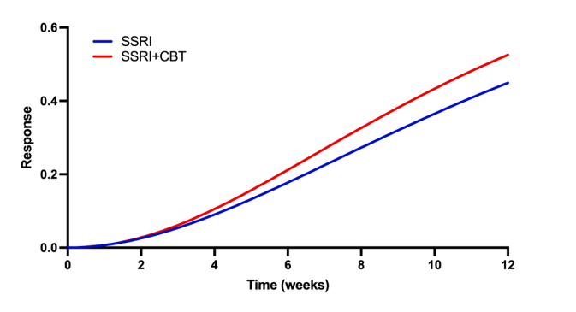
When does additive CBT benefit in SSRI-treated patients emerge?
Strawn et al, 2022

Slide 32
Practice Parameter for the Assessment and Treatment of Children and Adolescents with Depressive Disorders. JAACAP, 46:11, November 2007
Adjusting Treatment:
No response after a month…
Therapy:
  Therapeutic alliance?
  Appropriate modality?
  Consider medication?
Medication:
  Compliance?
  Dose?
  Withdrawal?
  Consider therapy?
  Consider alternative agent?
Notes:
No benefit after 3-4 weeks, time for a change?
Consider an alternative agent? There’s a paper for that…..

Slide 33
Treatment Resistance?
-334 pts (12-18), failed 2-month SSRI, 12 weeks
Intervention | Response Rate
Different SSRI | 47%
Venlafaxine | 48.2%
Different SSRI + CBT | 54.8%
Venlafaxine + CBT
Notes:
Treatment resistant depression is defined as the persistence of depression after having received adequate quality and dose of an evidence based treatment. The Treatment of SSRI-Resistant Depression in Adolescents (TORDIA) study was designed to determined what clinicians should do next after a patient does not respond to an adequate trial with an SSRI. In TORDIA, 334 adolescents were randomized to a switch to another SSRI, switch to venlafaxine, switch to another SSRI plus CBT, or switch to venlafaxine + CBT. After 12 weeks, the addition of CBT to either medication strategy resulted in a superior outcome to medication monotherapy, and the effects of the SSRI and venlafaxine interventions were similar, except that venlafaxine resulted in more side effects.
1) Switch to a second, different SSRI. Citalopram, fluoxetine, paroxetine (20-40mg)
2) Switch to a different SSRI + CBT.
3) Switch to venlafaxine (150-225)
4) Switch to venlafaxine + CBT
Of 334 adolescents enrolled in the study, 38.9% achieved remission by 24 weeks, and initial treatment assignment did not affect rates of remission. Likelihood of remission was much higher (61.6% versus 18.3% ) and time to remission was much faster among those who had already demonstrated clinical response by week 12.
Conclusions: for adolescents with depression not responding to an adequate initial treatment with an SSRI, the combination of cognitive behavioral therapy and a switch to another antidepressant resulted in a higher rate of clinical response than did a medication switch alone. However, a switch to another SSRI was just as efficacious as a switch to venlafaxine and resulted in fewer adverse effects.

Slide 34
Practice Parameter for the Assessment and Treatment of Children and Adolescents with Depressive Disorders. JAACAP, 46:11, November 2007
Relapse Prevention
20-40% of children and adolescents will have a depressive relapse within 2 years of a first episode, and 70% will do so by adulthood
Treatment should be continued for 6 to 9 months after remission is achieved

Slide 35
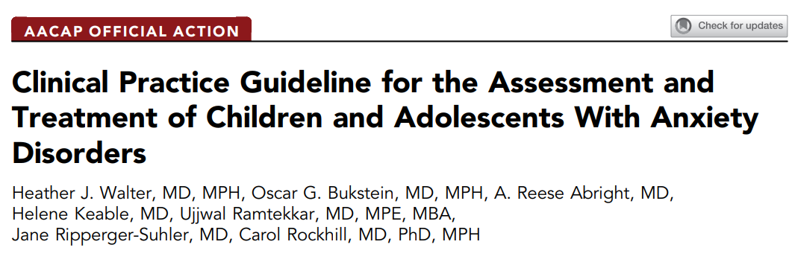
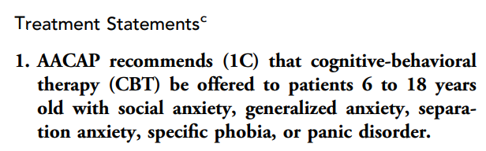
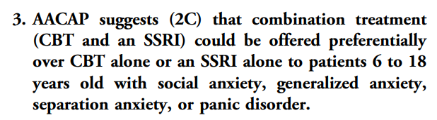
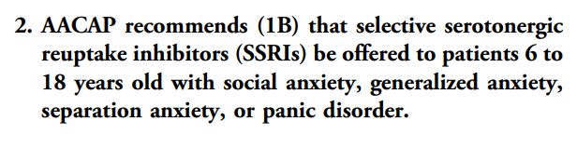
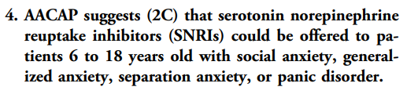

Slide 36
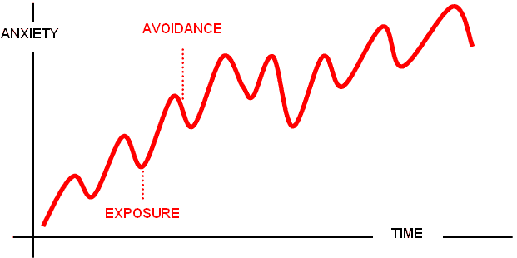
Volitional avoidance of perceived threatening stimuli contributes to the disability associated with anxiety disorders.

Slide 37
Remission After Acute Treatment in Children and Adolescents With Anxiety Disorders: Findings From the CAMS
488 pts (7-17), separation, social or generalized anxiety; 12 -> 24->36 wks
Intervention | Response Rate 12 weeks | Response Rate 24 weeks | Response Rate 36 weeks
Sertraline | 55% | 67% | 70%
CBT | 59.7% | 69% | 71%
Sertraline + CBT | 80.7% | 81.24% | 82.69%
Placebo | 28.3%
Compton SN, Walkup JT, Albano AM, et al. Child/Adolescent Anxiety Multimodal Study (CAMS): rationale, design, and methods. Child and Adolescent Psychiatry and Mental Health. 2010;4:1. doi:10.1186/1753-2000-4-1.

Slide 38

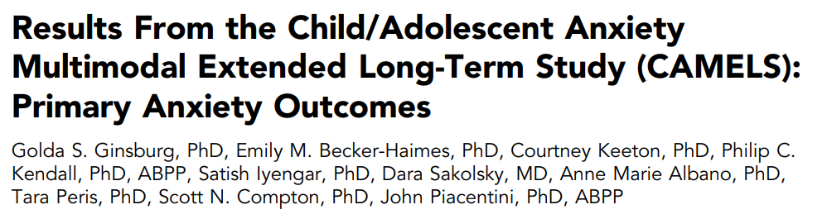
CAMS + 4-year follow-up beginning 4 to 12 years after CAMS
  21.7% consistently “anxiety free”
  30% chronically ill
  48% were relapsers
  Youth who made significant clinical improvement after 12 weeks of treatment, regardless of treatment type, were more likely to be in stable remission
  No association between type of treatment assigned and remission status
Notes:
The present study provides rarely obtained multiyear prospective data on the long-term outcomes for a large sample of youth with anxiety disorders who were treated in the context of a randomized controlled multisite trial comparing sertraline, cognitive-behavioral therapy, their combination, and a pill placebo. In contrast to cross-sectional follow-up studies and our initial hypothesis, findings revealed that despite receiving high-quality evidenced-based treatments for 12 weeks, less than half of the sample met the rigorous criteria for stable remission (ie, no longer met diagnostic criteria for any anxiety disorder across the follow-up years), revealing the chronic nature of pediatric anxiety disorders for a large portion of anxious youth and the need for enhanced treatment and relapse prevention strategies. Indeed, only 21.7% youth were consistently “anxiety free” (absence of all anxiety disorders) over the course of the follow-up, whereas the remainder of youth showed a pattern of relapse or chronic illness. Few studies have followed youth for multiple years, and these data suggest that cross-sectional snapshots may overestimate the durability of treatments’ success. Our findings also send a clear and disquieting message that some anxious youth are in need of longer or better treatments to reduce the burden of these illnesses over time.
Fortunately, youths who made significant clinical improvement after 12 weeks of treatment, regardless of treatment type, were more likely to be in stable remission (versus chronically ill), suggesting there are long-term benefits to getting good treatment early in the course of these disorders. However, the magnitude of this benefit over time was modest, indicating room for improvements in the short term efficacy even for our best evidenced-based treatments. With respect to the relative benefits of one specific treatment type (ie, cognitive-behavioral therapy, sertraline, or their combination), findings revealed no association between type of treatment assigned and remission status over time, suggesting that enhancing access to any effective treatment may have comparable long-term benefits.

Slide 39

Gibbons RD, Brown CH, Hur K, et al. Early evidence on the effects of regulators’ suicidality warnings on SSRI prescriptions and suicide in children and adolescents. Am J Psychiatry. 2007;164(9):1356–1363.
What about the black box?
-2003 FDA issues anti-depressant warning
-2004 FDA issues black-box warning
-2005 FDA implements black-box warning
-2003-2005: SSRI prescriptions ↓ 22% in both the United States and the Netherlands after the warnings were issued.
-Netherlands: suicide rate ↑ 49% (2003-2005)
-United States: suicide rates ↑ 14%* (2003-2004)
*Largest year-to-year change in suicide rates in this population since the CDC began systematically collecting suicide data in 1979
Notes:
In the years following the FDA’s first antidepressant warning in October 2003, there was a sudden, nearly 50 percent decline¹³ in the use of antidepressants among more than 400,000 poor children and adolescents in Tennessee who were covered by Medicaid. It’s hard to believe
In October 2004, the FDA required a so-called “black box warning”⁶ of this risk to be printed on the labels of all antidepressant drugs. It was implemented in January 2005. Two years later, the FDA extended the same warning to include young adults⁷, again based on industry studies. Each announcement was accompanied by a slew of media reports about the link between antidepressant use and suicide that exaggerated the danger message⁸. that this was not an unintended result of the warnings.
It’s time to rethink the warning.
The FDA knows that drug warnings are seldom totally harmless, and it carefully weighs the tradeoffs. The antidepressant warnings may have made sense to the FDA at the time, though critics have long charged that the data on which the FDA based the warnings are flawed. But the body of evidence that has been accumulated since then overwhelms the analysis⁴ that prompted the FDA’s decisions.
The risk of suicidal thoughts and behaviors and suicide attempts among youths, adolescents, and young adults due to taking antidepressants was never as high as the risk due to untreated depression.
In a paper providing details about this phenomenon,³⁰ Gibbons et al. observed that the 14% increase in the suicide rate between 2003 and 2004 for youths 5 to 19 years of age was the largest annual increase since 1979, when the Centers for Disease Control and Prevention (CDC) began collecting suicide data. The authors also pointed out that a 22% decline in SSRI youth prescriptions in the Netherlands was followed by a 49% rise in the rate of youth suicides between 2003 and 2005. If a causal connection between SSRI use and youth suicide truly existed, they said, the expected observation would have been a decrease in youth suicides during this period.
Gibbons RD, Brown CH, Hur K, et al. Early evidence on the effects of regulators’ suicidality warnings on SSRI prescriptions and suicide in children and adolescents. Am J Psychiatry. 2007;164(9):1356–1363.
OBJECTIVE:
In 2003 and 2004, U.S. and European regulators issued public health warnings about a possible association between antidepressants and suicidal thinking and behavior. The authors assessed whether these warnings discouraged use of antidepressants in children and adolescents and whether they led to increases in suicide rates as a result of untreated depression.
METHOD:
The authors examined U.S. and Dutch data on prescription rates for selective serotonin reuptake inhibitors (SSRIs) from 2003 to 2005 in children and adolescents (patients up to age 19), as well as suicide rates for children and adolescents, using available data (through 2004 in the United States and through 2005 in the Netherlands). They used Poisson regression analyses to determine the overall association between antidepressant prescription rates and suicide rates, adjusted for sex and age, during the periods preceding and immediately following the public health warnings.
RESULTS:
SSRI prescriptions for youths decreased by approximately 22% in both the United States and the Netherlands after the warnings were issued. In the Netherlands, the youth suicide rate increased by 49% between 2003 and 2005 and shows a significant inverse association with SSRI prescriptions. In the United States, youth suicide rates increased by 14% between 2003 and 2004, which is the largest year-to-year change in suicide rates in this population since the Centers for Disease Control and Prevention began systematically collecting suicide data in 1979.
CONCLUSIONS:
In both the United States and the Netherlands, SSRI prescriptions for children and adolescents decreased after U.S. and European regulatory agencies issued warnings about a possible suicide risk with antidepressant use in pediatric patients, and these decreases were associated with increases in suicide rates in children and adolescents.

Slide 40
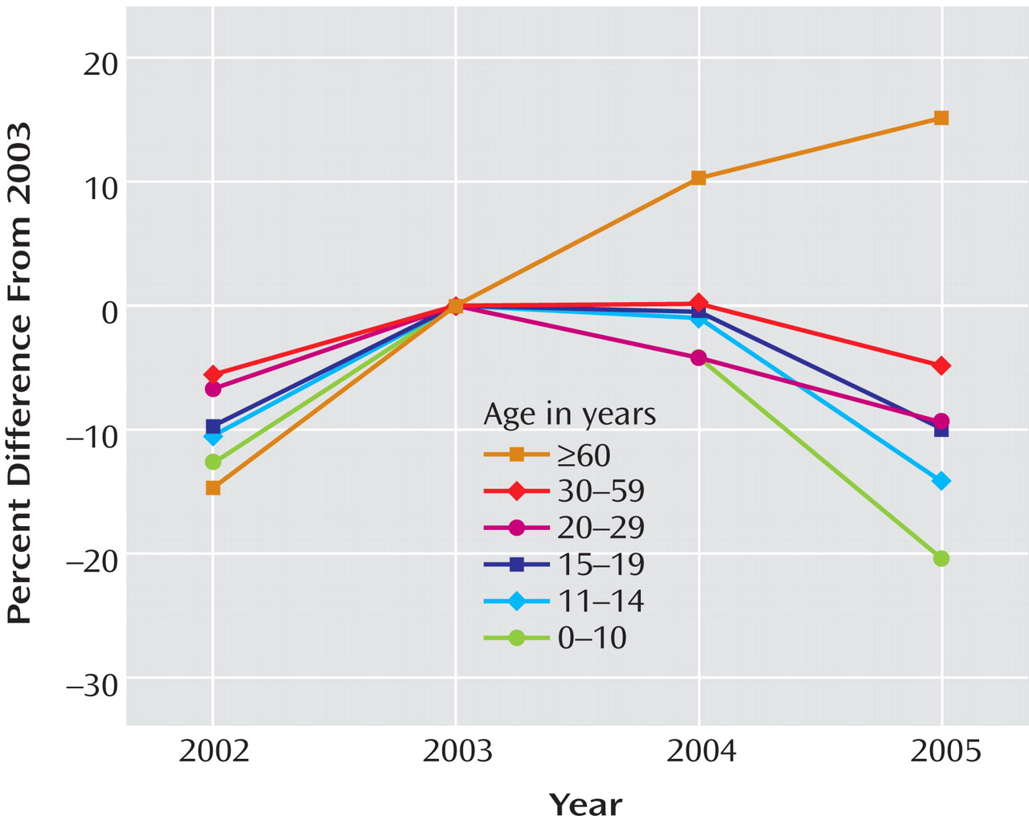
Source: Early evidence on the effects of regulators' suicidality warnings on SSRI prescriptions and suicide in children and adolescents. Am J Psychiatry. 2007 Sep; 164(9): 1356-63
SSRI Prescription Rates in the United States, 2002–2005, Stratified by Age Group and Expressed as a Percentage of the 2003 Rate

Slide 41
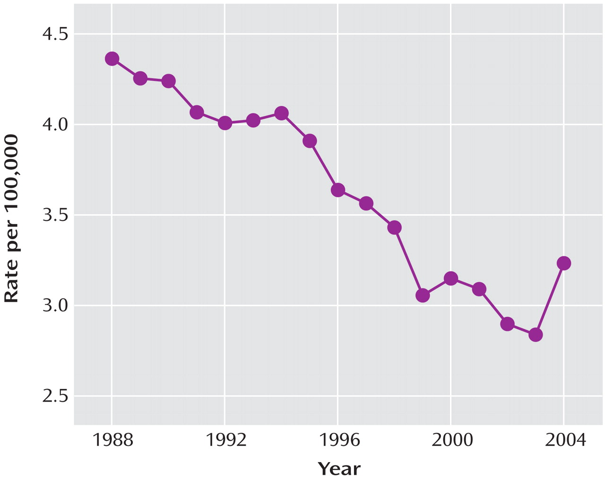
Source: Early evidence on the effects of regulators' suicidality warnings on SSRI prescriptions and suicide in children and adolescents. Am J Psychiatry. 2007 Sep; 164(9): 1356-63
Suicide Rate in Children and Adolescents (Ages 5–19 Years) in the United States, 1988–2004

Slide 42
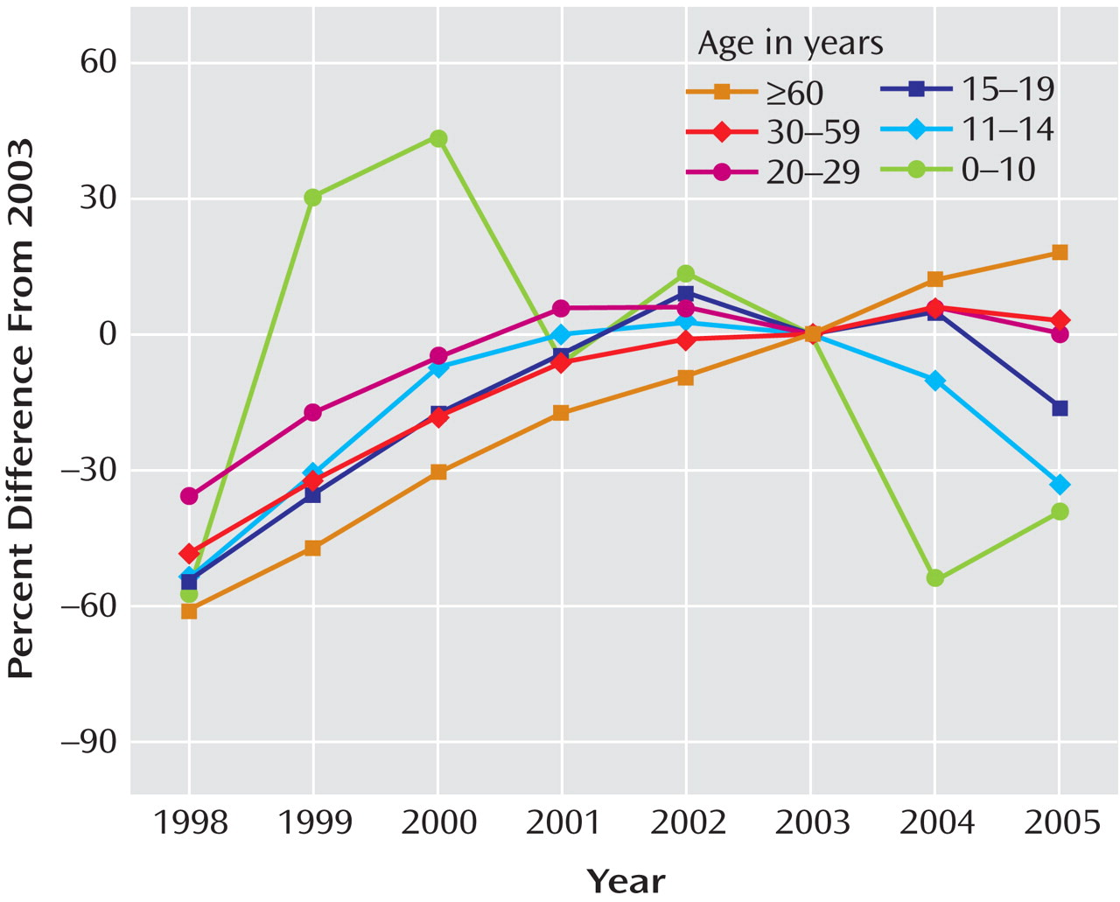
Source: Early evidence on the effects of regulators' suicidality warnings on SSRI prescriptions and suicide in children and adolescents. Am J Psychiatry. 2007 Sep; 164(9): 1356-63
SSRI Prescription Rates in the Netherlands, 1998–2005, Stratified by Age and Expressed as a Percentage of the 2003 Rate

Slide 43
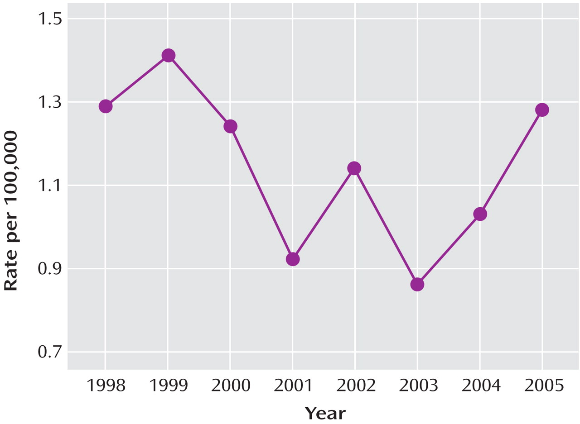
Source: Early evidence on the effects of regulators' suicidality warnings on SSRI prescriptions and suicide in children and adolescents. Am J Psychiatry. 2007 Sep; 164(9): 1356-63
Suicide Rate in Children and Adolescents (Up to Age 19) in the Netherlands, 1998–2005

Slide 44
Quoted with permission by lead author of STAT article, “FDA’s continuing use of ‘black box’ for antidepressants ignores the harms of this warning”, August 29, 2018. Stephen Soumerai is professor of population medicine, founding and former director of the Division of Health Policy and Insurance Research, and teaches research methods at Harvard Medical School.
“The risk of suicidal thoughts and behaviors and suicide attempts among youths, adolescents, and young adults due to taking antidepressants was never as high as the risk due to untreated depression…”
Notes:
In the years following the FDA’s first antidepressant warning in October 2003, there was a sudden, nearly 50 percent decline¹³ in the use of antidepressants among more than 400,000 poor children and adolescents in Tennessee who were covered by Medicaid. It’s hard to believe
In October 2004, the FDA required a so-called “black box warning”⁶ of this risk to be printed on the labels of all antidepressant drugs. It was implemented in January 2005. Two years later, the FDA extended the same warning to include young adults⁷, again based on industry studies. Each announcement was accompanied by a slew of media reports about the link between antidepressant use and suicide that exaggerated the danger message⁸. that this was not an unintended result of the warnings.
It’s time to rethink the warning.
The FDA knows that drug warnings are seldom totally harmless, and it carefully weighs the tradeoffs. The antidepressant warnings may have made sense to the FDA at the time, though critics have long charged that the data on which the FDA based the warnings are flawed. But the body of evidence that has been accumulated since then overwhelms the analysis⁴ that prompted the FDA’s decisions.
The risk of suicidal thoughts and behaviors and suicide attempts among youths, adolescents, and young adults due to taking antidepressants was never as high as the risk due to untreated depression.
In a paper providing details about this phenomenon,³⁰ Gibbons et al. observed that the 14% increase in the suicide rate between 2003 and 2004 for youths 5 to 19 years of age was the largest annual increase since 1979, when the Centers for Disease Control and Prevention (CDC) began collecting suicide data. The authors also pointed out that a 22% decline in SSRI youth prescriptions in the Netherlands was followed by a 49% rise in the rate of youth suicides between 2003 and 2005. If a causal connection between SSRI use and youth suicide truly existed, they said, the expected observation would have been a decrease in youth suicides during this period.
Gibbons RD, Brown CH, Hur K, et al. Early evidence on the effects of regulators’ suicidality warnings on SSRI prescriptions and suicide in children and adolescents. Am J Psychiatry. 2007;164(9):1356–1363.
OBJECTIVE:
In 2003 and 2004, U.S. and European regulators issued public health warnings about a possible association between antidepressants and suicidal thinking and behavior. The authors assessed whether these warnings discouraged use of antidepressants in children and adolescents and whether they led to increases in suicide rates as a result of untreated depression.
METHOD:
The authors examined U.S. and Dutch data on prescription rates for selective serotonin reuptake inhibitors (SSRIs) from 2003 to 2005 in children and adolescents (patients up to age 19), as well as suicide rates for children and adolescents, using available data (through 2004 in the United States and through 2005 in the Netherlands). They used Poisson regression analyses to determine the overall association between antidepressant prescription rates and suicide rates, adjusted for sex and age, during the periods preceding and immediately following the public health warnings.
RESULTS:
SSRI prescriptions for youths decreased by approximately 22% in both the United States and the Netherlands after the warnings were issued. In the Netherlands, the youth suicide rate increased by 49% between 2003 and 2005 and shows a significant inverse association with SSRI prescriptions. In the United States, youth suicide rates increased by 14% between 2003 and 2004, which is the largest year-to-year change in suicide rates in this population since the Centers for Disease Control and Prevention began systematically collecting suicide data in 1979.
CONCLUSIONS:
In both the United States and the Netherlands, SSRI prescriptions for children and adolescents decreased after U.S. and European regulatory agencies issued warnings about a possible suicide risk with antidepressant use in pediatric patients, and these decreases were associated with increases in suicide rates in children and adolescents.

Slide 45
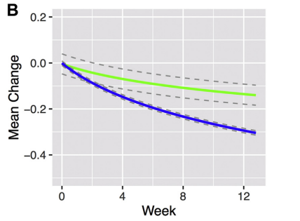
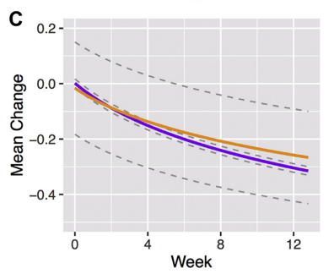
What about dose and class?
SNRI
LOW DOSE
SSRI
HIGH DOSE
Strawn et al. The impact of antidepressant dose and class on treatment response in pediatric anxiety disorders: a meta-analysis. JAACAP 2018; 57(4): 235-44
Notes:
Logarithmic improvement, most improvement at the start, slightly quicker with the SSRIs….
This meta-analysis of randomized, double-blind, placebo-controlled trials of SSRIs and SNRIs in pediatric patients with anxiety disorders does the following: (1) reveals a logarithmic response model; (2) highlights treatment-related early improvement in anxiety symptoms; (3) describes a greater trajectory and magnitude of response for SSRIs compared to SNRIs; and (4) suggests earlier improvement for trials involving high dose SSRI compared to low-dose SSRIs. Improvement occurred early in the course of antidepressant treatment (week 2 for both SSRIs and SNRIs). In fact, approximately 50% of the treatment-related improvement, at week 12, occurred by the fourth week of treatment, consistent with meta-analyses of SSRIs in pediatric patients with MDD and OCD.22 SSRIs and SNRIs differed in their response trajectories and magnitudes. For SNRIs, only 40% of the treatment response observed for SSRIs was observed at week 8, and the difference in trajectory was apparent by the second week of treatment
Strawn et al. The impact of antidepressant dose and class on treatment response in pediatric anxiety disorders: a meta-analysis. JAACAP 2018; 57(4): 235-44

Slide 46
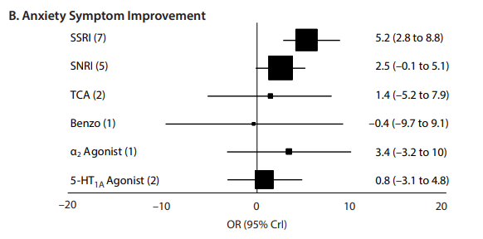
Efficacy and tolerability of pharmacotherapy for pediatric anxiety disorders: a meta-analysis
Dobson et al. Journal Clinical Psychiatry 2019; 80(1)

Slide 47
Efficacy and tolerability of pharmacotherapy for pediatric anxiety disorders: a meta-analysis
CONCLUSIONS:
SSRIs are superior to other classes of medications in reducing anxiety in pediatric patients with anxiety disorders.
SSRIs are associated with a greater likelihood of discontinuation as a result of adverse events.
Among SSRIs, sertraline might be considered prior to other SSRIs based on tolerability and efficacy, some SSRIs should be “second line” (e.g. paroxetine).
Our findings call for a reassessment of the specificity of the antidepressant black box warning, in particular with regard to youth with primary anxiety disorder.
Dobson et al. Journal Clinical Psychiatry 2019; 80(1)

Slide 48




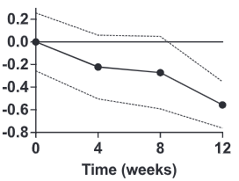
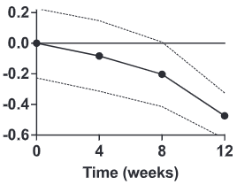
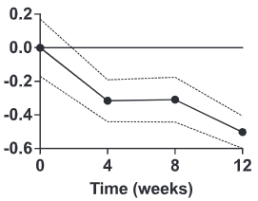
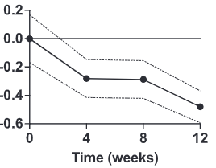




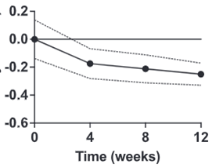
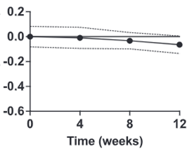
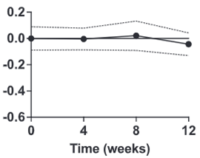
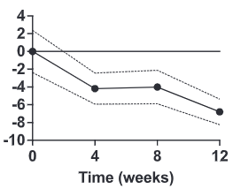
Time course of antidepressant-related tolerability in sertraline-treated youth
Strawn et al, 2022

Slide 49
Pro tips
SSRIs/SNRIs are effective for anxiety disorders
  SSRIs: greater and faster improvement
Psychotherapy
  In SSRI treated youth, additive effects of CBT emerge ~ 10 wks
  Consider SSRI early in treatment
ADHD + anxiety
  Be mindful of the differential
  Consider ADHD tx first, unless anxiety is severe
Antidepressant side effects in anxious youth decrease over time

Slide 50
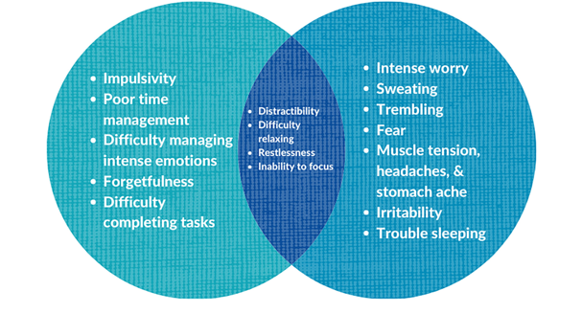
ADHD + Anxiety

Slide 51
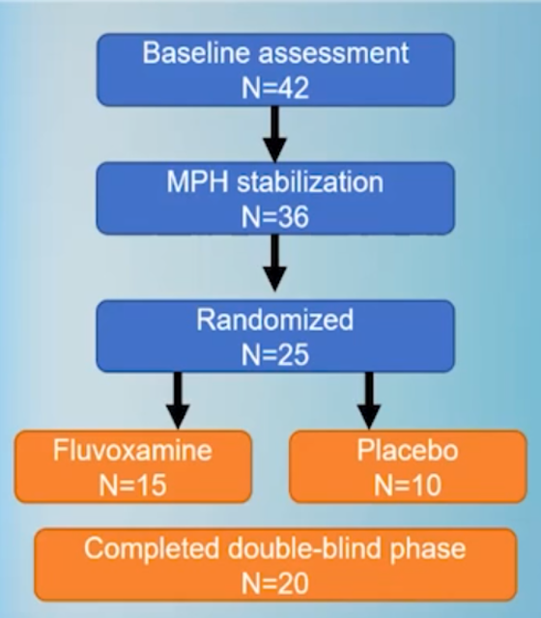
Which disorder should I treat first?
ADHD or anxiety?
6 to 17 years with ADHD/ANX
Optimized MPH first → FLV/PLB
26/31 (81%) improved ADHD sx
“The results indicate that stimulant treatment in children with ADHD/ANX leads to ADHD symptom reductions similar to those seen in non-comorbid ADHD and that stimulants are tolerated without significant exacerbation of anxiety or development of untoward side effects.”
Abikoff et al, JAACAP, 2005, May; 44 (5): 418-27
Notes:
Objective: Attention-deficit/hyperactivity disorder (ADHD) is often accompanied by clinically significant anxiety, but few empirical data guide treatment of children meeting full DSM-IV criteria for ADHD and anxiety disorders (ADHD/ANX). This study examined the efficacy of sequential pharmacotherapy for ADHD/ANX children.
Method: Children, age 6 to 17 years, with ADHD/ANX were titrated to optimal methylphenidate dose and assessed along with children who entered the study on a previously optimized stimulant. Children with improved ADHD who remained anxious were randomly assigned to 8 weeks of double-blind stimulant + fluvoxamine (STIM/FLV) or stimulant + placebo (STIM/PL). Primary efficacy measures were the Swanson, Nolan, Atkins, and Pelham IV Parent and Teacher Rating Scale ADHD score and the Pediatric Anxiety Rating Scale total score. ADHD, ANX, and overall Clinical Global Impressions-Improvement scores were also obtained.
Results: Of the 32 medication-naive children openly treated with methylphenidate, 26 (81%) improved as to ADHD. Twenty-five children entered the randomized trial. Intent-to-treat analysis indicated no differences between the STIM/FLV (n = 15) and STIM/PL groups on the Pediatric Anxiety Rating Scale or Clinical Global Impressions-Improvement-defined responder rate. Medications in both arms were well tolerated.
Conclusions: Children with ADHD/ANX have a response rate to stimulants for ADHD that is comparable with that of children with general ADHD. The benefit of adding FLV to stimulants for ANX remains unproven.

Slide 52
Pro tip: don’t be too clever
Some experts have advocated that non-stimulants be considered first-line interventions in patients with other comorbidities (such as tics and anxiety disorders), although the data fail to consistently support these approaches. For example, some have advocated the use of atomoxetine in patients with anxiety disorders and co-occurring ADHD given that atomoxetine results in improvements in both symptom domains and given concerns that stimulants may worsen anxiety. However, data from randomized controlled trials and meta-analyses have consistently failed to demonstrate stimulant-related worsening of anxiety symptoms in patients with anxiety disorders. In fact, sequenced treatment trials of adolescents with anxiety disorders and co-occurring attention-deficit/hyperactivity disorder (ADHD) suggest that stimulants may actually reduce anxiety symptoms and a recent meta-analysis that included almost 3000 pediatric patients with ADHD found that stimulant treatment was associated with a decreased relative risk of anxiety and also observed a dose-response relationship between stimulant dose and decreases in anxiety symptoms.
Strawn et al, 2017. Primary Pediatric Care Psychopharmacology: Focus on medications for ADHD, depression and anxiety

Slide 53
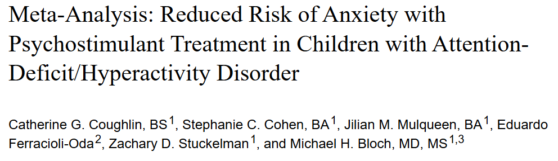
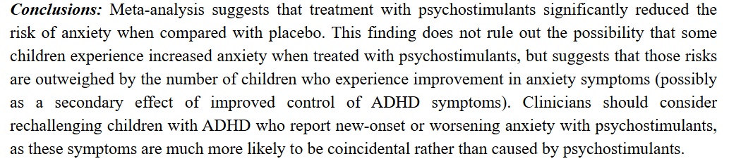
Notes:
Objective: Anxiety is a commonly reported side-effect of psychostimulant treatment. Our goal was to quantify the risk of anxiety as a side effect of psychostimulant treatment for attention-deficit/hyperactivity disorder (ADHD).
Methods: We conducted a PubMed search to identify all double-blind, randomized, placebo-controlled trials examining the efficacy of psychostimulant medications in the treatment of children with ADHD. We used a fixed-effects meta-analysis to examine the risk ratio of anxiety reported as a side effect in children treated with psychostimulants compared with those treated with placebo. We used stratified subgroup analysis and meta-regression to examine the effects of stimulant type, dosage, duration of use, and trial design on the measured risk of anxiety.
Results: We identified 23 studies involving 2959 children with ADHD for inclusion in our meta-analysis. The risk of anxiety associated with psychostimulant treatment was significantly lower than that experienced with placebo (relative risk [RR] = 0.86 [95% CI: 0.77, 0.95], z = –2.90, p < 0.05). Higher doses of psychostimulants were associated with a reduced measured risk of anxiety of psychostimulants when compared with placebo (β = −0.0039 [95% CI: −0.00718, −0.00064], z = −2.34, p = 0.019).
Conclusions: Meta-analysis suggests that treatment with psychostimulants significantly reduced the risk of anxiety when compared with placebo. This finding does not rule out the possibility that some children experience increased anxiety when treated with psychostimulants, but suggests that those risks are outweighed by the number of children who experience improvement in anxiety symptoms (possibly as a secondary effect of improved control of ADHD symptoms). Clinicians should consider rechallenging children with ADHD who report new-onset or worsening anxiety with psychostimulants, as these symptoms are much more likely to be coincidental rather than caused by psychostimulants.

Slide 54
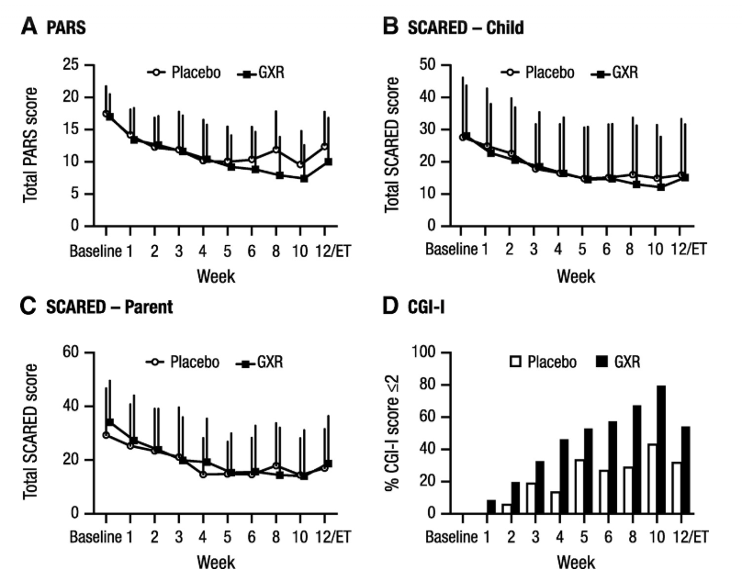
ADHD Co-morbidity anxiety treatment outcome: is there a role for alpha agonists? (Strawn et al, 2017)
-Ages 6-17: GAD, Separation Anxiety Disorder, Social Phobia
-3:1 randomization (Guanfacine ER (GX): Placebo)

Slide 55
Recommendations: Best practice
  Think through the differential, make a diagnosis
  Educate and recruit patient as a partner
  Start with best possible treatment
    Mild: family education, supportive counseling, problem solving
    Mod-Severe: specialized therapy + medication
  Use an adequate dose of treatment +for long enough
  Follow outcomes, adjust as needed
  Phone a friend: Opal-K
Notes:
Since there is a relatively high response rate to placebo or brief supportive treatment and education in many of the published treatment studies, the first approach for mild depression should be family education, supportive counseling, case management, and problem solving. For more persistent, moderate depression, one of the three empirically validated treatments, SSRI, CBT or IPT-A is indicated.
Initial treatment with any of the three treatments for moderate depression is reasonable, with the choice informed primarily by patient preference and the availability of local expertise. The patient does not show any improvement after 6 to 8 weeks, consideration should be given to a change of treatment (psychotherapy to medication or vice versa). In many communities, there is a paucity of clinicians trained in CBT or IPT-A, and the evidence suggests that more generic psychotherapies practice win the community may not be helpful in the treatment of youth depression. In the absence of available specialized psychotherapy, or in the face of patient’s disinclination to engage in psychotherapy, use of an antidepressant as a first-line intervention is indicated. Patient should be seen or evaluated by phone weekly for the first 4 weeks of antidepressant treatment or after a dose adjustment to monitor for adverse effects of antidepressants.
For more severely depressed adolescents, particularly those with difficulties with motivation, concentration, sleep and appetite, medication should be a first-line treatment. The combination of cbt and antidepressant results in a more rapid improvement, and is more effective than medication monotherapy for first onset, and for chronic, treatment resistant depression.
Use an adequate dose of treatment. THIS INCLUES FREQUENCY OF THERAPY!
Oregon Psychiatric Access Line about Kids (OPAL-K)
Many children and adolescents in Oregon with mental health issues remain untreated or experience significant delays before beginning treatment.
OPAL-K provides the support that medical practitioners need to care for more patients in their medical home. With OPAL-K, medical practitioners may be able to treat youth with mental health issues right away rather than placing patients on waiting lists to receive care. Earlier intervention may decrease complications of untreated mental disorders including hospitalization and suicides.
The program also offers evidence-based support to medical practitioners in need of psychiatric treatment information. Overall OPAL-K helps build a system that allows primary care providers to deliver the best possible care.

Slide 56

Follow-up: JK
15-year-old elite high school freshman with seizure
Treatment plan:
  Referred for CBT
  discontinued lorazepam
  started sertraline 25mg daily
  1 year later 25mg → 50mg
  100mg daily at HS graduation
  BDI-II: 19 → 6
  GAD-7: 17 → 5

Slide 57

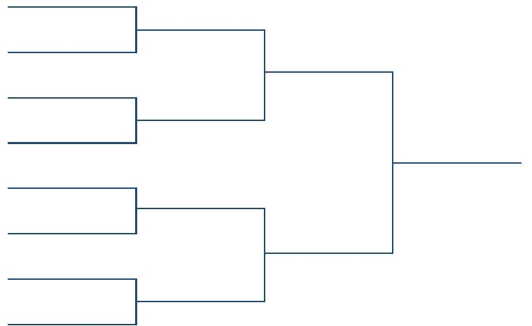
Follow-up: JT
12-year-old NA from Medford, OR
2 S/R prior to transfer, delayed x 3 days
CPS: “Plan B” discussion around discharge/skill building
Practice saying goodbye
What should they know?
What do you wish to know?
What to take/leave?
Accepting you are leaving

Slide 58
For all patients
Support
Educate
Management of suicidal ideation
Sleep hygiene
Exercise
Engagement
Management of low adherence and factors associated with no or partial response
Give HOPE

Slide 59
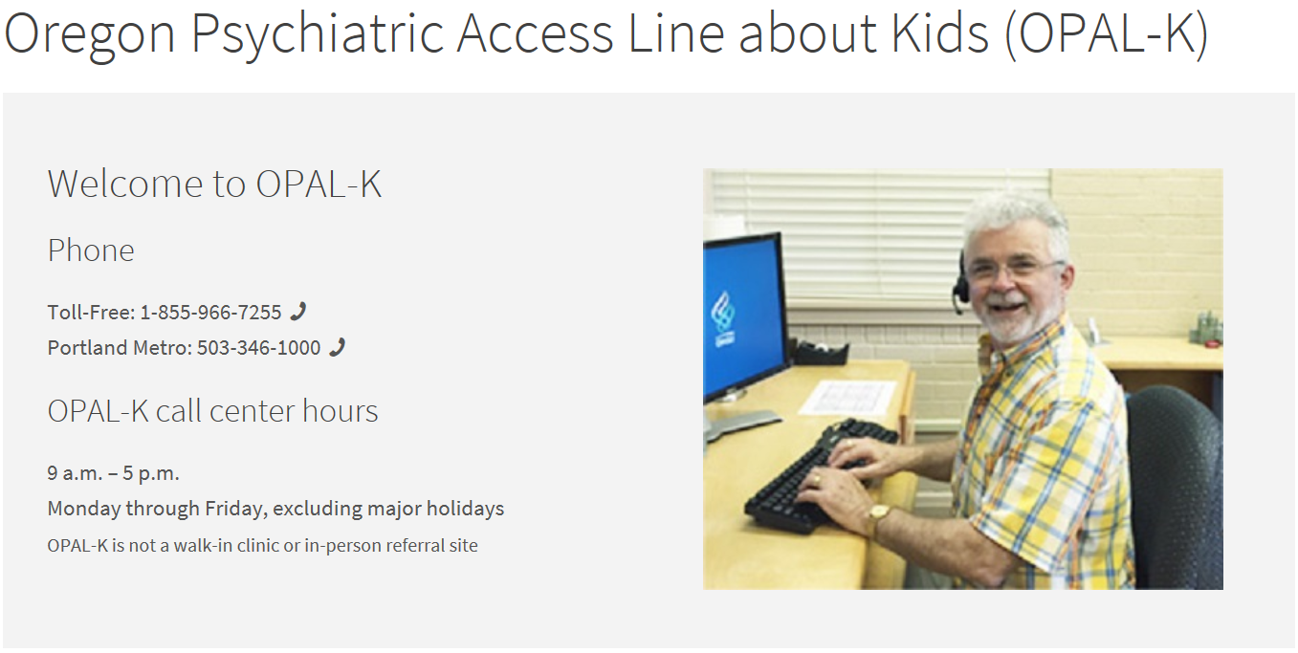
Contact Oregon Psychiatric Access Line about Kids (OPAL-K)
Consultation line for medical practitioners
Toll-free: 1-855-966-7255 (96-OPALK)
Portland Metro area: 503 346-1000
Notes:
Contact Oregon Psychiatric Access Line about Kids (OPAL-K)
Consultation line for medical practitioners
Toll-free: 1-855-966-7255 (96-OPALK)
Portland Metro area: 503 346-1000
Many children and adolescents in Oregon with mental health issues remain untreated or experience significant delays before beginning treatment.
OPAL-K provides the support that medical practitioners need to care for more patients in their medical home.
With OPAL-K, medical practitioners may be able to treat youth with mental health issues right away rather than placing patients on waiting lists to receive care. Earlier intervention may decrease complications of untreated mental disorders including hospitalization and suicides.
The program also offers evidence-based support to medical practitioners in need of psychiatric treatment information.
Overall OPAL-K helps build a system that allows primary care providers to deliver the best possible care.

Slide 60


