Slide 1
Spotlight on Spotting
Mastering Abnormal Uterine
Bleeding in Primary Care
Katie Putnam, MD MPH
Emily Waterman, MD MPH

Slide 2
Disclosures
Dr. Katie Putnam: no financial disclosures
Dr. Emily Waterman is a contractor with Organon as a NEXPLANON® clinical trainer. I will not discuss off-label use or investigational use in my presentation.

Slide 3
Objectives
Learn framework for differentiating structural and non-structural causes of abnormal uterine bleeding (AUB)
Review evidence-based tools for assessing AUB and appropriate diagnostic work-up
Emerge with confidence around appropriate treatment strategies

Slide 4

adolescents
Image source: Shutterstock

Slide 5

Case 1: Taylor
13-year-old presents with their mom
Reports heavy periods and irregular cycles
Menarche was approximately 1 year ago (age 12)
Cycles occur every 28 – 37 days
Occasionally miss a cycle
Menses last 8-9 days with 5 heavy days, sometimes with quarter-sized clots
Image source: YF Gender Identity Night – Resource Center

Slide 6
What is on your ddx?

Slide 7
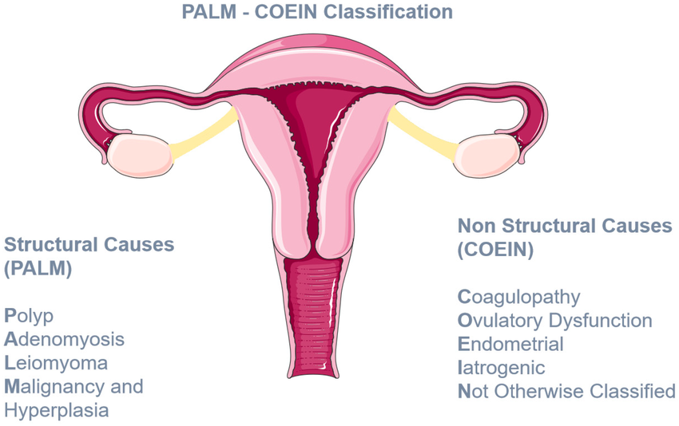
International Federation of Gynecology and Oncology (FIGO) classification system for abnormal uterine bleeding
Framework for differential considerations for abnormal uterine bleeding
Kontogiannis A, Matsas A, Valsami S, Livanou ME, Panoskaltsis T, Christopoulos P. Primary Hemostasis Disorders as a Cause of Heavy Menstrual Bleeding in Women of Reproductive Age. J Clin Med. 2023 Sep 1;12(17):5702.
Notes:
PALM COEIN system of nomenclature for causes of abnormal uterine bleeding

Slide 8
Immaturity of Hypothalamic-Pituitary-Ovarian axis
Polycystic Ovary Syndrome (PCOS)
Hormonal or Metabolic Imbalances
Infections
Kontogiannis A, Matsas A, Valsami S, Livanou ME, Panoskaltsis T, Christopoulos P. Primary Hemostasis Disorders as a Cause of Heavy Menstrual Bleeding in Women of Reproductive Age. J Clin Med. 2023 Sep 1;12(17):5702.
Notes:
PALM COEIN system of nomenclature for causes of abnormal uterine bleeding

Slide 9
Taking the history
Menstrual
Age at menarche
Bleeding
Medical
Family
Pregnancy possible?
Reproductive
Cycle length
Duration
Regularity
Approximate volume during menses
Endocrine disorders (thyroid, PCOS)
Recent weight change
Stress
New medications or supplements
Nosebleeds, bleeding after procedure, or prolonged bleeding after wound
Assess for heavy bleeding:
Bleeding disorders such as von Willebrand disease
STI risk
Contraceptive use
Soaking through pads/tampons every 1-2 hours; Passage of clots; Changing menstrual products at night; Bleeding though clothes and sheets

Slide 10
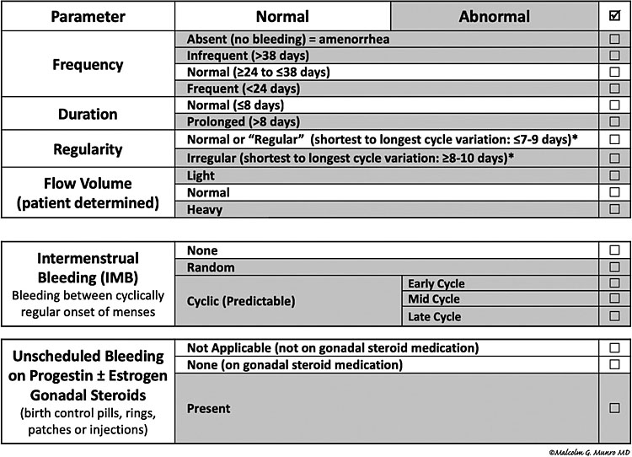
Assessment tools (FIGO)
FIGO System 1. Definition of normal and abnormal uterine bleeding.

Slide 11
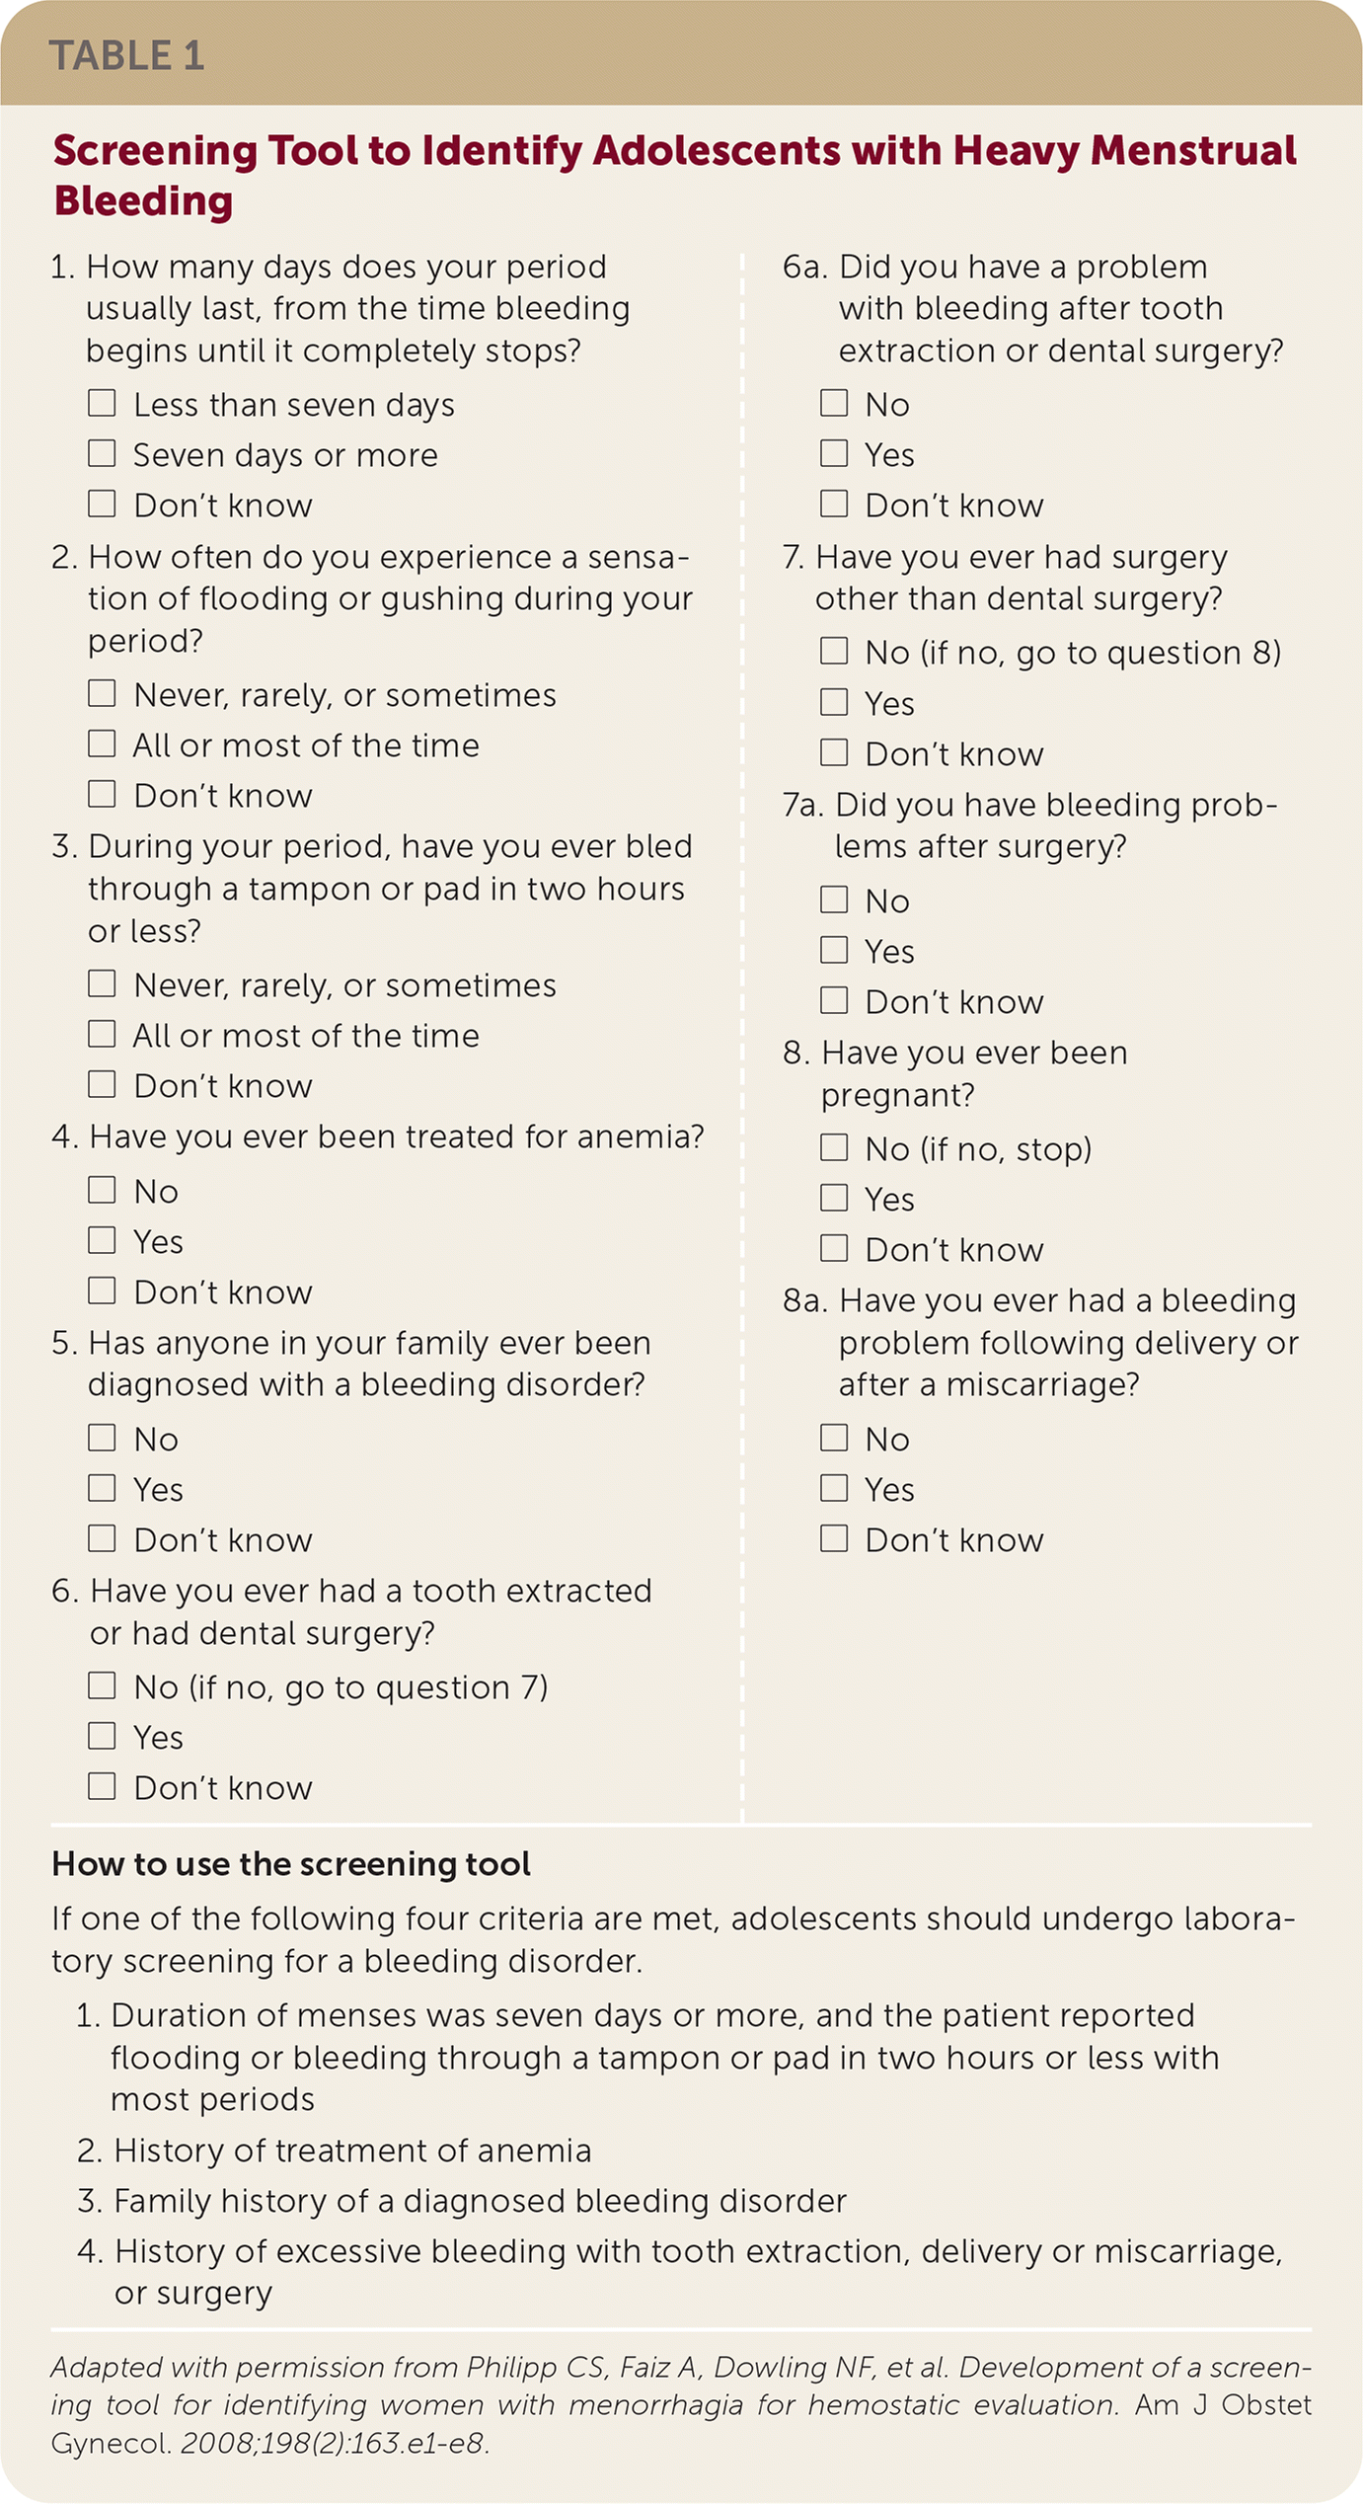
Assessment tools (ACOG)
1. Costlow, Laurie. "Heavy Menstrual Bleeding in Adolescents: ACOG Management Recommendations." American Family Physician 101.10 (2020): 633-635.
2. ACOG Practice Bulletin 785: Screening and Management of Bleeding Disorders in Adolescents With Heavy Menstrual Bleeding
3. Philipp CS, Faiz A, Dowling NF, et al. Development of a screening tool for identifying women with menorrhagia for hemostatic evaluation. Am J Obstet Gynecol. 2008;198(2):163.e1–e8.

Slide 12
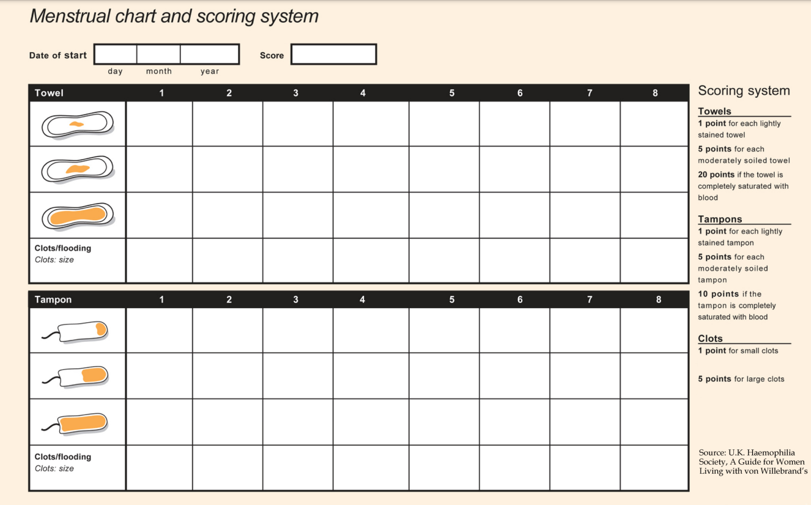
Assessment tools (PBAC)
Consider use of chart to help patients document bleeding
Multiple available pictographs, the Pictorial Blood Loss Assessment Chart (PBAC) is most common
Score>100 concerning for AUB

Slide 13
What is your workup?
Notes:
Consider STI testing if risk factors

Slide 14
workup
 | ACOG¹ | AAFP² | JAMA Peds³
Pelvic exam
Urine HCG | ? | ? | ?
GC/CT | ? | ? | ?
CBC + ferritin | ✓ | ✓ | ✓
Coagulation labs | ✓ | ✓ | ?
TSH | ✓ | ✓ | ✓
PCOS labs | ? | ✓ | ?
Pelvic ultrasound
Endometrial biopsy
1. ACOG Practice Bulletin 785: Screening and Management of Bleeding Disorders in Adolescents With Heavy Menstrual Bleeding
2. Costlow, Laurie. "Heavy Menstrual Bleeding in Adolescents: ACOG Management Recommendations." American Family Physician 101.10 (2020): 633-635.
3. Borzutzky C, Jaffray J. Diagnosis and Management of Heavy Menstrual Bleeding and Bleeding Disorders in Adolescents. JAMA Pediatr. 2020 Feb 1;174(2):186-194.

Slide 15
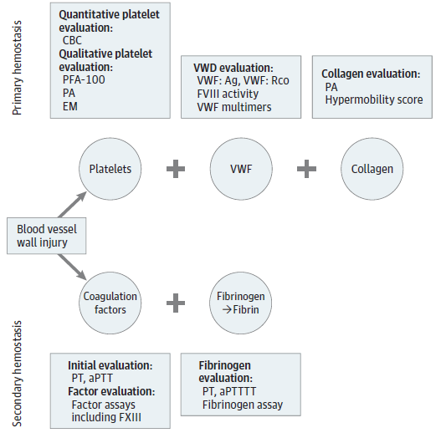
In adolescents, structural causes of AUB are less likely, so you do not need imaging as a part of initial workup unless there is a specific concern or if refractory to treatment
If hyperandrogenism present or suspicion for PCOS, consider
Free T, total T, DHEAS, prolactin
1. ACOG Practice Bulletin 785: Screening and Management of Bleeding Disorders in Adolescents With Heavy Menstrual Bleeding
2. Kontogiannis A, Matsas A, Valsami S, Livanou ME, Panoskaltsis T, Christopoulos P. Primary Hemostasis Disorders as a Cause of Heavy Menstrual Bleeding in Women of Reproductive Age. J Clin Med. 2023 Sep 1;12(17):5702.
Notes:
PALM COEIN system of nomenclature for causes of abnormal uterine bleeding

Slide 16
Case 1: Taylor
VSS, no orthostasis
Labs show:
  Hemoglobin 11, ferritin 5
  TSH 2.8
  Normal INR, PT, PTT, fibrinogen
  Normal prolactin
  Normal testosterone and DHEAS
They are still bleeding and have a big soccer tournament this weekend. Can you help?

Slide 17
What is the cause of taylor’s bleeding?
Immaturity of Hypothalamic-Pituitary-Ovarian axis
Kontogiannis A, Matsas A, Valsami S, Livanou ME, Panoskaltsis T, Christopoulos P. Primary Hemostasis Disorders as a Cause of Heavy Menstrual Bleeding in Women of Reproductive Age. J Clin Med. 2023 Sep 1;12(17):5702.
Notes:
PALM COEIN system of nomenclature for causes of abnormal uterine bleeding

Slide 18
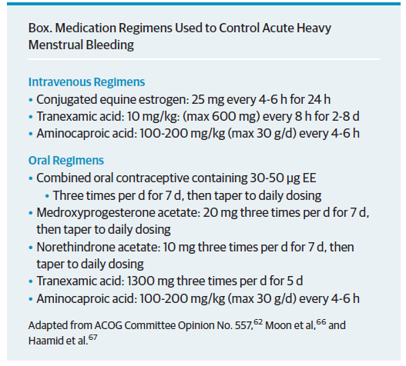
Acute management of aub
If a patient is presenting with:
  Current, ongoing bleeding, and
  Is stable for outpatient management
  Consider treatment to quickly stop the bleeding
IV vs PO regimens
Both hormonal and nonhormonal options
Then taper to ongoing management
Borzutzky C, Jaffray J. Diagnosis and Management of Heavy Menstrual Bleeding and Bleeding Disorders in Adolescents. JAMA Pediatr. 2020 Feb 1;174(2):186-194.

Slide 19
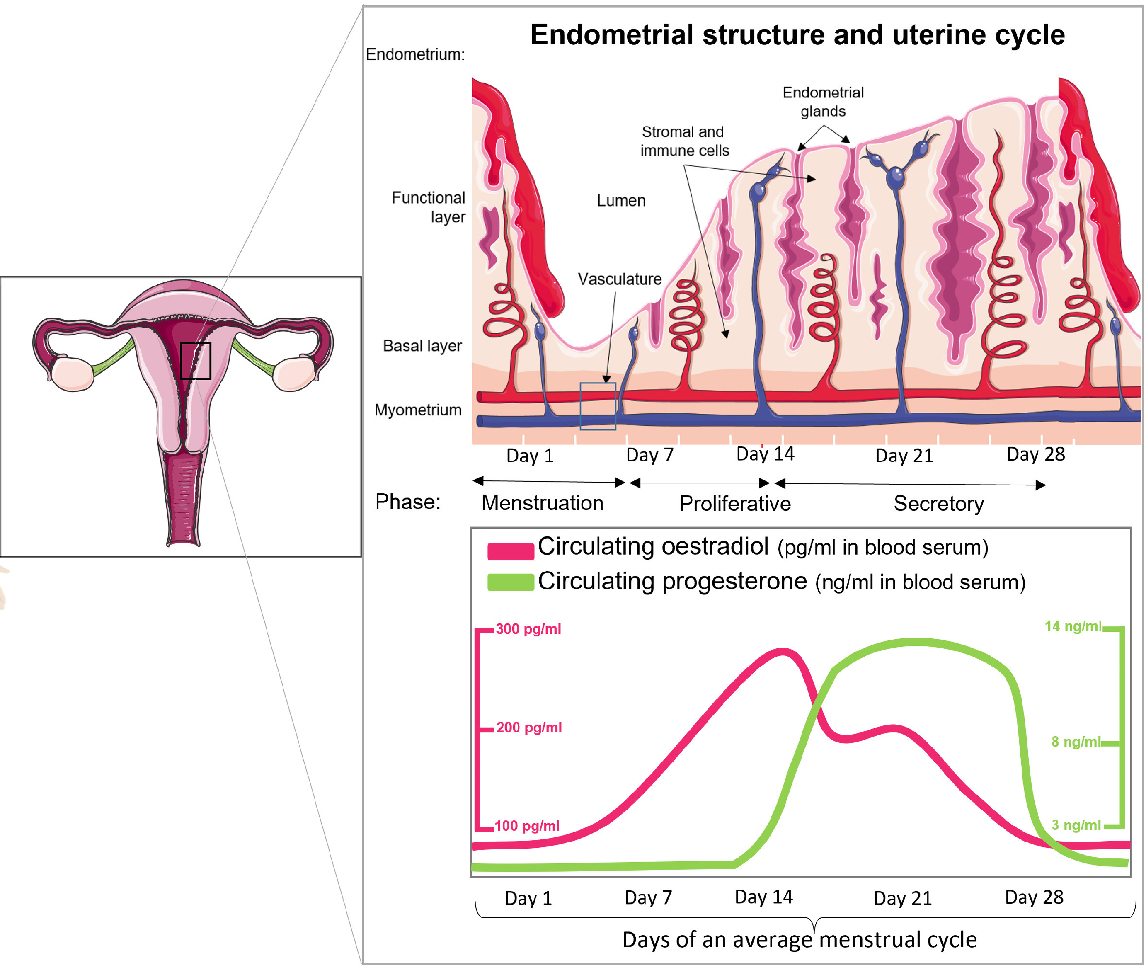
Ongoing management of aub
Consider starting hormonal contraceptives
  Progestin +/- estradiol
  Progestin downregulates estrogen receptors -> decrease glandular proliferation -> induce endometrial atrophy
Treat iron deficiency anemia
  CDC recommends 60-120 mg daily of iron¹
    Once daily or every other day dosing appropriate²
    3-6 month course then re-eval with CBC, ferritin
1. Recommendations to prevent and control iron deficiency in the United States. Centers for Disease Control and Prevention. MMWR Recomm Rep 1998;47(RR-3):1–29.
2. Stoffel NU, Cercamondi CI, Brittenham G, Zeder C, Geurts-Moespot AJ, Swinkels DW, et al. Iron absorption from oral iron supplements given on consecutive versus alternate days and as single morning doses versus twice daily split dosing in iron-depleted women: two open-label, randomised controlled trials. Lancet Haematol 2017;4: e524–33.
Image from: Tsolova AO, Aguilar RM, Maybin JA, Critchley HOD. Pre-clinical models to study abnormal uterine bleeding (AUB). EBioMedicine. 2022 Oct;84:104238. doi: 10.1016/j.ebiom.2022.104238. Epub 2022 Sep 5.

Slide 20


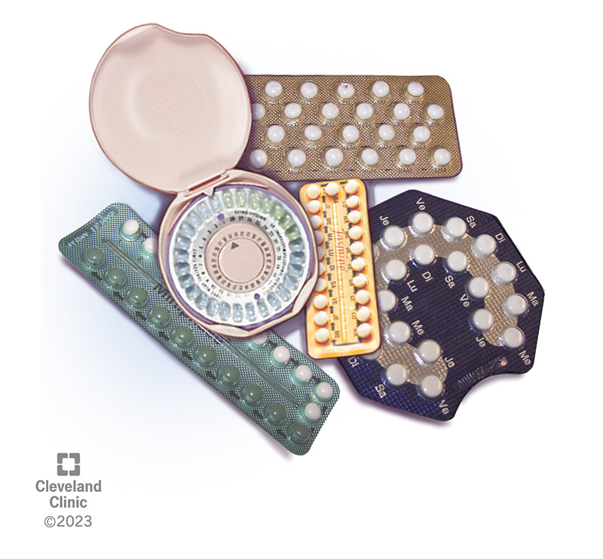
Ongoing management of aub
Progestin-only
Medoxyprogesterone acetate 2.5-5 mg daily, uptitrate to 20 mg as needed
Norethindrone 2.5-5 mg daily, uptitrate to 20 mg as needed
Drosperinone 4 mg daily
Combined estradiol-progestin
Second generation progestin (levonorgestrel or norgestrel) preferred³
30-50 mcg ethinyl estradiol preferred³
Consider estradiol valerate and dienogest (FDA approved for HMB)^{4,5}
Non oral options are also acceptable!
Patch, ring
Progestin IUD
General tips
Reference CDC MEC for contraindications¹
Avoid low dose progestin (minipill)²
  Norethindrone 0.35 mg
Avoid ultra-low estradiol (10 mcg) should be avoided due to association with breakthrough bleeding²
Recommend continuous administration (skip placebo) until stabilized
Progestin implant not recommended
Nguyen AT, Curtis KM, Tepper NK, et al. U.S. Medical Eligibility Criteria for Contraceptive Use, 2024. MMWR Recomm Rep 2024;73(No. RR-4):1–126
Borzutzky C, Jaffray J. Diagnosis and Management of Heavy Menstrual Bleeding and Bleeding Disorders in Adolescents. JAMA Pediatr. 2020 Feb 1;174(2):186-194.
ACOG Committee Opinion No. 785, Screening and Management of Bleeding Disorders in Adolescents With Heavy Menstrual Bleeding: Correction. Obstet Gynecol. 2023 Jan 1;141(1):228.
FDA approves Natazia for heavy menstrual bleeding [press release]. Wayne, NJ: Bayer HealthCare Pharmaceuticals Inc; March 14, 2012. https://www.drugs.com/newdrugs/u-s-fda-approves-first-only-oral-contraceptive-demonstrated-heavy-menstrual-bleeding-hmb-3150.html.
Yu Q, Zhou Y, Suturina L, Jaisamrarn U, Lu D, Parke S. Efficacy and Safety of Estradiol Valerate/Dienogest for the Management of Heavy Menstrual Bleeding: A Multicenter, Double-Blind, Randomized, Placebo-Controlled, Phase III Clinical Trial. J Womens Health (Larchmt). 2018 Oct;27(10):1225-1232.

Slide 21

Reproductive ageD
Image source: National Association of Colleges and Employers

Slide 22

Case 2: SOFIA
Sofia is a 36yo G3P3003 with Type II DM, HLD, BMI 34, history of cesarean x 2, bilateral salpingectomy
Had normal periods until after her second pregnancy, which was delivered by c/s
Now reporting ongoing intermenstrual and heavy bleeding
Image source: iStock

Slide 23
What is on your ddx?

Slide 24
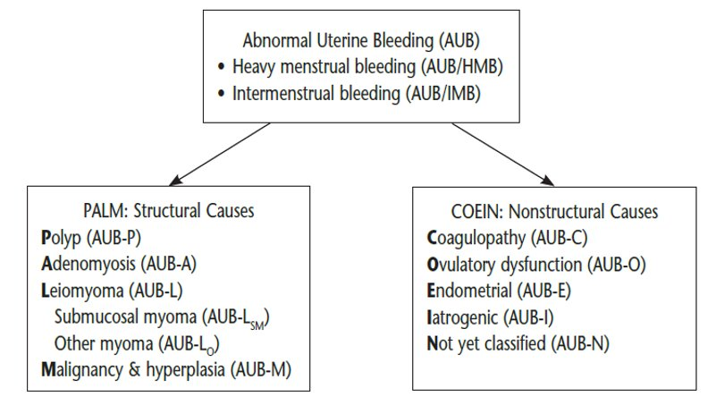
Case 2: what is your ddx?

Slide 25
What is your workup?
Notes:
Consider STI testing if risk factors

Slide 26
When to do what
TVUS to rule out
Labs to eval
EMB to rule out

Slide 27
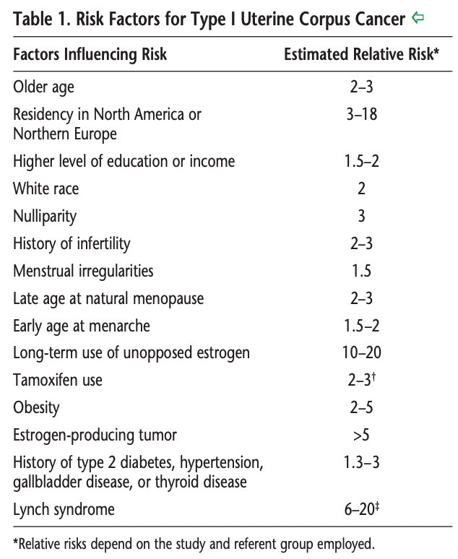
Malignancy risk
Most women are diagnosed after menopause, with only 15% diagnosed before age 50 years and only 5% before age 40 years
Practice Bulletin No. 149: Endometrial cancer. Obstet Gynecol. 2015 Apr;125(4):1006-1026. doi: 10.1097/01.AOG.0000462977.61229.de..

Slide 28
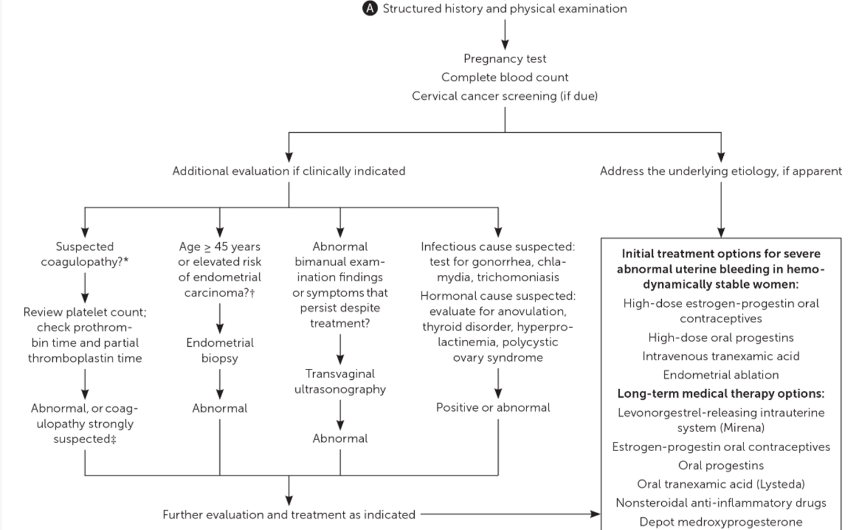
Take home points
HCG for all
Pelvic exam and TVUS to evaluate for structural causes
Lab work pending clinical scenario
EMB to rule out hyperplasia/malignancy
  Always recommended for AUB >45 yo
  For ≤45 yo if risk factors for endometrial hyperplasia
    History of unopposed estrogen exposure: obesity, PCOS
    Failed medical management of AUB
    Persistent AUB
Wouk N, Helton M. Abnormal Uterine Bleeding in Premenopausal Women. Am Fam Physician. 2019 Apr 1;99(7):435-443.
Practice Bulletin No. 128: Diagnosis of Abnormal Uterine Bleeding in Reproductive-Aged Women. Obstetrics & Gynecology 120(1):p 197-206, July 2012.

Slide 29
Case 2: SOFIA
Hgb of 11.5, ferritin of 12, normal TSH, neg UPT
TVUS was unremarkable
She returns to the office - you perform an EMB and place an IUD
The EMB is normal

Slide 30
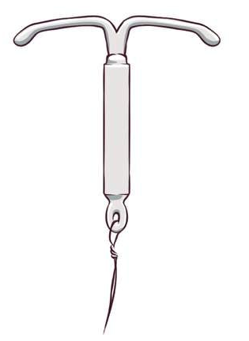
Long-acting reversible contraception (LARC) for aub
Progesterone-containing IUDs¹
  Mirena/Liletta (52mg, 8 years): highest rates of amenorrhea and least BTB
    5 years of use recommended for endometrial protection
  Kyleena (19.5 mg, 5 years)
  Skyla (13.5 mg, 3 years)
Etonogestrel subdermal implant (Nexplanon)²
  Not recommended for management of AUB due to risk of irregular spotting. Likely to help with dysmenorrhea
  Not considered sufficient endometrial protection for HRT purposes
Copper IUD (Paragard) most likely to increase uterine bleeding
Data Sources: https://www.ncbi.nlm.nih.gov/pubmed/26916172, https://www.ncbi.nlm.nih.gov/pubmed/27125892; https://www.ohsu.edu/sites/default/files/2019-06/IUD-comparison-Chart-Final.pdf ; https://www.pi.bayer.com/sites/g/files/vrxlpx33726/files/2022-01/20211221_var_ap_BEC20783-18310_HCPI_Mirena_en_mt.pdf
Faculty of Sexual and Reproductive Healthcare (2023). FSRH Clinical Guideline: Contraception for Women Aged over 40 Years (August 2017, amended July 2023)
IUD image source: https://www.google.com/url?sa=i&url=https%3A%2F%2Fwww.plannedparenthood.org%2Flearn%2Fbirth-control%2Fiud&psig=AOvVaw1I71HrzKEzi7Oea4gViKNj&ust=1738095847929000&source=images&cd=vfe&opi=89978449&ved=0CBQQjRxqFwoTCKifseDdlosDFQAAAAAdAAAAABAE

Slide 31
Case 2: SOFIA
She returns 6 months later for continued spotting between periods, and spotting with intercourse
She finds this bothersome and would like to know what else she can do to stop the spotting

Slide 32
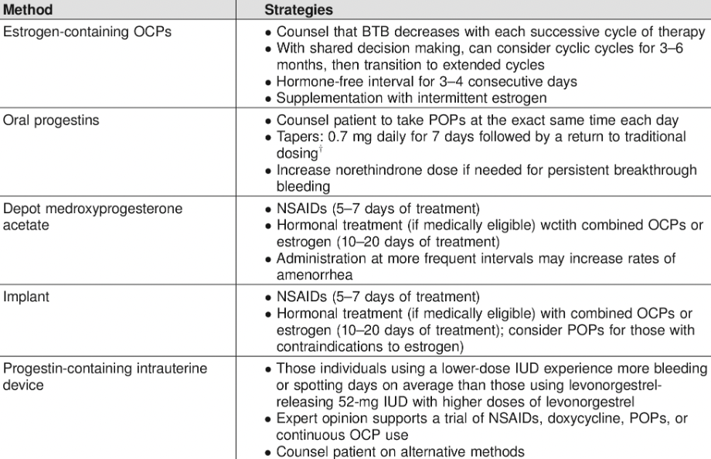
Management of Breakthrough (Iatrogenic) Bleeding
Unscheduled bleeding can decrease with continued use; trial of 3–6 months before initiating medical management
Can initiate sooner if unacceptable¹
1. American College of Obstetricians and Gynecologists’ Committee on Clinical Consensus–Gynecology. General Approaches to Medical Management of Menstrual Suppression: ACOG Clinical Consensus No. 3. Obstet Gynecol. 2022 Sep 1;140(3):528-541. doi: 10.1097/AOG.0000000000004899. PMID: 36356248.

Slide 33
CASE 2: SOfia
She would prefer a non-hormonal additional agent and would like more predictable bleeding

Slide 34
Non- Hormonal
Naproxen 500 mg BID, administer only when bleeding¹
  Less effective than TXA, though also helps with pain ²
  CI: renal disease, PUD
PO TXA 1000 mg – 1500mg TID ^{1,2} , administer only when bleeding
  Reduced bleeding by 35-50%², safe when trying to conceive¹
  CI: acquired color vision impairment, active VTE. Caution: increased risk of thrombosis, OCPs
1. Wouk N, Helton M. Abnormal Uterine Bleeding in Premenopausal Women. Am Fam Physician. 2019 Apr 1;99(7):435-443. PMID: 30932448.
2. ACOG committee opinion no. 557: Management of acute abnormal uterine bleeding in nonpregnant reproductive-aged women. Obstet Gynecol. 2013 Apr;121(4):891-896. doi: 10.1097/01.AOG.0000428646.67925.9a. PMID: 23635706.

Slide 35

perimenopausE
Image source: UMMS Health

Slide 36

Case 3: leah
48 yo female, PMHx depression stable on sertraline x years; BMI 26
Irregular menstrual bleeding x 4 months
Previously periods were regular, every 29-31 days, light to medium flow
Not on hormonal contraception; single male partner is s/p vasectomy
+mild night sweats, mood fluctuations, sleep disruption, undesired weight gain
 | Oct | Nov | Dec | Jan | Feb
LMP: | 5th-10th | None | 3rd-17th | 1st-6th
 |  |  |  | 20-24th
Zuber TJ. Endometrial biopsy. Am Fam Physician. 2001 Mar 15;63(6):1131-5, 1137-41. PMID: 11277550.
Image source: iStock

Slide 37
What is on your ddx?

Slide 38
Case 3: ddx
?
Practice Bulletin No. 128: Diagnosis of Abnormal Uterine Bleeding in Reproductive-Aged Women. Obstetrics & Gynecology 120(1):p 197-206, July 2012.
Notes:
Structural:
Polyp – incidence increases with age; 95% benign; usually intermenstrual spotting
Adenomyosis – heavy, painful, prolonged UB
Leiomyoma – increased prevalence with age, up to 80% all ppl with uteruses; most asx; heavy, prolonged bleeding; pain, enlarged irregular uterus on bimanual
Malignancy/hyperplasia - ¼ diagnoses <age 55; variable presentation
Pregnancy
Non-uterine (UTI)
Thyroid
Iatrogenic (med changes?)

Slide 39
Does Leah have AUB?

Slide 40
Perimenopausal "AUB"?
Abnormal Uterine Bleeding =
"Menstrual flow outside of normal volume, duration, regularity, or frequency"¹ ​
ACOG: "Puberty and the perimenopause typically are associated with AUB-O and are considered to be physiologic in these circumstances"²
AAFP: "Infrequent or absent ovulation during the first few years after menarche and during perimenopause is common and not necessarily a sign of underlying pathology"³
  ACOG: "In women aged 40 years to menopause, abnormal uterine bleeding may be due to anovulatory bleeding, which represents normal physiology in response to declining ovarian function. It also may be due to endometrial hyperplasia or carcinoma, endometrial atrophy, and leiomyomas."¹
Practice Bulletin No. 128: Diagnosis of Abnormal Uterine Bleeding in Reproductive-Aged Women. Obstetrics & Gynecology 120(1):p 197-206, July 2012
Practice Bulletin No. 136: Management of Abnormal Uterine Bleeding Associated With Ovulatory Dysfunction. Obstetrics & Gynecology 122(1):p 176-185, July 2013.
Wouk N, Helton M. Abnormal Uterine Bleeding in Premenopausal Women. Am Fam Physician. 2019 Apr 1;99(7):435-443. PMID: 30932448.

Slide 41
Perimenopausal “AUB“ and endometrial cancer
  In U.S.:
  Mean age of menopause: 51.4 years
  Mean duration perimenopause: 4 years¹
Median age Dx ECa = 61 yo
5% of diagnoses <age 40
20-25% diagnoses pre-menopause²
Incidence of endometrial cancer age 40-50 = Approx 20 cases per 100,000 woman-years¹
Risk factors:
Obesity
Nulliparity
Unopposed estrogen
Late menopause
Protective factors:
CHC use²
LNG IUD use³
~1 in 50 US women in their lifetime²
Age < 45 yo = lower rate of advanced-stage disease, higher degree of tumor differentiation, better prognosis (82% vs 70% 5=year survival)²
Practice Bulletin No. 136: Management of Abnormal Uterine Bleeding Associated With Ovulatory Dysfunction. Obstetrics & Gynecology 122(1):p 176-185, July 2013
Pellerin GP, Finan MA. Endometrial cancer in women 45 years of age or younger: a clinicopathological analysis. Am J Obstet Gynecol. 2005 Nov;193(5):1640-4.
Yi H, Zhang N, Huang J, Zheng Y, Hong QH, Sundquist J, Sundquist K, Zheng X, Ji J. Association of levonorgestrel-releasing intrauterine device with gynecologic and breast cancers: a national cohort study in Sweden. Am J Obstet Gynecol. 2024 Oct;231(4):450.e1-450.e12.
Notes:
Pellerin study was a study of N=38 </= age 45, 70% obese, 60% nulliparous, Vs 425 W >45 yo, no demographic comparison

Slide 42
What is your workup?

Slide 43
Perimenopausal "AUB"?
"All women older than 45 years who present with suspected anovulatory uterine bleeding should be evaluated with endometrial biopsy (after pregnancy has been excluded).“¹
 | ACOG | Us?
Urine HCG | ✓
Pelvic exam | ✓
CBC
TSH
Endometrial biopsy | ✓
Pelvic ultrasound
Practice Bulletin No. 136: Management of Abnormal Uterine Bleeding Associated With Ovulatory Dysfunction. Obstetrics & Gynecology 122(1):p 176-185, July 2013.

Slide 44
Case 3: Management of perimenopausal AUB-O
Goals of management: | Contraception | Endometrial protection | Menstrual regulation / bleeding | Vasomotor symptoms
L-52 IUD | ✓ | ✓ | ✓
Low-dose CHC or POP | ✓ | ✓ | ✓ | ✓
Cyclic progesterone |  | ✓ | ✓ | ✓
Cyclic HRT |  | ✓ | ✓ | ✓
Practice Bulletin No. 136: Management of Abnormal Uterine Bleeding Associated With Ovulatory Dysfunction. Obstetrics & Gynecology 122(1):p 176-185, July 2013.

Slide 45
Surgical treatment of aub
Not first line for AUB-O
Ablation:
  Need to have completed reproduction
  Unable to assess uterus for hyperplasia after ablation
  Possible surgical complications
  Possible increased cancer risk – does not address anovulation
Hysterectomy - consider if:
  Completed childbearing
  Bleeding not managed with, or contraindication to, medical treatment
  Structural cause of bleeding
Practice Bulletin No. 136: Management of Abnormal Uterine Bleeding Associated With Ovulatory Dysfunction. Obstetrics & Gynecology 122(1):p 176-185, July 2013.

Slide 46

POST-MENOPAUSAL
Image source: Shutterstock

Slide 47

Case 4: June
72 yo healthy woman with recent episode of 2 days of vaginal bleeding, now resolved
S/p menopause age 53, no bleeding since
Thinks might have been due to vigorous jumping during Zumba class
No f/c/n/v/dysuria/diarrhea/firm stools/pelvic pain/weight changes
No recent med changes
Image source: https://www.silversneakers.com/blog/benefits-zumba-older-adults/

Slide 48
what is on your ddx?
PALM-COEIN: is for classification of AUB for reproductive-aged persons
Post-menopausal:
  Malignancy
  Malignancy
  Malignancy
  Non-uterine: UTI, rectal bleeding
Atrophic changes of the vagina or endometrium
ACOG Committee Opinion No. 734: The Role of Transvaginal Ultrasonography in Evaluating the Endometrium of Women With Postmenopausal Bleeding. Obstet Gynecol. 2018 May;131(5):e124-e129.
Notes:
Structural:
Polyp – incidence increases with age; 95% benign; usually intermenstrual spotting
Adenomyosis – heavy, painful, prolonged UB
Leiomyoma – increased prevalence with age, up to 80% all ppl with uteruses; most asx; heavy, prolonged bleeding; pain, enlarged irregular uterus on bimanual
Malignancy/hyperplasia - ¼ diagnoses <age 55; variable presentation
Pregnancy
Non-uterine (UTI)
Thyroid
Iatrogenic (med changes?)

Slide 49
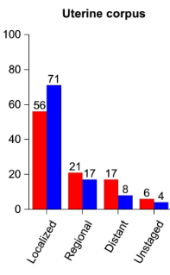
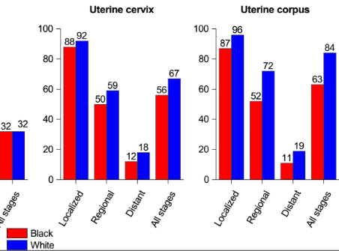
Health Inequities and Endometrial Cancer
Stage distribution at diagnosis, 2014-2018
5-year survival rate by stage, 2011-2017
Similar chance of developing uterine cancer in Black women compared to Non-Hispanic white women (1:32 vs 1:31)
When corrected for hysterectomy status (higher rates in Black women), incidence of endometrial cancer is 15-20% higher in Black women
~2x the death rate for Black women diagnosed with uterine cancer compared to NH white women (9.0 vs 4.6 per 100,000)
Largest disparity in 5-year relative survival of all cancers
Giaquinto AN, Miller KD, Tossas KY, Winn RA, Jemal A, Siegel RL. Cancer statistics for African American/Black People 2022. CA Cancer J Clin. 2022 May;72(3):202-229. doi: 10.3322/caac.21718. Epub 2022 Feb 10. PMID: 35143040. https://acsjournals.onlinelibrary.wiley.com/doi/10.3322/caac.21718

Slide 50
Health Inequities and Endometrial Cancer
Possible reasons for disparities^{1,2}
  Non-endometrioid subtypes – more aggressive tumors
  Later stage diagnosis (but lower survival at all stages)
  Lower likelihood of timely, optimal treatment
  Providers not adequately educating patients about symptoms and workup⁴
  Obesity? (Social drivers of health?)
  Social / cultural influences on health seeking behaviors and knowledge
Caveats
  Quality and frequency of racial/ethnic reporting in studies of endometrial cancer is low³
  Low involvement of Black women in clinical trials²
Giaquinto AN, Miller KD, Tossas KY, Winn RA, Jemal A, Siegel RL. Cancer statistics for African American/Black People 2022. CA Cancer J Clin. 2022 May;72(3):202-229. doi: 10.3322/caac.21718. Epub 2022 Feb 10. PMID: 35143040
Schlumbrecht M, Wright K, George S. Unique Considerations in Early Detection, Risk, and Awareness of Endometrial Cancer in Black Women. Cancer Control. 2023 Jan-Dec;30:10732748231202952. doi: 10.1177/10732748231202952. PMID: 37732413; PMCID: PMC10515581. https://pubmed.ncbi.nlm.nih.gov/37732413/
Raimondo D, Raffone A, Pezzullo AM, Doglioli M, De Benedetti P, Celerino P, De Meis L, Maletta M, Raspollini A, Travaglino A, Guida M, Casadio P, Seracchioli R. Race and ethnicity reporting in endometrial cancer literature. Int J Gynecol Cancer. 2023 Sep 4;33(9):1402-1407. doi: 10.1136/ijgc-2023-004552. PMID: 37479465.
Doll KM, Hempstead B, Alson J, Sage L, Lavallee D. Assessment of Prediagnostic Experiences of Black Women With Endometrial Cancer in the United States. JAMA Netw Open. 2020 May 1;3(5):e204954. doi: 10.1001/jamanetworkopen.2020.4954. PMID: 32412636; PMCID: PMC7229523. https://pubmed.ncbi.nlm.nih.gov/32412636/

Slide 51
What is your first step in workup for June?

Slide 52
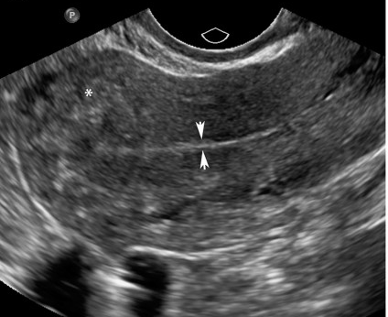
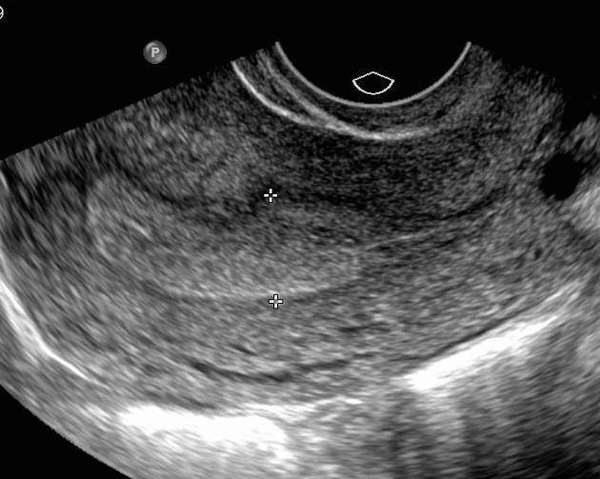
Transvaginal ultrasound
ACOG Committee Opinion (2018)
TVUS appropriate for initial evaluation of first episode of post-menopausal bleeding
Endometrial thickness of ≤4 mm has 99% NPV for endometrial cancer
  If >4 mm thickness, endometrial biopsy is indicated
  If EMB is negative but bleeding persists, refer for hysteroscopy
Not recommended as a screening tool for post-menopausal people without bleeding
Image source: Sadro CT. Imaging the Endometrium: A Pictorial Essay. Canadian Association of Radiologists Journal. 2016;67(3):254-262. doi:10.1016/j.carj.2015.09.012
Image source: https://radiopaedia.org/articles/endometrial-thickness?lang=us
ACOG Committee Opinion No. 734: The Role of Transvaginal Ultrasonography in Evaluating the Endometrium of Women With Postmenopausal Bleeding. Obstet Gynecol. 2018 May;131(5):e124-e129.

Slide 53
Endometrial biopsy
Comparable to D&C (prior standard)¹: Sensitivity 75-83% for malignancy^{1,2}, 67% for hyperplasia¹
Negative predictive value for malignancy ~99%¹
Can be done in outpatient PCP office; fast, safe, generally straightforward
Limitations:
  Unable to visualize intrauterine lesions (focal lesions – polyp, fibroid or specific area of abnormality - SIS or diagnostic hysteroscopy with focal biopsy are superior³
  Samples ~4% of the endometrium⁴
  Insufficient sample does not r/o malignancy (need further eval)⁵
  Stenosis, uterine distortions will limit ability to perform⁶
Demirkiran F, Yavuz E, Erenel H, Bese T, Arvas M, Sanioglu C. Which is the best technique for endometrial sampling? Aspiration (pipelle) versus dilatation and curettage (D&C). Arch Gynecol Obstet. 2012 Nov;286(5):1277-82.
Guido RS, Kanbour-Shakir A, Rulin MC, Christopherson WA. Pipelle endometrial sampling. Sensitivity in the detection of endometrial cancer. J Reprod Med. 1995 Aug;40(8):553-5.
Practice Bulletin No. 136: Management of Abnormal Uterine Bleeding Associated With Ovulatory Dysfunction. Obstetrics & Gynecology 122(1):p 176-185, July 2013.
Rodriguez GC, Yaqub N, King ME. A comparison of the Pipelle device and the Vabra aspirator as measured by endometrial denudation in hysterectomy specimens: the Pipelle device samples significantly less of the endometrial surface than the Vabra aspirator. Am J Obstet Gynecol. 1993 Jan;168(1 Pt 1):55-9.
Pasqualotto EB, Margossian H, Price LL, Bradley LD. Accuracy of preoperative diagnostic tools and outcome of hysteroscopic management of menstrual dysfunction. J Am Assoc Gynecol Laparosc. 2000 May;7(2):201-9. Farrell T, Jones N, Owen P, Baird A. The significance of an 'insufficient' Pipelle sample in the investigation of post-menopausal bleeding. Acta Obstet Gynecol Scand. 1999 Oct;78(9):810-2.

Slide 54
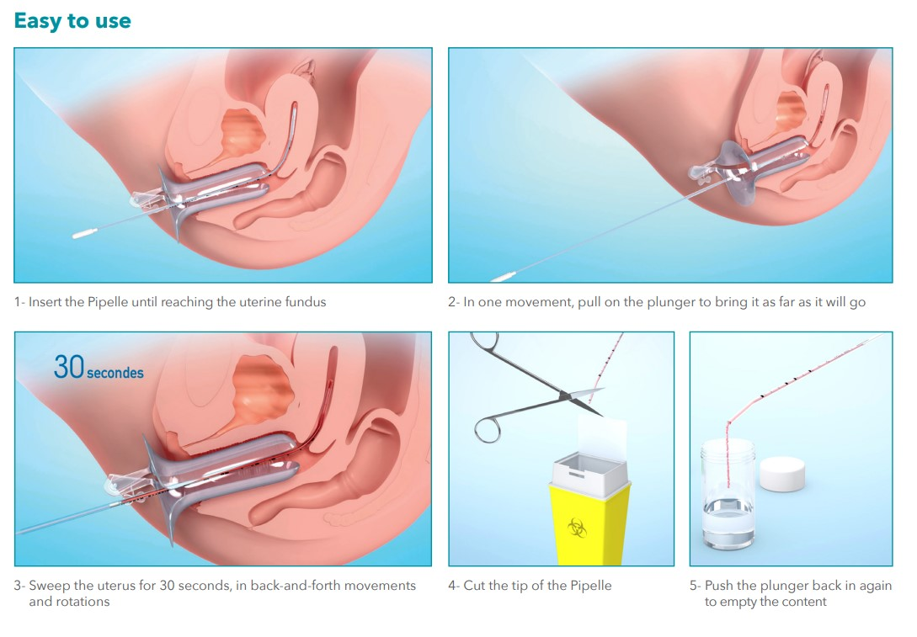
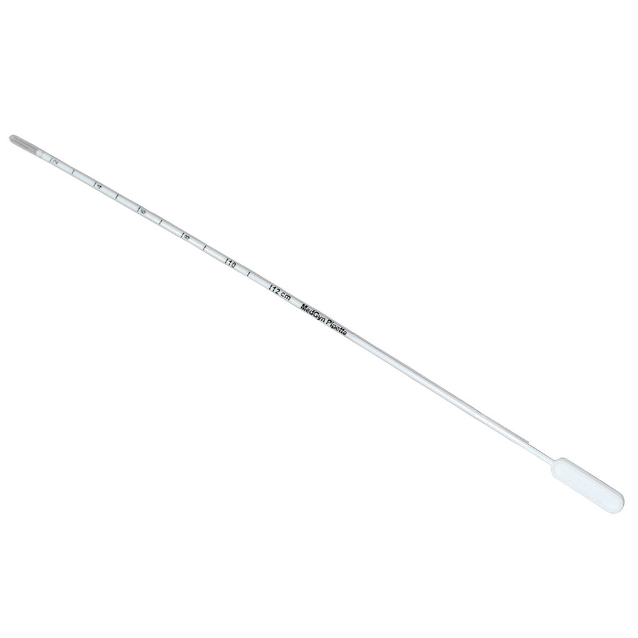
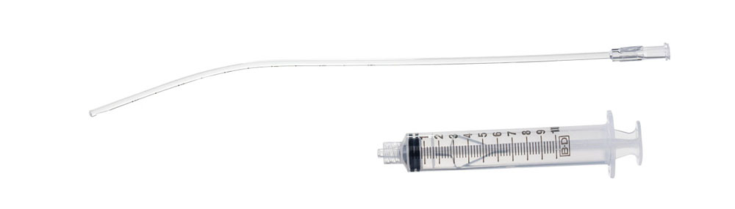
EMB Technique
Image sources: https://www.eurosurgical.co.uk/gynaecology/1997-2/, https://www.medgyn.com/product/medgyn-pipette-2/, https://www.medgyn.com/product/medgyn-endosampler-2/

Slide 55
Summary
Use PALM-COEIN framework for differential diagnosis of abnormal uterine bleeding (AUB) in non-pregnant reproductive-age patients
Evaluation of AUB should be guided by age and DDx
Postmenopausal: atrophic changes, malignancy → TVUS can be first step; EMB >4mm
Treatment strategies: hormonal (progesterone) and non-hormonal; surgical rare
 | Adolescents | Repro-age | Perimenopausal | Workup (besides HCG!)
Polyps |  | X | X | Pelvic exam TVUS
Adenomyosis |  | X | X
Leiomyoma |  | X | X
Malignancy/ hyperplasia |  | (X) | X | EMB TVUS
Coagulopathy | X | (X) |  | VIII, VWF, CBC, iron, INR, fibrinogen
Ovulatory | X | X | X | TSH; PCOS w/u
Endometrial | X | X | X | Pelvic exam; GC/CT; (EMB)
Iatrogenic | X | X | X | Med review
NOS | X | X | X | Pelvic exam; GC/CT…

Slide 56
Thank you!
Katie Putnam bergerk@ohsu.edu
Emily Waterman watermae@ohsu.edu

