Slide 1
The Oregon Wellness Program: An Aid to Enhanced and Renewed Professional Satisfaction
Please Stay Tuned for:
Lunchtime Lectures will begin today, September 10th at Noon.

Slide 2
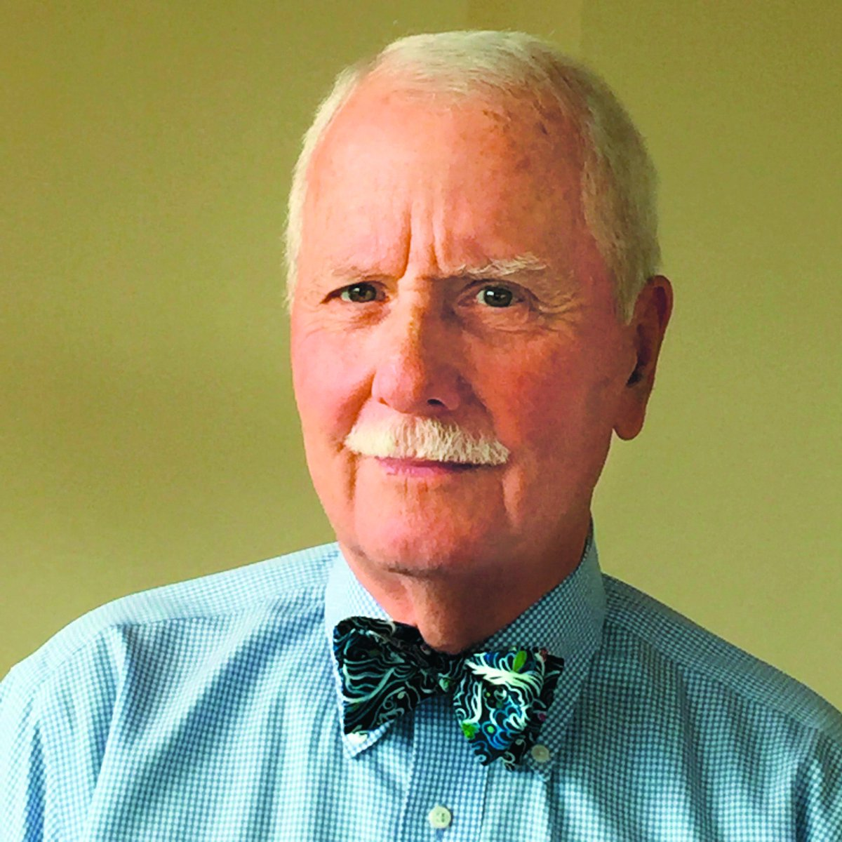
Donald E. Girard, MD, MACP
Emeritus Professor of Medicine,
Division of General Internal Medicine,
School of Medicine - OHSU, Portland, OR
Chair, Executive Committee,
Oregon Wellness Program
I have no relevant financial relationships
to disclose.

Slide 3
Course Objectives
REMEMBER: The Oregon Wellness Program (OWP): (oregonwellnessprogram.org/ph: 541-242-2805)
Burnout: A Brief History
Burnout as a destructive force for health care professionals
The inherent conflict among health care professionals: Caring for patients vs Caring for one self
The OWP: A Brief History
The OWP: Access
Counseling: Diagnosis and Management
OWP Outcomes to date (9-2020)
Client Survey Outcomes (4-2020)
Example of Resilience Self Teaching
Questions and comments from your colleagues

Slide 4
Burnout: A Brief History
H. J. Freudenberger: Burnout: High Cost For High Achievement: 12 steps, including excess need to succeed, inability to compromise, increasing attention to success and giving up personal interests
Christina Maslach’s definition as Occupational Disorder with markers: A. Professional Exhaustion; B. Depersonalization; C. Inability to appreciate professional accomplishments
Medicine as Profession: +/- for much of history; but in US a Golden Era from WWII through 1970s
The profession becomes industrialized: 1970s to present
Professional burnout rates rise from: less than 20% in 1980; about 33% in 2000; to more than 50% present
Primary care, emergency medicine and select subspecialties the most; pathology and dermatology the least; Family Physicians high!
Precipitants: Industry replaces profession (wealth for health); professional loss of control; worker bees; technology and information overload; regulatory requirements explosion (certification, recertification, credentialing, governmental requirements, preauthorization, etc)
EPIC and other electronic medical record systems became the straw that broke the camel’s back: while established to serve the physicians, it became the system’s payment tool and requires more time per practitioner than direct patient care
OUTCOME: Professional Burnout

Slide 5
Professional Burnout as a Destructive Force
Burnout Prevalence among all US Physicians 2020: @ 50%
An Occupational Health Disorder identified by three characteristics:
Professional Exhaustion
Depersonalization: (cynicism, anger, disrespect)
Inability to appreciate success in one’s professional life
All lead to bad care; bad relations; somatic complaints, bad behavior, attrition from practice; depression and suicide

Slide 6
Professional Burnout as a Destructive Force
continued
Outcomes of burnout:
Unhappy and dissatisfying professional lives
Poor relationships with patients, colleagues, friends, supervisors, others
Bad patient care and bad patients’ outcomes
Attrition from profession
Bad behavior (gateway to alcohol and substance abuse, boundary breaches, poor cognition, chronic, unforgiving somatic complaints (headaches, back pains, etc), depression, suicide

Slide 7
Understanding the Professionals’ Inherent Conflict Between Caring for Patients vs Caring for Self
Caring for Patients: the Mantra instilled from the beginning of medical education, increasing through graduate medical education and sustained through one’s practice life: Your patients come first, always!!!!
Caring for Self: Ignored during medical education, completely displaced during graduate medical education and never recovered during professional careers
Thus health care professionals are frequently not as well as they can be in their professional lives; AND IF THEY ARE NOT AT THEIR BEST, THEY CANNOT PROVIDE THE BEST PATIENTS’ CARE

Slide 8
The OWP: Brief History
2014 the Oregon Wellness Coalition is organized
2016 An Executive Committee is formed and has the authority to manage the program
Four chapters are established at medical society sites: MSMP, LCMS, MPCMS, COMS, and Medford and one pending
Psychologists and psychiatrists respected for expertise in treating physicians are recruited and vetted to provide counseling services in these five sites
2018 Formal Contract ratified by all site directors bring programs under the umbrella of the OWP to develop together, receive and give financial support and share expertise
2018 The Foundation for Medical Excellence partners with the OWP as its fiduciary and becomes the seat of financial recruitment
THE PRODUCT: Voluntary counseling services for all OR licensed physicians, physician assistants and advanced nurses; confidential, no records, no referrals, no tracking, all free and 8 per year, 48-72 hours wait time; in person or telemedicine visits
Financial support has now been received from health care systems, legislative approval of licensee fees use, individual donations

Slide 9
The OWP: Access
The Program is accessible live during usual work hours or thru voice mail all other times; crisis line available at all times
Website: oregonwellnessprogram.org or phone: 541-242-2805
Operator from Cascade Health (Eugene) answers and asks only for name and contact phone number
Operator reviews request from caller and together identity the mental health provider best suited for him/her; in his/her locale or anywhere in the state; in person visit or via telemedicine
Currently 20 mental health providers are available (Psychiatrists, PsyDs, PhDs, or MSW/LSWs)

Slide 10
Counseling Diagnosis and Management
The Client: Health care professionals represent a continuum; from well and inquisitive, to flirting with un-wellness, to impaired; to crisis!
Through initial counseling sessions, mental health provider diagnoses individual’s state of burnout.
The initial diagnosis allows the mental health provider to focus treatment on the problem; or for some identify referral sources who are more able to care for the individual’s need
Goal is to facilitate increased personal insight; establish a work plan to address the problem and with that improved satisfaction; refreshed professional investment and enjoyment.

Slide 11
OWP Statistics to date 6-2020
Over 1350 client visits; majority in person but increased telemedicine
Average visit number 3.5++ per individual (and increasing)
Most common age range 41-50 years; more women than men (2/1)
Research Pilot Study Results very positive about professional value

Slide 12
Client survey outcomes 4-2020
Universally helpful (95%)
Comments about the program: Helpful (95%); helps personally (93%); change in life (90%); made one or more change in life (88%)
Quality of life improved with more visits
Symptoms of burnout decrease with increased visits
Most recent data reveal help with COVID concerns, from spring 2020

Slide 13
Examples of resilience self teaching https://www.ursusprogram.com
Simple, effective techniques so that your body thoughts and motions work as a well functioning team
One breath reset: Use a single breath to shift your body and mind to optimal state
Power recharge: Use a 1 minute breathing technique to recharge your physician and mental reserves
Values: Identify your values and train your body to help you live up to them
Habits: Learn skills for creating helpful habits
Wise mind: Use the breath to tune into wise, helpful thoughts
Emotional intelligence: Experience your emotions as a source but not control of information
Social skills: Listening to learn - use your breath and thinking skills to understand the other person
Social skills: Learn how to reach agreement on what is important and improve teamwork
Maintaining Energy: Create habits using breath, attention, thoughts, and behavior to keep your energy high
Continuous improvement: Use mental rehearsal to increase successful actions

Slide 14
Questions from Your Colleagues
How do I maintain compassion and empathy in delivering efficient patient care and be present for family when coming through the door at home?
How do I feel good about tackling patient problems in a fast-paced clinical care setting without becoming a magnet for difficult cases that anyone can solve?
What are some rewarding milestones in the arc of a physician’s career?
What are some of the common modifiable factors that lead to dissatisfaction when looking back on a career?
What is a simple tool or easy to use parameter(s) for self check in on wellness?
Discuss coping strategies, managing anxiety.
Ways to build/enhance(ment) resilience.
With increase amount of time working from home, how can I re-learn to disconnect from work when home?
For family physicians working in larger health systems, wellness committees and employee assistance programs are already in place to provide resources. They are not used. Resources available in OR for family physicians confidential, voluntary only and free is OWP.
“I strongly second the topic of insidious work creep and maintaining/establishing appropriate boundaries… we are always busy and often thinking of work-related things outside of clinic/office time, but this has run amok during COVID-19

Slide 15
Thank you for joining us today for the first in our Lunchtime Lecture Series.
Upcoming topics include:
Bag of Worms or Teachable Moment: The Role of Family Physicians in Addressing Unhealthy Alcohol Use
Social Determinants of Health & Health Justice: A Vision for Action
Social Determinants of Health: From Theory to Practice
Each of these webinars has been approved for 1.00 AAFP Online Only, Live AAFP Prescribed Credit.

