Slide 1


Caring for Children and Adolescents With Obesity: A Practical Clinical Update
Oregon Academy of Family Physicians Annual Conference
April 1, 2026
Angela-Tu Nguyen, MD, FAAP, Dipl. of the ABOM

Slide 2
Disclosures
No Financial Disclosures

Slide 3
Learning Objectives
1
2023 AAP CPG
2
Intensive Health Behavior and Lifestyle Treatment
3
Comorbidities
Apply the guidelines to evaluation, lifestyle treatment, pharmacotherapy, and referral for bariatric surgery.
Recognize and manage common obesity-related comorbidities in children and adolescents.
Provide age-appropriate family-centered lifestyle counseling
Notes:
- Today I'm going to give an overview on the management of pediatric obesity, the framework of which comes from the clinical practice guidelines published by the AAP in 2023. It will include intensive health behavior and lifestyle treatment, screening for obesity comorbidities, and what medication and surgery options are available for kids.
I imagine that those of you who treat adults have been treating obesity longer and more frequently than we do in pediatrics. Many of the concepts of counseling and tools are not going to be new to YOU all, but I'll try to highlight what is unique to kids

Slide 4
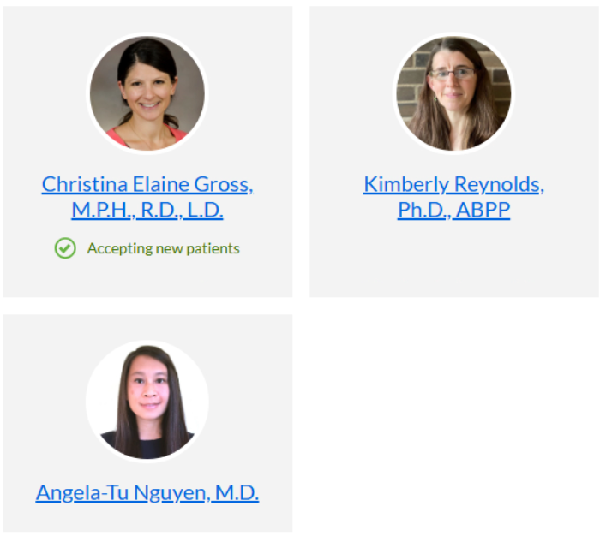
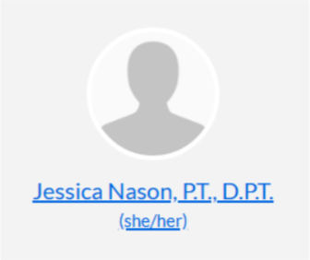

OHSU Healthy Lifestyles Clinic
Notes:
Along with practicing primary care pediatrics, I have an obesity medicine certification and also serve in the OHSU Healthy Lifestyles Clinic.
We’re a multidisciplinary team that includes Dr. Kimberly Reynolds, a child psychologist; Christina Gross, a dietician; and Jessica Nasan, a physical therapist.
Anyone with obesity can be referred. There is no age limit and they do not have to have metabolic comorbidities. We have a higher than average prevalence of kids with neurodevelopmental diagnoses, psychiatric or social complexities as well although none of these are required either.
We are a good “one stop shop” for kids who may need extra support.
We only see patients on Wednesdays, and our waiting list is about a year. And once they are established in our clinic, we see most families about once every three months. As you’lll earn in a few moments, this is less often than what is recommended by the AAP for “intensive” treatment. And so we ask that primary care practices continue to be involved as the medical home, fill the gaps of follow-up and counseling, and assist with care coordination.

Slide 5
Obesity Care at OHSU
Patient
PCP
HLC
Endo
GI
Card
Sleep
Psych
RD
PT
MBS
LCSW
CDRC
Many more!
Ortho
Notes:
At OHSU, we have a lot of people doing excellent work to care for children with.
Our gastroenterologists will see those with Steatotic Liver Disease. Dr. Maggie Likes in pediatric cardiology sees kids with suspected familial hyperlipidemia. Nephrology will see the kids with hypertension. Our endocrinology department sees those with Type 2 Diabetes but they also have a prediabetes clinic. Their waiting list is as long, if not longer than ours so they are prioritizing the kids with a HbA1C of 6 and above. We have pediatric sleep medicine who see kids with obstructive sleep apnea. We have a chronic pain clinic.
You can also refer to physical therapy, nutrition, or psychology as individual services outside of the Healthy Lifestyles Clinic as well.
So there are many specialities at OHSU to whom you can refer to, to tailor care for your patient. We all live in different departments, so at this time you have to refer to each of up separately.

Slide 6
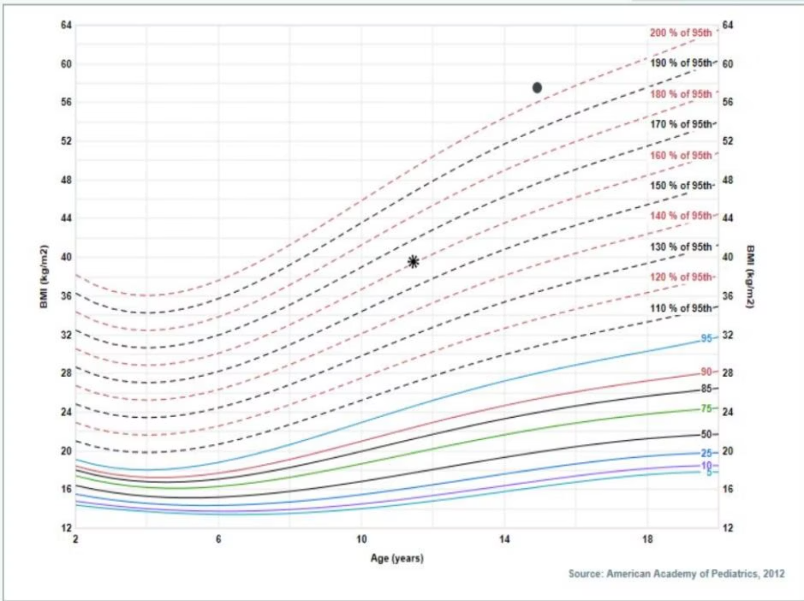

Diagnosing Obesity
"Obesity is a chronic complex disease defined by excessive fat deposits that can impair health."
— WHO, 2024
Use BMI ≥95th percentile and extended growth charts as practical screening tools.
BMI limits: Ignores body composition, ethnicity, and fat distribution.
Notes:
Obesity is a chronic complex disease of excess adiposity that can impair health. In kids, we imprecisely approximate it using BMI or weight-for-length percentiles.
Growth charts for kids
Less than 2 y.o. - WHO charts, which uses weight-for-length %tile
Above 2 y.o., use CDC charts, which uses BMI %tile
For those with obesity, we might have to use extended growth charts and report obesity as a % of the 95%tile. The CDC release these extended charts just a few years ago. The one I have on this slide is EPIC generated, which gives me the same percentile but more lines, which I prefer.
We cannot forget the fact that BMI is oversimplified. It cannot tell the difference between fat and fat-free mass. It will over or under diagnose obesity in certain racial or ethnic groups, and cannot tell you where that adipose tissue is distributed on the body – which can affect metabolic risk.
I don't use waist circumference in kids. There are no established norms in kids like there are in adults, and it doesn't change management for me.

Slide 7
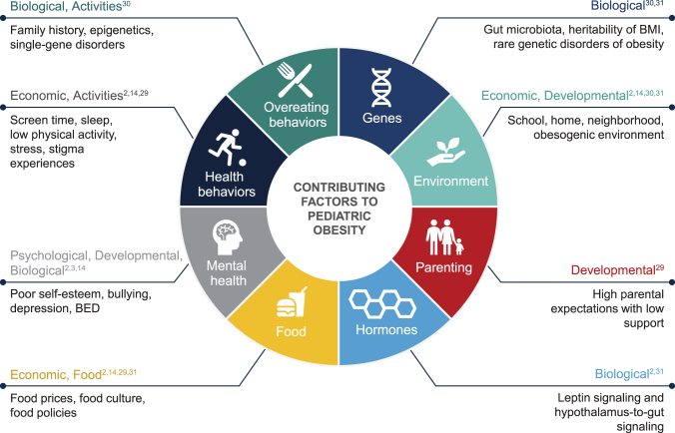
Complexity of Pediatric Obesity
(Haqq, et al., 2021)
Notes:
The prevalence of pediatric obesity has been increasing for decades, and it is multifactorial.
Genetics plays about half the part (somewhere between 40-70%), but for the vast majority of people it is not syndromic or a single gene mutation. For most kids, it is polygenic and shaped by generations of ancestors fighting for survival. Now their genetic make-up is interacting with this modern world – one that favors inactivity and lower quality, energy-dense foods.
The individual choices we make matter, but we can only function within the environment and systems that we live in. It is a chronic disease that reflects a society and political structure that favors profits over public health. Families are living with financial strain, cuts to social programs, and poor access to healthcare or mental health support make healthy choices sustainable. It costs money to be healthy in this country.
On top of that, inequities like racism, weight stigma, adverse childhood experiences, and other social determinants of health are also contributing factors.
To treat obesity, we need to partner with families, work with our colleagues in other disciplines, push for systems-level change, and make sure newer treatments are being used thoughtfully and equitably. Treating obesity is just as much a fight for social justice as it is treatment of a medical disease.
---
A small minority of severe, early-onset cases are monogenic, generally under five percent, and true endocrine causes are even rarer, under one percent.

Slide 8

History & Physical Examination
Key History Elements
Syndromic Red Flags
Take a thorough history — divide across multiple visits if needed
Review medications for weight-promoting effects
Note early-onset obesity, family history of extreme obesity, or incessant hunger
Abnormal finger morphology or unusual facies
Developmental delays or intellectual disability
Features suggesting a genetic or endocrine syndrome
Notes:
Once you've diagnosed obesity, taking a thorough history and physical is imperative. In the healthy lifestyles clinic, we have the luxury of doing 3-4 hour long intake visits to gather all this history. In primary care, there is little time for this in a single visit, but should probably be divided up into multiple.
Take note of what medications they take or have taken that might promote weight gain or metabolic changes.
Very early-onset obesity (less than 5, and especially less than 2 y.o.), having a strong family history of severe obesity, hyperphagia, severe developmental delays or anatomic abnormalities might suggest a stronger genetic component and warrant a work-up or earlier treatment. However this is quite rare - less than 5% of kids have an identifiable genetic variant or endocrine etiology for their obesity, so it's something to have on your radar but not common enough to screen for on a regular basis.

Slide 9

Headaches (IIH, OSA), vision changes (IIH)
Acne, hirsutism (PCOS)
Tonsillar hypertrophy
Rashes (intertrigo, acanthosis, hidradenitis)
Cervicodorsal fat accumulation (Cushings, especially w/ striae, proximal muscle wasting, full facies, HTN)
Chest pain (CV, GERD, asthma, deconditioning)
Don’t forget:
Vitals (BP)
Mental health (depression, anxiety)
Syndromic features
Neuromuscular eval including balance, coordination, LE strength, flexibility, and motor skills
Difficulty breathing (asthma, OHS)
Gynecomastia
Hard, painful stools (constipation)
Abdominal pain, hepatomegaly (NAFLD)
Irregular periods (PCOS)
Striae (Cushings)
Polyuria, nocturnal enuresis (diabetes, OSA, constipation
Knee or hip pain, abnormal gait (SCFE, Blounts, OA)
Penile size (buried penis, low testosterone)
Genu varum or valgum
Ankle pain, foot pain (ankle eversion, flat feet)
9
Notes:
I'll talk a little bit more about comorbidities in subsequent slides, but I put this busy slide here to show that a review of systems and physical exam for obesity is head to toe.
What I'll see most often in kids is acanthosis nigricans, abdominal striae, enlarged tonsils, and low arches in the feet. Sometimes I'll see rashes like intertrigo. Their blood pressures are always high when they come in, but are rarely sustained when I ask for repeats from their PCP or when getting ambulatory blood pressure measurement. It's probably more of a reflection of white coat hypertension, especially when they come into our office expecting to talk about their weight – a topic that brings up a lot of stress.
Mental health issues are very common, including eating disorder behavior. It's often exacerbated by bullying at school or even at home.
Neurodevelopmental disabilities including autism, ADHD, intellectual disabilities, communication and motor delays are more common in this population. Again, these rarely a part of a larger genetic syndrome, but often does play a part in impulse control and behavior, sedentary behaviors, and sensory issues leading to limited diets.

Slide 10
Laboratory Evaluation: Etiology
Endocrine Workup
Avoid routine endocrine labs unless stature or height velocity is attenuated — do not reflexively order thyroid or cortisol panels.
Insulin Levels
Avoid measuring plasma insulin levels — results are not clinically actionable
Genetic Testing
Consider for early-onset obesity +/- syndromic features and/or a FH of severe obesity.
Notes:
I practice as the endocrinologists do and don't order thyroid studies as part of their work-up because hypothyroidism is such as rare cause of obesity. The guidelines only suggest screening for thyroid disease if there are other clinical features like poor linear growth. Often, obesity can cause a mildly elevated TSH with a normal free T4, and then you might get stuck having to chase something that is an incidental finding.
I don't test insulin levels because like waist circumference, we don't have standardized norms in kids and it doesn't inform management.
I do sometimes do a buccal swab for monogenetic causes of obesity, particularly if the patient had obesity at an early age or there is a strong family history of severe obesity. OHSU is involved in a medication trial and gets a free test kit from a company called Prevention Genetics. Otherwise, I believe it's a $700 test that may or may not be covered by insurance but I haven't needed to go down that route yet. If the child is found to have one of four genetic conditions (Bardet-Biedl syndrome (BBS) and deficiencies in POMC, PCSK1, or LEPR) they would qualify for a specialized medication called Setmelanotide. But the vast majority of the time, I'll get a negative result or the child is carrier for one of other 83 genes that they test for, for which we don't have any specific treatment for.

Slide 11
IHBLT
Intensive Health Behavior & Lifestyle Treatment
IHBLT is the essential, long-term, family-based foundation for pediatric obesity care.
Duration & Dose
Family-Based
Minimum 26 contact hours over 3-12 months.
Include parents and family for better outcomes.
Multidisciplinary
Setting
Coordinate physician, dietitian, behavioral, and exercise experts.
Clinical or community-based, prioritized face-to-face contact.
Notes:
On to treatment. When the AAP released its first clinical practice guideline on obesity in 2023, it shifted away from the four stage escalation approach that their published in 2007. The new CPG is asking us to offer immediate and intensive obesity treatment once a child is diagnosed. This includes providing Intensive Health Behavior and Lifestyle Treatment or what's known as IHBLT.
The most effective IHBLT provides at least 26 hours of face-to-face, family-based, multicomponent care over 3 to 12 months. On top of that, they also recommend offering medications or surgery from the beginning. There was pushback that the guidelines were too aggressive and hard to implement. But we all recognized that what we were doing already was not effective. With stronger evidence for medications and surgery, and more shared experience using them, it’s worth thoughtfully integrating these tools alongside lifestyle treatment, especially for patients with severe disease.

Slide 12
IHBLT
When Intensive Programs Are Not Available
Build intensity by partnering with others in the community.
Registered Dietitian Nutritionists
Behavioral Health
Physical therapists
Community Programs
Address food insecurity, SDoHs, mental health or other factors that can be influential
Notes:
The reality is that many primary care providers don’t have access to a structured multidisciplinary programs like the HLC. And even within our clinic, we don’t have the capacity to see patients as frequently as recommended.
When IHBLT falls to primary care, the goal is to deliver the most intensive care you can: schedule frequent follow-up, use motivational interviewing to set goals, and utilize resources in your community if you can like dieticians, physical therapists or trainers who have experience with kids, local community centers or sports programs, food resources, and behavioral health support.
This coordination from the PCP is often very helpful for us at the HLC because we see kids from all over the Pacific North West, and we often don’t know what their neighborhood looks like and what resources are available in their community. So we might ask PCP to help with this.

Slide 13
Keys to Successful IHBLT
What the evidence says
Core Philosophy
Intervene early. Avoid watchful waiting.
Use Motivational interviewing
Build skills
Prevent attrition by addressing mismatched weight-loss expectations.
Focus on health behaviors over weight alone, building self-efficacy for the entire family.
Outcome Metrics
Success is not exclusively measured by weight but also in cardiometabolic health and quality of life.
Modest 1%–3% BMI percentile decline is expected.
Notes:
IHBLT is best started early, and again, often.
It is also important to use our motivational interviewing skills to meet families where they are, while focusing on health behaviors and skill building for the whole families as opposed to focusing on weight loss.
Admit that lifestyle changes alone will deliver very modest weight loss – only about 1-3%. And this is where we have to be honest with ourselves and our patient families about these expectations. "I don't expect your child to lose an extraordinary amount of weight from just diet and exercise alone. The main reason they have a larger body is because it is baked into their genetics. But we know that eating healthy and moving our bodies regularly helps is live longer, healthier, and happier lives at whatever size our bodies are." It's particularly important to emphasize this with families or patients who are weight focused, or otherwise it can be extremely disappointing when they don't reach the size they want to be in their minds. Sometimes 1-3% BMI reduction is enough, but should they need it, that's when it's time to have that conversation about layering on medications and surgery.

Slide 14

Reframing the Goal
"Healthy weight is what you reach while living your best lifestyle."
— Freedhoff, 2010
They feel good about eating
They move with joy
They know they are more than a body
Notes:
So this is why before starting IHBLT, it is important to reframe the goal from weight loss to achieving a healthy weight. A healthy weight is one that supports a long, joyful, and fulfilling life.
We want children to grow into people who genuinely enjoy food, who can explore and appreciate it without guilt. We want them to experience movement as something positive and energizing, not as a punishment. Just as importantly, we want them to build meaningful relationships and develop a strong sense of self-worth that isn’t tied to a number on a scale.
If medical concerns arise, then it’s appropriate to have more specific, number-based conversations. But when those concerns are absent, there is no single “ideal” body shape or size they need to pursue. Instead, the focus should remain on overall well-being—physically, emotionally, and socially.
There is enough weight bias in the world, in the health care system, even in our offices. We should be fighting it constantly and ensure that we provide a space where they can be seen and not judged.

Slide 15

SMART Goals
Then set 1–3 family-centered SMART goals
Specific
Measurable
Achievable
Relevant
Time-based
Schedule follow-up visits. Praise behaviors, not numbers.
Notes:
IHBLT is coaching with follow-up, and the coaching has two parts. First is the content we provide and the second is how to make change stick.
One strategy is making SMART goals, which are goals that are specific, measurable, achievable, relevant, and time-based.
Making positive behavior goals are typically more motivating than negative or avoidance goals
Mastery goals focus on gaining new skills, which gives patients more control, and are important at the beginning because it will boost confidence and self-efficacy.
For parents, if they are setting the goal, it should be within their control. It can't be that their child will eat more vegetables at every meal, it needs to be that the parent will offer a vegetable at every meal.
Action Plans
Steps to achieve the goal. For example, if the goal is for them to drink only water or milk for the next 2 weeks, the action plan could be to replace the orange juice with a whole orange for breakfast, and to not buying soda for the house.
Could be an opportunity to addresses barriers, how to be accountable and how to monitor their achievements.

Slide 16
The Science of Habit Change
43%
66
Daily Actions rooted in the unconscious
Number of days to new habits
Change the Environment
Habit Stack
Add or remove friction
Attach new habits to existing routines.
Reward Behavior
Identity & Social Context
Immediate rewards reinforces
Align habits with family and peer identity.
Notes:
Research suggests that approximately 43% of daily activities are rooted in unconscious patterns
It takes an average of 66 days of intentionally doing something daily to start doing it automatically. Going to the gym, not surprisingly, takes about 3 months to become a habit. The important point is that it takes practice.
If they’re willing to habit track, print out print calendar pages for kids hang up at home, so it serves as both a visual reminder and a reward system. For older kids, there are also habit-tracking apps they can use for free. The goal isn’t perfection, it’s consistent practice.
Habit stacking is another helpful tool, linking a new behavior to an existing routine: “After snack, we take a 10-minute walk,” or “After dinner, we pack lunch for tomorrow.”
Encourage parents to praise for effort and consistency, not outcomes. What we pay attention to tends to grow.
Finally, changing one’s environment is one of the most effective tactics for behavior change, particularly decreasing friction to more preferred behaviors and increasing friction to less desirable ones.

Slide 17
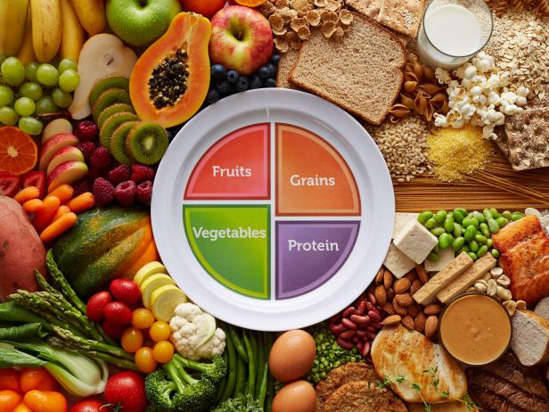
NUTRITION COUNSELING
DIY IHBLT: Nutrition Foundations
MyPlate
Scheduled meals and snacks
Snacks with 2-3 food groups
Settings
How is food served
Idaho Food Bank
Notes:
The dietary advice we give to kids mirrors what we tell adults. Eat lots of fruits and vegetables, whole grains, lean protein, and minimizing intake of highly processed foods, saturated fat and added sugar. The DASH diet and the Mediterranean diet are examples of this, and the evidence in adults is abundant that they reduce chronic disease.
We still use MyPlate, a simplified visual graphic of the Healthy US-style Dietary Pattern developed by the USDA.
Easier to eat visually than to be calculating calories and tabulating nutrition labels. There's a time and a place to be doing these things, but they require knowledge and aren't sustainable.
Eating schedule and encourage a rhythm of three meals and one to two planned snacks reduces grazing.
Setting is important – where is eating is happening? At a table, in bedrooms, or in front of the TV? Keeping meals screen-free can help kids notice fullness and can reduce distracted overeating. Which meals are at school vs at home? Do they get snacks at school, at home after school or at after school care?
How is food served? Using plates or shallow bowls and pre-portioning helps kids see what they’re eating, and smaller plates or bowls can help with portion perception. Could fruits and vegetables come out first, like an appetizer, or be available to munch on while dinner is being made? Could we avoid putting all the food out at once and keep extra portions in the kitchen or away in the fridge?

Slide 18
NUTRITION COUNSELING
Getting Kids to Eat — and Not Overeat
Responsive feeding
Satter's Division of responsibility
Offer new foods repeatedly without pressure
Model
Share family meals, focusing on social interactions and not on food
Tools
Visual kitchen schedule
List of alternative activities
Practice mindfulness
Cook together
Recipes and strategies for meal prep
Notes:
Truthfully, many parents are already familiar with what a healthy diet is supposed to look like. The difficulty lies in understanding where they have control and setting boundaries, especially as their kids go through different developmental stages. For example, many parents come to our clinic saying they want their child to make healthier eating decisions on their own, and yes that is the ultimate goal for when they grow up and their frontal lobe is better developed, but often it's not an age-appropriate expectation for their child. Even for some teenagers.
Responsive Feeding is a feeding style that we start counseling parents when their kids are still newborns. Once they've regained their birthweight at 2 weeks, we tell them to "feed on demand", to recognize and respond to their hunger or fullness cues. This should continue throughout their childhood. Don't use food as a reward or comfort when they are distressed, because this will act on the pleasure center of their brain and become associated with a positive memory or feeling. Later in life they may then turn to food when they are anxious or sad, and this is what becomes emotional eating.
Ellyn Satter’s Division of Responsibility is the operational model through which we can practice repsonsive feeding. Parents decide what, when, and where food is available. Kids decide whether and how much to eat from what’s offered. The more something is offered, the more likely they will eat it. Conversely, kids can't eat what parents don't buy.
Getting kids to eat more of something requires a lot of offering without any pushing – not even "try this". If you MUST say something, you can point out the color, texture (squishy, crunchy) etc. Just put it out, alongside their preferred foods. Offer it in a lot of different ways, or leave it out between meals.
Modeling is important – they definitely won't eat it if they don't see you eat it. Let them hear you listening to your body about hunger and fullness, and avoid negative self-talk or dieting.
Prioritize family meals because families who eat together more often are more likely to eat nutrient dense foods and more balanced diets, and enjoy it more. Focus not on the food, and more on the social interactions at the table, which will also make the experience more enjorable.
To help with boundaries, our psychologist often recommends visual schedules or menus to many of our kids, which is particularly useful for kids with intellectual or developmental disabilities.
Avoid saying certain foods are good or bad, or healthy or unhealthy. All food provides nutrition! All foods help you grow! But different foods have different "vitamins" that help you become strong in different ways (video game example), so we need to eat a little bit of everything. And restricting certain foods makes us want it more. We want what we can't have, and then when we get it, it's now this special thing. We feel more pleasure when we get to eat it, and then ashamed because we've been conditioned to think it is bad for us and we were weak for not resisting it. This cycle of pleasure and shame was imprinted onto us as parents through the evolution of diet culture, and sometimes we need to look inward and recognize how much of this we are projecting onto our children.

Slide 19

SLEEP COUNSELING
DIY IHBLT: Sleep
Counsel families to:
Maintain consistent sleep schedules
Establish screen-free bedtime routines
Limit devices in the sleep environment
1
Poor sleep increases obesity risk.
Screen for OSA
2
Assess for snoring and restless sleep
Refer to specialists when indicated
Notes:
Not getting enough sleep can promote weight gain in several ways. When we’re sleep-deprived, we tend to crave more energy-dense foods and have less self-regulation. We’re also less likely to want to be active.
Sleep timing is also important. The body expects sleep, food, and activity at certain times, and when those happen at the “wrong” times, it affects energy balance, mood, appetite, and metabolism. There’s adult data suggesting that shifting calories earlier in the day can support weight loss and glucose metabolism, so the intervention isn’t just “more sleep,” it’s also more consistent sleep on a normal schedule.
Teenagers need 10 hours of sleep, not 7-8 hours like adults do. Ask about their screen use before bed, which screens are in their rooms, and whether they are drinking caffeinated beverages.
And don’t forget to screen for obstructive sleep apnea. OSA can fragment sleep, which can contribute to weight gain, and gaining weight can worsen OSA. Screening for OSA and treating sleep issues can be a meaningful part of obesity care.

Slide 20

PHYSICAL ACTIVITY
DIY IHBLT: Movement
1
2
3
Core principles
Practical ideas
When to refer to PT
Prioritize enjoyment
60 min/day moderate-vigorous activity
Movement variability to prevent burnout
Interactive games and online videos
Sustainable, family-inclusive or social activities
Pain, disability, deconditioning, or fear limits movement
Notes:
For physical activity, the target for school-age kids and teens is 60 minutes a day. Younger kids are supposed to play all day. But start small if you need to and choose activities they enjoy because consistency matters most. Then build variety and intensity. Exercise alone is not enough for weight loss, but it's essential for cardiometabolic and mental health, and preserving lean body mass, especially when weight loss happens through medications and surgery.
For older kids who want to go to a gym, ask about their school gym use policy. Community centers might have lower cost gyms or pools, and Planet Fitness has free summer memberships for teens. Help them brainstorm options at home or nearby. Do they already have exercise equipment at home? Can they habit stack a family walk with dinner? Can they walk to school? Schedule dance breaks, bike rides, hikes. Bring ball to kick around at the park. Movement based video games can be enjoyable, and YouTube is a great resource for kid-friendly exercise videos. For kids already in sports, you could focus what they can do to stay active in the off-season or on their off-days. Finally, kids with chronic pain might avoid movement, so address it early and consider asking PT for help, especially for those with developmental differences.

Slide 21
Screening for Metabolic Comorbidities
Age Group
Condition
Screen For
≥3 years
BMI ≥85th %ile
Blood pressure (every visit)
2–9 years
Obesity
Lipids
≥10 years
Overweight
Lipids; glucose & liver if risk factors present
≥10 years
Obesity
Lipids, glucose, and liver function
Repeat all labs every 2 years if normal; perform sooner if clinical risk factors increase.
Notes:
Obesity has many short- and long-term comorbidities, and the risk chronic comorbid conditions increases with age, severity, and duration of obesity.
Early intervention effectively improves short-and long-term health outcomes. Untreated childhood obesity tracks into adulthood, raising risk of premature death
This information was lifted from the clinical practice guidelines and gives an overview of when to screen children for associated comorbidities. Probably the easiest point to remember from this slide is that everyone 10 and older with obesity should get metabolic labs to look for dyslipidemia, abnormal glucose metabolism, and steatotic liver disease.
Kids who have obesity who are less than 10, or kids above ten with overweight BMI, should still get a lipid panel. And then whether you get the rest of the labs depends on their risk, such as the extent of their obesity, of they are on obesogenic medications, are at higher risk of CVD, have a family history of metabolic disease or if they already have a metabolic comorbidity already.
And then every kid should really have a BP measured at every visit for ages 3 and up.
If everything comes back normal, repeat the labs every 2 years.

Slide 22
Dyslipidemia
Screening test
Abnormal Values
Lipid panel
Repeat fasting if non-HDL >145 or HDL <40
TC >200 · LDL >130
HDL <40 · TG >130 (≥10y) / >100 (<10y)
Pharmacotherapy
Dietary Treatment
Statins for age >10 if elevated despite 6 months of lifestyle changes
LDL >190 or
LDL ≥130–160 w/ risk factors
TG >200: consider Omega-3
Refer if LDL ≥250 or TG ≥500
CHILD-1 (↓ sat fat/cholesterol)
CHILD-2-LDL (↓ sat fat)
CHILD-2-TG (↓ carbs/sugars)
Notes:
Screening for dyslipidemia requires doing a lipid panel
If you have them in your office they are not fasting, it is recommended to draw the lipid panel anyway but just know that eating may make their triglycerides come back high. So I would bring them back into a fasted lipping panel if they're non HDL level is above 145 or their HDL level is less than 40
The abnormal values for kids are more lenient than those for adults. Their total cholesterol should be less than 200 their LDL should be less than 130 for triglycerides it depends on age but if there are 10 years old and above their triglycerides should also be less than 30 so same as LDL and if they're less than 10 they're trackless rides should be less than 100 and then we'd like further each deal to be above 40.
For treatment, the first recommendation is dietary treatment. There's a nutritional plan for children called the cardiovascular health integrated lifestyle diet or the CHILD-1 diet. It involves restricting their total fat intake (especially saturated fats), increasing fiber intake, and limiting SSB.
When the CHILD-1 diet doesn't work we move to the child 2 diet and there are two types of child 2 diets. There's one for high LDL which further restricts saturated fat intake and cholesterol intake and then the CHILD-2 diet is for high triglycerides which focuses on decreasing refined carbohydrate intake.
With regards to statins, you might consider using a statin for the kids above the age of 10 with an LDL of at least above 190 and hasn't changed despite 6 months of lifestyle changes. You could consider treating the kids with LDLs between 130-160 if they do have strong risk factors for cardiovascular disease after trying lifestyle changes first
For elevated triglycerides above 200 you might consider omega-3 supplementation
And for kids with LDL's above 250 or triglycerides above 500 you might consider sending them to pediatric cardiology for a workup of familial hypercholesterolemia

Slide 23
Prediabetes / Type 2 diabetes mellitus
Screening test
Thresholds
HbA1c, fasting glucose, or OGTT.
Prediabetes: HbA1c 5.7–6.4%
Diabetes: HbA1c ≥6.5%
Follow-up
Management
5.7–6.0% + risk → repeat annually.
6.0–6.4% → repeat every 3–6 months.
Puberty ↓ insulin sensitivity (60% resolve)
Consider Metformin if HbA1c >6.0%
Refer >6.5% and rule out T1DM
Notes:
In my population I see a lot of prediabetes. I have very few kids with type 2 diabetes which is encouraging
The screening tests you could consider would be a HgA1C, fasting glucose or oral glucose tolerance test. The HbA1c is the most convenient to obtain in the office it doesn't require any fasting. It is also the test we use for follow-up.
The thresholds for prediabetes in diabetes are the same between kids and adults
Puberty does increasing insulin resistance, which resolves 60% of the time.
For prediabetes, we will usually just focus on lifestyle changes and then consider repeating the HbA1C annually
If they are at higher risk od diabetes with a HbA1C between 6-6.4%, our pediatric endocrinologists are using metformin more frequently for these kids because the evidence is suggesting that metformin will buy them time. They have a prediabetes clinic but we discovered not long ago that we shared a lot of the same patients and were providing the same counseling. Plus our individual waiting lists were very long so as of a few months ago we've decided that the prediabetes clinic is going to priroritize seeing the kids with HbA1c of so 6% and higher.

Slide 24
Metabolic Dysfunction-Associated Steatotic Liver Disease (MASLD)
Screening test
Follow-up
ALT (normal ALT does NOT exclude MASLD)
↑ AST & GGT → increased severity.
ALT ≥2× ULN → repeat in 3–6 months for diagnosis
Consider follow-up every 6–12 months if persistently elevated
Diagnosis & Evaluation
Exclusion-based diagnosis. Exclude autoimmune and secondary causes. Refer to Gastroenterology if concerned or automatically if >80 mg/dL
Treatment
Lifestyle modification
Eliminate sugar-sweetened beverages
Notes:
For MASLD, we screen using an ALT. for kids normal ALTs should be in the 20s. I think for adults it is normal for ALTs to be in the 30s from what I remember, but that would be abnormal for a child
Having an increased AST or increased GGT might suggest that their liver disease is more severe
I will usually get a CMP for all the kids instead of LFT's alone, because a lot of them also have high blood pressures so I want to look at their kidney function anyway
If their ALT is twice the upper limit of normal, repeat it in three to six months for a diagnosis. And then after that you could consider getting a follow up ALT every 6-12 months. You do not have to get the liver ultrasound for diagnosis but it helps rule out other etiologies. It also isn't useful for staging, and for that you would need a liver biopsy. So typically if their ALT is persistent elevated or ever above 80, then you could refer them to pediatric GI for that biopsy. GI will also want to do additional lab testing to rule out autoimmune liver diseases.
Treatment of MASLD is lifestyle modifications. Losing weight is the ultimate treatment, but if there's one change supported by the evidence to reduce inflammation quickly, it is eliminating sugary sweetened beverages. No more soda or juice.
The combination of abnormal lab work that I see for kids with obesity is a high triglyceride level, a low HDL, a mildly high ALT and prediabetes. The common thread between them all is a high refined carb diet. I very rarely see an elevated LDL. So I will mention saturated fats but most of the time these kids are eating a diet that's too many refined carbs and added sugar.

Slide 25
Hypertension
Screening test
Staging
Auscultatory blood pressure
Age/sex/height-based reference values
Elevated BP or Stage 1: confirm x3 visits
Stage 2: confirm x2 visits
Diagnosis and work-up
Ambulatory Blood Pressure Measurement
UA, chem panel, lipid panel
If <6 y.o., abnormal UA or renal function, get renal ultrasound
When clinically indicated get TSH, drug screen, sleep study, or CBC
Pharmacotherapy
Lifestyle changes (e.g. DASH diet)
Initiate if lifestyle fails, or patient is symptomatic/diabetic.
Agents: ACEi/ARBs, CCBs, Thiazides.
Notes:
For hypertension obviously we should be checking blood pressures
The AAP released separate clinical practice guidelines for pediatric hypertension back in 2017. Blood pressure normals are dependent on age, sex, and the height of the child. You can find these reference values in charts but now many online calculators like Medcalc and electronic medical records like EPIC calculate what percentile your patients blood pressure is in, whether it is elevated stage 1 or stage 2 hypertension
Once you confirm their elevated blood pressure or hypertension over separate visits, the recommendation is then to obtain an ambulatory blood pressure measurement. As adult physicians you might be more comfortable ordering these on your own but we will usually get them through pediatric nephrology.
For all kids they should do a urinalysis, chemistry panel and a lipid panel. And if they are under the age of 6 have an abnormal urinalysis or renal function then get a renal ultrasound. Back in the day, we were getting renal ultrasounds and ECHOs more readily but that is no longer the case now
If kids are 6 and up, they do not need an extensive evaluation for secondary causes of hypertension, especially if they have a FH, they are overweight or have obesity, and their history of physical isn't suggestive of a secondary cause
First line treatment is again lifestyle changes such as using the DASH diet and then if that doesn't work then kids can also take blood pressure medications like diuretics just like adults do. In general Pediatrics we hardly ever do this, so typically when they get to this stage they are usually already plugged in to see pediatric nephrology

Slide 26
Other Comorbidities
OSA
MSK
Risks: Tonsillar hypertrophy, craniofacial anomalies.
Signs: Snoring, somnolence, labored breathing.
Rule out Slipped Capital Femoral Epiphysis or Blount's disease for LE pain
Look at arches.
Manage chronic pain via PT
PCOS
Intracranial Hypertension
Hyperandrogenism + irregular cycles ≥2yr post-menarche.
Treatment: hormonal contraception; metformin if glucose impaired.
Headache, tinnitus, vision changes. Perform fundoscopic exam for papilledema
Suspect with rapid weight gain. Neuro or ophtho consult.
Notes:
Here's some other comorbidities I look out for
I've already mentioned obstructive sleep apnea, which is very common in this population. Kids get sleep studies and use CPAPs just like the adults do. Ask about snoring, daytime somnolence, naps, or academic issues like inattantion. There is a bidrectional relationship between OSA and ADHD with up to 30% of kids with ADHD having sleep disordered breathing.
Musculoskeletal complaints are very common we have to look out for slipped capital femoral epiphysis or bumps disease if they ever complain of hip pain or knee pain but a lot of these kids have chronic lower extremity pain just due to the excess weight on their lower extremities. Most of the patients we see have collapsed arches and chronic foot pain for which our physical therapist recommends orthotics.
Think about PCOS if there are signs of hyperandrogenism, but remember that in the first 2 years of menses, their periods are going to be irregular. So you technically cannot make a diagnosis of PCOS before they are two years out from menarche. We will treat pesos with hormonal contraception if they are having a regular periods and then if they do have abnormal glucose metabolism we will treat with metformin
Finally, intracranial hypertension is something we look out for. I honestly don't see it often. I see tension headaches and migraine headaches pretty frequently in this population but due to other reasons besides intracranial hypertension.

Slide 27
Where Medications & Surgery Fit
Don't delay for those with
Consider meds for ≥12 y.o.
With intensive health behavior and lifestyle treatment (IHBLT)
Severe obesity
Consider surgery for ≥13 y.o. with severe obesity
Comorbidities
Genetic obesity
Notes:
We should be considering offering medications for all kids with obesity at age 12 and up and considering surgery for all kids with severe obesity at age 13 and up
We should be offering these tools at the same time we are beginning intensive health behavior and lifestyle treatment. We shouldn't be practicing watchful waiting anymore.
For kids with severe obesity, comorbidities, or have a more genetic basis for their obesity whether diagnosed her undiagnosed I will be up front with the families and tell them that lifestyle changes may not and may never be enough for them. That it will probably be like swimming upstream for the rest of their life. And so a lot of the times medications and or surgery can be helpful tools that just make that uphill swim a little bit easier

Slide 28

Choosing a Medication
FDA Approval & Age
Efficacy Needed
Hunger Phenotype
Off-label use requires documented consent & lack insurance coverage
Severe obesity may require multiple meds or surgery + medication
Meds help most with physical hunger — less effective for emotional eating
Cost & Insurance
Dual Benefits
Consider long-term cost; Prior auth may require lifestyle changes and failure of other meds first
Topiramate for migraines, phentermine for ADHD, GLP-1 for prediabetes or diabetes
Notes:
Which medications do you choose? As far as FDA approved medications there aren't as many for kids as there are for adults.
Qsymia, which is the combination medication that contains topiramate and phentermine. Orlistat, and then a couple GLP-1s. The ones that are FDA approved for kids are expensive and hard to get insurance coverage so sometimes I will have to use medications off label. For example I might prescribe phentermine or topiramate or phentermine and topiramate to take together if they can't afford Qsymia.
I also think about which medications Could kill two birds with one stone for example a kid who has chronic migraines might benefit from topiramate or a kid with ADHD could benefit from phentermine. Phentermine is usually never enough to treat ADHD though, so there is a kid who might have to go on a stronger stimulant for their ADHD then I might not start phentermine and maybe just add on a medication like topiramate to their ADHD regimen
We don't have any administrative or nursing staff without the lifestyles clinics will have to do my own prior authorizations. But they're pretty straightforward through CoverMyMeds, and either insurance companies will outright not pay for any weight loss medications, or they will require documentation of intensive lifestyle counseling for a certain number of months, evidence of behavior change, and the failed trial of an oral medication. But it's been pretty straightforward and predictable. The price of these meds have also come down over the years, and pharmaceutical companies are offering coupons or lower prices if you use their mail order pharmacies.
And then the reality is that a lot of these kids with severe obesity might lead to more than one medical or surgical intervention. I go through the efficacies with each family so they know what to expect and warned them that their child might need multiple medications or surgery and medication you can come too think that they need to be

Slide 29
MEDICATION
Qsymia (Phentermine/Topiramate ER)
FDA-approved ≥12 y.o. | ~10% BMI reduction over 52 weeks (vs. 2–5% for each alone)
Phentermine
Topiramate
⚠️ Key Side Effects
🚫 Contraindications
Sympathomimetic · FDA approved >16 y.o. alone
Neurotransmitter modulator · FDA approved for migraines & seizures
Tachycardia, HTN, cognitive slowing, mood changes, kidney stones, metabolic acidosis, paresthesias
CVD, uncontrolled HTN, hyperthyroidism, glaucoma, pregnancy, MAOI use within 14 days
Notes:
Qsymia is usually the oral weight loss medication that insurance companies will request we try before approval for GLP-1s but I've had quite a few patients who have been satisfied with Qsymia alone and nothing more.
In kids I expect about a 10% BMI reduction over about a year and then if I'm prescribing phentermine or topiramate separately I would expect about 5% percent from each of them
The side effect profile is a combination of the side effects of the two medications. Phentermine as a stimulant, so I have to worry about tachycardia, hypertension, or insomnia they are taking it too late in the day. For topiramate, I worry about cognitive slowing and drowsiness so if I am prescribing that alone I will have them take it at night. We also warn against mood changes, kidney stones, metabolic acidosis, and paresthesias in their hands and feet. I hear about paresthesias pretty commonly but it usually is never anything debilitating and it doesn't make them stop taking it
The contraindications would be active cardiovascular disease, uncontrolled hypertension, untreated hyperthyroidism, glaucoma pregnancy, or and they allow use within the past 14 days

Slide 30
MEDICATION
GLP-1 Receptor Agonists
FDA-approved ≥12 y.o. | 4–16% BMI reduction after ~1 year
Liraglutide
Mechanism
Common Side Effects
Daily injection · Pre-filled multi-dose pen
Delays gastric emptying, reduces hypothalamic hunger, increases insulin, reduces glucagon
Nausea, vomiting, diarrhea, injection site reactions
Semaglutide
Weekly injection · Pre-filled single-dose pen
🚨 Red Flags
🚫 Contraindications
Severe/persistent abdominal pain → obstruction, pancreatitis, or gallbladder disease
Personal/family hx of medullary thyroid cancer or MEN2, pregnancy; caution with pancreatitis hx
Notes:
GLP-1s that are approved for kids are liraglutide and semaglutide. I have never prescribed liraglutide, because none of the kids want daily injections.
The way they work is they slow gastric emptying and reduce hypothalamic hunger. They also increase insulin and reduce glucose, so if the child also has prediabetes or diabetes, you could kill two birds with one stone.
Side effects are mostly gastrointestinal – n/v, constipation, or diarrhea. Any severe or persistent abdominal pain should lead you to worry about a bowel obstruction pancreatitis or gallbladder disease
A personal or family history of medullary thyroid cancer or Multiple Endocrine Neoplasia syndrome type 2 (MEN2) are contraindications to GLP-1s. Pregnancy is also a CI
The efficacy of GLP-1s between kids and adults is comparable. About 15-16% for semaglutide, a little lower for liraglutide.

Slide 31
MEDICATION
Orlistat & Setmelanotide
Orlistat
Setmelanotide
FDA approved ≥12 y.o.
Lipase inhibitor
GI side effects (oily stools, urgency) limit use
Risk of fat-soluble vitamin deficiencies
MC4R agonist
FDA approved ≥2 y.o.
Only for genetic obesity: POMC, PCSK1, LEPR, Bardet-Biedl Syndrome
Notes:
Orlistat is approved for kids 12 and up, but one that I never use because of the G.I. side effects. Kids can get oily stools, still urgency and flatulence, which really affects their adherence to the medication. They are also at risk of deficiencies and facts soluble vitamins since it’s a lipase inhibitor and blocks that absorption in the gut.
And then the last medication I’ll mention setmelanotide, which is a melanocortin-4 receptor (MC4R) agonist and it’s approved for kids who have one of four mutations, POMC, PCSK1, LEPR, and Bardet-Biedl syndrome.

Slide 32
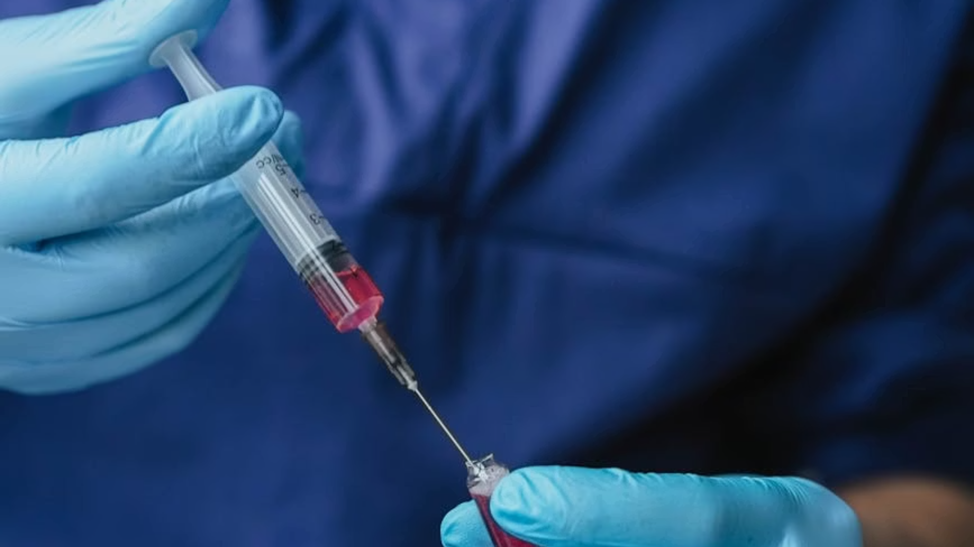
Medication Follow-Up
Phase 1
Phase 2
Phase 3
Monthly visits for 3 months
Every 3 months until 1 year
Maintenance TBD
If BMI continues to rise after 3 months → discontinue.
Check serum bicarb for topiramate/Qsymia in 3-6 months then yearly; reduce dose if <18 mEq/L.
Notes:
Follow up once a month for the first three months and then every three months after that for at least a year.
I don’t have a ton of kids on maintenance doses, but for those kids, I usually still follow up with them if you’re 3 to 6 months whether they stay on the medication or not.
If during those first three months their BMI continues to rise, you should stop the medication. Even if you are still on the titration of phase of a GLP one receptor agonist.
As far as a lab monitoring on these medication’s, you should consider checking a serum bibarb for kids on topiramate or Qsymia because of the risk of metabolic acidosis. You might also want to get a pregnancy test for these kids given the teratogenicity of topiramate.

Slide 33
Sleeve Gastrectomy: First line for Kids
~80% Stomach Removed
Decreases ghrelin, increases GLP-1
No Rerouting
Lower risk of dumping syndrome & vitamin deficiencies vs. Roux-en-Y
Upgradeable
Can be converted to more complex procedures later
Refer to OHSU Bariatric Surgery Program — families can learn without committing
Notes:
- The OHSU bariatric surgeons are doing sleeve gastrectomy on kids. They started operating on kids shortly before the pandemic and have had about 20 or so cases at this point. Sleeve gastrectomy involve removing about 80% of the stomach so it really limits the volume of food that they can take in but also has hormonal effects like decreasing grain and increasing GLP1.
Compared with Roux-en-Y gastric bypass, sleeve gastrectomy avoids intestinal rerouting, so it does not carry the same degree of risk for issues like dumping syndrome or malabsorption-related vitamin deficiencies. It is still a major surgery requiring lifelong nutritional monitoring, but it is often favored as an initial option in adolescents. Another advantage is that it can later be converted to a rerouting procedure if needed.

Slide 34
SURGERY COMPARISON
Bariatric Surgery Outcomes
Weight Loss
Comorbidity Resolution
Adolescents average 25–32% total body weight loss at 3–5 years
T2DM remission ~75–86% in adolescents (similar or superior to adults); HTN and dyslipidemia resolution rates also high
Long-Term Durability
Bone Health
7-year data shows sustained ~29% TWL in adolescents; some weight regain expected in both groups over time
Ongoing skeletal development increases risk of bone density loss; calcium + vitamin D critical
Notes:
Bariatric surgery can work very well in adolescents. Their weight-loss outcomes are at least comparable to adults, and for some comorbidities the outcomes may actually be better. In the Teen-LABS data, adolescents had substantial and durable weight loss. They also saw major improvements in obesity-related comorbidities, depression rates and quality of life. In longer-term gastric bypass data, remission rates for type 2 diabetes and hypertension were actually higher in adolescents than in adults.
Some degree of weight regain can happen over time, so long-term follow-up still matters. Our surgeons often recommend restarting obesity medications after surgery to help limit regain, although that is still an evolving area.

Slide 35

SURGERY COMPARISON
Bariatric Surgery Complications
Short-Term (<30 days)
Nutritional Deficiencies
GERD
Leak, bleeding, surgical site infection — rates similar to adults (~1–3%)
Iron, B12, folate, fat-soluble vitamins. Children at higher risk due to growth demands
More common after sleeve gastrectomy. May require conversion to Roux-en-Y bypass
Psychosocial
Reoperation
Depression, substance use, and eating disorders can emerge post-op.
~5–10% require revisional surgery within 5 years
Overall complication rates in adolescents are comparable to adults. Benefits generally outweigh risks in appropriately selected patients with severe obesity and comorbidities.
Notes:
The short-term risks are pretty similar in teens and adults — things like bleeding, infection, or other surgical complications.
Where we have to be especially careful in kids is nutrition, because they are still growing and can be more vulnerable to vitamin deficiencies. Like adults, they will need lifelong supplementation.
We also watch closely for psychosocial issues like depression, substance use, and eating disorders which which teens have a higher prevelence of anyway.
And because these patients have many years ahead of them, they will more often need revisional surgery later in life compared to adults.
Even with that, the overall safety profile in adolescents is similar to adults, and for teens with severe obesity and important comorbidities, the benefits generally outweigh the risks.

Slide 36
Questions?

Slide 37
Key Takeaways for Practice
1
Screen for obesity early, act promptly
2
IHBLT is your treatment backbone
3
Be explicit about the goals are expectations of treatment
4
Medications and surgery can beimportant tools, evenfor kids

