Slide 1
Buprenorphine
for chronic pain
Radu Moisa, MD
Madeline Boyd, MD
Notes:
Radu

Slide 2
Disclosures
We have no financial conflicts of interest.

Slide 3
Objectives:
Describe the pharmacologic properties of Buprenorphine as well as benefits and burdens associated with use.
Compare different formulations of Buprenorphine and their potential uses.
Explain different strategies to use Buprenorphine in primary care in patients with chronic pain.

Slide 4
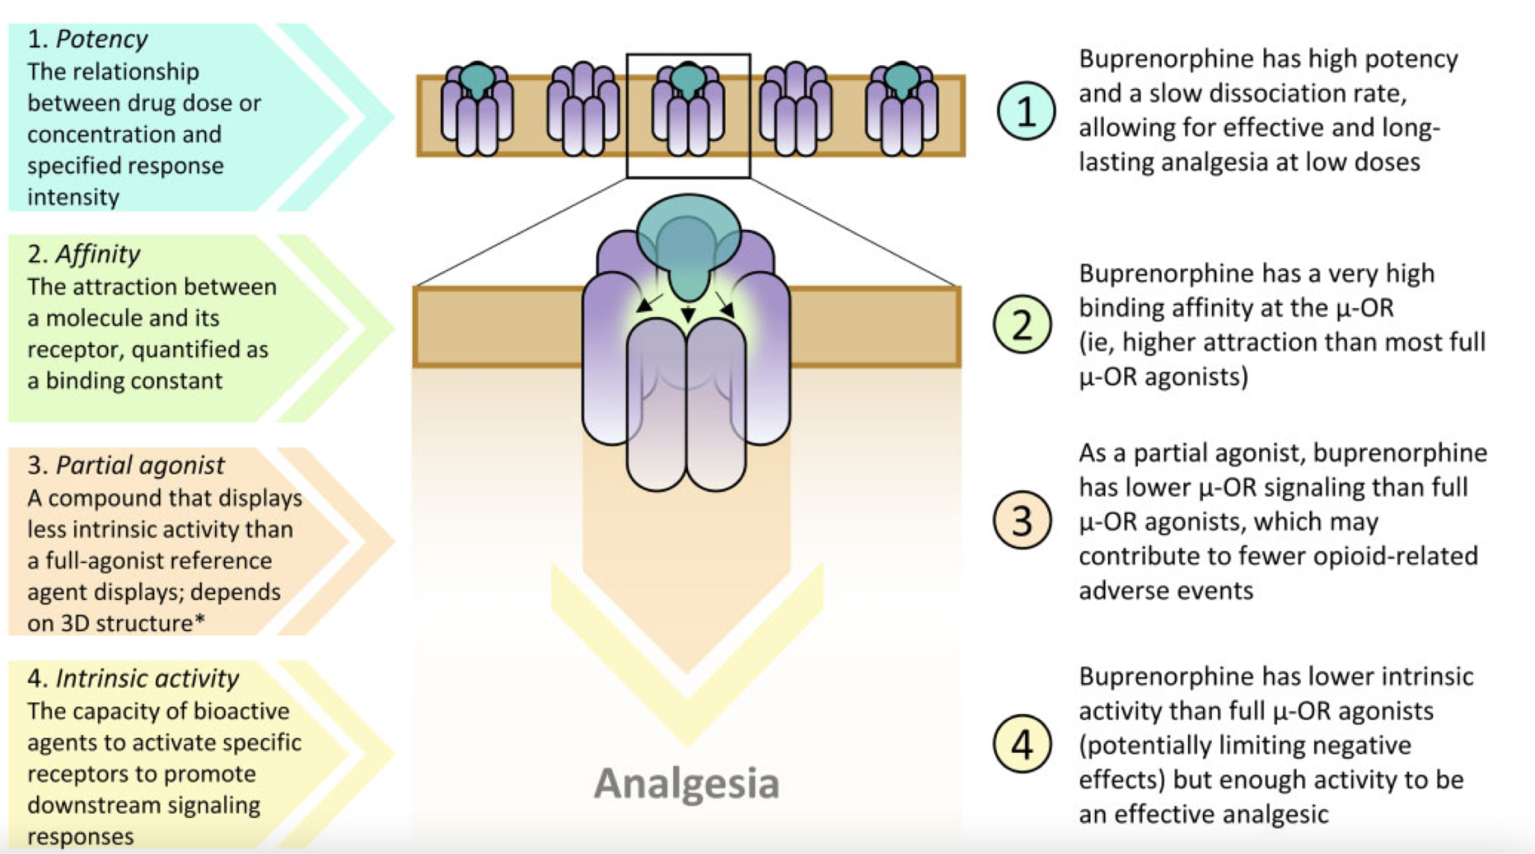
Webster L, Gudin J, Raffa RB, Kuchera J, Rauck R, Fudin J, Adler J, Mallick-Searle T. Understanding Buprenorphine for Use in Chronic Pain: Expert Opinion. Pain Med. 2020 Apr 1;21(4):714-723. doi: 10.1093/pm/pnz356. PMID: 31917418; PMCID: PMC7139205. https://pubmed.ncbi.nlm.nih.gov/31917418/
Notes:
Madeline

Slide 5
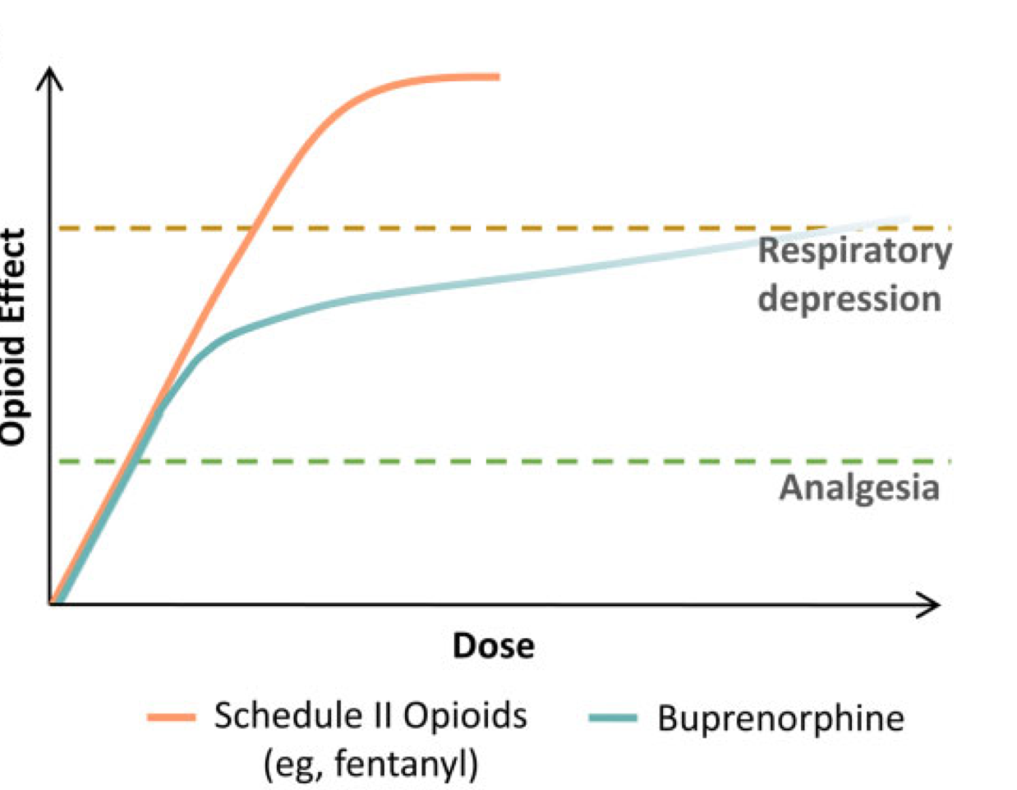
Notes:
Radu

Slide 6
Metabolism
Hepatically metabolized by CYP3A4 to norbuprenorphine
Decreased availability with inducers: Carbamazepine, phenytoin, rifampin.
Increased availability with inhibitors: fluvoxamine, ketoconazole, indinavir, saquinavir, erythromycin
Kumar R, Viswanath O, Saadabadi A. Buprenorphine. [Updated 2024 Jun 8]. In: StatPearls [Internet]. Treasure Island (FL): StatPearls Publishing; 2026 Jan-. Available from: https://www.ncbi.nlm.nih.gov/books/NBK459126/
Notes:
Madeline

Slide 7
Metabolism
Liver disease: Advanced disease - minimize starting dose and decrease titration dose by 50%.
Renal disease: No dose adjustment, including HD. Norbuprenorphine accumulates but does not cross BBB.
Kumar R, Viswanath O, Saadabadi A. Buprenorphine. [Updated 2024 Jun 8]. In: StatPearls [Internet]. Treasure Island (FL): StatPearls Publishing; 2026 Jan-. Available from: https://www.ncbi.nlm.nih.gov/books/NBK459126/
Notes:
Madeline

Slide 8
Adverse Effects
Anticholinergic-like
QT prolongation
Lowered seizure threshold
Hypotension
Constipation (BOWEL REGIMEN!)
Kumar R, Viswanath O, Saadabadi A. Buprenorphine. [Updated 2024 Jun 8]. In: StatPearls [Internet]. Treasure Island (FL): StatPearls Publishing; 2026 Jan-. Available from: https://www.ncbi.nlm.nih.gov/books/NBK459126/
Notes:
Madeline

Slide 9
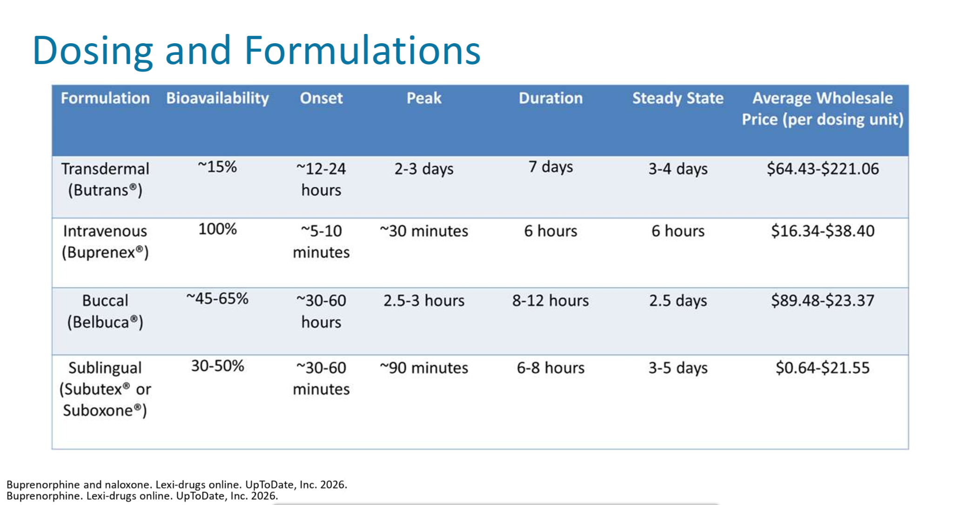
Notes:
Madeline

Slide 10
Receptor availability
With no buprenorphine, 100% of m-opioid receptors are available.
At 2 mg of buprenorphine, 59% of m-opioid receptors are available.
At 16 mg of buprenorphine, 20% of m-opioid receptors are available.
At 32 mg of buprenorphine, 16% of m-opioid receptors are available.

Slide 11
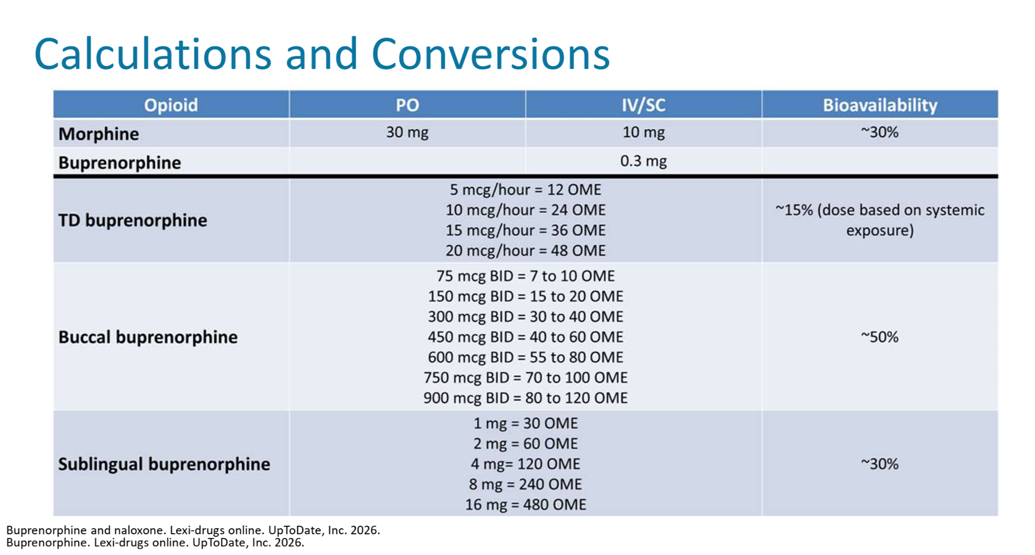
1mg

Slide 12
Q&A
When an opioid is considered for a patient with chronic pain, should buprenorphine be your first choice?

Slide 13
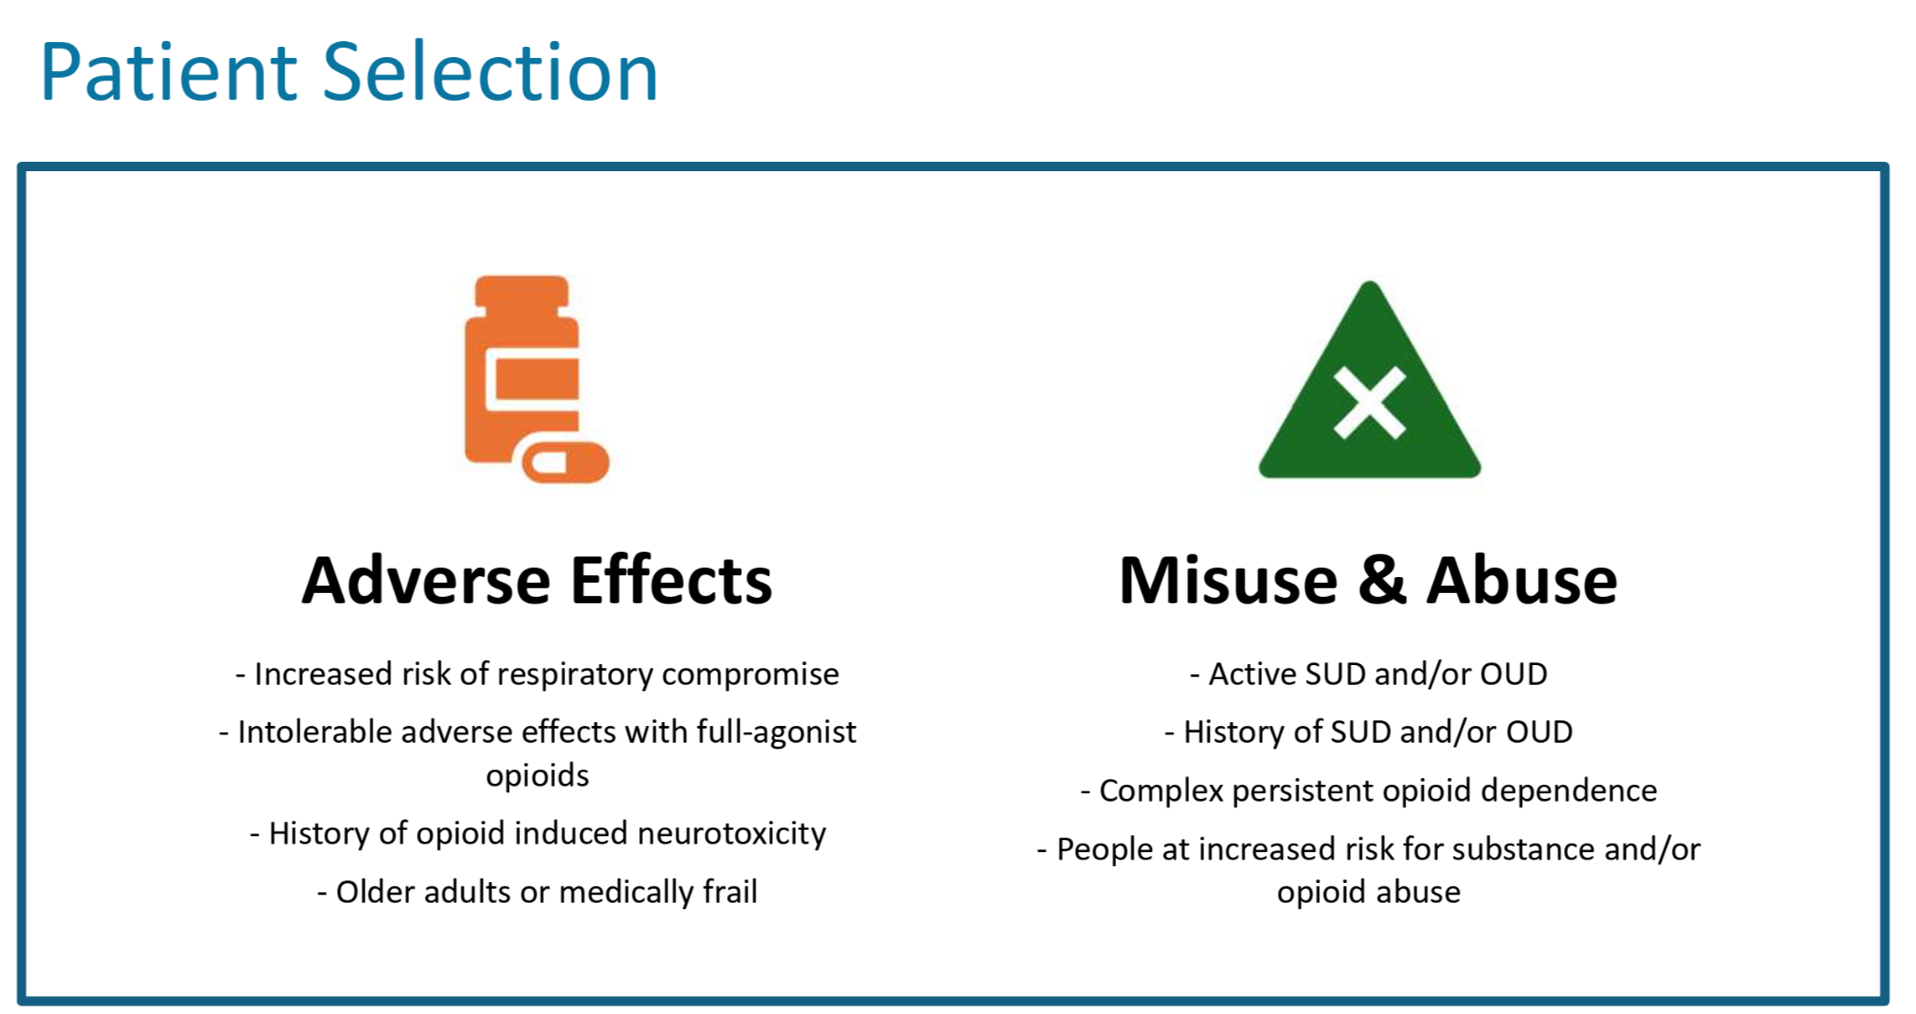
Notes:
Madeline
Lack of efficacy (including tolerance or hyperalgesia)
Previously mentioned reasons to initiate buprenorphine before a Schedule II opioid (e.g., risk of adverse events and OUD)
Concern from health care providers regarding prescription of a Schedule II opioid due to risk of addiction, misuse, and/or overdose death
The limited ability to utilize oral formulations in patients with altered gastrointestinal motility/function (e.g., after bariatric surgery)
A patient is receiving immediate-release treatment and would benefit from a longer-acting analgesic with a relatively favorable safety profile and Schedule III classification

Slide 14
How to start buprenorphine?
Why and how to start buprenorphine and/or convert from a full m-opioid receptor agonist to buprenorphine?
Four cases:
Opioid naive patient (Madeline)
Short acting stop/start (Radu)
Short acting cross titration (Radu)
Long acting full agonist continuation (Madeline)

Slide 15

Buprenorphine in opioid naive patients
Greta is an 83 year old woman with COPD, diabetic neuropathy, and chronic low back pain who wants to cook, enjoy time with her great grandchildren, and enjoy walks with her girlfriends.
Notes:
Madeline

Slide 16
Q&A
How does one start buprenorphine in a patient who is opioid naive?

Slide 17
Who is opioid naive?
For the purpose of this talk:
People not taking any opioids
OR
Anyone on oral morphine equivalents (OME) <30mg/day.
Notes:
This could be a patient who has never used an opioid or someone who uses Norco 5-325mg up to every 4 hours PRN.

Slide 18
Buprenorphine in opioid naive patients
Buprenorphine transdermal patch (Butrans) 5mcg/hr qWeek
Uptitrate weekly as needed (USA max 20mcg/hr)
OR
Buprenorphine sublingual film (Butrans) 75mcg 1-2x daily
Uptitrate every ~5 days by 150mcg/d
VA Pharmacy Benefits Management Services, National Formulary Committee, VHA National Office of Pain Management, Opioid Safety and PDMP (PMOP). Buprenorphine for the Management of Chronic Pain: National Guidance Document. March 2024. U.S. Department of Veterans Affairs. https://www.va.gov/formularyadvisor/DOC_PDF/CRE_Buprenorphine_for_Chronic_Pain_MAR_2024.pdf

Slide 19
Comparing starting doses
Common Starting Doses | Oral Morphine Equivalent (OME)
Fentanyl patch 12mcg/hr q3d | ~25mg/24hr
Norco 5-325mg q4hr prn | Up to 30mg/24hr
Oxycodone IR 5mg q4hr prn | Up to 45mg/24hr
Butrans patch 5mcg/hr q1wk | ~12mg/24hr
Belbuca sublingual film 75mcg BID | ~7-10mg/24hr
American Society of Health-System Pharmacists. Selected Equianalgesic Opioid Dosing. Bethesda, MD: American Society of Health-System Pharmacists; 2022. Accessed April 20 2026.

Slide 20
Where is Greta now?
Walking with her girlfriends. Feeling pretty good on Butrans patch 10mcg/hr weekly.
Guess what! Her breathing feels better too.
Thomas S, Jackson L; Transdermal Buprenorphine: A Safer Option for Dyspnea and Rhinorrhea in End-Stage Pulmonary Disease; Journal of Pain and Symptom Management, 67, e531-e532; https://www.jpsmjournal.com/article/S0885-3924(24)00388-9/fulltext
Blumenfeld-Kouchner F, Bullis L, Koch K. Transmucosal Buprenorphine in the Treatment of Dyspnea: Case Series and Review of the Literature. Palliat Med Rep. 2021 Jan 12;2(1):21-24. doi: 10.1089/pmr.2020.0091. PMID: 34223499; PMCID: PMC8241374. https://pmc.ncbi.nlm.nih.gov/articles/PMC8241374/
Notes:
This could be a patient who has never used an opioid or someone who uses Norco 5-325mg up to every 4 hours PRN.

Slide 21
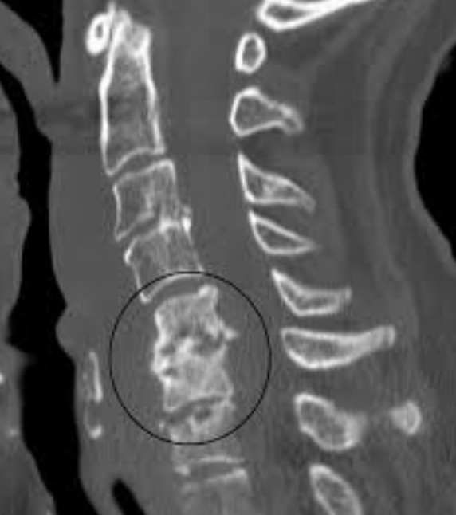
Buprenorphine in chronic opioid use Stop/Start
73 year old woman with a history of cervical spine osteomyelitis resulting in chronic pain

Slide 22
Q&A
Why should I offer Bup to my patient on chronic opioids?
Can you start Bup without stopping other opioids?
Do you have to be sick (withdrawal) before you start?
What is the dose of Buprenorphine that we aim for?
How Should Patients Be Converted from a Full m-Opioid Receptor Agonist to Buprenorphine?

Slide 23
Converting from full agonist to buprenorphine
1. Have a thorough visit with your patient.
2. Discontinue after the last nighttime dose.
3. Consider initiating an adrenergic a2 agonist (e.g., clonidine) or an immediate-release opioid (e.g., current opioid) to reduce the risk of withdrawal.
4. Initiate buprenorphine the following morning per the prescribing information.
5. Titrate gradually to achieve functional goals.

Slide 24
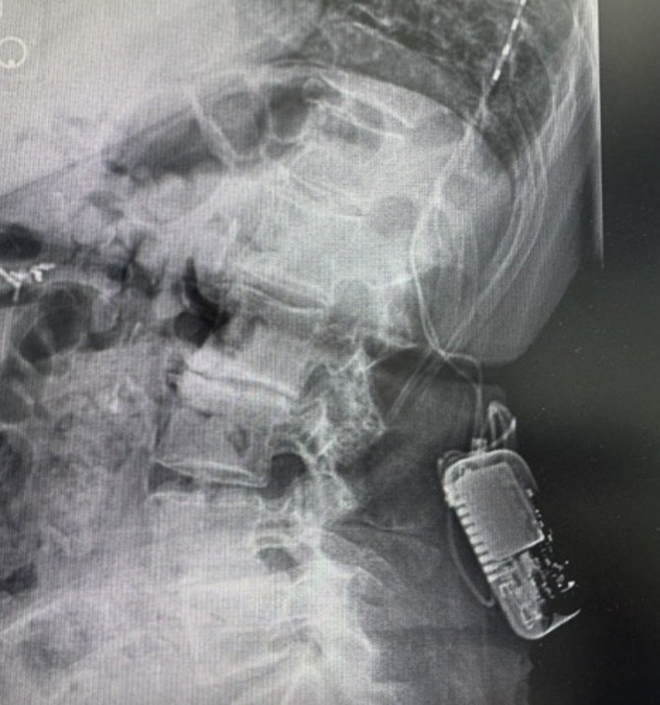
Buprenorphine in chronic opioid use cross titration
76 years old on opioids for chronic back pain. She has been on chronic opioids for the last 25 years.

Slide 25
Q&A
Why should I offer cross titration to my patient on chronic opioids?
What is microdosing?
How long to do microdosing?
Risk of microdosing? Side effects?
Should I worry about causing withdrawal in my patients with microdosing?
At what dose should I start tapering the direct agonist?

Slide 26
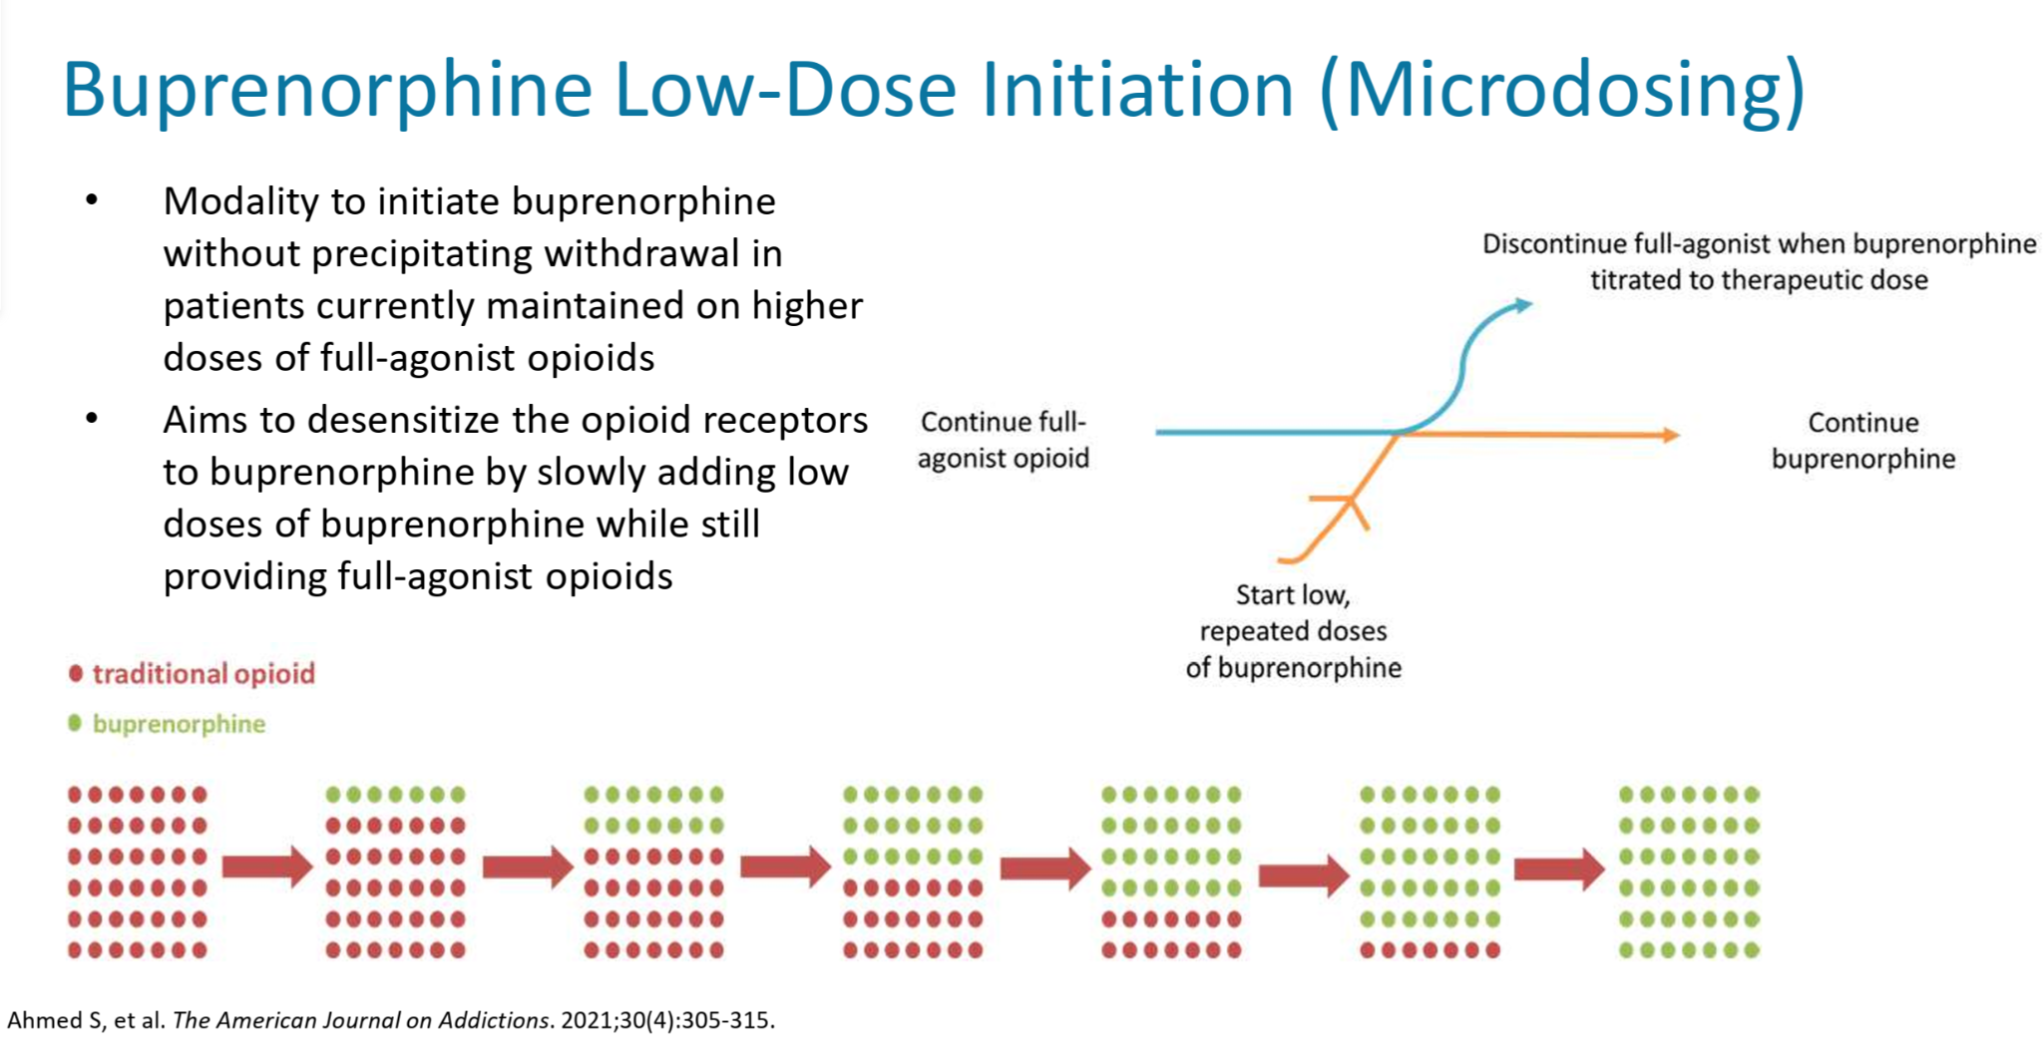
Buprenorphine Cross Titration
Modality to initiate buprenorphine without precipitating withdrawal in patients currently maintained on higher doses of full agonist opioids.
Aims to desensitize the opioid receptors by slowly adding low doses of buprenorphine while slowly removing full-agonist opioids

Slide 27

Buprenorphine initiation with long acting full agonist continuation
Donna is an 83 year old woman with complex chronic pain from an old hang-gliding injury. Current opioid regimen: morphine ER 100mg BID + morphine IR 45mg/day. Worsening renal function, progressive frailty, and hyperalgesia.

Slide 28
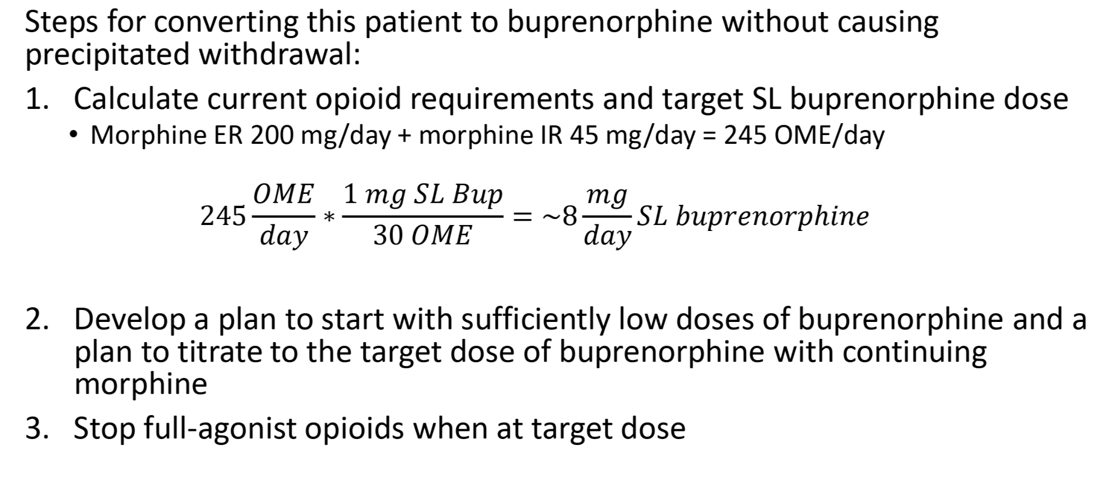
Buprenorphine initiation with long acting full agonist continuation

Slide 29
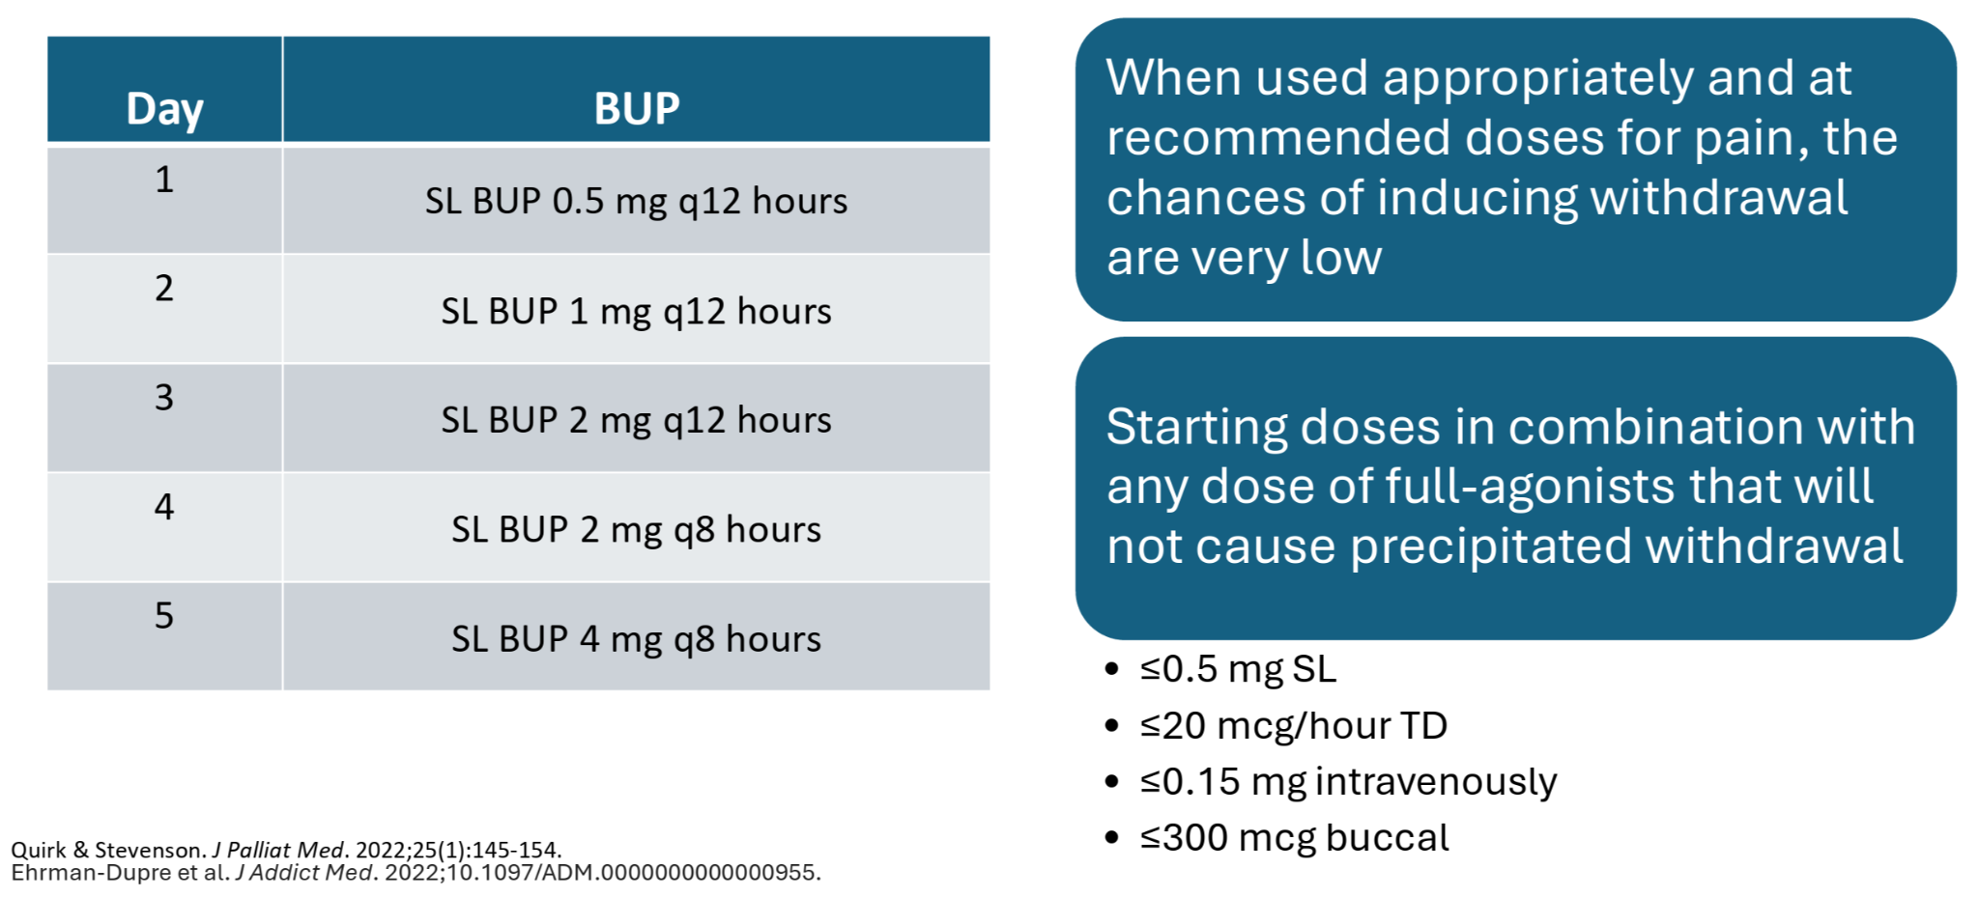
Buprenorphine initiation with long acting full agonist continuation

Slide 30
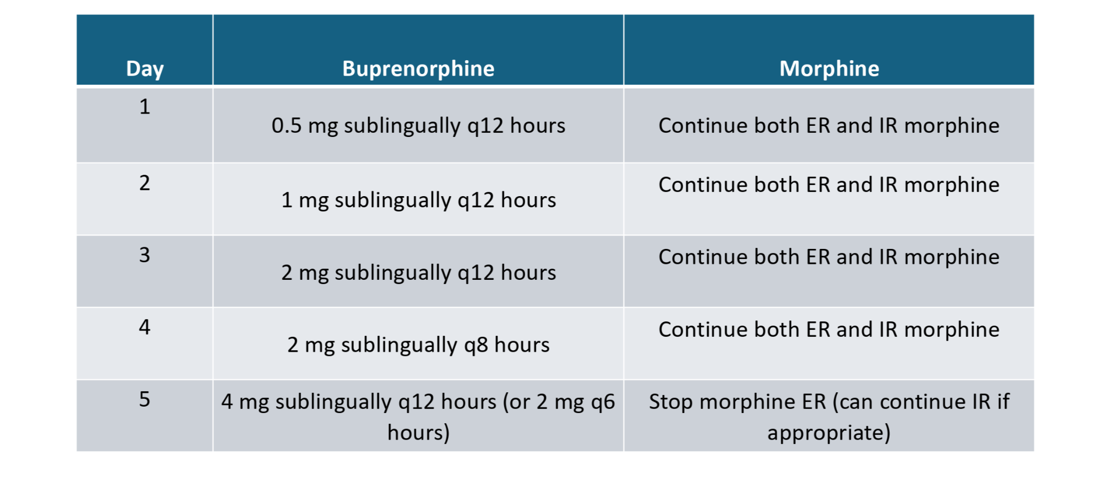
Buprenorphine initiation with long acting full agonist continuation

Slide 31
Q&A
How should patients receiving buprenorphine be managed during the perioperative/trauma period?

Slide 32
Acute pain management for patients on buprenorphine
Step 1: Continue buprenorphine at home dose.
Step 2: Consider dividing home dose into q8hr or q6hr dosing to maximize analgesia.
Step 3: Treat acute pain!
Buresh M, Ratner J, Zgierska A, Gordin V, Alvanzo A. Treating Perioperative and Acute Pain in Patients on Buprenorphine: Narrative Literature Review and Practice Recommendations. J Gen Intern Med. 2020 Dec;35(12):3635-3643. doi: 10.1007/s11606-020-06115-3. Epub 2020 Aug 21. PMID: 32827109; PMCID: PMC7728902.

Slide 33
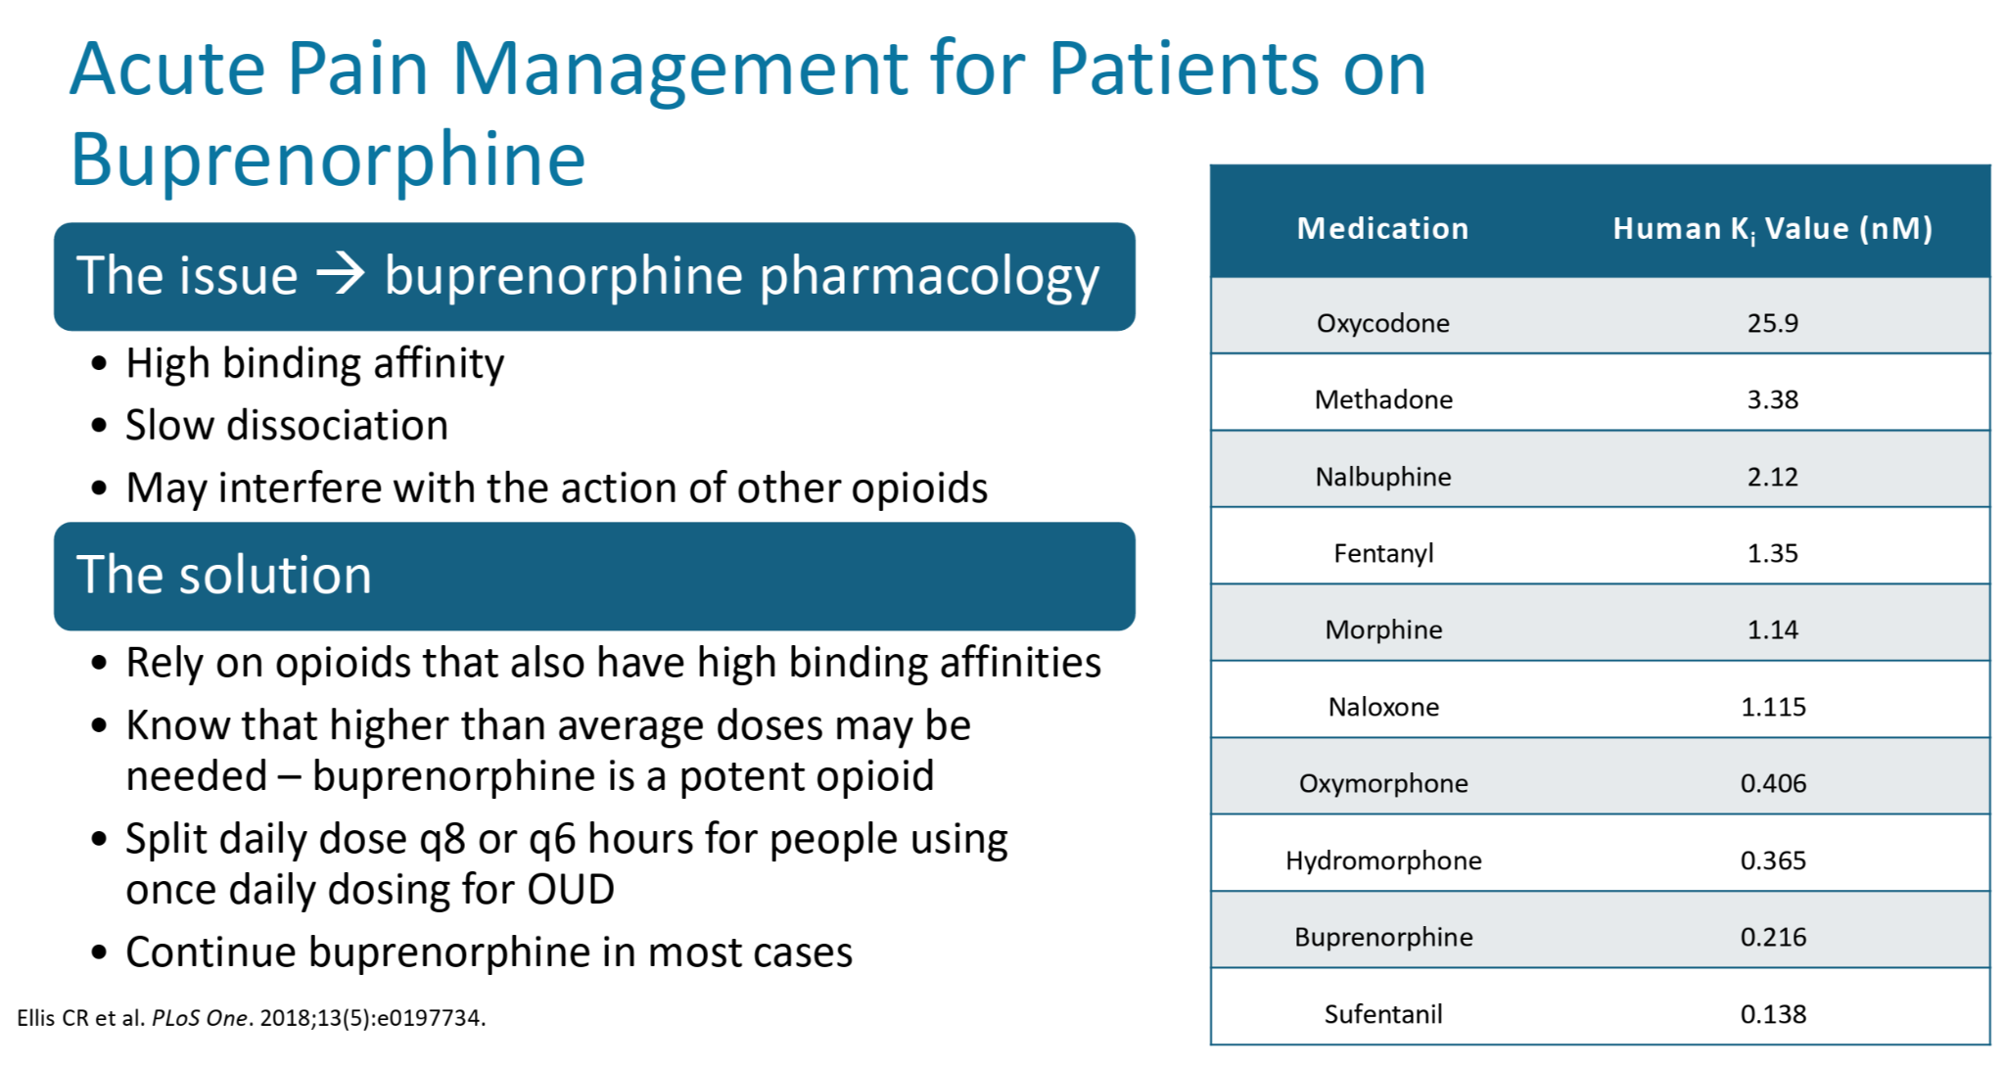

Slide 34
Discussion!
Buprenorphine for chronic pain?
Titration?
Guidelines?
Barriers?

Slide 35
Thank you!
moisar@ohsu.edu
madeline.boyd@skylakes.org

