Slide 1
BP at a glance

Slide 2
Disclosure
I have no actual or potential conflict of
interest in relation to this
program/presentation.

Slide 3
CURRENT ACA/AHA GUIDELINES
BP Classification:
Normal: <120/80 mm Hg
Elevated: 120–129/<80 mm Hg
Stage 1 hypertension: 130–139/80–89 mm Hg
Stage 2 hypertension: ≥140/90 mm Hg
Treatment Thresholds and Goals:
The overarching BP treatment goal is <130/80 mm Hg for all adults, with individualized considerations for those with limited life expectancy, institutional care, or pregnancy.
Initiate antihypertensive medication for all adults with BP ≥140/90 mm Hg, and for those with BP ≥130/80 mm Hg who have clinical CVD, prior stroke, diabetes, CKD, or a 10-year CVD risk ≥7.5% (new PREVENT* calculator)
For adults with BP ≥130/80 mm Hg and lower CVD risk), start medication if BP remains elevated after 3–6 months of lifestyle modification.
Notes:
Prevent 6M pts over 30 years. Vs 26K over 20 years. Incorporates GFR, A1C, and microalbumin. Uses zip codes as part of social deprivation calculus

Slide 4
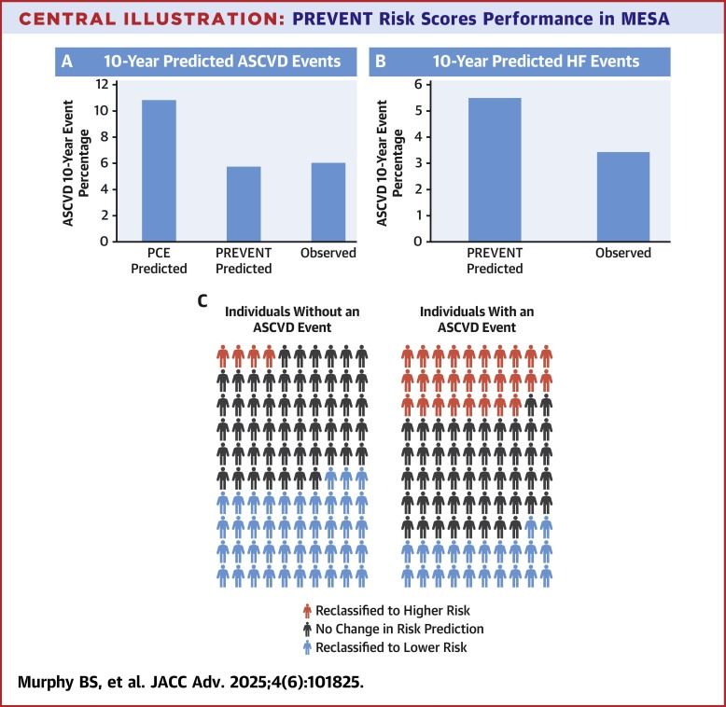
What is the new PREVENT calculator?
This is the new calculator that was rolled out by AHA in 2023
More accurate predictive model which is race free, incorporates GFR, and has an expanded age range (30-79) and can also be used to prevent ASCVD + Heart Failure
Available on the AHA.org website
Notes:
BMI limits may underestimate risk if > 40 and overestimate risk in lean muscular pts.

Slide 5
How did we get these guidelines
ACCORD trial –2009*
4700 pts with diabetes. Stroke was not an exclusionary factor
NO RRR in primary endpoints w lower BP but we did get a 41% RRR in more strokes
SPRINT trial -- 2016
9000 pts > 50 yo. no DM. no prior stroke
Pushing to 120 is better than 140 w 25% RRR for primary endpoints (MI, ACS, stroke, heart failure, or CV death)
STEP trial (not to be confused w the STEP semaglutide trial) --2020
8500 Chinese pts. 60-80 yo. 18% DM. No prior stroke
Pushing 120 over 140 shows a 26% RRR in primary endpoints (stroke, ACS, heart failure, revascularization, atrial fibrillation, or CV death)
BPROAD – 2025
12k Chinese pt > 50 with DM (RCT)
~21% RRR in primary cardiac endpoints in DM pts (AMI, stroke, HF, SCD) w intensive control
All studies did show RRI in AKI, hypotension, falls, and electrolyte abnormalities in the intensive control group. Be mindful of frail pts who are high risk for bad outcomes for falls! Use your clinical judgement

Slide 6
Initial workup
CBC
CMP
Lipids
A1C
TSH
UA
Microalbumin → this is new
Aldosterone/Renin* was considered, is on the EU guidelines, but did not make it into this most recent round of guidelines

Slide 7
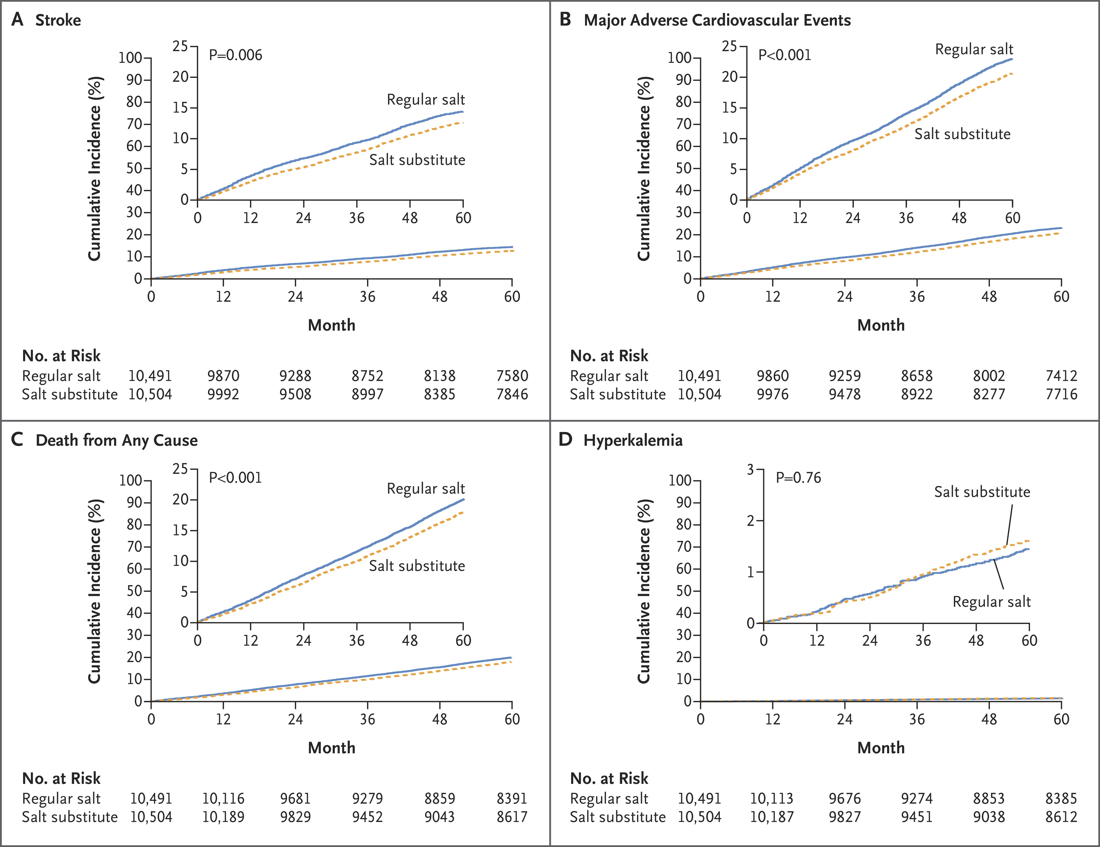
Lifestyle Recommendations
Strongly recommended for all adults: weight management, heart-healthy diet (e.g., DASH), sodium reduction (average intake is 3.5g/day), increased potassium - unless contraindicated
Regular physical activity, stress management, and NO alcohol (US vs EU/CAN guidelines).
ACC/AHA want 150 mins of aerobic exercise a week
AND 2 sessions of resistance training a week
Salt reduction and increased K intake(SSaSS study)
14% relative reduction in stroke risk
13% reduction in major cardiovascular events
12% reduction in all-cause mortality
Notes:
SSaSS – 600 villages in rural China. 5 year follow up. 27k pts

Slide 8
WHERE TO START
For stage 2 hypertension, initiate two first-line agents from different classes, preferably as a single-pill combination
First line: ACE/ARB, Thiazide, CCB
Accomplish trial (2008) shows that benazepril amlodipine is superior to benazepril HCTZ (20% RRR for end point CVD, 48% less ckd progression) – even at similar BPs
Single Pill Combo meds are better!
START study 2023 shows significant RRR in hospitalization and all cause mortality and better compliance over individual pills (retrospective study of 58k pts)
Another 2021 meta-analysis shows SPC (-4 SBP/ -1.5 DBP) over equivalent individual pills with better compliance
Olme/Valsartan+amlo+HCTZ are commercially available
Second line: BB (not as great – but useful for other issues), MRA
Don’t forget about Guanfacine*/Clonidine for ADHD + HTN
GLP1s (STEP/SELECT for semaglutide. SURMOUNT for tirzepatide) all show BP reductions in line with weight loss
Notes:
Discuss diminishing returns on single agents. 80% effect at 50% dose. Combos give more BP reductions w less side effects. Guanfacine has less sedation, once daily dosing, and less rebound risk than clinidine

Slide 9
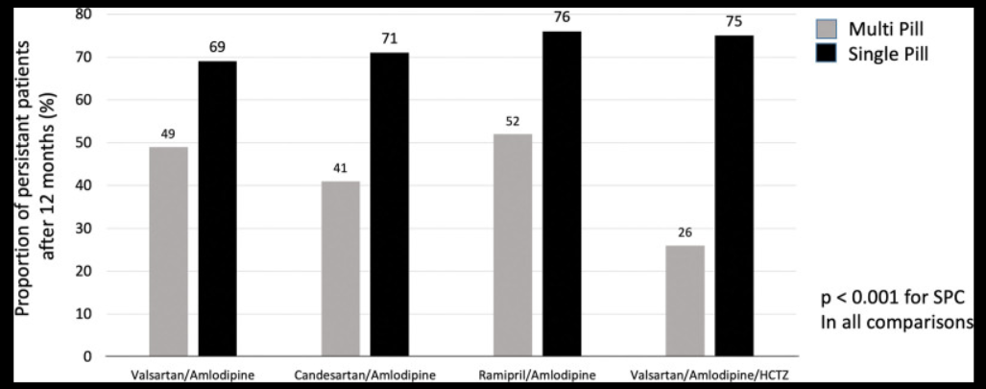
START study -2023

Slide 10
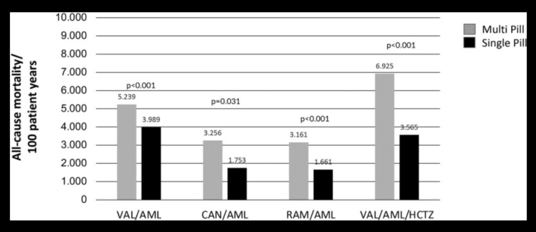
START study - 2023

Slide 11
ACE/ARBS
ACE inhibitors or ARBs are recommended for patients with diabetes and CKD
Special notes:
Normal to see up to a 30% drop in GFR due to efferent arteriole dilation reducing filtration pressure
If > 30% start thinking about RAS
Telmisartan has a unique metabolic benefit due to its PPAR-Gamma (partial) effects and can be helpful with metabolic syndrome pts (lowers A1C!) as it has been shown in improve insulin sensitivity. Due to its partial PPAR-Gamma effects, you avoid the side effects of pioglitazones
Losartan has a unique effect on increased uric acid excretion and can reduce the risk of gout flares but its half life is not great and often can need bid dosing.
Most of us are using ARBS over ace, but in HFrEF ACEI have been shown to be superior due to ACEIs effects on bradykinin which has more vasodilatory effect, although Entresto has been shown to be even better than ACE (ARNI > ACE > ARB). If swapping from ACE to Entresto – will need 36 hour wash out
The efferent vasodilatory effects of ACE/ARBS can be more effective than thiazides at counteracting the edema from CCBs (as CCBs dilate the afferent vessels – thus this combo can balance out capillary hydrostatic pressure)

Slide 12
MRAs
Good to try as the fourth agent -- has better CVD risk reduction as compared to Hydralazine, Clonidine, or Alpha blockers
Reminder that spironolactone has significant anti-androgenic effects and cause gynecomastia/breast tenderness/sexual dysfunction
Eplerenone does NOT do this – so in men who develop gynecomastia, eplerenone is a good option but it is expensive and weaker and twice a day
~ 20% of resistant HTN pts are hyperaldo, and this class addresses that pathology very well
These DO need to be held to test for hyperaldosteronism if you decide you want to test for that later (hold for at least 4 weeks)

Slide 13
Home BP cuffs
ValidateBP.org is good reference site to direct pts to shop for a cuff
Wrist cuffs can be useful but make sure they’re using it correctly (elbow on the table, 2 fingers on the opposite clavicle)
The watch devices are not quite ready! (sensitivity for apple watch ~ 41%, Google is 46%)
Remember for home BPs:
No exercise within 30 mins
Empty bladder
No talking or texting during the reading
feet on the floor, arm at heart height, back supported
Best to take average of 2-3 readings at least 1 min apart
Check twice a day morning and evening

Slide 14
What about White Coat Syndrome
Less likely to be WCS > 160/100
If you suspect WCS w no evidence of end organ damage, ok to do ambulatory BP monitoring
WCS pts are more likely to develop real HTN over long term follow up, so these pts do need regular check in’s
ACC/AHA state that WCS leads to zero to slightly ~30% RRI ascvd risk – more risk in higher baseline risk pts and in untreated WCS (use the home readings if you have a trustworthy cuff and good technique)
Notes:
2022 metaanalysis by the AHA looking at WCS seems to indicate a roughly 30% RRI for WCS 100%+ for chronic htn

Slide 15
What about Masked HTN
Inverse of WCS, pts BP is good in office, but worse at home
Usually in older pts who have autonomic dysfunction (supine BP is higher than upright), CKD, and OSA pts
24H BP monitoring is best at catching this (bc you get night time BPs)
HBPM can catch this too – home BP are consistently above office BP
Long half life meds are thought to be better (but evidence is still lacking)
Telmi (24), Olme (15), Losartan 6-9 hours (metabolites), Valsartan (7)
Chlorhtalidone (60) – more hypoK, HCTZ (10-12) –> DCP trial*
Notes:
13k pt over mean f/u 2.4 years shows no difference in CV endpoints. More hypoK w chlorthalidone. However DCP used lower doses, shorter duration f/u and does not reflect real world clinical practice where longer half lives and inconsistent dosing may still favor chlorthalidone.

Slide 16
What about secondary HTN
Who to screen?
Strongly consider it on anyone < 40
Resistant HTN (blood pressure > goal despite treatment w three antihypertensive medications of complementary mechanisms, including a diuretic at maximally tolerated doses, or blood pressure at goal but requiring four or more medications)
Sudden new or worsening HTN
What do we look for?
Hyperaldo state – 20+% of resistant HTN – do not just rely on K (only 30% are low)
Bruits, > 30% drop in GFR s/p ACE/ARB (RAS)
OSA – STOP BANG
substances (NSAIDS, ADHD meds, UDS, ETOH, smoking, tizanidine – chronic tizanidine withdrawal acts like clonidine withdrawal)
Hyperthyroidism
Pheochromocytoma (sure why not)
Subclinical Cushings (10% of pts w an adrenal incidentaloma have this)

Slide 17
Hyperaldosteronism
20% of resistant HTN pts
K is only low in 30% of pts. And we often use medications that will affect K
Check an aldo and renin. Ratio > 30 is suggestive
K must be normalish (ideally close to 4)!
No salt restrictions prior to testing
Measure in the AM
Can also check a renin activity level (should be low in the presence of elevated aldosterone)

Slide 18
Hyperaldosteronism
The most current recommendations for workup from 2025 American College of Cardiology/American Heart Association (ACC/AHA) guidelines and the 2025 Endocrine Society Clinical Practice Guideline.
Ideally, mineralocorticoid receptor antagonists (MRAs) should be withdrawn for 4 weeks before testing, and ACE inhibitors/ARBs for 2 weeks if safe and feasible
Patients should have normal serum potassium and unrestricted salt intake before testing.
If medication withdrawal is not safe, the 2025 guidelines acknowledge that screening can sometimes be interpreted despite interfering medications.
If you have high index of suspicion:
1. Withdraw interfering medications for appropriate durations: beta-blocker and ARB for 2 weeks, diuretics (including triamterene) for 4 weeks 2. Substitute with non-interfering agents during this period: non-dihydropyridine calcium channel blockers (verapamil), alpha-blockers (doxazosin, prazosin), or vasodilators (hydralazine)
3. Ensure normal potassium before repeat testing, as hypokalemia can falsely lower aldosterone 4. Repeat ARR after medication adjustment
Notes:
But again, lets be pragmatic. ACE and ARB should suppress aldosterone. Low K should suppress Aldosterone. Less than 1% of cases tested in academic medical centers vs 20% incidence. So just start by checking and you’ll be doing your patients a favor.

Slide 19
Whats coming next?
Aldosterone Synthase inhibitors (no hormonal effects, less hyperK) – 11 SBP reduction
Hepatic Angiotensinogen Inhibitor - Zilebesiran (Q6 mo injections)
Lowers bp by about 10SBP/5DBP x 6 months
Needs an antidote
Renal Denervation (catheter ablation for renal sympathetic nerves – up to 10 years of effect!)
Modest effects ~ 3-4 SBP
Notes:
ASIs were interfering with cortisol synthase – but not the case now. Bextrostat and Lorundrostat

Slide 20
Take home points
Start shifting that Overton window from 130/90 to 120/80
Start with low doses of multiple agents as first line (SCP are great for this)
Don’t forget about hyperaldosteronism
Practice changes
Check a microalbumin on diagnosis
Use the PREVENT calculator instead of the PCEs

Slide 21
THANK YOU

