Slide 1


Top 10 Primary Care Articles of 2025
Esteban Garza, MD
Andrew Janssen, MD, FAAFP

Slide 2
Disclosures
We have no financial interests.
We are grateful for the OAFP support of this effort.

Slide 3

Introductions
Andrew Janssen, MD
Trained in Alaska,
Practiced in John Day, Ethiopia, and now Hillsboro
Family medicine, clinic, inpatient, OB, and rural ER
Passionate about full spectrum FM and rural care
Esteban Garza, MD
Grew up in Yakima, WA
Trained and practiced at OHSU, now in Newport
Family medicine, clinic and inpatient
Passionate about Latino health, working with underserved communities, resident education

Slide 4
What are we going to talk about?
HTN – New evidence, new/old options.
Dyslipidemia – New guidelines
Social media
Pre-eclampsia
Vaccinations and dementia
Impact of USAID defunding
Management of Complicated UTIs
Colon cancer screening
Prediabetes and cardiovascular morbidity
Post-partum depression intervention

Slide 5
Reflections: Top 10 Articles of 2024
Effectiveness of GLP-1 Receptor Agonists
Global Strategy for Asthma Management and Prevention 2025
Global Burden of Antimicrobial Resistance
Twice-yearly Lenacapavir for HIV Prevention
Cardiovascular Disease in Transgender People: A Systematic Review and Meta-analysis
Low-Dose Triple-Pill vs Standard-Care Protocols for Hypertension Treatment in Nigeria A Randomized Clinical Trial
Metabolic-Dysfunction-Associated Steatotic Liver Disease (MASLD
Association between maternal diabetes and neurodevelopmental outcomes in children: a systematic review and meta-analysis
A Systematic Review and Meta-analysis of Prenatal, Birth, and Postnatal Factors Associated with Attention-Deficit/Hyperactivity Disorder in Children
Roles of Income and Acculturation in the Hispanic Paradox: Breastfeeding Among Hispanic Women
Comparing Physician and AI Chatbot Responses to Patient Questions Posted to a Public Social Media Forum

Slide 6
Methodology
Watching for relevant articles throughout the year.
Searching NEJM, JAMA, BMJ, and the Lancet for large, impactful studies.
Attempted AI search for primary care articles by citation.
Scopus search
Personal interest

Slide 7
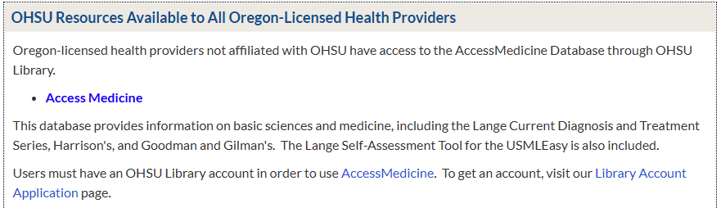
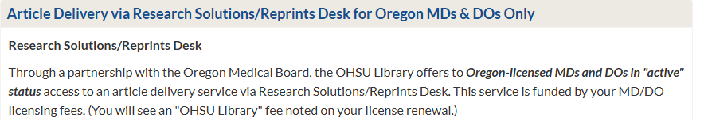
Library Resources Available to non-OHSU Practitioners
Home - Resources for Oregon-Licensed Health Providers - LibGuides at Oregon Health & Science University

Slide 8
BP-lowering Efficacy of Antihypertensives and Combos
Title | Blood pressure-lowering efficacy of antihypertensive drugs and their combinations: a systematic review and meta-analysis of randomized, double-blind, placebo-controlled trials
Source | Nelson Wang et al, Lancet 2025; 406: 915–25
Purpose | We aimed to quantify the blood pressure-lowering efficacy of antihypertensive drugs and their combinations from the five major drug classes.
Study Design | Systematic review and meta-analysis of randomized, double-blind, placebo-controlled trials involving adult participants

Slide 9
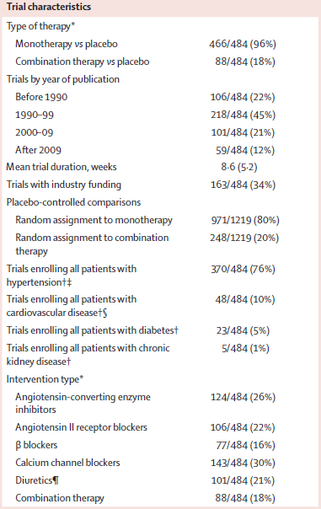
Study Design
A wide variety of RCTs. 104,176 patients.
Data Analysis
Reduction in clinic SBP with active treatment vs placebo.
Secondary outcome was DBP reduction.
Primary focus on ACEI, ARBs, beta-blockers, CCBs and thiazide or thiazide-like diuretics.
Supplemental analysis of mineralocorticoid receptor antagonists or other diuretics.
Standardized all treatment effects to baseline 154/100 mmHg using drug-class-specific fixed-effects meta-regression models with inverse variance weighting

Slide 10
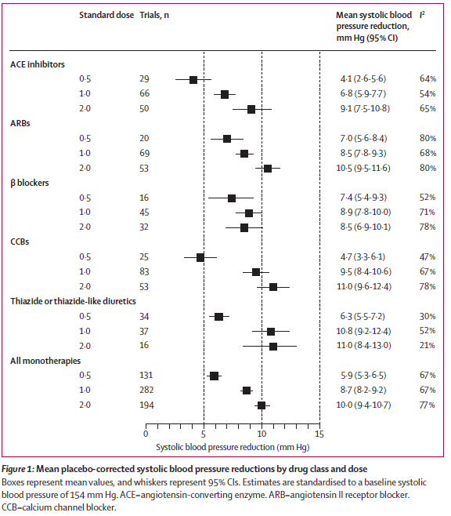
Mean placebo-corrected systolic blood pressure reductions by drug class and dose.
Doubling the dose from 1.0 standard dose to 2.0 yields small increase in effectiveness.

Slide 11
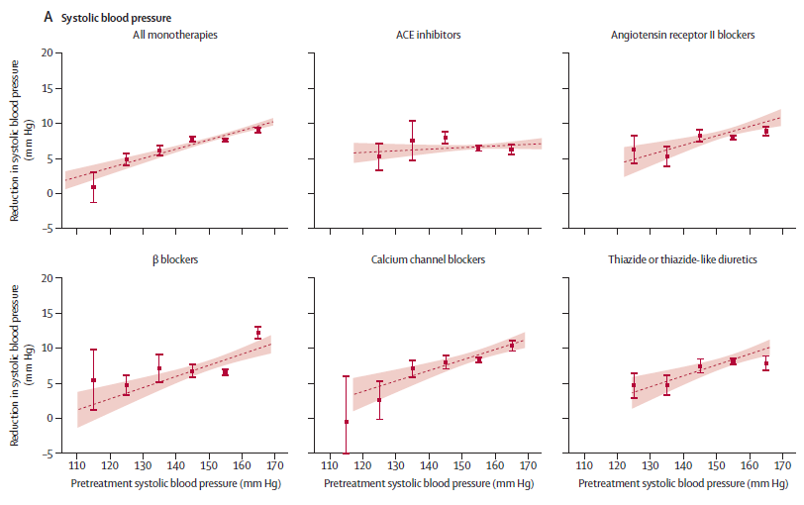
Associations between pretreatment BP and reductions in systolic BP – Dose Response
Certain agents demonstrate increase effectiveness at higher baseline SBP.
ACEI barely change effectiveness as SBP increases.

Slide 12
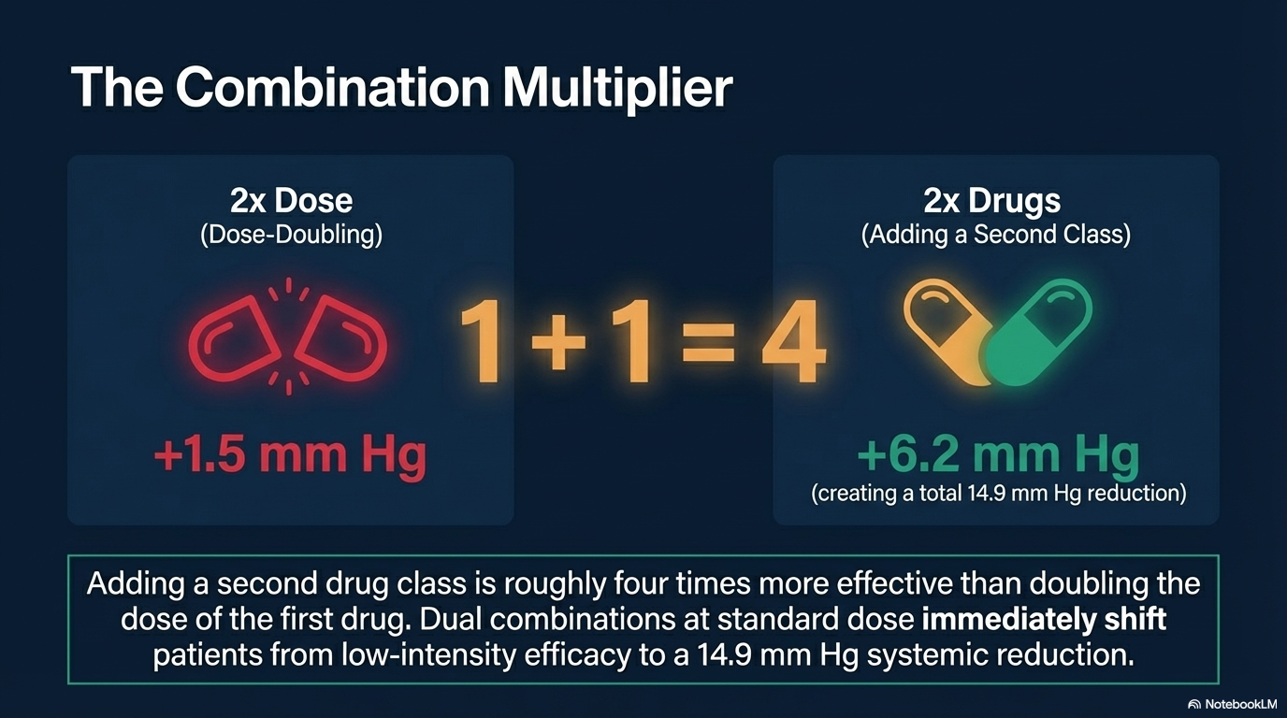

Slide 13
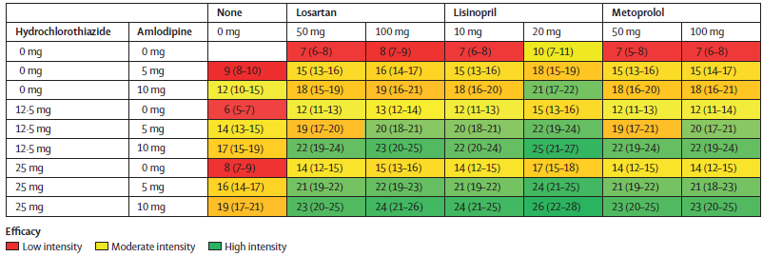
Predicted Reductions in Systolic BP for baseline SBP 154 mmHg
Which combos are most effective?

Slide 14
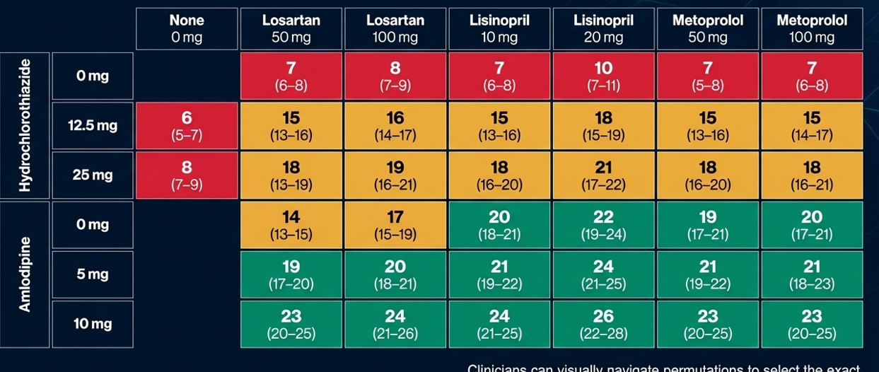
Be Careful – NotebookLM Error
Attempting to recreate the previous table NotebookLM changed it from a 3-drug combo table to a 2-drug combo table.

Slide 15
Discussion
Robust expected BP reductions from 484 double-blind placebo controlled RCTs.
Consider high-level treatment regimen categorization
Low < 10 mmHg
Mod 10-19 mmHg
High >= 20mmHg
Current guidelines do not specifically refer to expected efficacy.
Widely held perception that reliable BP measurements are sufficient to assess individual response.
However, intra-individual BP variability far exceeds inter-individual differences in treatment response.
There are thousands of combinations making data difficult to get.

Slide 16
My Conclusions
Does my patient have HTN? How high?
Any medical conditions that warrant a particular class of med? (DM, CKD, a.fib, HF, etc…)
Allergies? Contraindications? (asthma, renal artery stenosis, etc…)
Do they need low, moderate or high BP control?
Low – consider single agent at normal dose but do not titrate.
Mod – consider combo dual or triple agent
High – start combo triple agent Olmesartan 20 or 40 / amlodipine 5 or 10 / HCTZ 12.5 or 25 Valsartan 160 or 320 / amlodipine 5 or 10 / HCTZ 12.5 or 25
Why would I start ACEI rather than ARB?
Cough, angioedema, flat response curve
Why would I start losartan when longer half-life ARBs are available?
Notes:
Andrew responsible for us ordering Olmesartan

Slide 17





Predictive Model – www.bpmodel.org

Slide 18
BREAK

Slide 19
Single-Pill Combination Therapy for Management of HTN
Title | Single-Pill Combination Therapy for the Management of Hypertension: A Scientific Statement From the American Heart Association
Source | Jordan King, et al. Hypertension. 2025;82:e00–e00. DOI: 10.1161/HYP.0000000000000258
Purpose | This scientific statement provides an overview of the clinical evidence surrounding the use of single-pill combination medications for hypertension, strategies to implement single-pill combination medications into clinical practice, and knowledge gaps that merit further investigation.

Slide 20
Guidelines
Single-pill combination medications (SPCMs) = combo pills
Adding a second antihypertensive with complementary mechanism of action results in around 5 times larger BP reduction compared to doubling the dose of one drug.
Combo therapy yields more uniform BP control across populations irrespective of age, sex, race, obesity.
Medication side effects are less using lower-dose combinations.
2-drug combos should be started if BP >= 20 systolic or 10 >= diastolic goals.
Current evidence supports RAS inhibitor (ACEI/ARB) with CCB or diuretic.

Slide 21
Benefits of SPCMs vs Free-equivalent Meds
Improved adherence and persistence
Meaningful improvement in BP control
15-30% lower incidence of major adverse CV events
Appear to be cost-effective
Barriers
Insurance coverage
SDOH
Manufacturing, regulatory approval, availability
Prescriber knowledge and practices

Slide 22
Available Generic Options
HCTZ with
Lisinopril or benazepril or enalapril
HCTZ with
Losartan or Olmesartan or Valsartan or Telmisartan or Irbesartan or Candesartan
Amlodipine with
Losartan or Olmesartan or Valsartan or Irbesartan or Telmisartan or Candesartan
HCTZ / amlodipine / Olmesartan
HCTZ / amlodipine / Valsartan
ARB Half-life
Losartan 1.5-2.5 hrs
Olmesartan 13 hrs
Valsartan 6 hrs
Telmisartan 24 hrs
Candesartan 5-9 hrs
Irbesartan 11-15 hrs

Slide 23
BREAK

Slide 24
UTIs…But Make it Complicated
Title | 2025 Guideline on Management and Treatment of Complicated Urinary Tract Infections
Source | Clinical Practice Guideline by the Infectious Diseases Society of America (IDSA) (2025)
Purpose: | Need to expand the scope of prior UTI guidelines
Study Design | Systematic review and meta-analysis utilizing the GRADE (Grading of Recommendations Assessment, Development and Evaluation) framework to assess evidence certainty and recommendation strength
Notes:
Pregnant women no addressed in thes guidelines

Slide 25
Purpose & Background
Massive Clinical Burden:
404 million global cases
approximately 236,790 deaths in 2021
Need for an Update: omitted men and complicated UTI
Rising Resistance: Resistance rates for Enterobacterales in ambulatory settings now exceed 20% for FQs, TMP-SMX, and nitrofurantoin, (2010 empiric recommendations obsolete).
Leading Source of Sepsis: UTI was the leading cause of gram-negative bacteremia in US hospitals in 2021
Notes:
Massive Clinical Burden: UTI is one of the most frequent reasons for clinic and ER visits, with over 404 million global cases and approximately 236,790 deaths in 2021.
Need for an Update: Prior 2010 guidelines focused only on uncomplicated cystitis and pyelonephritis in women, omitting men and complicated UTI (cUTI).
Rising Resistance: Resistance rates for Enterobacterales in ambulatory settings now exceed 20% for fluoroquinolones, TMP-SMX, and nitrofurantoin, rendering many 2010 empiric recommendations obsolete.
Leading Source of Sepsis: UTI was the leading cause of gram-negative bacteremia in US hospitals in 2021

Slide 26
Methods
Formulated clinical questions using the PICO (Patient, Intervention, Comparator, Outcome) format.
Literature search conducted through September 2024 across Medline, EMBASE, and Cochrane databases.
Panel Composition: 17 experts (including primary care, ID, and pharmacists) and 4 patient representatives.
Focus: Evaluation of empiric antibiotic selection, parenteral-to-oral switch, and treatment duration

Slide 27
Active Learning!

Slide 28
What is a complicated UTI?

Slide 29
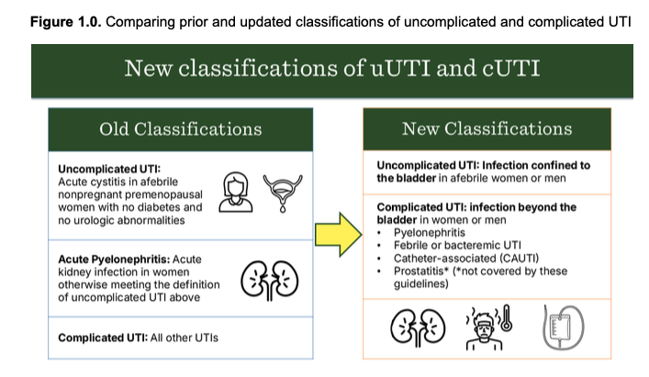
New Definitions

Slide 30
Comorbidities & Males ♂
Comorbidities ≠ Complicated: Patients with diabetes, immunocompromise, or stable urologic abnormalities (e.g., BPH, cystocele) are no longer automatically classified as cUTI if they are not systemically ill.
The Male UTI Shift: Men can now be diagnosed with uUTI if the infection is localized to the bladder, though clinicians must still exclude prostatitis, which requires longer therapy.

Slide 31
Clinical vs. Microbiologic Cure
Patient-Centered Outcomes:
Prioritize symptom resolution (clinical cure) over negative follow-up cultures.
Avoiding Overtreatment:
DO NOT order “test-of-cure” cultures in asymptomatic patients—treating asymptomatic bacteriuria doesn’t prevent future infections.
Notes:
Patient-Centered Outcomes: The panel prioritized clinical cure (the resolution of symptoms) over "microbiologic cure" (a negative follow-up culture).
Avoiding Overtreatment: In primary care, follow-up "test-of-cure" cultures are discouraged in asymptomatic patients because treating asymptomatic bacteriuria has not been shown to prevent future symptomatic infections

Slide 32
Empiric Antibiotic Recommendations (or lack thereof…)
Resistance Thresholds: 2010 recommendations→ avoid certain drugs if local resistance exceeds 10–20%
Current Resistance Rates: surpassed 20% for FQs, TMP-SMX, and nitrofurantoin.
No formal recommendations were made for oral empiric therapy based on the panel’s GRADE review.
Notes:
Selecting Empiric Therapy: While the guideline emphasizes the need to reevaluate empiric choices based on these resistance levels, the provided source material does not list specific first-line empiric drug names for cUTI. It instead notes that for oral empiric antibiotics in cUTI, there were "no formal recommendations" made for their use as initial therapy based on the panel's GRADE assessment of the mapping review
Resistance Thresholds: 2010 recommendations to avoid certain drugs if local resistance exceeds 10–20% are now difficult to meet.
Current Resistance Rates: In US ambulatory settings (2018–2020), resistance among common uropathogens has surpassed 20% for fluoroquinolones, trimethoprim-sulfamethoxazole (TMP-SMX), and nitrofurantoin.
The guideline stresses reassessing empiric therapy based on local resistance patterns but does not specify first-line oral agents for cUTI. It notes that no formal recommendations were made for oral empiric therapy based on the panel’s GRADE review.

Slide 33
Conclusions
- uUTI: infection confined to bladder in afebrile individuals
- cUTI: infection beyond the bladder in men and women
01
Systemic Assessment Focus: Define complicated vs uncomplicated by vital signs/systemic symptoms—and prioritize symptom resolution over follow-up cultures.
02
Evidence-Based Empiricism: Look at your Biogram!
03
Notes:
Shift to Systemic Assessment: Primary care doctors should base the "complicated" vs "uncomplicated" distinction on vital signs and systemic symptoms rather than just the patient's medical
Include Device History: Patients with indwelling catheters, stents, or nephrostomy tubes are generally classified as cUTI due to the presence of a foreign body.
history.

Slide 34
BREAK

Slide 35
Colon Cancer: A Tale of Two Screens
Title | Effect of invitation to colonoscopy versus faecal immunochemical test screening on colorectal cancer mortality (COLONPREV): a pragmatic, randomised, controlled, non-inferiority trial
Source | The Lancet; Published Online March 27, 2025 (Corrected April 10, 2025)
Purpose | To determine if an invitation for biennial FIT screening is non-inferior to an invitation for one-time colonoscopy in reducing CRC mortality at 10 years among average-risk adults
Study Design | A pragmatic, multicenter, randomized, controlled, non-inferiority trial
Notes:
This was for average risked population (50+ without personal or family history of CRC)

Slide 36
Background
The Clinical Dilemma:
Colorectal cancer (CRC) is the second leading cause of cancer death globally.
Lacking evidence with FIT vs colonoscopy: which performs better in a population-based, organized screening program.
Study Objective:
To determine if an invitation for biennial FIT screening is non-inferior to an invitation for one-time colonoscopy in reducing CRC mortality at 10 years among average-risk adults

Slide 37
Methods
Design: A pragmatic, multicenter, randomized, controlled, non-inferiority trial.
Participants: 57,404 "average-risk" individuals (ages 50–69) across 15 hospitals in Spain.
Methods:
Randomization: Participants were assigned 1:1 to either one-time colonoscopy or biennial FIT (performed every 2 years).
Primary Analysis: Intention-to-screen population, meaning everyone randomized was included, regardless of whether they actually showed up for the test.
Threshold: FIT positivity was defined as ≥15–20 µg hemoglobin per gram of feces.
Follow-up: Primary endpoint was CRC-related mortality at 10 years

Slide 38
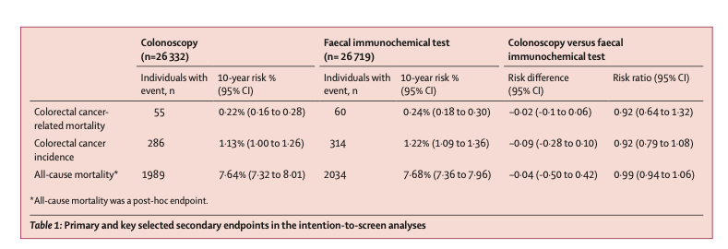
Findings
The Bottom Line: FIT was non-inferior to colonoscopy.
At 10 years, CRC mortality was 0.24% in the FIT group vs. 0.22% in the colonoscopy group.
Notes:
Table 1: The "Bottom Line" Results
This table compares the two groups (those invited to get a colonoscopy vs. those invited to do a FIT stool test every two years) to see if one was better at preventing death or cancer.
Colorectal Cancer Deaths: Out of tens of thousands of people, only 0.22% in the colonoscopy group died of colon cancer compared to 0.24% in the FIT group. This tiny difference was small enough to prove that FIT is "non-inferior" (essentially just as good) as colonoscopy for saving lives.
Cancer Incidence: The rate of actually getting cancer was also nearly identical: 1.13% for colonoscopy vs. 1.22% for FIT.
All-Cause Mortality: The researchers even checked if one group lived longer in general; again, the numbers were virtually the same (7.64% vs. 7.68%)

Slide 39
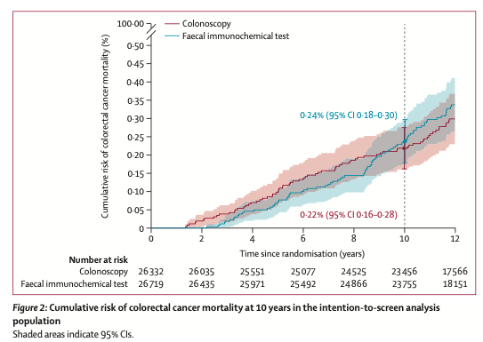
Cumulative Risk: The Death Gap
Notes:
This is a cumulative risk graph, often called a "survival curve." It tracks the percentage of people who died from colon cancer over the 10-year study period.
In this graph, the line for colonoscopy and the line for FIT are pasted right on top of each other.
The Message: If colonoscopy were significantly better at saving lives, its line would be much lower on the graph. Because the lines are inseparable, it shows that

Slide 40

Why this Matters for Primary Care
Colonoscopy is a more powerful one-time test, but uptake is lower (31.8%) compared to FIT (39.9%).
The higher "buy-in" for the stool test counterbalances the fact that a colonoscopy is a more sensitive procedure.
Is Cologuard better than we thought?
Notes:
The reason these tables and figures look so similar is largely due to participation. While a colonoscopy is a more powerful "one-time" test, only 31.8% of people actually showed up to get one. In contrast, 39.9% of people were willing to do the FIT test. The higher "buy-in" for the stool test counterbalances the fact that a colonoscopy is a more sensitive procedure.
While a colonoscopy is a more powerful "one-time" test, only 31.8% of people actually showed up to get one. In contrast, 39.9% of people were willing to do the FIT test.
The higher "buy-in" for the stool test counterbalances the fact that a colonoscopy is a more sensitive procedure.

Slide 41
Conclusions
FIT is Validated: FIT-based screening is as effective as colonoscopy for reducing CRC deaths over 10 years.
Patient Preference Matters: Higher uptake with FIT—less invasive tests improve participation.
Programmatic Focus: Supports organized, population-based screening over opportunistic case-finding.
Notes:
FIT is Validated: An organized screening program based on FIT is as effective as colonoscopy for reducing CRC-related deaths over a 10-year period.
Patient Preference Matters: The higher participation in the FIT group suggests that a less invasive approach is better accepted by patients and can counterbalance the potentially higher sensitivity of a colonoscopy.
Programmatic Focus: The findings support the shift toward organized, population-based screening rather than opportunistic "case-finding" to ensure equity and coverage

Slide 42
BREAK

Slide 43
PREVENT-PE Pre-eclampsia prevention
Title | Scheduled birth at term for the prevention of pre-eclampsia (PREVENT-PE): an open-label randomised controlled trial
Source | Lancet 2026; 407: 67–77 Published Online December 4, 2025 https://doi.org/10.1016/S0140-6736(25)01207-3
Purpose | We aimed to investigate the effect of screening for pre-eclampsia risk at 36 weeks’ gestation and offering risk-stratified, planned, early-term birth.
Study Design | RCT 1:1 to intervention and control groups with primary outcome as birth with pre-eclampsia.

Slide 44
Background
In high-risk pregnancies, there is no reliable intervention to reduce term pre-eclampsia.
3% of pregnancies are complicated by pre-eclampsia.
75% occur at term accounting for > half maternal deaths and at least 25% of fetal / newborn deaths or major morbidity.
60% of pre-term preeclampsia can be prevented by prophylactic aspirin offered to women at increased risk.
The Fetal Medicine Foundation (FMF) competing risks model at 35-0 to 36-6 can identify 70% of women who subsequently develop PE.
Incorporates maternal factors, mean art pressure, placental growth factor, soluble fms-like tyrosine kinase receptor 1.
Could screening for PE risk at 36 weeks and offering risk-stratified, planned, early-term birth reduce risk of subsequent PE?

Slide 45
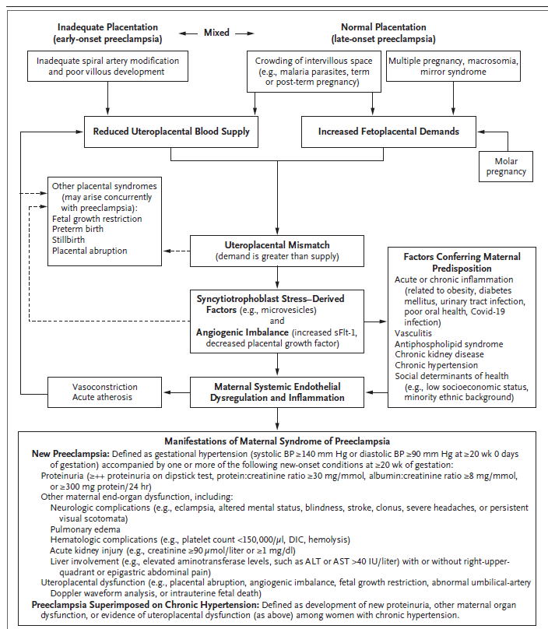
PE pathogenesis
N Engl J Med 2022;386:1817-32.
DOI: 10.1056/NEJMra2109523
Copyright © 2022 Massachusetts Medical

Slide 46
Study Design
Two-arm, parallel-group, open-label, randomized trial.
Two large diverse UK hospitals.
King’s College (site of 2017 NEJM ASA study)
Medway
Participants recruited at “birth plan scan” at 35-0 to 36-6
Included women with singleton pregnancy, live fetus without anomalies.
Excluded women < 16yo, with PE or participating in other trial.
10,803 eligible, 2,667 declined to participate, 8,136 randomized.

Slide 47
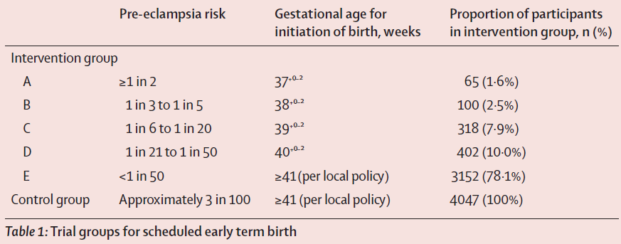
Intervention
Offered risk-stratified planned early term birth at 37, 38, 39 or 40 weeks gestation.
Initiation of birth by local protocol induction or elective CS.

Slide 48
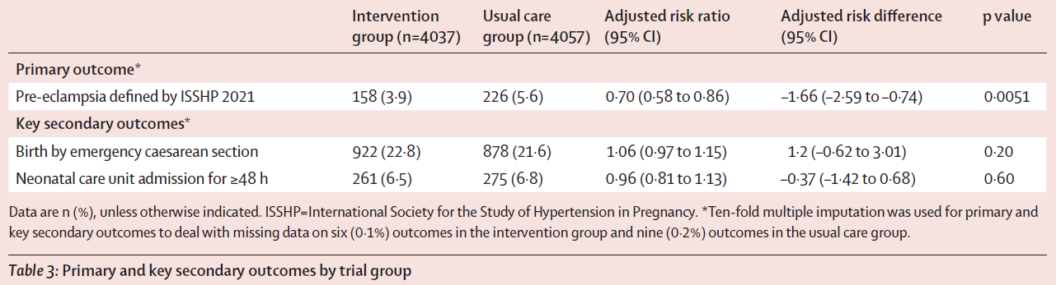
Study Results

Slide 49
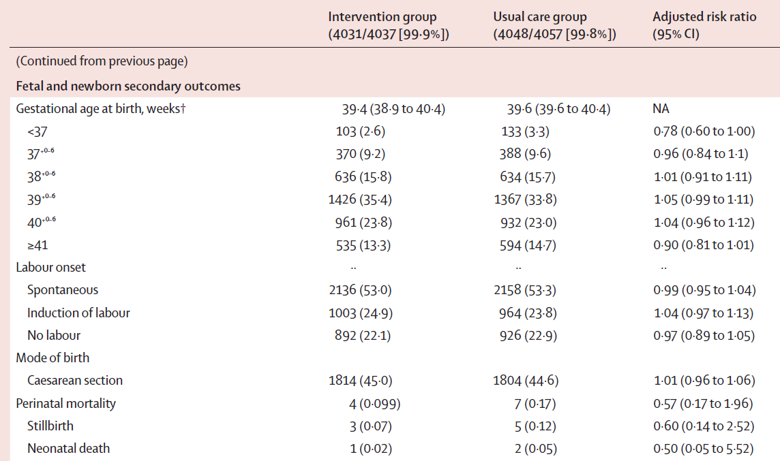
Study Results

Slide 50
Results
Reduced risk of subsequent PE at term by 30%.
No increase in post-partum PE.
No significant increase in emergency CS or NICU needs.
To reduce one case of postscreening pre-eclampsia, 13 women would need to be screened for pre-eclampsia risk and offered personalized timed birth between 37 weeks’ and 40 weeks’ gestation.
Previously, timed birth at term has reduced term pre-eclampsia in nulliparous women and those with chronic or gestational hypertension.

Slide 51
BREAK

Slide 52
A Shot at Prevention: Vaccines and Risks of Dementia
Title | Association Between Vaccinations and Risks of Dementia
Source | Stefania Maggi et al. Age and Ageing. 2025 Oct 30;54(11):afaf331. https://doi.org/10.1093/ageing/afaf331
Purpose | To systematically evaluate whether common adult vaccinations are associated with a reduced risk of dementia and mild cognitive impairment (MCI)
Study Design | Systematic review and meta-analysis of observational studies

Slide 53
Purpose & Background
The Global Burden: Dementia prevalence is projected to reach 150 million people by 2050
The Infectious Hypothesis: Infections contribute to dementia via neuroinflammation, glial activation, and blood-brain barrier dysfunction
Study Objective: To systematically evaluate whether common adult vaccinations are associated with a reduced risk of dementia and mild cognitive impairment (MCI)
Notes:
Low vaccination uptake in older populations maybe driven by combo of hesistancy, lack of awareness, access
The Global Burden: Dementia prevalence is projected to reach 150 million people by 2050, creating a massive public health and economic challenge.
The Infectious Hypothesis: Emerging evidence suggests that infections (e.g., Herpes Simplex, influenza, pneumonia) contribute to dementia via neuroinflammation, glial activation, and blood-brain barrier dysfunction.
Study Objective: To systematically evaluate whether common adult vaccinations are associated with a reduced risk of dementia and mild cognitive impairment (MCI)

Slide 54
Methods
Design: Systematic review and meta-analysis of observational studies.
Scope: 21 studies involving over 104 million participants (mean age 74).
Inclusion: Studies comparing dementia/MCI incidence between vaccinated and unvaccinated adults aged ≥50 years.
Analysis: Risk ratios (RRs) were pooled using a random-effects model, adjusting for an average of 15 confounders per study (e.g., sociodemographics and clinical factors)
Notes:
Primary outcome was risk of dementia according to vaccination status; risk of MCI was secondary outcome

Slide 55
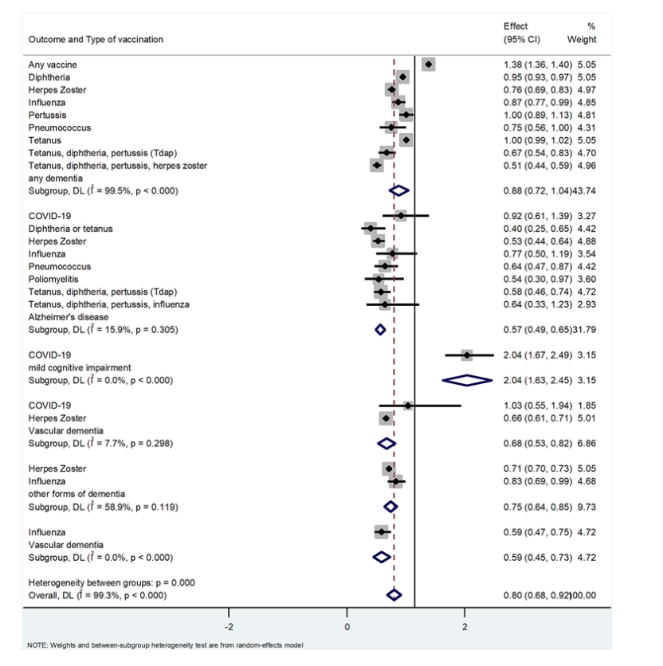
Notes:
“If you look quickly, most of these dots are to the left of 1, meaning vaccination is associated with a lower risk of dementia. The strongest signal comes from the shingles vaccine, and overall we’re seeing about a 20% relative risk reduction. Important to remember this is observational—but the consistency across vaccines is pretty compelling.”

Slide 56
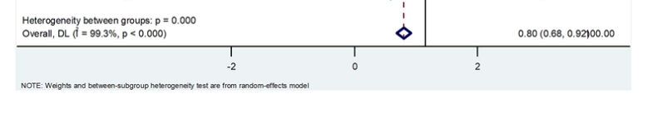

Slide 57
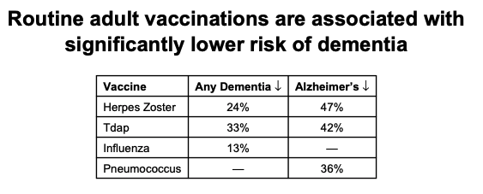
Findings
Global Effect:
When looking at multiple vaccine types combined, there is a consistent signal for neuroprotection against both Alzheimer’s and dementia.
Notes:
“If you look quickly, most of these dots are to the left of 1, meaning vaccination is associated with a lower risk of dementia. The strongest signal comes from the shingles vaccine, and overall we’re seeing about a 20% relative risk reduction. Important to remember this is observational—but the consistency across vaccines is pretty compelling.”
Herpes Zoster (Shingles): 24% reduction in any dementia; 47% reduction in Alzheimer’s disease.
Tdap (Tetanus, Diphtheria, Pertussis): 33% reduction in any dementia; 42% reduction in Alzheimer’s disease.
Influenza: 13% reduction in any dementia risk.
Pneumococcus: 36% reduction in Alzheimer’s risk.

Slide 58
The “COVID-19 Caveat”
The Finding: One large study suggested a two-fold increase in MCI risk shortly after COVID-19 vaccination.
This is likely due to reverse causation and methodological limits:
Follow-up was only 3 months, whereas dementia takes years to develop.
Vaccination may have occurred in individuals already experiencing early post-COVID cognitive decline (Long COVID).
Long-term studies are still required to determine the true cognitive impact of COVID-19 vaccines.

Slide 59
Biological Plausibility: The ‘Why’
Reduced Inflammation: Vaccines prevent systemic infections that trigger the neuroinflammation known to accelerate neurodegeneration.
"Trained Immunity": Vaccinations may prime the innate immune system to more effectively clear pathological proteins like beta-amyloid plaques.
Vascular Protection: By preventing infections that cause myocardial infarction and stroke, vaccines indirectly lower the risk of vascular dementia

Slide 60
Limitations
Observational Nature: Not randomized controlled trials
"healthy vaccine bias" cannot be fully excluded (people who get vaccinated may generally be more health-conscious)
High Heterogeneity: Significant variability in how different studies diagnosed dementia and adjusted for confounders.
Notes:
I2 higher than 75%, Individual study results vary far more than expected by change alone. Pooled estimate is statistically significant, level of heterogeneity raises concerns about the validity of combing studies into a single summary estimate.
Results are statistically significant, but clinically should be interpreted with some caution

Slide 61
Conclusions & Future Developments
Conclusions: Adult vaccines (≥50 yo)are a modifiable factor for dementia prevention—integrate into public health.
Future: Need prospective trials + clarify optimal timing/frequency.
Takeaway: Boost vaccine uptake in ≥50 yo (often <40%) to support healthy aging.
Notes:
Conclusions: Adult vaccinations (50+ yo) are a potent, modifiable risk factor for dementia prevention. Vaccination strategies should be formally incorporated into public health initiatives for cognitive health.
Future Developments:
Need for prospective intervention trials to confirm causality.
Investigation into the optimal timing and frequency of vaccinations for lifelong cognitive benefit.
Takeaway for Family Physicians: Improving vaccine uptake in the ≥50 population (currently often <40% for shingles/pneumonia) is a critical, evidence-based strategy for healthy aging

Slide 62
BREAK

Slide 63
New Year, New Lipids: 2026 ACC/AHA Updates
Title | 2026 ACC/AHA/AACVPR/ABC/ACPM/ADA/AGS/APhA/ASPC/NLA/PCNA Guideline on the Management of Dyslipidemia
Source | Circulation, Published March 2026 https://doi.org/10.1161/CIR.0000000000001423
Purpose | Address the evaluation, management, and monitoring of individuals with dyslipidemias.
Study Design | Developed by a multi-disciplinary committee including representatives from the American Academy of Physician Associates, the American Diabetes Association, and the American Geriatrics Society

Slide 64
Purpose & Background
The Paradigm Shift: This guideline replaces the 2018 version, moving from a focus on "blood cholesterol" to "dyslipidemia".
Targeting "Lifelong Risk": Reduce the lifelong burden of exposure to atherogenic lipoproteins
Need for Accuracy: Replaces older risk calculators with more contemporary equations to reduce over-prediction of risk in the U.S. population
Notes:
Targeting "Lifelong Risk": The primary goal is reducing the lifelong burden of exposure to atherogenic lipoproteins (including LDL, Triglycerides, and Lp(a)) rather than just treating short-term 10-year risk.

Slide 65
Methods
Design: Comprehensive clinical practice guideline based on a systematic review of randomized controlled trials (RCTs) and meta-analyses.
Key Trials Incorporated: Includes new evidence from major outcomes trials like FOURIER (evolocumab), ODYSSEY (alirocumab), CLEAR (bempedoic acid), and REDUCE-IT (icosapent ethyl).
Recommendation Framework: Utilizes the standard ACC/AHA Class of Recommendation (COR) and Level of Evidence (LOE) format

Slide 66
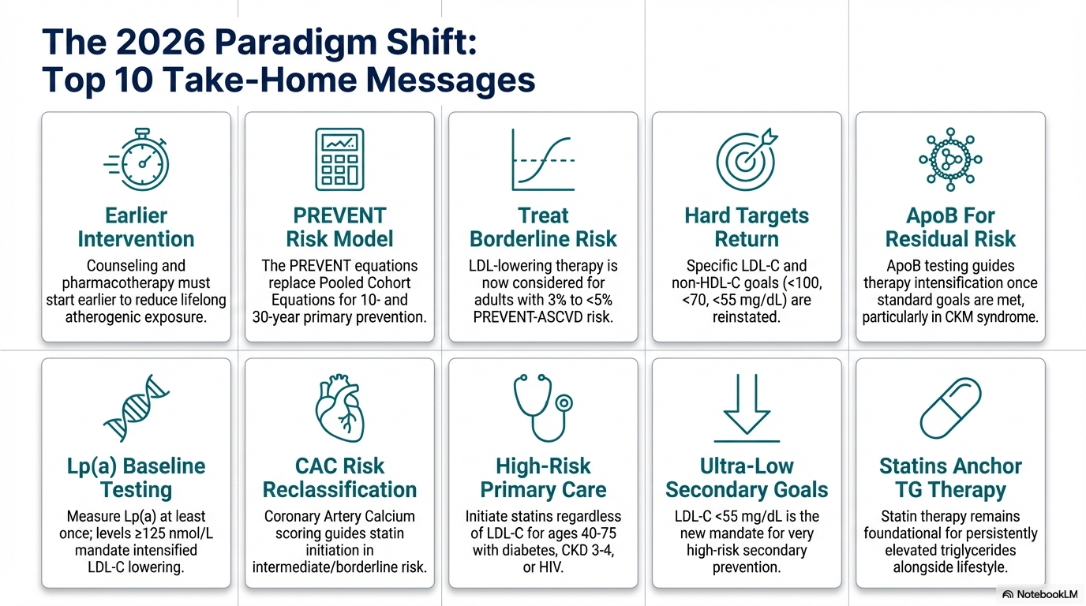

Slide 67
High Yield!

Slide 69
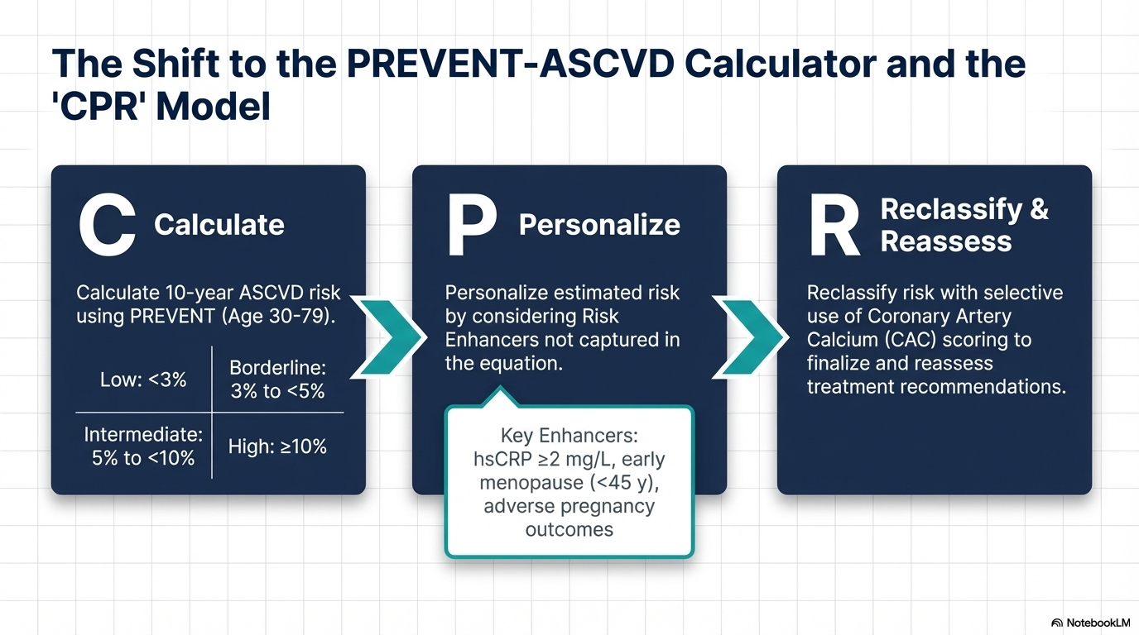
Notes:
Calculate: Use the new PREVENT™ equations (instead of the older Pooled Cohort Equations) to estimate 10- and 30-year ASCVD risk for adults aged 30–79.
Personalize: Consider factors not in the equations, such as risk enhancers (family history, inflammatory diseases, CKM syndrome) and reproductive risk markers (preeclampsia, early menopause).
Reclassify: Use Coronary Artery Calcium (CAC) scoring to resolve clinical uncertainty, especially in intermediate-risk patients

Slide 70
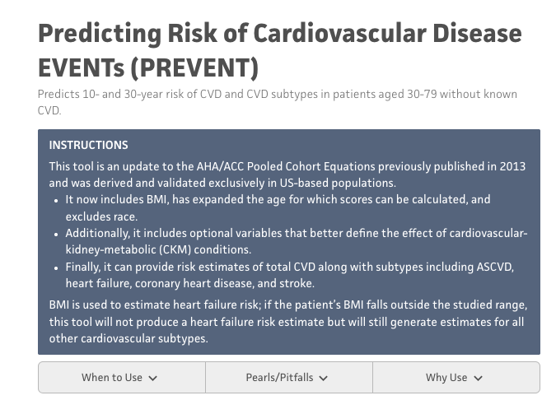
Findings
PREVENT vs. PCE: Risk estimates from the new PREVENT equations are generally 40% to 50% lower than the older PCE calculator for the same patient profile.
Notes:
PCE = pooled cohort equations

Slide 71

Findings
Universal Screening:
Adults: Starting at age 19 and repeating every 5 years.
Children: Universal lipid profile at ages 9 to 11 is now recommended to detect Familial Hypercholesterolemia (FH) early.

Slide 72

Findings
Lp(a) Measurement: All adults should have Lipoprotein(a) measured at least once in their lifetime for risk assessment.
ApoB: Measure to guide further therapeutic intensification once other dyslipidemia goals achieved, or to guide decisions about initiation of LLT.

Slide 73
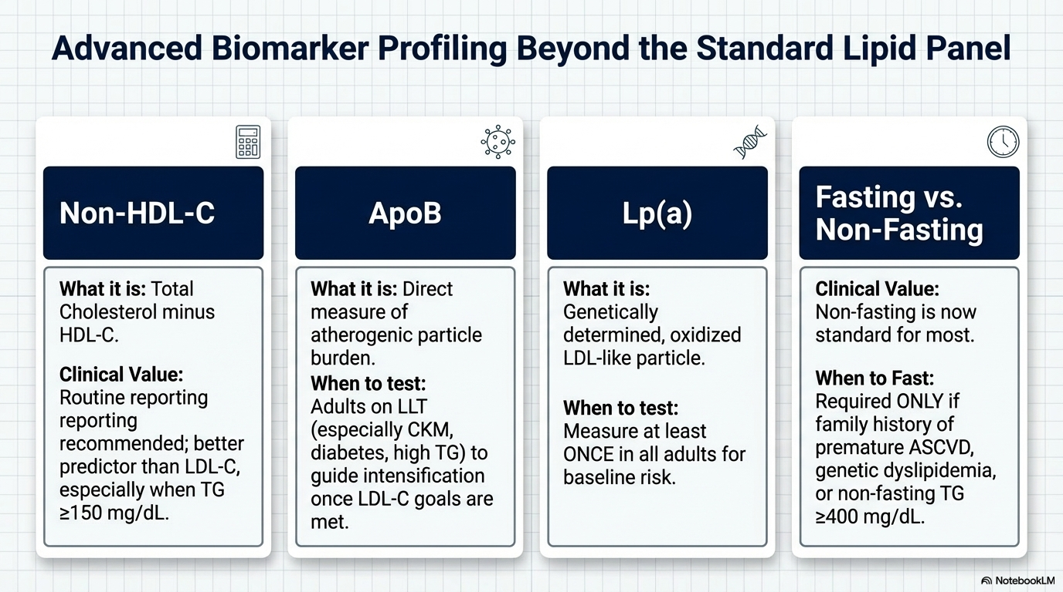

Slide 74
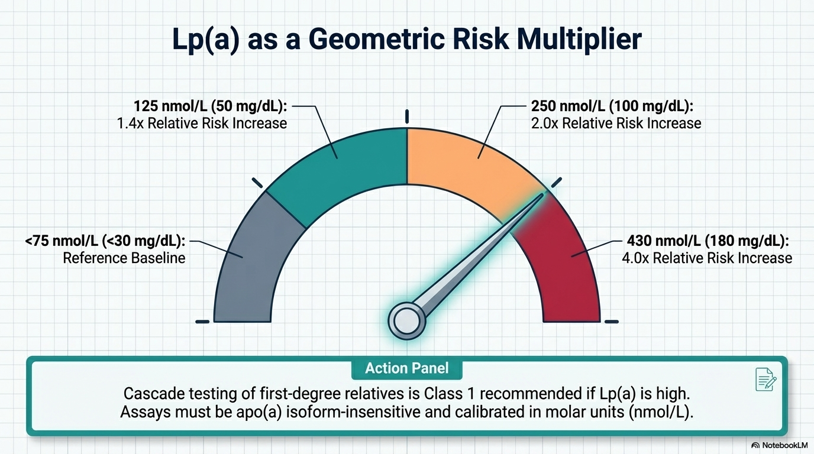

Slide 75
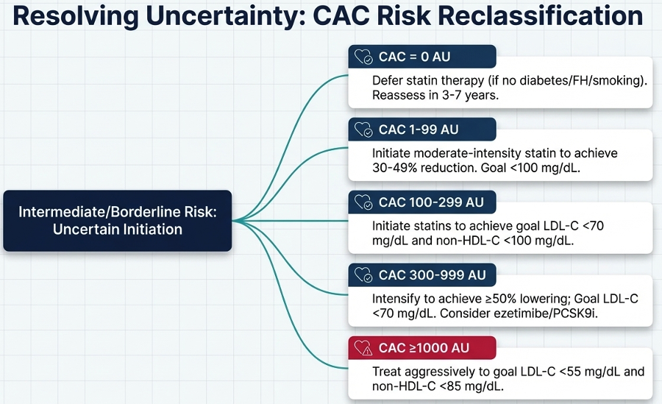
Findings
CAC: Primarily used to resolve clinical uncertainly in men > 40 and women > 45

Slide 76
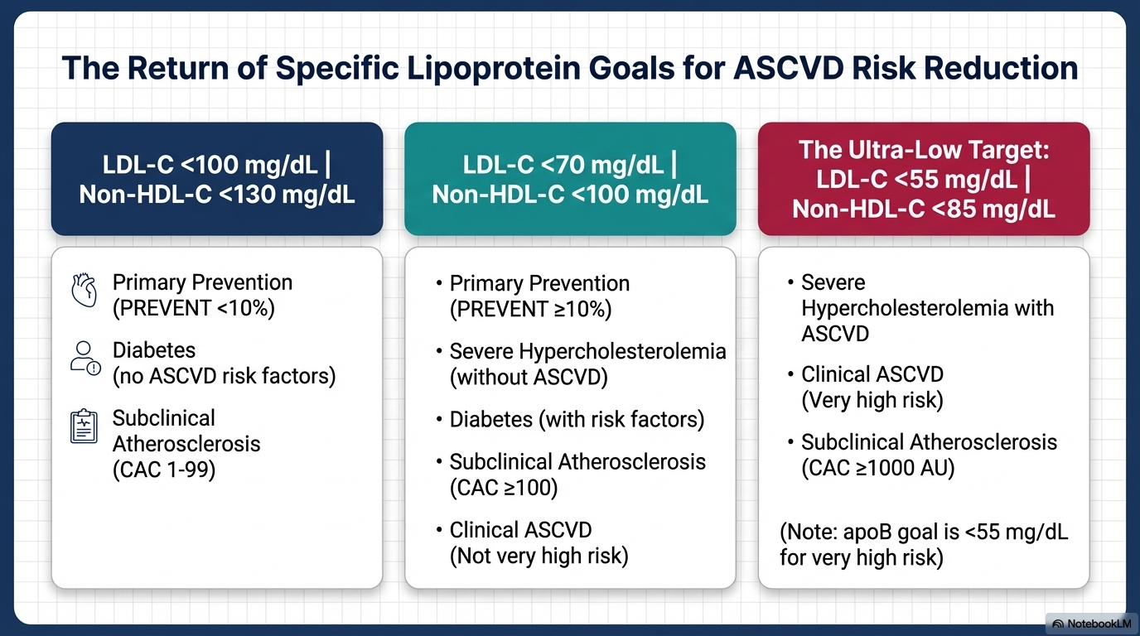
Treatment Goals
Notes:
The Return of Goals: Specific LDL-C and non-HDL-C treatment targets have returned to guide therapy.
Primary Prevention High Risk (PREVENT ≥10%): Goal is LDL-C <70 mg/dL.
Secondary Prevention (Very High Risk): Goal is LDL-C <55 mg/dL.
Triglycerides: For TG ≥1000 mg/dL, the primary focus shifts to preventing pancreatitis through diet and pharmacotherapy (e.g., olezarsen).

Slide 77
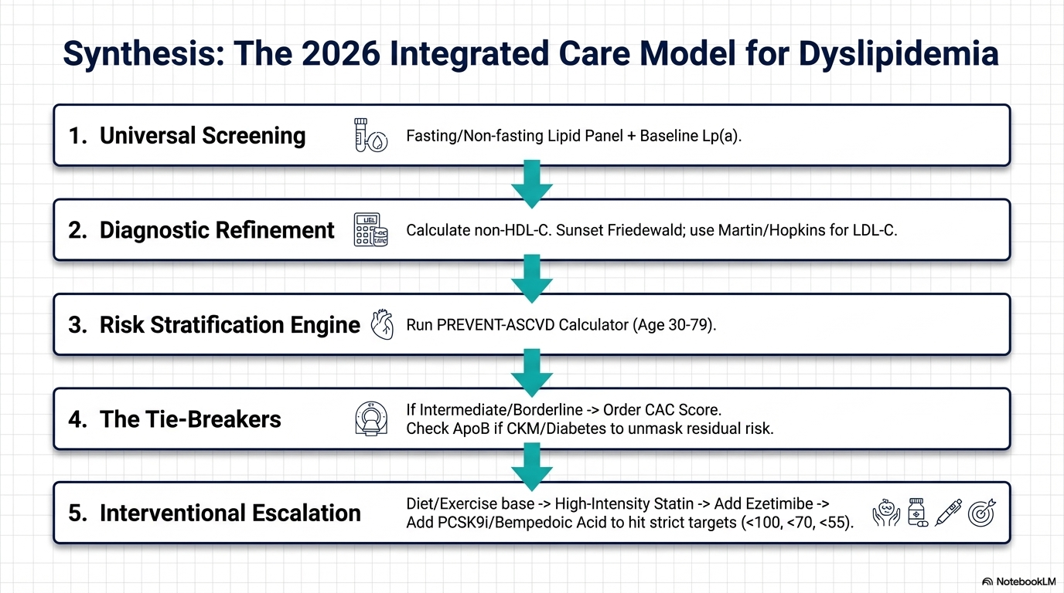

Slide 78
BREAK

Slide 79
Scroll, Like, Repeat: The Impacts of Social Media
Title | Social Media Is Harming Young People at a Scale Large Enough to Cause Changes at the Population Level
Source | Jonathan Haidt and Zachary Rausch https://www.worldhappiness.report/ed/2026/social-media-is-harming-adolescents-at-a-scale-large-enough-to-cause-changes-at-the-population-level/ DOI: https://doi.org/10.18724/WHR-G490-BG86

Slide 80
Purpose & Background
The Global Context: Since the early 2010s, adolescent well-being has declined across most Western nations.
Two Core Questions:
The Product Safety Question: Is ordinary social media use safe for individual adolescents?
The Historical Trends Question: Did the rapid adoption of social media cause the population-level rise in mental illness?
A "Sensitive Period": Puberty (ages 10–19) is a period of high brain plasticity where environmental factors like heavy digital use can alter neuronal growth and myelination.

Slide 81
Methods
Framework: A systematic review of seven independent lines of evidence.
Standard of Proof: The authors utilize a "preponderance of the evidence" standard (common in civil trials), arguing that the cost of incorrectly concluding social media is safe is "catastrophically high".
The Evidence Lines:
Testimony: Surveys of youth, parents/teachers/clinicians, and internal corporate documents
Academic Research: Cross-sectional, longitudinal, randomized controlled trials (RCTs), and natural experiments

Slide 82
Findings
Gen Z Regret: 34% to 50% of young adults wish platforms like Instagram, TikTok, and X had never been invented.
Internal Corporate Admissions:
Meta: One in three teen girls reported Instagram made their body image issues worse.
TikTok: Internal memos acknowledge that the product has "baked into it compulsive use" and "interferes with essential personal responsibilities" like sleep and eating.
Snapchat: Receives approximately 10,000 reports of sextortion monthly.
Clinician Observations: 81% of clinicians surveyed by Meta reported that social media exacerbates anxiety in their patients.

Slide 83
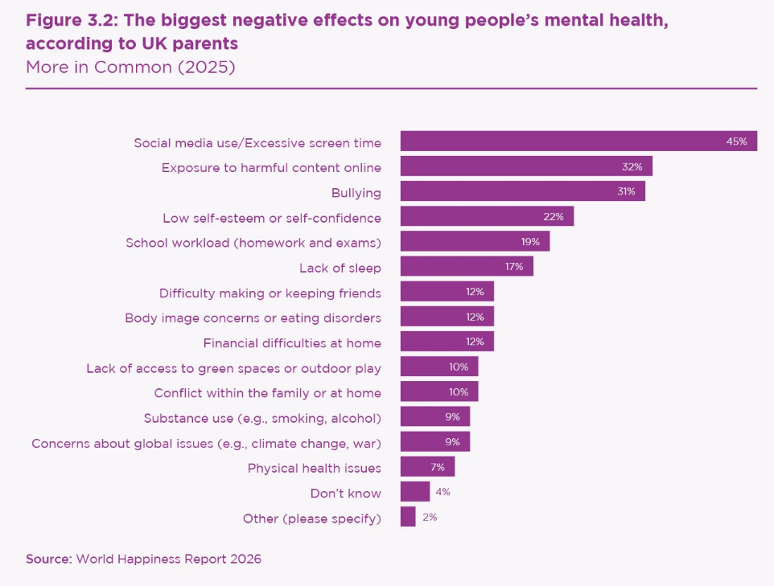
What the Witnesses Say: UK Parents

Slide 84
Academic and Clinical Data
The "Dose-Response" Effect: Adolescents spending 5+ hours per day on social media (common among U.S. teens) are twice as likely to be depressed compared to light users.
RCT Evidence: Reducing social media use for just one to three weeks leads to significant improvements in depression and anxiety (Effect size: Hedges’ g = 0.19 for depression).
Direct Population Harms (US estimates):
Addiction: ~4 million teens suffer from problematic use.
Sleep: 17.5 million teens report social media harms their sleep.
Harassment: Estimated 5.7 million teens receive unwanted sexual advances weekly on Instagram.

Slide 85
Conclusions
Safety Status: The preponderance of evidence indicates social media is not safe for adolescents as currently designed.
Clinical Goal: Primary care should advocate for delaying account creation until age 16.
The "Collective Action Trap": It is difficult for one teen to quit if all peers remain online; doctors can encourage parent groups to coordinate "waiting" together.
Key Modifiable Risk: Addressing social media is a critical intervention for improving adolescent sleep, which is a major driver of mental health outcomes

Slide 86
Recent Jury Trials
New Mexico
Jury found “Meta misled users about the safety of its platforms and enabled the sexual exploitation of young users.”
“State investigators posed as underage users to lure online predators to document instances of solicitation. Instagram is a ‘breeding ground’ for sexual exploitation” – NY Times
Social Media Addiction Case Against Meta and YouTube
Jury found Meta and YouTube harmed a young user with design features that were addictive and led to her mental distress
Infinite scroll, autoplay, algorithmic recommendations
Internal documents showed companies knew their products had negative effects on children.

Slide 87
BREAK

Slide 88
Effects of Defunding USAID
Title | Evaluating the impact of two decades of USAID interventions and projecting the effects of defunding on mortality up to 2030: a retrospective impact evaluation and forecasting analysis
Source | Daniella Medeiros Cavalcanti et al. Lancet 2025; 406: 283–94 https://doi.org/10.1016/S0140-6736(25)01186-9
Purpose | The aim of this study is to comprehensively evaluate the effect of all USAID funding on adult and child mortality over the past two decades and forecast the future effect of its defunding.
Study Design | A retrospective impact evaluation integrated with forecasting analysis using panel data from 133 countries and territories with USAID support ranging from none to very high.

Slide 89
Study Design
We used fixed-effects multivariable Poisson models with robust SEs adjusted for demographic, socioeconomic, and health-care factors to estimate the impact of USAID funding on all-age and all-cause mortality from 2001 to 2021.
We evaluated its effects by age-specific, sex-specific, and cause-specific groups.
We did several sensitivity and triangulation analyses.
We integrated the retrospective evaluation with validated dynamic microsimulation models to estimate effects up to 2030.

Slide 90
USAID Support
Natural disasters
Food assistance
Global Alliance for Vaccines and Immunizations (GAVI)
President’s Malaria Initiative (PMI)
President’s Emergency Plan for AIDS Relief (PEPFAR)

Slide 91
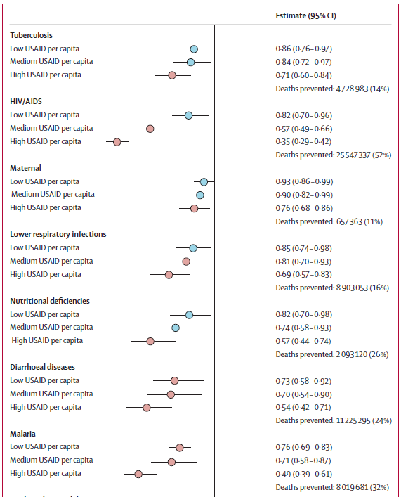
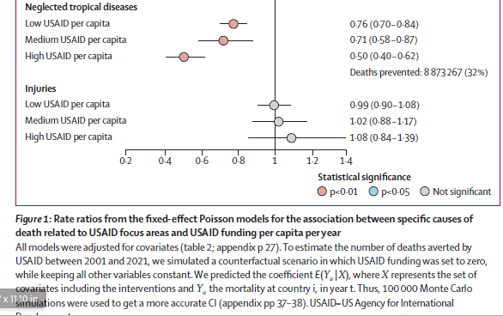
Study Results

Slide 92
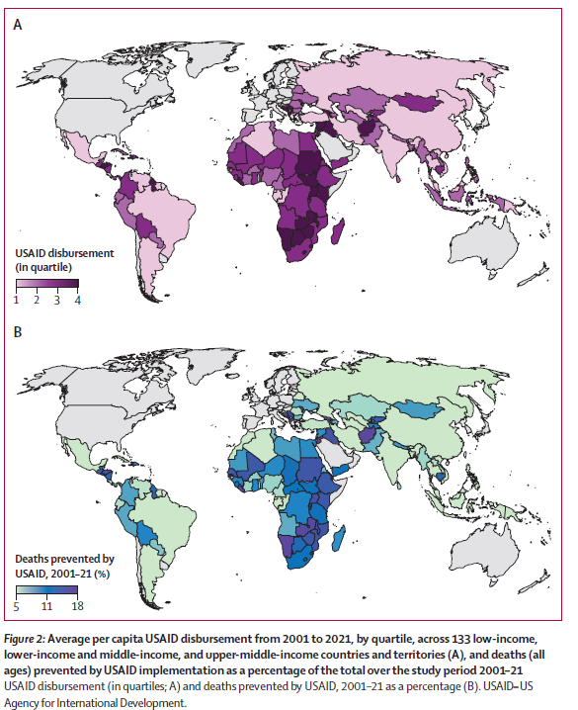
USAID Disbursement and Deaths

Slide 93
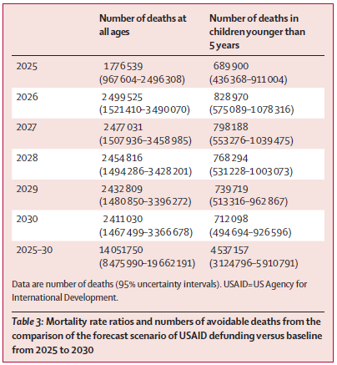
Avoidable deaths comparing the forecast scenario of USAID defunding vs baseline from 2025-2030.
2026
2.5M all age deaths
Almost 830,000 deaths in children < 5
95-100 avoidable child deaths in the past hour
3,100 avoidable child deaths over this conference
2024 budget: $44.2B for foreign assistance out of $6.5 trillion budget = 0.68%
The US had allocated 0.25% of gross national income.

Slide 94
BREAK

Slide 95
The Sweet Spot: Prediabetes – It is Important
Title | Prediabetes remission and cardiovascular morbidity and mortality: post-hoc analyses from the Diabetes Prevention Program Outcome study and the DaQing Diabetes Prevention Outcome study
Source | The Lancet Diabetes & Endocrinology 2025; 14, 137-148 (Published Online December 12, 2025) https://doi.org/10.1016/S2213-8587(25)00295-5
Purpose | Investigate the association with prediabetes and cardiovascular health
Study Design | Observational post-hoc analysis using data from two landmark diabetes prevention trials

Slide 96
Purpose & Background
The Problem: Prediabetes is linked to an increased risk of heart failure, atherosclerotic cardiovascular disease, and premature death.
Current Gap: While lifestyle interventions effectively reduce the risk of progressing to type 2 diabetes, their long-term impact on specific cardiovascular outcomes has remained unclear.
The Hypothesis: Restoring normal glucose regulation (remission) leads to a "legacy effect" that significantly reduces future cardiovascular death and heart failure hospitalizations.

Slide 97
Methods
Design: Observational post-hoc analysis using data from two landmark diabetes prevention trials:
US Diabetes Prevention Program Outcomes Study (DPPOS)
Chinese DaQing Diabetes Prevention Outcomes Study (DaQingDPOS).
Remission Criteria (ADA):
(FPG) <100 mg/dL
2-h plasma glucose <140 mg/dL
HbA1c <5.7%.
Timeline: Remission was assessed after 1 year of intervention in DPPOS and 6 years in DaQingDPOS.
Primary Endpoint: A composite of cardiovascular death or hospitalization for heart failure over a 20-year (DPPOS) and 30-year (DaQingDPOS) follow-up period

Slide 98
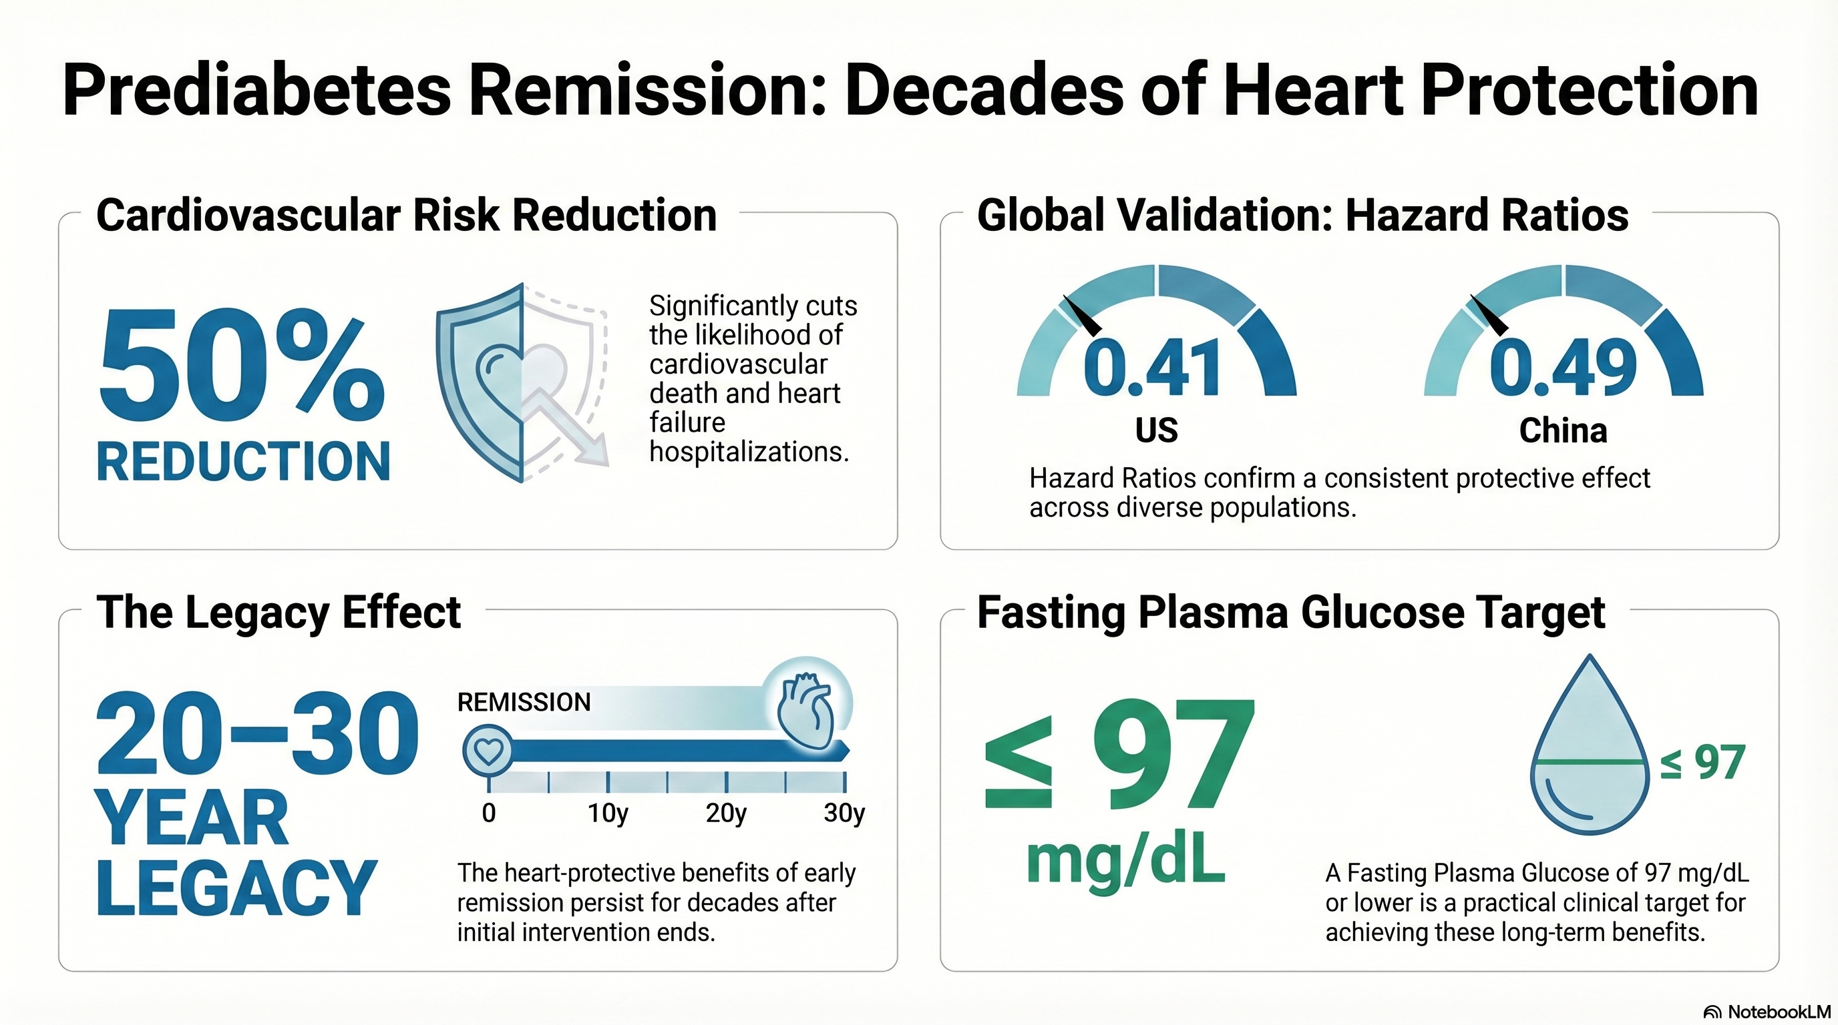
Findings

Slide 99
Conclusions
Shift the Goalpost: Treatment for prediabetes should move beyond merely "preventing diabetes" to actively pursuing remission to normoglycaemia.
New Therapeutic Target: Normalizing blood sugar in prediabetes should be treated with the same clinical priority as normalizing blood pressure in hypertension or LDL in hypercholesterolemia.
Primary Care Strategy: Target a fasting glucose of <100 mg/dL (and ideally ≤97 mg/dL) as a clear, measurable endpoint for lifestyle counseling and management

Slide 100
BREAK

Slide 101
And now for something completely different…

Slide 102
Clinical effectiveness of singing for symptoms of post-natal depression
Title | Clinical effectiveness, implementation effectiveness and cost-effectiveness of a community singing intervention for postnatal depressive symptoms, SHAPER-PND: randomised controlled trial
Source | Bind, Rebecca et al The British Journal of Psychiatry , Volume 227 , Issue 6 , December 2025 , pp. 836 - 845 DOI: https://doi.org/10.1192/bjp.2025.10377
Purpose | To evaluate, in a larger sample and across a longer timeframe than previously, the clinical effectiveness, implementation effectiveness and cost-effectiveness of the Melodies for Mums (M4M) singing intervention for symptoms of PND.
Study Design | RCT
 | https://breatheahr.org/programmes/melodies-for-mums/

Slide 103
Study Design
199 mothers experiencing symptoms of post-natal depression (PND) with Edinburgh Postnatal Depressio Score >= 10 were randomized to:
10 weeks in-person singing sessions using Melodies for Mums (M4M) (n=133)
Or active control group (n=66) received details of other non-music mother-baby activities in the community and the same schedule of texts and phone calls. Also monitored for safeguarding concerns similar to the M4M group.
Mothers were reassessed at weeks 6, 10, 20, and 36 for depression, healthcare use for themselves and their babies, and healthcare-related quality of life.

Slide 104
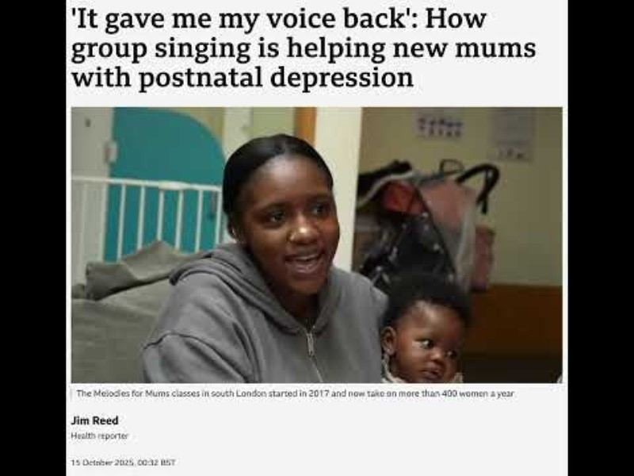
Melodies for Mums

Slide 105
Study Results
Participant retention was higher in the singing group
PND symptoms improved with the singing group intervention, but were only lower than controls at 20 and 36 weeks
M4M was significantly more (and very highly) acceptable
4.75 vs 4.0 (CI 0.25-0.83)
 | Singing Group | Control Group
Week 6 | 89% | 62%
Week 10 (end) | 77% | 57%
Week 20 | 66% | 55%
Week 36 | 66% | 38%

Slide 106
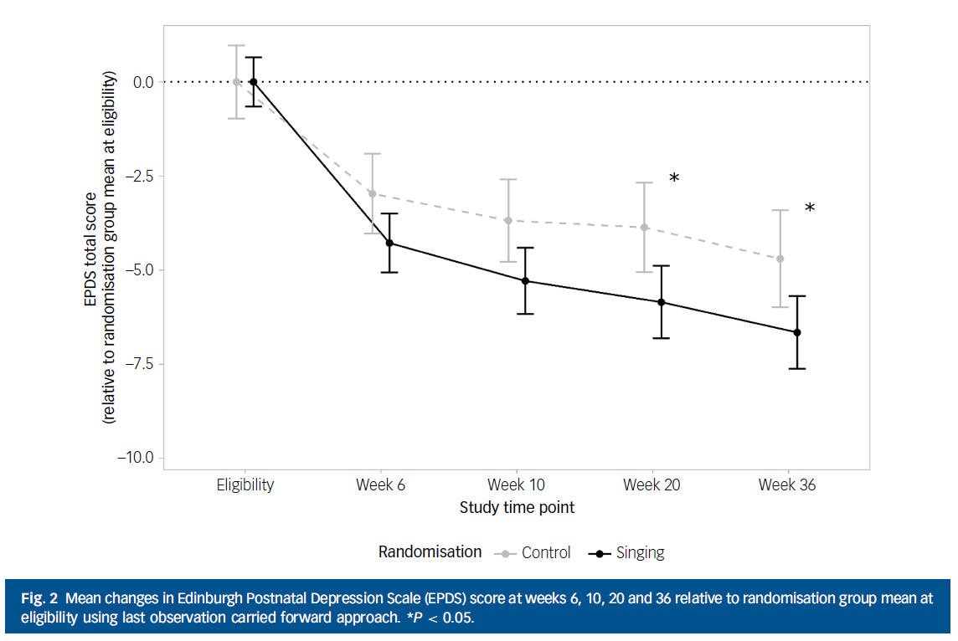

Slide 107
Strengths and Limitations
Assessing clinical effectiveness, implementation effectiveness, cost-effectiveness.
36-week timeframe
Limitations
Strongest findings used Intention to Treat analysis
Initial inclusion criteria expanded from diagnosed depression to PND
Recruitment lower than intended due to COVID-19 limitations

Slide 108
Summary
M4M singing program is effective at reducing post-natal depression at week 36.
Mothers find it more suitable than existing community-based activities.
Mothers in the M4M intervention were more likely to attend.
This is important given that previous studies show that attendance at community-based mother-infant and social groups is typically low for mothers with PND.
What is being done in your community?
How could singing or other arts-based interventions be developed? See DOI 10.3389/frhs.2025.1582517 for additional implementation details.

Slide 109
Final Thoughts
Selection process is very subjective
We’re in an era of massive data, global collaboration, and increasingly complex study designs
Emerging tools—especially AI– are shaping what we study and how we study it

Slide 110
Questions and Thank You!
Andrew Janssen
janssean@ohsu.edu
Esteban Garza
egarza@samhealth.org

