Slide 1



Integrating Community Health Worker Services
Improving Outcomes and Experience for Patients and Providers in a Community Health Center

Slide 2


CHWs on the team
CHWs are experts at linking the health care system, social services and the community. CHWs help our clinic provide a comprehensive wraparound care model that works to address the root causes of health.
"The Heart of the Team"
While doctors handle the clinical diagnosis, and the care teams in the clinic handle the administrative burden of our current healthcare system, the CHWs handle the human logistics on the patient’s side. Without them, many patients would fall through the cracks of a complex and often intimidating healthcare system.
Equity Champions
Health equity isn't just about everyone getting the same care; it’s about everyone having the opportunity to be as healthy as possible. CHWs are essential to this because they address the structural and social barriers that make "equal care" ineffective for many.
Resource Redistribution: CHWs actively move resources to the people who need them most.
Upstream Intervention: By addressing social needs, they prevent health crises.

Slide 3
Essential building blocks for an integrated CHW
Foundational functions:
1. SDOH screening Administering screening tools (like PRAPARE) to identify needs for food, housing, or transportation.
2. Resource mapping and referral A CHW must know the local landscape better than anyone else in the clinic, and be able to connect patients with resources. This means closing the loop—not just giving the patient a phone number, but calling the agency with the patient to ensure they get the service.
3. Patient navigation and appointment support The CHW acts as the "concierge" for the patient’s journey through the healthcare system. Includes helping with registration paperwork, explaining the sliding-fee scale, and screening for barriers to attending appointments.
4. Culturally specific outreach Acting as the clinic’s "eyes and ears" in the community.
Integration essentials:
check_circleEHR access and documentation
check_circleStructured protocol for warm handoffs
check_circleTeam huddles to identify high-risk patients and coordinate support

Slide 4






The "Swiss Army Knife" Model
Multi-Purpose Tool
Proactive Solvers
Rapid Responders
Our CHW team describes itself as a “multi-purpose tool”, able to handle most of the questions that come their way, and getting creative to meet identified needs.
In addition to responding to referrals and warm hand-offs, the team identifies emerging community needs as food, housing, and transportation resources shift.
Direct lines of communication (Tiger Chat internally, and a CHW phone number externally) help meet the goal of rapid responsiveness.

Slide 5


Evolution of the CHW Role
From Assistance to Advocacy
The CHW role at Winding Waters model has evolved from basic resource assistance into a longer-term advocacy model.
First added Health Coach support as part of small provider QI grant from HRSA in January 2013
Added function of Application Assister later that year (in preparation for 1st Open Enrollment under ACA that October)
Expanded to include SDoH screening in 2015 when we became an FQHC (part of OHA/OPCA APCM for Medicaid patients)
PRAPARE tool adopted 2018, integrated into OCHIN EPIC
Role has expanded since to meet the needs of our team and our community
Initially isolated touches to resolve basic needs
Now ongoing relationships with key advocacy and empowerment components

Slide 6



Hospital-to-Home: Supporting the Transition
Assist with resource gaps identified by RN during TCM calls. Responsive to assist with immediate needs and home safety.
Support ongoing engagement and connection to resources to help avoid readmissions.
7-14 Days
Discharge
CHWs join hospital multidisciplinary rounds and are essential in planning for safe transitions.
48 Hours
Coordinating PCP follow-up appointments post-discharge, including problem-solving barriers to attending visits.
Long-term

Slide 7
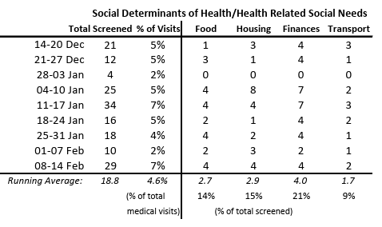
Addressing Social Drivers (SDOH)
Social Determinants of Health/Related Social Needs
Food Security
Connect patients with Fresh Alliance, Veggie Rx & WIC programs. CHWs bring about 550 pounds of food into Wallowa County each week, mitigating food insecurity.
Housing Support
Actuating the HRSN housing benefit for Wallowa County residents.
Legal Aid
Facilitating medical-legal partnership to address social barriers.
Transportation
Help with transportation to visits within and outside of Wallowa County.
Climate Response
Connecting with support devices to mitigate health effects of extreme weather.

Slide 8

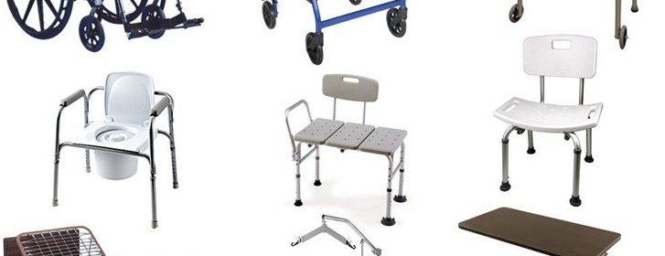
Integrated Clinical Synergy
Pharmacy Collaboration
PT & Home Safety
CHWs help support the medication preparation program, which supports independent living and aging in place.
CHWs help connect patients with needed home improvements identified during home safety evaluations, including:
Procuring and delivering essential durable medical equipment (DME) like walkers, hospital beds, commodes and shower chairs.
Arranging for installation of structural changes like grab bars and ramps.

Slide 9



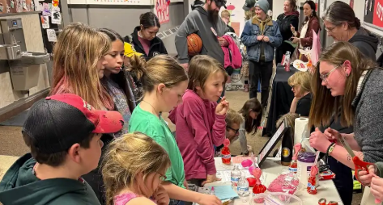

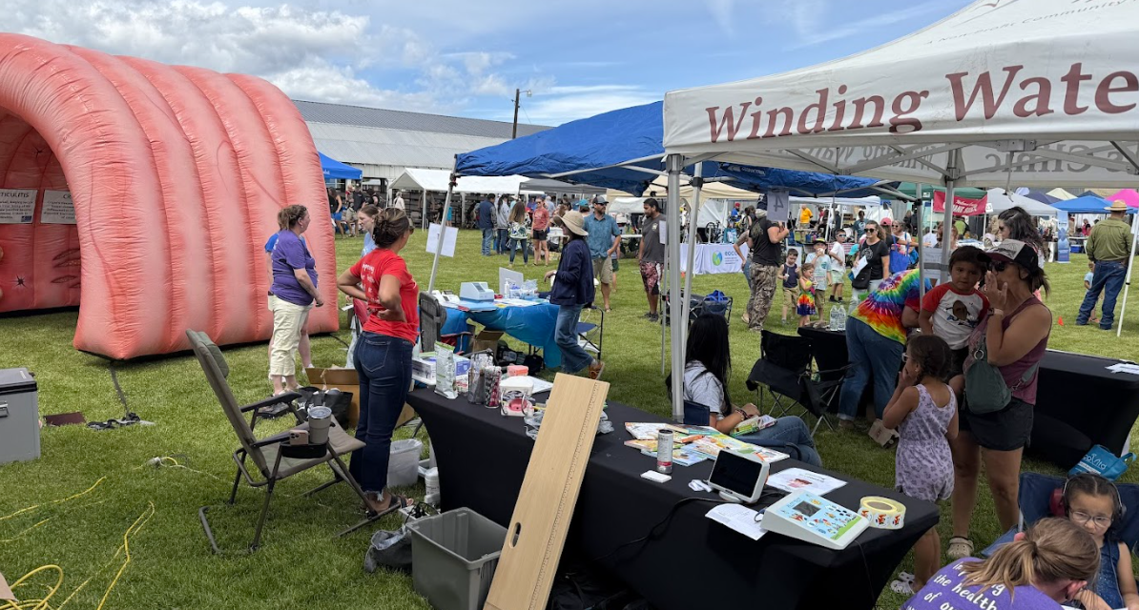
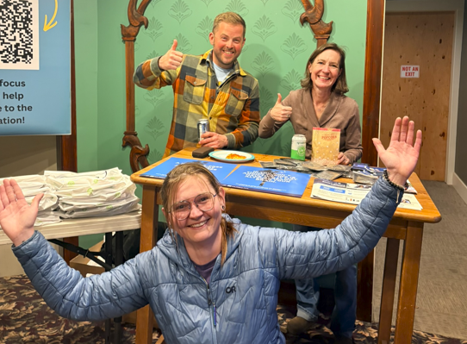
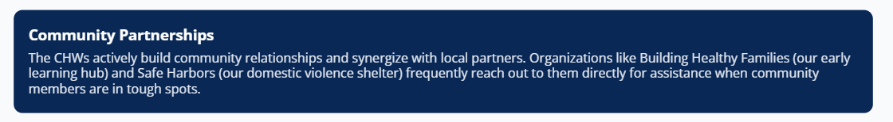
Working Beyond Clinic Walls
School Screenings
Supporting and administering hearing, vision, and dental screenings within local schools.
Public Health
Pivotal team players for WIC services and our Tobacco Prevention and Education Programs.
Community Events
Getting out in the community to offer screening and prevention services and social supports.

Slide 10
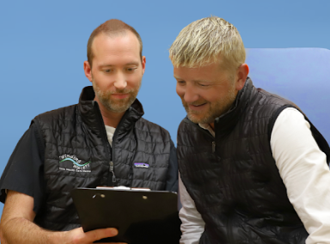
The Value Proposition
Patient Experience
By having CHWs involved in their care, patients are more likely to reach out when they need something, get connected to appropriate resources, and develop increased health knowledge and self-sufficiency.
Physician Experience
By delegating social and environmental navigation to CHWs, physicians can focus on high-level clinical decision-making, reducing burnout and improving the quality of the exam room experience.

