Slide 1

Community Health Workers in Primary Care Settings: Two Successful Oregon Models
Nancy Goff, MPH Director, Health Systems Transformation, ORPRN
Elizabeth M Foster, MD, MA Clinical and Policy Advisor, Connected Care for Older Adults
Elizabeth C. Powers, MD, MHA, FAAFP, FACHE Family Physician, Winding Waters Clinic

Slide 2


Oregon Rural Practice-based Research Network (ORPRN)
We are a statewide network founded at OHSU in 2002.
Our mission is to improve health for all Oregonians through community partnered research, education and policy.
REACH & IMPACT
Since 2019, we’ve worked with:
Over 400 primary care clinics
All of Oregon’s Coordinated Care Organizations (CCOs)
Over 5,200 unique learners in education programs
Nearly 70,000 individual patients
Partners and professionals in all 36 Oregon Counties
PROGRAMS & STAFF
Research & Policy programs related to priorities: 28
Education programs through Oregon ECHO Network related to priorities: ~40 per year
About 55 staff, 30% embedded in rural Oregon communities
ORPRN’s 2019-2023 and 2024-2025 Impact Reports are available at: https://www.ohsu.edu/orprn

Slide 3
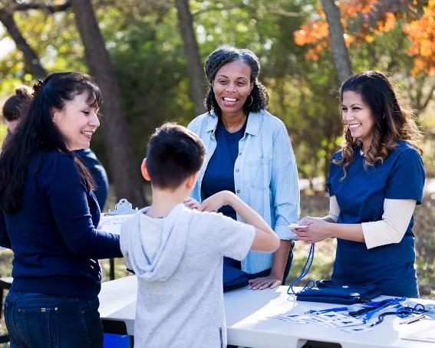
Community Health Workers
Trusted community members who bridge health systems and communities
Focus on outreach, navigation, health education, social needs
Growing integration into primary care teams- driven by value-based care and cost effectiveness
Notes:
Clinic-Embedded Model CHWs part of care team (warm handoffs, panel management)
Community-Integrated Model CHWs work across clinics + community orgs (housing, food, WIC)
Home Visiting Model Focus on high-risk patients (e.g., older adults, chronic conditions)
Cross-Sector / Public Health Model Partnerships with public health, legal aid, food systems
AHRQ – CHW integration frameworks
National Academy for State Health Policy (NASHP) – CHW models

Slide 4
Community Health Workers improve health
Abundance of evidence for the use of CHWs and improvements in:
Access to care & care coordination
Health outcomes- diabetes, hypertension, HIV, asthma, CVD, prevention behaviors, quality of life
Patient satisfaction with care
Cost savings- ROI $1.37 to $2.00 for every dollar spent on CHWs, reduced ED & hospitalization rates
Improving health equity
Molly Knowles, Aidan P. Crowley, Aditi Vasan, Shreya Kangovi. 2023. Community Health Worker Integration with and Effectiveness in Health Care and Public Health in the United States. Annual Review Public Health. 44:363-381. https://doi.org/10.1146/annurev-publhealth-071521-031648

Slide 5
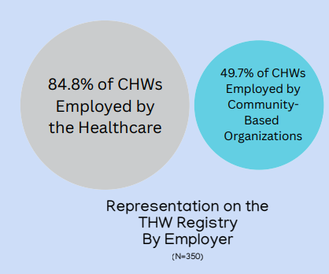
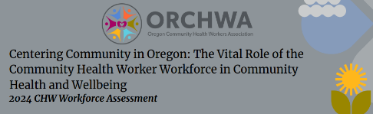
Oregon’s Strong Community Health Worker Infrastructure
CHWs are an important part of Oregon’s health care reform in Oregon
Training: CHWs may become certified in Oregon by attending an approved training program
Coverage: Theoretically, CHW services are reimbursable through Medicaid and Medicare in Oregon
Must be supervised by a licensed health care professional in most cases
Growing workforce: State registry lists 2,390 CHWs in all 36 Oregon counties!
Policy: CHWs are an integral part of the CCO model

Slide 6
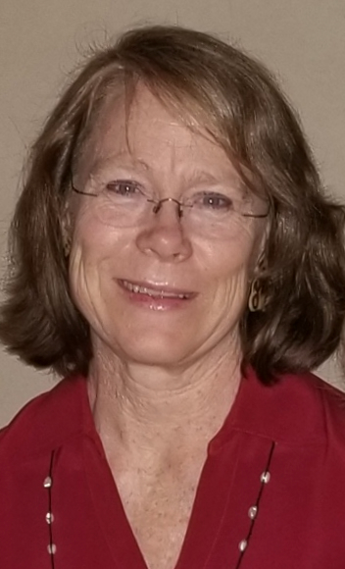
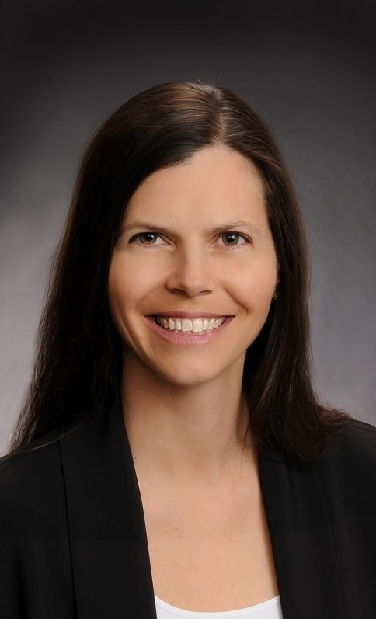
Today’s Speakers
Elizabeth M Foster, MD, MA
Clinical and Policy Advisor
Connected Care for Older Adults
Elizabeth C. Powers, MD, MHA, FAAFP, FACHE
Family Physician
Winding Waters Clinic
Notes:
Elizabeth Foster MD
Elizabeth Foster is the lead clinician working to develop and implement a pilot model for older adult outreach and support in rural areas of Oregon using Age Friendly Health Care. Community Health Workers are the outreach agents, working closely with rural Primary Care Clinicians.
Dr. Foster retired from practicing as a Rural Family Medicine Physician with a full spectrum practice: providing care in clinics, hospitals, and nursing home settings with newborn, pediatric, adult, obstetric and geriatric populations. She owned and worked in private practice as well as for a Federally Qualified Health Center. Additionally, she taught and worked in international rural medical settings, especially in Maternal and Child Health.
Prior to her career in medicine, she worked as an economist, researcher, grantmaker and program specialist in International Rural Development.
Dr. Elizabeth “Liz” Powers, MD, MHA is a family physician and rural health leader serving as Chief Medical Officer and Health Services Officer at Winding Waters Health Center in Enterprise, Oregon. Inspired by a childhood in a medical family, she pursued a career in community-based care, earning her medical degree from Stanford and completing her family medicine residency at Oregon Health & Science University. She joined Winding Waters early in her career and has since helped guide its evolution into a nationally recognized Federally Qualified Health Center.
Dr. Powers has led efforts to transform rural care delivery through integrated, team-based services that address medical, behavioral, and social needs. Under her leadership, Winding Waters has expanded access to care across its region while improving health outcomes. She also serves as Wallowa County’s public health officer and is a strong advocate for innovative care models, workforce development, and equitable healthcare for underserved communities.

Slide 7
Thank you.

