Slide 1

Alzheimer's Disease:
Evaluation and Treatment in Primary Care
OAFP Annual Conference 2026
Robin Brown, MD & Nick Johnson, MD| Geriatrics
browrobi@ohsu.edu| johnnico@ohsu.edu

Slide 2
Disclosures
We do not have any financial disclosures

Slide 3
Objectives
Differentiate normal aging, MCI, and dementia
Describe the role of screening tools, biomarkers and neuroimaging to aid in diagnosis
Identify behavioral and pharmacologic management options & available resources

Slide 4
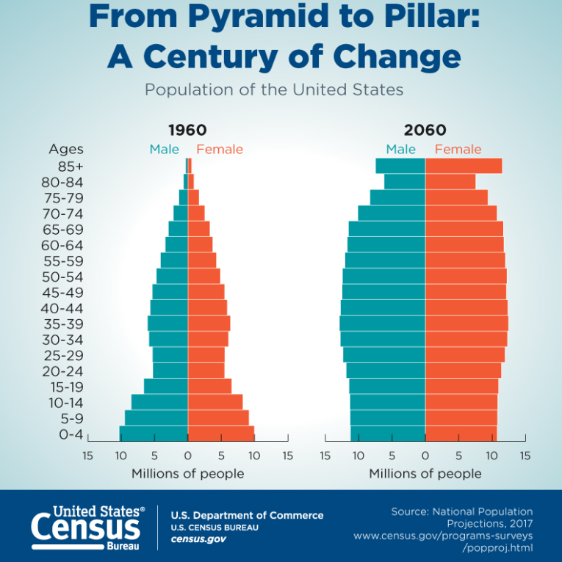
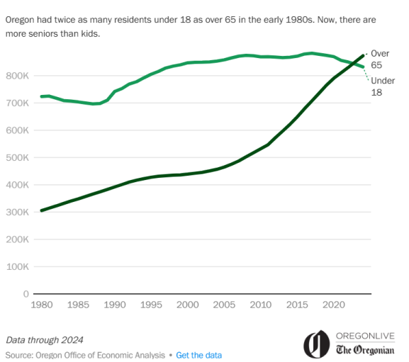
Notes:
I’m sure you all are aware that our country is aging.
This graphic comes from the CDC showing the projected change in age demographics from 1960 > 2060 where you see the biggest change in expansion of older adults, particularly the 80 year olds and beyond
Here are very recent statistics from data up through 2024 that shows that the # of older adults just surpassed younger adults in Oregon
Take home point here is that with the exception of those of you that go into pediatrics, most of you will be caring for older adults in your future practice

Slide 5
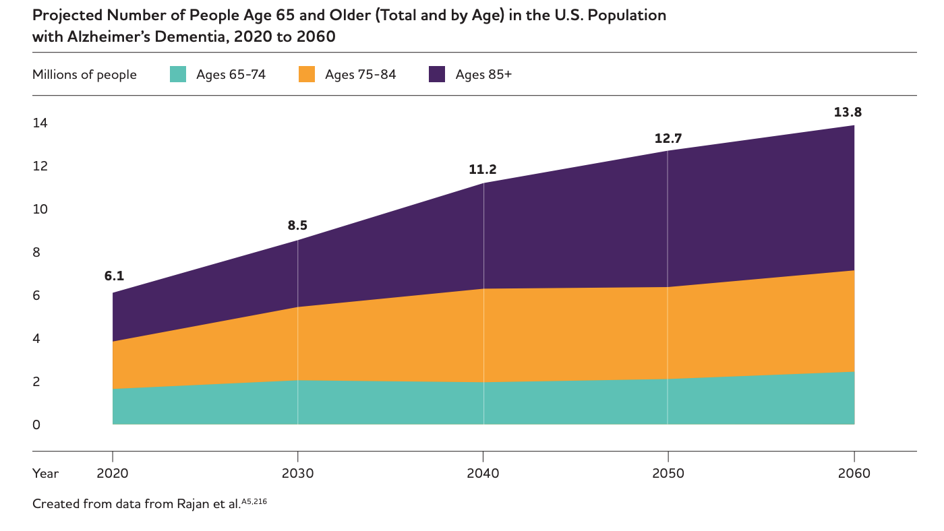

https://www.alz.org/media/Documents/alzheimers-facts-and-figures.pdf
Notes:
I used this slide to illustrate the importance of this topic. This the projected number of older adults with dementia in the next 40 years. Bc of the boomers and live expectancy, you are going to see the biggest increase in the 85+ year olds.
As your career continues you will continue to see more and more older adults and b/c of that you will inherently see more patients with dementia

Slide 6

Patient case - Celia 73yow
CC: memory concerns
Celia is brought in by her daughter who was called last month by a gas station attendant who found her mother sitting in the car confused about how to get home.
Her daughter is worried, she says her uncle has dementia and he lives in a nursing home.
She wants to know if her mother has dementia?

Slide 7
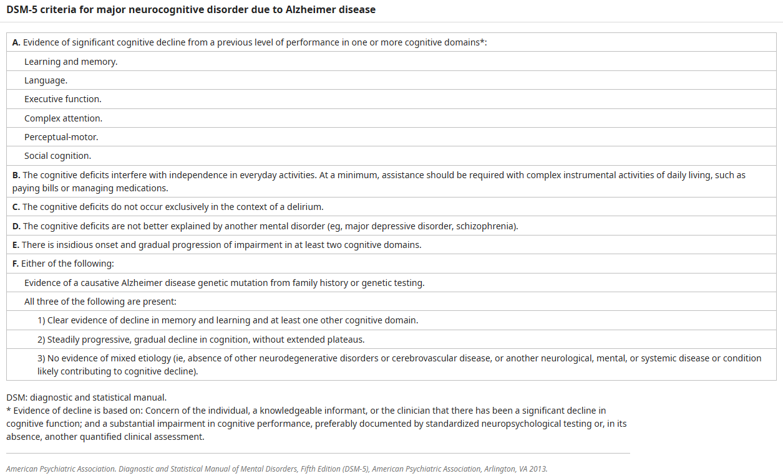
DSM-5: Major Neurocognitive Disorder

Slide 8
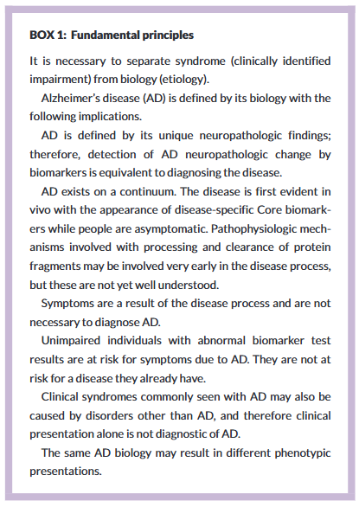
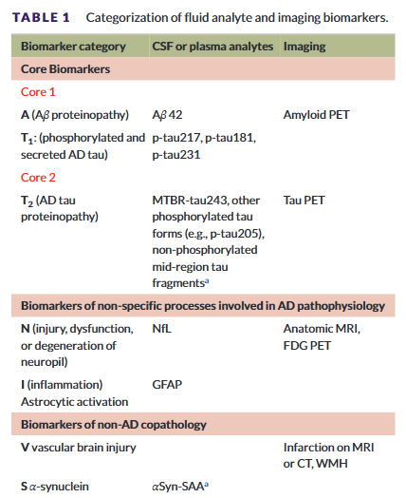


2024 Revised criteria for diagnosis and staging of Alzheimer's disease: Alzheimer's Association Workgroup
Notes:
It has been an era of breakthrough in Alzheimer’s research, novel biomarkers and monoclonal ab tx have emerged in the last couple years. This evolution in AD care has led to revised criteria for diagnoses and staging Alzheimer's disease.
These revised criteria state that AD is defined entirely by biology (biomarkers). Symptoms are the result of the disease and not necessary for the diagnoses. If you have an abnormal biomarker then you have the disease, regardless of if you develop cognitive decline.
This table shows which biomarkers are considered core in making the dx. Going into detail on these later in our talk.
This is a big shift from the prior criteria – which is primarily clinical. Experts in the field do not agree on these criteria and whether or not we should be using biomarkers alone to define AD.
I want you all to know that these new criteria exist, but also that there is uncertainty in if/how it will be used going forward.
Jack CR, Andrews JS, Beach TG, et al. Revised criteria for diagnosis and staging of Alzheimer's disease: Alzheimer's Association Workgroup. Alzheimer's Dement. 2024;20:5143–5169. https://doi.org/10.1002/alz.13859

Slide 9
A dementia diagnosis requires:
Impairment in ≥1 cognitive domain
Functional loss
Progression over time
Pearl #1

Slide 10

Dementia is not normal aging
Notes:
Really important that you all realize that dementia is NOT normal aging. Many times patients will come in thinking cognitive impairment is a normal part of aging (which it isn’t).
But there are normal cognitive changes that do happen with aging. And it falls upon us a their primary care providers to differentiate what is normal vs what is not normal

Slide 11

Normal age-related change?
cognitive domain: memory
Normal = harder to remember the names of people you recently met
Not normal = having trouble remembering the name of close friends or relatives

Slide 12
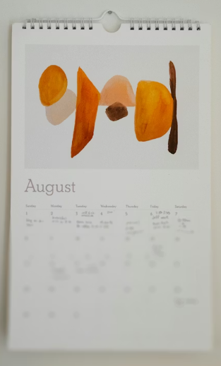
Normal age-related change?
cognitive domain: memory
Normal = use a calendar to keep track of appointments
Not normal = repeatedly asking spouse when a doctor’s visit is, forgetting to reference the calendar

Slide 13

Normal age-related change?
cognitive domain: attention
Normal = to find it harder to watch a movie and carry on a conversation with others (to multitask)
Not normal = be unable to follow the plot of a movie when it is quiet (sustain attention on one task)

Slide 14

Normal age-related change?
cognitive domain: executive function
Normal = to need help with driving directions in a new city
Not normal = become lost driving to a familiar place

Slide 15
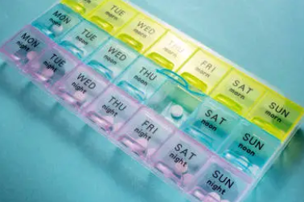
Normal age-related change?
cognitive domain: executive function
Normal = rarely miss a medication when you have a busy day
Not normal = need reminders to take your daily medications

Slide 16

Normal age-related change?
cognitive domain: psychomotor skills
Normal = reaction time is slower
Not normal = no longer be able to do your favorite hobby when there is unlimited time

Slide 17
Cognitive screening options:
SLUMS
Free!
Normal ≥27/30
Easier than the MoCA
Multiple languages
*Validated in a VA population – English speakers, mostly
men, varying education levels and diverse backgrounds
MoCA
Proprietary ($125 one-time fee)
Normal ≥26/30
90% sensitive for MCI
Multiple languages
Versions for those with low literacy, hearing or visual impaired
Validated to support concern of unsafe driving (score <18,
abn trails, clock draw, or attention components)
*Validated in mostly white, college-educated, English or French speakers
RUDAS
Free!
Normal ≥23/30
*Validated in persons with low literacy or non-English speaking
IQ CODE (short version)
Free!
Surrogate questionnaire, if patient is absent or delirious
Irrespective of education level
Supports dementia if score is > 3.38
MMSE
Proprietary ($1.23/test)
Normal ≥25/30
Less sensitivity for MCI
The only validated method for dementia ”staging”
Mini-cog
Free!
Quick and easy
≤2/5 is an abnormal score -> further testing
99% sensitive
Notes:
To identify if there is cognitive impairment, we use cognitive screeners.

Slide 18
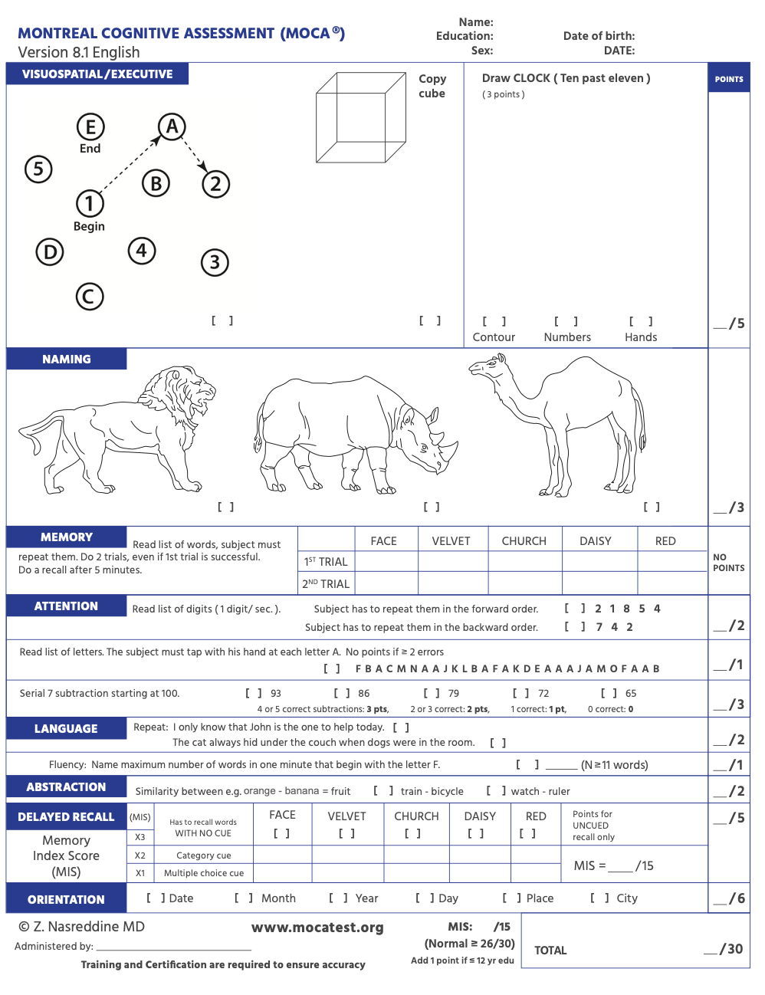
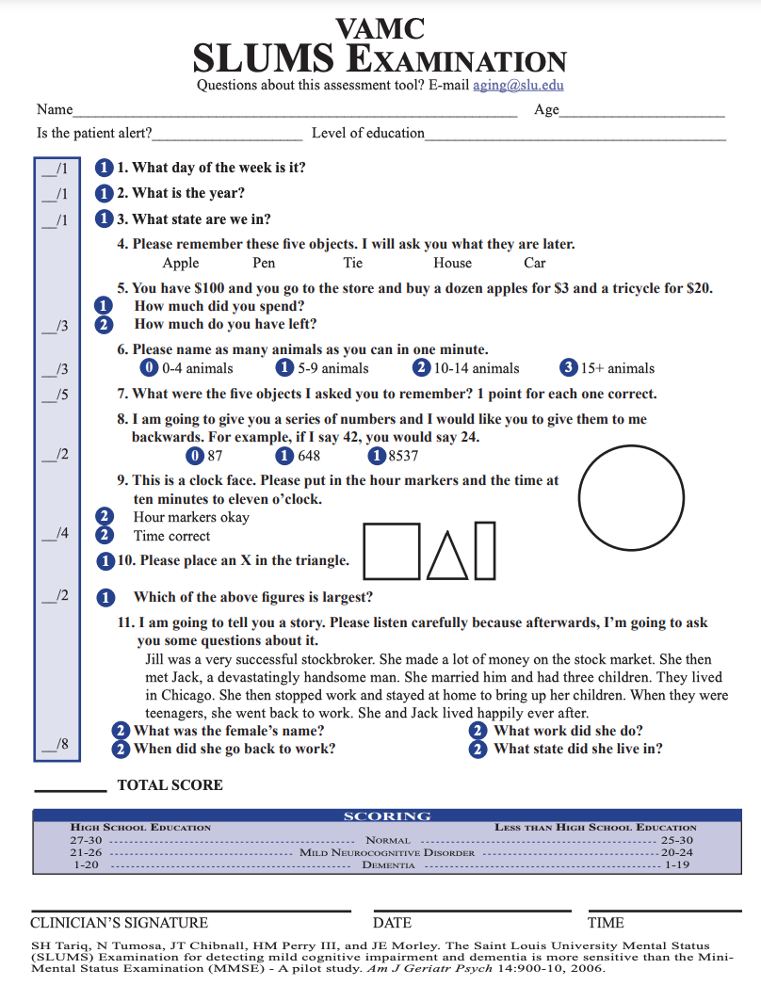
MoCA website: https://www.mocatest.org/
Step-by-step (free) training video: http://bcove.me/gke40f7p
SLUMS website: https://www.slu.edu/medicine/internal-medicine/geriatric-medicine/aging-successfully/assessment-tools/mental-status-exam.php
SLUMS instructions/scoring: https://www.albertahealthservices.ca/assets/info/hp/hpsp/if-hp-hpsp-cognitive-screening-slums-scoring.pdf
SLUMs training video: https://www.youtube.com/watch?v=z4ctoWU-qzw

Slide 19
Neuropsychology assessment
2-4 hour comprehensive evaluation
Helps support a diagnoses in more complex cases:
Highly educated persons
Mild cognitive impairment
Differentiating learning disabilities from dementia
Differentiating attention or mood disorders from dementia

Slide 20
Tips – for cognitive screening
Schedule a separate (extended length) appointment
Bring hearing aids and/or glasses
Bring instructions into the room
Use in-person interpreter and language-specific screening test if needed
*scores are used for comparison to peers
*by itself, a low score on a screening test does not equate to dementia. To make a dementia diagnosis you need to also show functional decline.

Slide 21
Taking a functional history:
IADLs:
Manage finances
Use transportation
Take medications
Prepare meals
Do housework
Use telephone
ADLs:
Bathe
Dress
Toilet
Transfer
Ambulate
Feed

Slide 22


Taking a functional history:
Look for changes as compared to baseline
Functional abilities exist on a continuum (independent>assist>dependent)
IADLs are higher level and will become impaired first before ADLs
IADLs:
Manage finances
Use transportation
Take medications
Prepare meals
Do housework
Use telephone
ADLs:
Bathe
Dress
Toilet
Transfer
Ambulate
Feed
Notes:
ase

Slide 23
What is mild cognitive impairment (MCI)?
Cognitive impairment without functional decline
Pearl #2

Slide 24
What is mild cognitive impairment (MCI)?
Cognitive impairment without functional decline
MCI ≠ mild dementia
Limited benefit of dementia medications in MCI
Aggressively target risk factors for dementia! And create a surveillance plan!
10-20% of patients with MCI will develop dementia each year
Notes:
Risk factors – CV disease, hearing loss, physical inactivity, poor diet

Slide 25
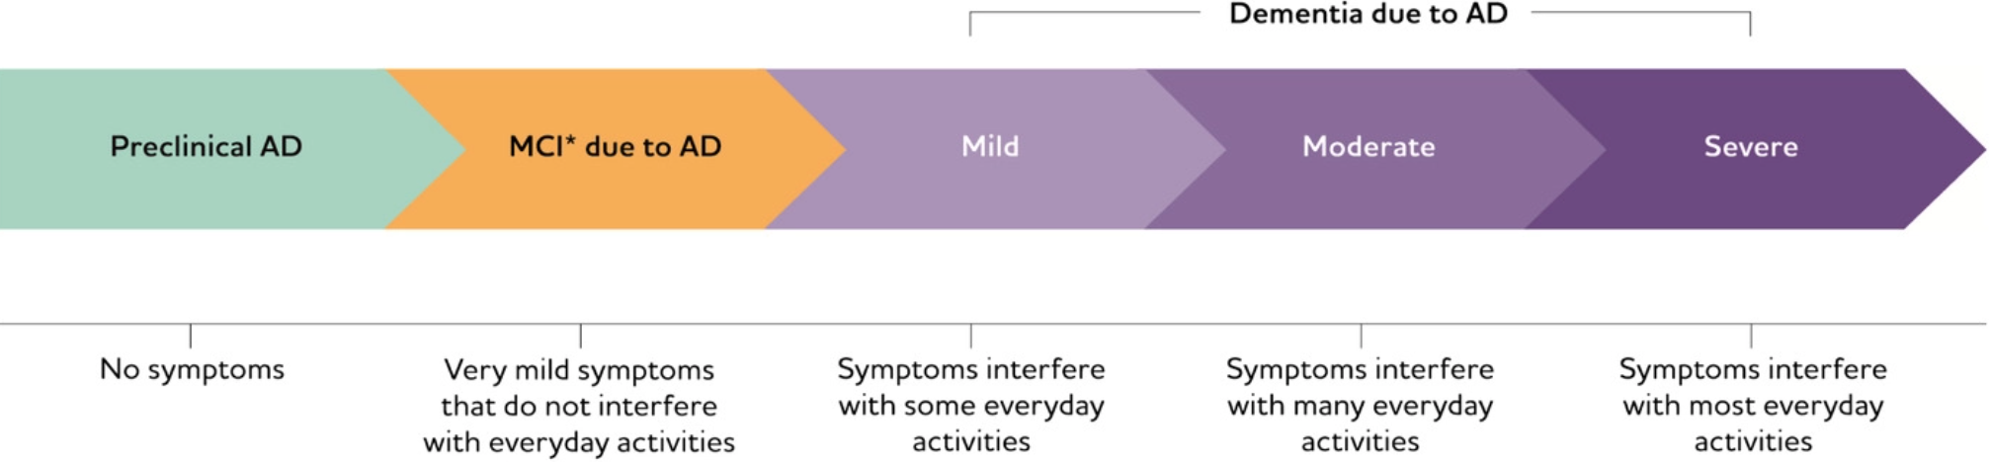
Functional impairment
Adapted from: https://www.alz.org/
Notes:
MCI may not be due to dementia, but if it were due to Alzheimer’s disease then this is how it would fit in to the spectrum of the disease

Slide 26

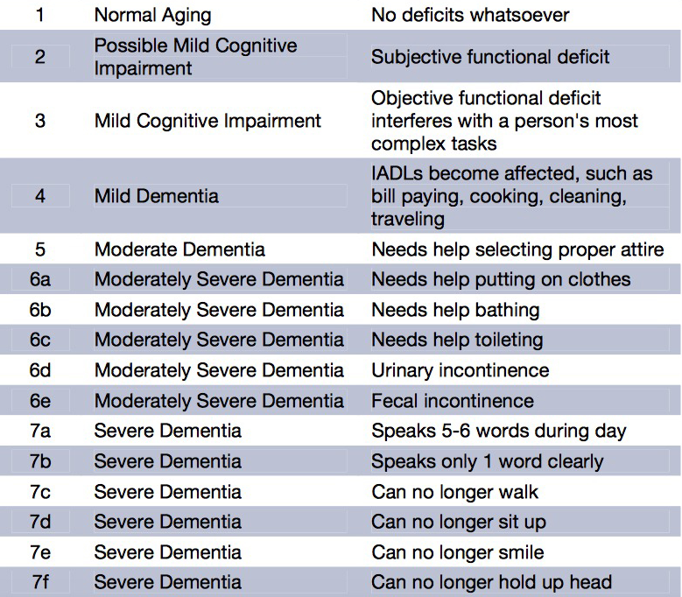

FAST Scale for Dementia Staging
Hospice eligibility for dementia
Stage 7 or beyond,
AND
One or more in the last 12 months:
Aspiration pneumonia
Pyelonephritis
Sepsis
Multiple pressure ulcers (≥ stage 3)
Recurrent fever despite abx
10% weight loss or albumin <2.5
Other condition that suggests limited prognosis
Notes:
When is someone eligible for hospice due to their dementia

Slide 27
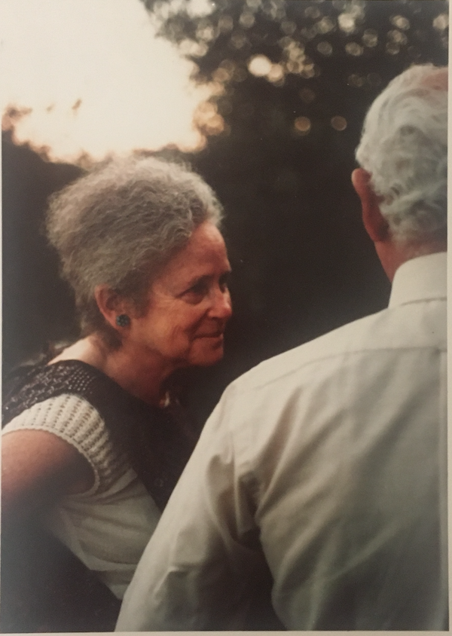
You must have collateral history
Because insight is impaired in dementia
Pearl #3
Notes:
I cannot emphasize this enough and I think this is what I see as a limitation is many of my peers evaluation for dementia.
Request that they bring a family or friend to the visit
If unrepresented pt – look to verify their history through chart review, have them bring meds in for med rec (refer to pharmacy), HH RN to assess home and medications
Those with preserved insight are more likely to have depression (and in my experience anxiety). Those without insight are more likely to have behavioral symptoms (psychosis)

Slide 28
Patient case - Celia 73yow
IADLs:
Manage finances – A, her daughter took over bill pay, Celia uses her checkbook and cash
Use transportation – D, recently became lost in familiar place
Take medications – D, multiple pill bottles are expired
Prepare meals – I, uses the microwave more
Do housework – I
Use telephone – I
ADLs:
Bathe – I, every other day
Dress – I
Toilet – I, no incontinence
Transfer – I
Ambulate – I
Feed – I
I = independent
A = assist
D = dependent

Slide 29

Differential diagnosis: 6 Ds
Dementia
Delirium
Depression/mood disorders
Damaged brain
Deficient education
Developmental delay
Cognitive impairment is often multifactorial!
Notes:
Like any diagnoses we are making, we should always be considering a differential diagnosis. In fellowship I was taught the 6 Ds when considering the differential for a dementia.
I think about these as a layer cake, there are often more than one contributing. For most of our patients cognitive impairment is multifactorial.
Dementia is on the ddx
Delirium – most people think about acute delirium (infectious and illnesses) but from a clinic standpoint I think about “subacute delirium” which can be
Chronic dehydration, over sedation from CNS acting med, recurrent hypoglycemia, hypothyroidism etc
Depression or mood disorders – “pseudodementia” which can create cognitive impairment but is reversible with treatment
New late onset mood disorders are often associated with development of a neurodegenerative disorder. In fact 40% of older adults with a new depression dx go on to develop dementia.
Deficient education – education provides cognitive reserve and knowing their level of education helps you understand what their baseline could be. A physician may score higher on a MoCA even in early dementia that someone without dementia but no or little formal education.
Developmental delay – fairly self explanatory, but again tells you baseline
Sometimes people have trouble differentiating the apathy from dementia from anhedonia from depression. In apathy from a neurodegenerative disorder i.e. dmentia patient’s aren’t really bothered by it. They won’t have most of the SIGECAPs symptos (like guilt, energy, sleep, concentration, appetite etc) The caregiver mostly bring si tup (it bothers me s/he/they no longer want to do x,y,ox) where as with anhedonia in depression the patient’s are often very bothered by it.

Slide 30
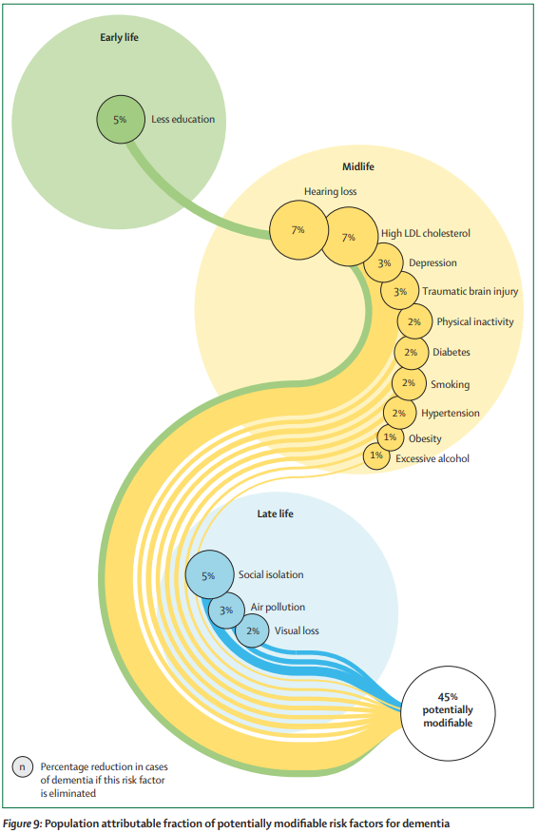


Livingston G et al. Lancet. 2024;404(10452):572-628
Notes:
graphic from 2024 lancet article showing potentially modifiable risk factors for dementia throughout a person’s lifespan, from early > mid > late life.
45% of all dementia cases are thought to have potentially modifiable risks factors. Hearing loss is associated with 7% of dementia cases. If your patient is hard of hearing, get them to an audiologist and get them some hearing aids, as it could prevent dementia.
Speaks to the need for preventive care and a good primary care doctor, who plays an important role in preventing dementia.

Slide 31
Workup – of cognitive impairment
History of cognitive changes, behaviors, brain insults (TBI, falls, strokes), CV risks, fam hx, sensory loss (hearing, vision)
Functional status ADLs/IADLs
Social history education level, occupation, social support, substance use
Cognitive screen MoCA or SLUMS, +/- formal neuropsychology testing
Mood disorder screen PHQ9 or GDS, GAD7
Neurologic exam for focal deficits, gait and balance, parkinsonism
Labs: CBC, CMP, TSH reflex, B12 +/- RPR, HIV (if risk factors) +/-APOE e4 allele (if considering anti-amyloid tx)
Biomarkers: next slide
Imaging* – CT head wo, MRI head wo to r/o neoplasm, NPH, regions of brain atrophy, CVA or degree of white matter disease * check records (ER visits) for prior head imaging
Notes:
GDS does not include questions about “vegetative symptoms” since people often slow down in older age (appetite loss, weight loss, fatigue)

Slide 32
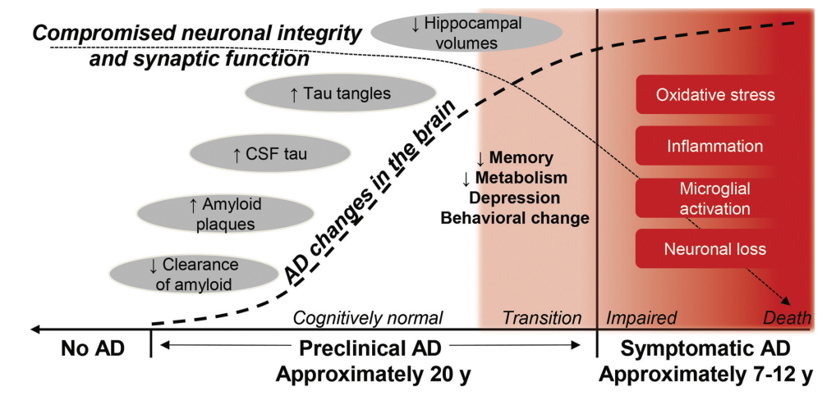
Figure 1-1 The Lifespan of Alzheimer Disease
Day, G. Diagnosing Alzheimer’s Disease. Continuum. 2024. 30(6)1584-1613
Notes:
The next couple slides I will talk about the biomarkers that can be considered in the diagnostic pathway for dementia. To understand how the biomarkers came to be it is helpful to understand changes that occur as the disease progresses
In preclinical disease, there is a reduction in amyloid clearance, then an increase in amyloid plaques, then an increase is CSF tau, and increase is Tau tangles, as someone transitions into clinical disease
There is a reduction in hippocampal volumes
Day, G. Diagnosing Alzheimer’s Disease. Continuum. 2024. 30(6)1584-1613
FIGURE 1-1 The lifespan of Alzheimer disease (AD). Inciting pathophysiologic factors lead to the onset of the protracted preclinical phase of AD marked by the formation and accumulation of cerebral (amyloid) plaques, neurofibrillary (tau) tangles, and other changes that compromise neuronal integrity and synaptic function in cognitively normal individuals. Accumulating AD neuropathologic change heralds the emergence of subtle changes in cerebral metabolism, memory, and behaviors (ie, the transition phase) and eventually the onset and progression of cognitive impairment that marks the symptomatic phase of the disease. Modified with permission from Morris JC, Dana Foundation Newsletter.14 © 2013 Dana Foundation.

Slide 33

Alzheimer’s Disease – Fluid Biomarkers
CSF
Aβ42/Aβ40 ratio
p-tau181/Aβ42
t-tau181/Aβ42
Blood based
P-Tau217 (best option! equivalent accuracy to FDA approved CSF biomarkers and amyloid PET scan)
Aβ42/Aβ40 ratio
P-Tau217/Aβ42 ratio
Others: p-Tau181, p-Tau 231, NfL
Salivary – in studies
When to use?
Early in disease (MCI or mild dementia) to help differentiate or support a hypothesis
Not for screening of asymptomatic persons
Not yet being used to evaluate disease progression or to monitor treatment response
Logistics:
Check collection requirements
Not covered by insurance ($200-1,400)
Notes:
Biomarker = objective marker of disease
CSF – has been around for awhile, these are the available options.
The blood-based ones are what is emerging rapidly and changing the field, as they are much more cost effective and accessible than other biomarkers. P-tau 217 is considered the best option available, sensitivity/specificity 90% and 90%. Salivary ones are in studies
When to use the blood based biomarkers?
Early in the disease, MCI or mild dementia, to help differentia or support a hypothesis..
They should not be used alone or to screen for asymptomatic persons, as we cannot give information about what a positive means. Need to be used in addition to clinical evaluation.
They are not yet being used to evaluate disease progression or monitor treatment response, but this is in progress.

Slide 34
Alzheimer’s Disease – Imaging Biomarkers
Amyloid PET
Core biomarker for Alzheimer’s Disease (AD)
Available at OHSU
Covered by Medicare B ($3K, patient will pay 20%)
Tau PET
Core biomarker for AD
Emerging use, mostly in research
Not covered by Medicare
MRI with volume analysis
Non-specific biomarker for AD
Available at OHSU
MRI dementia protocol to OHSU (not HMC) with “NeuroQuant” analysis
FDG-PET
Non-specific biomarker for AD
Available at OHSU
To differentiate frontotemporal dementia from AD, further evaluate the patterning of brain disease
Notes:
Amyloid PET – abnormal earlier on in disease
Tau PET – if you remember the earlier chart, tau shows up later in the disease course, so will not be positive as early as amyloid will
While it’s really enticing to have a quick diagnostic marker. A diagnosis of Alzheimer disease should never be made based on subjective complaints alone or a single abnormal test, whether it be a low score on a cognitive examination or an abnormal biomarker. The diagnosis requires a comprehensive clinical evaluation.
Jack CR, Andrews JS, Beach TG, et al. Revised criteria for diagnosis and staging of Alzheimer's disease: Alzheimer's Association Workgroup. Alzheimer's Dement. 2024; 20: 5143–5169.

Slide 35
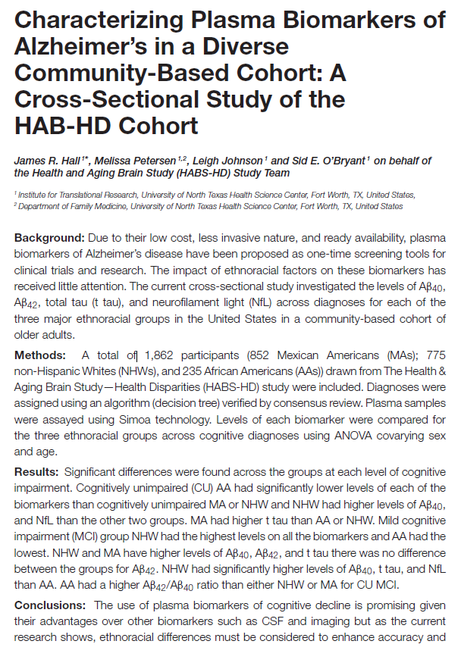
Racial & ethnic differences – blood biomarkers
Lack of representation in dementia research, both in biomarkers and treatment
This 2022 study showed significant differences in blood-based biomarker levels across Mexican American, Non-Hispanic White, and African Americans
We need normative values for different groups
Hall JR et al. Characterizing Plasma Biomarkers of Alzheimer's in a Diverse Community-Based Cohort: A Cross-Sectional Study of the HAB-HD Cohort. Front Neurol. 2022;13:871947
Notes:
Hall JR, Petersen M, Johnson L, O'Bryant SE. Characterizing Plasma Biomarkers of Alzheimer's in a Diverse Community-Based Cohort: A Cross-Sectional Study of the HAB-HD Cohort. Front Neurol. 2022;13:871947

Slide 36
Patient case - Celia 73yow
Memory changes were first notice two years ago. She is repeating herself more. The progression has been gradual. She denies mood symptoms.
Phmx: hypothyroidism, osteopenia, anxiety in remission
Meds: levothyroxine 75mcg QD, sertraline 100mg QD,OTC Ca/D3, OTC Tylenol PM
Social hx: 1 year of college. Worked as a receptionist in a dental office. 2 children. Lives alone after becoming widowed. Daughter and son-in-law are nearby.

Slide 37
Patient case - Celia 73yow
Follow-up visit #1: Her neuro exam is normal. TSH is elevated. Head imaging shows generalized atrophy and a mild white matter changes.
You suspect dementia. However, you recommend the daughter start supervising her medications (levothyroxine) and reassess once her thyroid levels are normal. You counsel her to stop using Tylenol PM and instead recommend melatonin.
You say it is not safe for her to continue driving until she has a driving evaluation, she does not think she’ll pass so she gives up the keys.
Notes:
I often find with people with anxiety they don’t try to do the driving assessment when presented to them.

Slide 38
Patient case - Celia 73yow
Follow-up visit #2: She returns in 3 months. Her TSH is now normal.
You repeat a MoCA and she scores 15/30 (prior was 16/30). She continues to require assistance and is dependent for multiple IADLs.
You diagnose dementia

Slide 39
Tips – for disclosing a diagnosis
Don’t make a dementia diagnosis on the first visit
Be deliberate in sharing the diagnosis
Make a follow-up to discuss management
Disclosure example: https://www.alz.org/professionals/health-systems-clinicians/dementia-diagnosis/disclosure-of-diagnosis
Notes:
Unless totally obvious. You want to make sure you have been thorough in your evaluation often want to prove to yourself there is functional decline if you are unsure. Plus it just takes multiple visits to get all of the information.
Be deliberate in sharing a dementia diagnosis, it is delivering difficult news. I will review the workup thus far and the reasoning for a dementia diagnosis. And I always come out and be intentional about the diagnosis.
If unexpected, there are usually a lot of questions about what to do next.

Slide 40
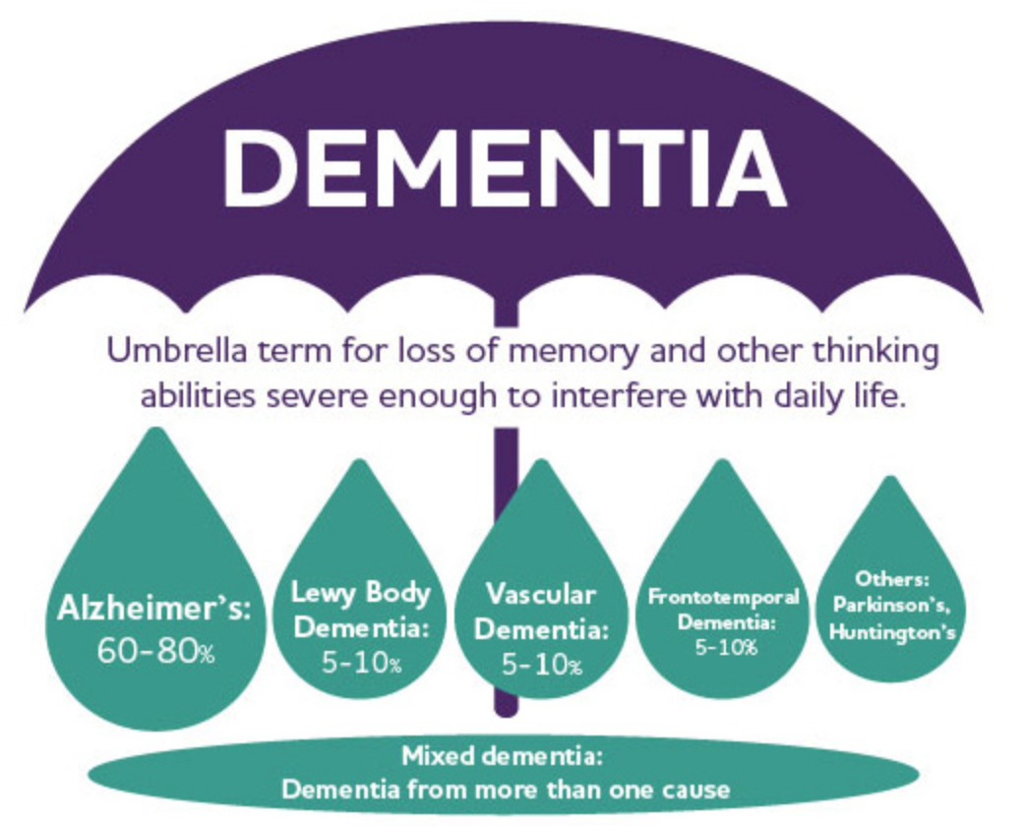
https://www.alz.org/alzheimers-dementia/what-is-dementia
Notes:
Dementia is an umbrella term
For most of our patients we are diagnosing a “dementia syndrome” (the umbrella) and making a inference about the most likely type (Alzheimer’s, vascular etc), new biomarkers are going to change our ability to rule in or out AD, where previously that was only possible on autopsy.
These percentages vary depending on which study you read, more recent literature suggests vascular is 2nd most likley

Slide 41
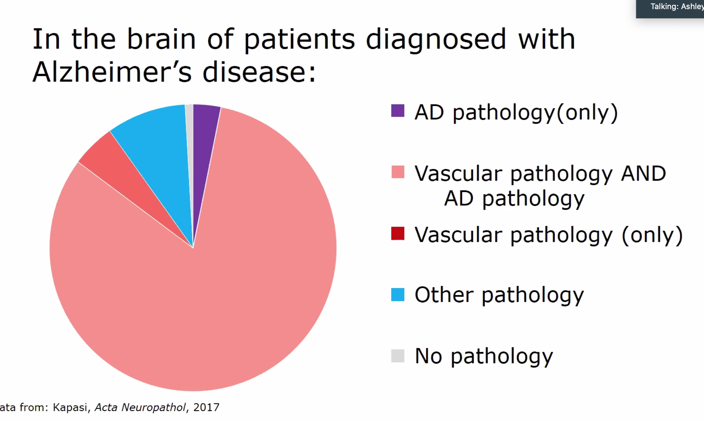

Adapted from: Kapasi et al. Acta Neuropathol. 2017
Notes:
Vascular pathology is likely much more prevalent than we realized
graphic comes from research at UoO
autopsies of patient clinically diagnosed with Alzheimer's and found that a majority (>75%) also met the criteria for vascular dementia (burden of microvascular disease and/or infarcts). thus they had a mixed Alzheimer's and vascular etiology
This is important for you all as primary care doctors, b/c by identifying and managing our patients cardiovascular disease (BP, OSA, DM)

Slide 42
 | Alzheimer’s Disease (AD) | Vascular Dementia (VaD) | Dementia with Lewy Bodies (DLB) | Frontotemporal Dementia (FTD) | Parkinson’s Disease Dementia (PDD)
Prevalence *varies by source | #1 cause 60-70% of cases | 20-40% of cases A common contributor “mixed dementia” to AD | 10-30% of cases | 5-10% of cases | <5% of cases
Defining features | Slowly progressive Memory changes are predominant “amnestic presentation” Impaired learning and recall of new information | Insidious onset from microvascular disease Abrupt “step-wise” progression for large vessel infarcts/CVA Consider CV risk factors (HTN, DM2, OSA etc) | Core features: Parkinsonism (bradykinesia) Cognitive fluctuations Visual hallucinations Supportive features: Autonomic dysfunction Anosmia Constipation REM sleep behavior disorder | Younger onset (50-60yo), often misdiagnosed as MH disorder Behavioral variant (BvFTD): personality changes, disinhibition, socially inappropriate, apathy, sweet cravings Language variants (PPA): loss of language use or meaning | Motor symptoms proceed cognitive impairment by ≥1 year and typically 5-10 years Prevalence is high (40-80%) in late stage Parkinson’s Disease (PD)
Findings on cognitive tests | Deficits in memory/delayed recall No improvement in memory with cueing (low MIS) | Variable deficits depending on lesion: : executive function, attention Improvement in memory with cueing (high MIS) | Deficits in visuospatial/executive function and attention, memory may be relatively preserved | Deficits in executive function and language | Deficits in visuospatial/executive function, memory may be relatively preserved
Imaging findings | Medial temporal lobe atrophy, decreased hippocampal volume Special imaging: Volumetric MRI used to assess patterns of atrophy and hippocampal volume, amyloid-PET (research only) | Single large infarct, multiple small infarcts, or moderate (>25%) white matter changes MRI is more sensitive to white matter changes than CT | Special imaging: DaT Scan used to differentiate essential tremor from PDD/DLB) | Fontal and temporal predominant atrophy Special imaging: FDG-PET used to differentiate AD from FTD | Special imaging: DaT Scan used to differentiate essential tremor from PDD/DLB
Medications | mild: cholinesterase inhibitors (ex. donepezil) mod-severe: NMDA-antagonists (ex memantine) | If mixed etiology try cholinesterase inhibitors (not for pure VaD) Manage CV disease No evidence for ASA or statins | Cholinesterase inhibitors helpful for cognition and psychosis Careful with antipsychotics (use only quetiapine and pimavaserin) | Avoid dementia medications, they may worsen symptoms | Cholinesterase inhibitors helpful for cognition and psychosis Careful with antipsychotics (use only quetiapine and pimavaserin)
Prognosis | 10-14 years (onset to death) Median survival after dx is 7 years | Heterogeneous | 5-7 years | 4-6 years, however diagnosis may be missed for years Longer for language variants
Notes:
Comparing dementia types – for your future reference

Slide 43
Treatment is largely environmental
Pearl #4
Notes:
Pearl #4
Note that I didn’t say there was no treatment, rather pharmacologic treatment is not the most effective
Unfortunately, tx cannot cure or reverse cognitive decline, however we can sometimes slow it, and we can certainly reduce harms, and improve quality of life of the person with dementia, and their caregiver

Slide 44
Treatment
Promote healthy lifestyle – social support/engagement, cognitive stimulation, Mediterranean diet, physical activity (Tai Chi), smoking cessation ​
Manage comorbidities – HTN, OSA, diabetes (especially hypoglycemia risk) etc.​
Optimize sensory function – hearing, vision, tactile​
Advance care planning – understand finances, living situation, caregiver support, Advance Directives, POLST
7% of dementias are attributed to untreated hearing loss!
Notes:
Treatment will vary based on staging of dementia, and thus needs of the patient, but in general I think about these areas for treatment.

Slide 45

“the long goodbye”
Notes:
People often refers to the caregiver’s experience of dementia as the “long goodbye”
Many of us have had experience through family/friends, it is devastating to watch the loss of the mind and character of your loved one
important to acknowledge this

Slide 46
Treatment – the 5 S's
Safety --> weapons, drivability, door locks, stoves, scalding bath water
Structure --> orientation, regular sleep/wake cycles, mealtimes, medication admin
Stimuli --> throughout the day to reduce boredom and stress
Supervision --> Do they need 24/7 supervision? Do not prescribe any medications if there is not adequate supervision!
Stress --> patient & caregiver
Notes:
As dementia progresses patients are either going to need more cares brought into the home, or to move into a community facility. I use the 5 S’s to help determine what is needed
Stimuli – creativity, social engagement, outdoor time

Slide 47
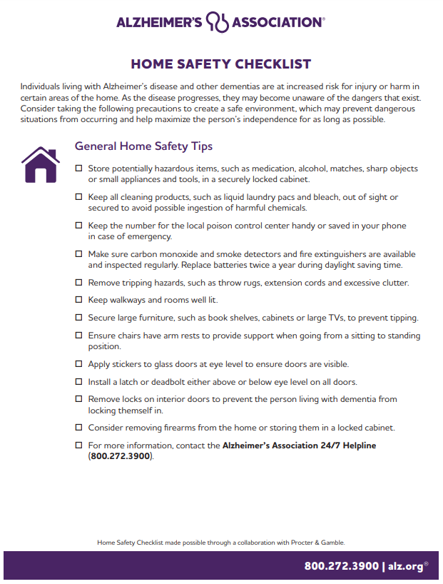
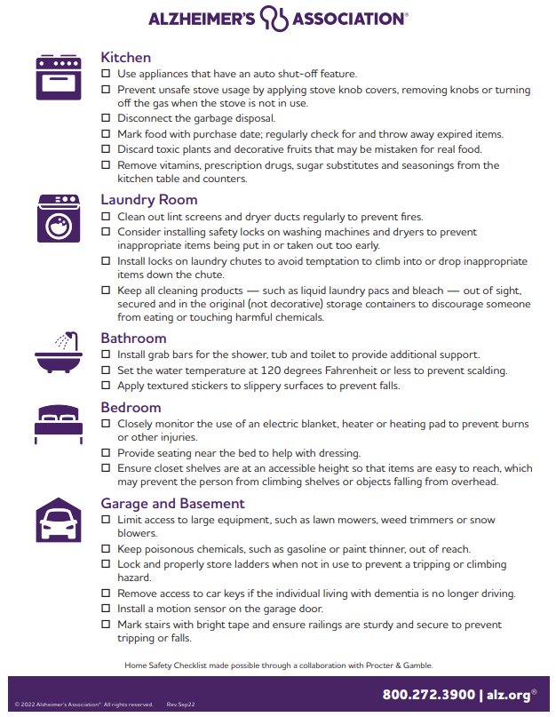
Home safety checklist from Alzheimer's Association: https://www.alz.org/media/Documents/alzheimers-dementia-home-safety-checklist.pdf
Notes:
Here is a safety checklist you can give a patient’s caregiver to check the home for safety when living with someone with dementia – things on here include making sure the water heater has max temp so they cannot burn themselves in the shower

Slide 48
Dementia behaviors
Psychosis - delusions, hallucinations
Aggression, irritability – verbal or physical, anger
Resistance to cares – bathing, peri-care, dressing
Wandering or exit seeking
Sleep disturbances – REM sleep disorders (ex. dream enactment) are associated with LBD
Inappropriate sexual behavior
* Avoid using the term “agitation” it is non-specific
* Ask about preceding triggers, in hopes of reducing or eliminating that trigger
* When treating behaviors, identify “target symptom”
Notes:
and is based on what the observer thinks is appropriate, be more specific
Image of the behavior – play by play

Slide 49

Avoid the 2 Cs:
Confrontation
Correction
Avoid poking them with a sharp stick!
Notes:
practical communication tips for mod-severe dementia behaviors

Slide 50
Avoid the 2 Cs:
Encourage the 3 Ds:
Confrontation
Correction
Distraction
Re-direction
Do nothing
Notes:
practical communication tips for mod-severe dementia behaviors

Slide 51
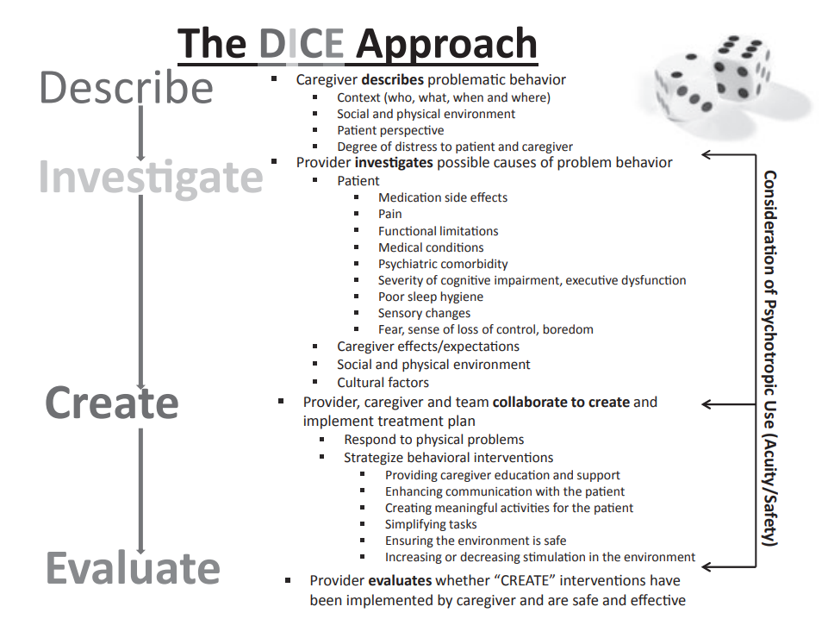
Kales HC et al. J Am Geriatr Soc. 2014;62(4)762-769
Notes:
DICE is a simple systematic method for understanding, assessing and managing behavioral and psychological symptoms in dementia
Kales HC, Gitlin LN, Lyketsos CG; Detroit Expert Panel on Assessment and Management of Neuropsychiatric Symptoms of Dementia. Management of neuropsychiatric symptoms of dementia in clinical settings: recommendations from a multidisciplinary expert panel. J Am Geriatr Soc. 2014;62(4):762-769

Slide 52
Treatment - pharmacologic
Deprescribe
CNS-acting meds (anticholinergics, sleep meds, opiates, muscle relaxers, hypoglycemia inducing) *refer to 2023 AGS Beers Criteria
Simplify/reduce pill burden
Pharmacy consult
To consider
Acetylcholinesterase inhibitors & NMDA-R antagonists
Anti-amyloid therapy

Slide 53
Cognitive and functional impairment
Time
Notes:
effectiveness of these drugs
Some patients will have more, and some will have less improvement in symptoms. Dementia is a devesting disease and patients should be given the option to try these medications to see if they are responsive.
However, can be very beneficial in lewy body dementia!!
Best case gives you “modest” benefit
(2.7 points on a 70 point scale)

Slide 54
Standard meds – for Alzheimer's Disease
Acetylcholinesterase Inhibitors: donepezil, rivastigmine, galantamine
FDA approved for mild-to-severe dementia
Modest improvement in cognitive and functional scores at 6-12 months
Not shown to improve QOL or reduce healthcare costs
Common (typically transient) adverse effects: nausea, diarrhea
Rare AE: vivid dreams, bradycardia
NMDA-R antagonist: memantine
FDA approved for moderate-to-severe dementia
Commonly added to donepezil though no obvious benefit of one over the other (or if additive)
Renal dosing
Possible (typically transient) adverse effects: dizziness, headache, constipation
Notes:
Skip this – here for your reference for how to prescribe dementia medications for Alzheimer’s, note that these medications are not used for all dementia types
The most common medication used in dementia is donepezil, it is an acetylcholinesterase inhibitor that can improve the symptoms of dementia. Unfortunately there is no cure for dementia. This medication works well for some people but has little effect for others. I recommend we start it and track how your symptoms change in the next 3-6 months. If you are having serious side effects and/or by 6 months do not notice improvement then I recommend we stop it.

Slide 55
Anti-amyloid – for Alzheimer's Disease
Lecenemab/Leqembi & Donanemab/Kisunla
FDA approved for MCI and mild dementia + amyloid presence in brain
IV infusions every 2-4 weeks, serial MRI monitoring
$$$ (20-30K per year for infusion, Medicare B covers + 20% co-pay)
Adverse events:
infusion reactions
Amyloid Related Imaging Abnormalities (ARIA) → cerebral edema, intracranial hemorrhage (risk highest in first 6 months, higher with ApoE ε4 Homozygotes)
Outcomes (Disease-oriented vs Patient-oriented)

Slide 56
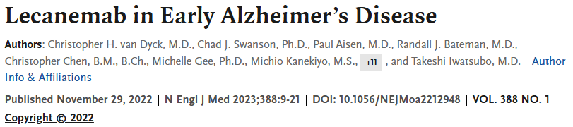
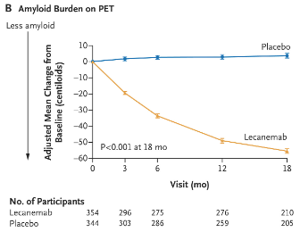
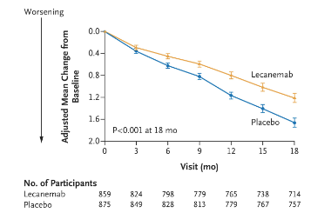
Clarity-AD2 trial, double-blind, placebo controlled, n = 1795 +diagnosed AD, median age 72, 77% white
Notes:
The mean CDR-SB score at baseline was approximately 3.2 in both the lecanemab and placebo groups, findings consistent with early Alzheimer’s disease (score of 0.5 to 6 out of possible 18 total points (combination of cognitive and functional assessment) where a change of 0.5-1 is considered clinically meaningful). The adjusted mean change from baseline at 18 months in the CDR-SB score was 1.21 in the lecanemab group and 1.66 in the placebo group (difference, −0.45; 95% confidence interval [CI], −0.67 to −0.23; P<0.001)

Slide 57
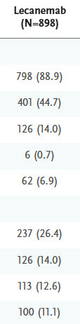

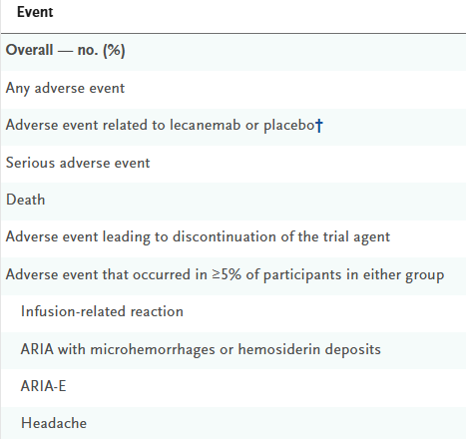
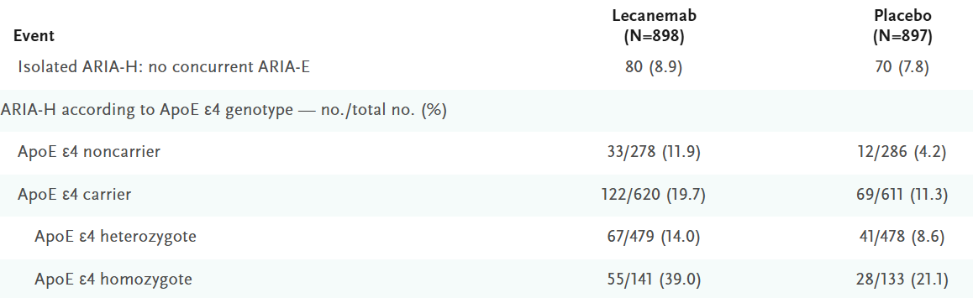
Macrohemorrhage --> 5 (0.6) vs 1 (0.1)

Slide 58
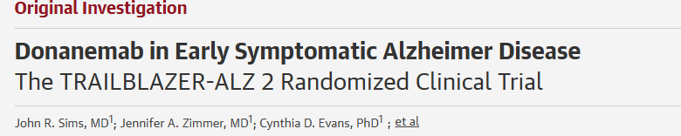
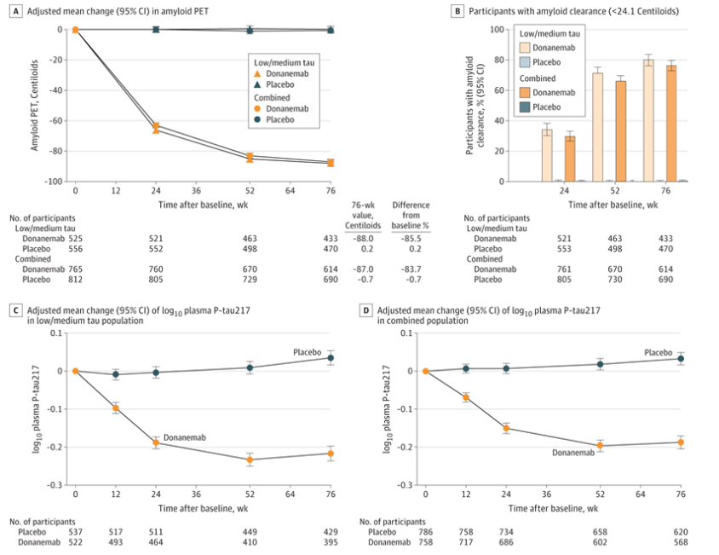
Double-blind, RCT → n = 1736 +MCI/mild AD, +biomarker, +PET, mean age 73, 91% white

Slide 59
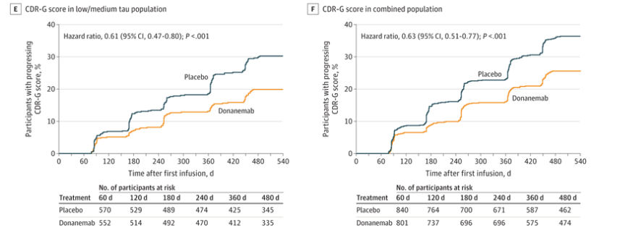

Slide 60
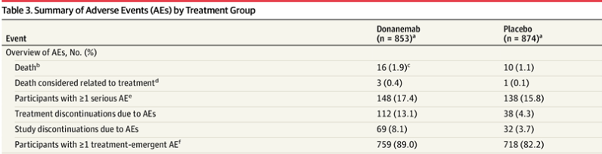
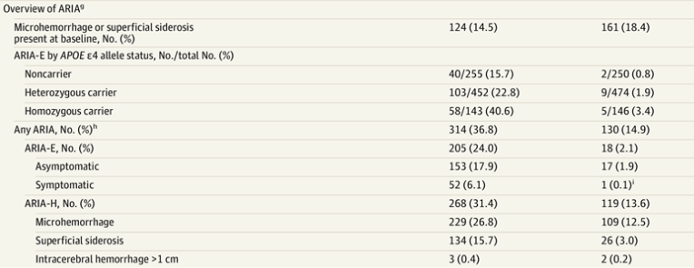

Slide 61
Anti-amyloid - inclusion/exclusion criteria
Inclusion Criteria
MCI or mild AD
+Biomarker (CSF vs serum) and/or PET
Can tolerate multiple MRIs & infusions
Relatively healthy!
Exclusion Criteria
Active malignancy, PD, on immunomodulators, hx large vessel ischemia, new stroke in past year, prior hemorrhage
Anticoagulation (antiplatelet ok)
Homozygous APOE4 (relative contraindication)

Slide 62
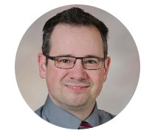
Anti-amyloid @ OHSU
OHSU Neurology Referral (put in comments: anti-amyloid clinic)
Started Feb 2025 by Andrew Natonson, MD
Has around 50 people on MABs (mostly on donanemab)
Wait times may be several months... working on improving access
Utilize both OHSU & HMC Infusion clinics

Slide 63
Patient case - Celia 73yow
Follow-up visit #3: Celia is needing more supervision. Her daughter (who lives next-door) comes over daily to administer her medications and check in. She starts accompanying her mother to her doctor’s appointments.
You recommend they tour local ALF and adult group homes to help plan for her future.
She starts donepezil and tolerates the standard dosing. After discussion with patient/family they decline consideration of anti-amyloid treatment
You follow-up with her every 3-6 months to monitor her dementia.

Slide 64
Who else can help you?
Home health – nursing for med management, PT for balance/fall risk, OT for home safety
Non-skilled home services - companionship, respite, bathing and grooming (ex. Home Instead, Visiting Angels) *not covered by insurance
Pharmacy – med rec, deprescribing
Social work, CHW – caregiver support, community resources, levels of care
OT evaluation – drivability
DMV mandatory reporting form – for patients with severe, uncontrolled cognitive impairment: https://www.oregon.gov/odot/Forms/DMV/7230fill.pdf
Referral to geriatrics or neurology– diagnosis, management, support
Hospice/Palliative Care – when indicated

Slide 65
Patient resources
Alzheimer's Association: www.alz.org
Oregon Care Partners: https://oregoncarepartners.com/
Oregon Dementia Roadmap - https://oregoncarepartners.com/wp-content/uploads/2021/10/Oregon-Dementia-Road-Map_ODHS_ADRC.pdf
Oregon Alzheimer's Disease Research Center (ADRC): www.ohsu.edu/alzheimers-disease-research-center
Oregon Project Independence (OPI) - www.oregon.gov/odhs/providers-partners/community-services-supports/pages/opi.aspx
Disability, Aging, Veteran Services - https://www.oregon.gov/odhs/aging-disability-services/pages/default.aspx
Teepa Snow, dementia expert: https://www.youtube.com/teepasnow/videos
Books:
Help is here: when someone you love has dementia by Marian Hodges
Learning to speak Alzheimer's by Joanne Koning Coste

Slide 66
References
Gaster B, Larson EB, Curtis JR. Advance Directives for Dementia: Meeting a Unique Challenge. JAMA. 2017;318(22): 2175–2176
Jack CR, Andrews JS, Beach TG, et al. Revised criteria for diagnosis and staging of Alzheimer's disease: Alzheimer's Association Workgroup. Alzheimer's Dement. 2024; 20: 5143–5169.
Hall JR, Petersen M, Johnson L, O'Bryant SE. Characterizing Plasma Biomarkers of Alzheimer's in a Diverse Community-Based Cohort: A Cross-Sectional Study of the HAB-HD Cohort. Front Neurol. 2022;13:871947
Livingston G, Huntley J, Liu K, et al. Dementia prevention, intervention, and care: 2024 report of the Lancet Commission. Lancet. 2024;404(10452):572-628
Mayeda ER, Glymour MM, Quesenberry CP, Whitmer RA. Inequalities in dementia incidence between six racial and ethnic groups over 14 years. Alzheimers Dement. 2016;12(3):216-224.
Nielsen, TR, Jorgenson K. Cross-cultural dementia screening using the Rowland Universal Dementia Assessment Scale: a systematic review and meta-analysis. International Psychogeriatrics. 2020;32:9, 1031–1044
Kapasi A, DeCarli C, Schneider JA. Impact of multiple pathologies on the threshold for clinically overt dementia. Acta Neuropathol. 2017;134(2):171-186
Birks JS, Harvey RJ. Donepezil for dementia due to Alzheimer's disease. Cochrane Database of Systematic Reviews 2018, Issue 6. Art. No.: CD001190. DOI:10.1002/14651858.CD001190.pub3. Accessed 11 February 2026.
Howard R, McShane R, Lindesay J, Ritchie C, Baldwin A, Barber R, Burns A, Dening T, Findlay D, Holmes C, Hughes A, Jacoby R, Jones R, Jones R, McKeith I,Macharouthu A, O'Brien J, Passmore P, Sheehan B, Juszczak E, Katona C, Hills R, Knapp M, Ballard C, Brown R, Banerjee S, Onions C, Griffin M, Adams J, Gray R,Johnson T, Bentham P, Phillips P. Donepezil and memantine for moderate-to-severe Alzheimer's disease. N Engl J Med. 2012 Mar 8;366(10):893-903. doi:10.1056/NEJMoa1106668. PMID: 22397651.
van Dyck CH, Swanson CJ, Aisen P, Bateman RJ, Chen C, Gee M, Kanekiyo M, Li D, Reyderman L, Cohen S, Froelich L, Katayama S, Sabbagh M, Vellas B, Watson D, Dhadda S, Irizarry M, Kramer LD, Iwatsubo T. Lecanemab in Early Alzheimer's Disease. N Engl J Med. 2023 Jan 5;388(1):9-21. doi: 10.1056/NEJMoa2212948. Epub 2022 Nov 29. PMID: 36449413.
Sims JR, Zimmer JA, Evans CD, et al. Donanemab in Early Symptomatic Alzheimer Disease: The TRAILBLAZER-ALZ 2 Randomized Clinical Trial. JAMA. 2023;330(6):512–527. doi:10.1001/jama.2023.13239
Images:
If not otherwise cited, images were either personally taken or open sourced from https://unsplash.com/

Slide 67
Thank you!
Robin Brown, MD & Nick Johnson, MD| Geriatrics
browrobi@ohsu.edu| johnnico@ohsu.edu

